Slide 1
Macros and charts
Spreadsheet modelling
3rd Edition

Slide 2
Objectives
Create a macro to reset all seats to unbooked
Assign the macro to a button
Create and customise a pie chart to show the number of seats remaining

Slide 3
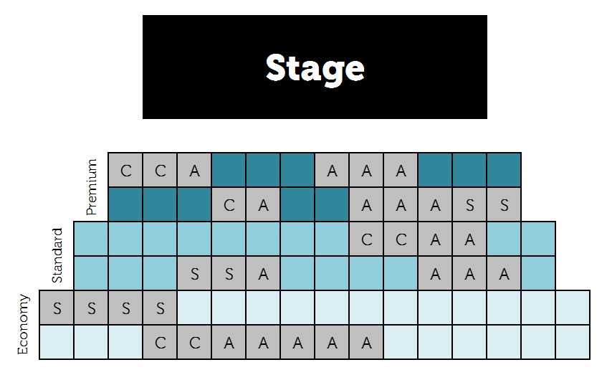
Clearing the seats
We would like to be able to clear all the bookings at the click of a button

Slide 4
Creating a macro
A macro is a small program that you can use to automate a series of tasks
When you create a macro, you record the keystrokes and mouse clicks and save them
You can then create a button to run the macro
Reset all seats

Slide 5
The Developer tab
In Excel 2013, before you record a macro, you need to make sure the Developer tab is visible
Load the spreadsheet you created in the last lesson
Click the File tab, click Options and click Customize Ribbon in the left column of the window
In the Main Tabs list, click Developer, then click OK

Slide 6
Setting up the macro
In the Code group on the Developer tab, click Record Macro
Enter the name ResetSeats in the Macro Name box, a shortcut key in the Shortcut key box, a description in the Description box
Click OK to start recording

Slide 7
Record the macro
Now clear all the seat bookings in your seating plan. Your keystrokes are being recorded!
On the Developer tab, click Stop Recording
Try out your macro using the shortcut key you specified

Slide 8
Assigning the macro to a button
On your worksheet, below the seating plan, insert a button from the Form Controls panel
Select your macro and click OK
You could also assign the macro to a text box with your own formatting
Reset all seats

Slide 9
Charts
Charts are a useful way of displaying data in an easy-to-grasp, visual way
A bar chart can be used when you have one or more series of data to display – say, maximum and minimum monthly temperatures
A pie chart is useful to display parts of a whole – say, the number or percentage of pupils in a year group getting A, B, C or D grades

Slide 10
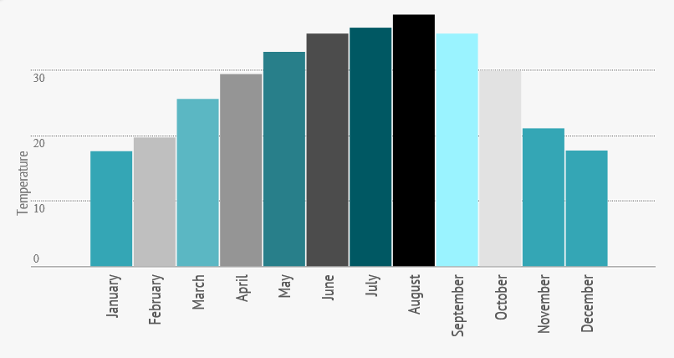
A bar chart
Record maximum temperatures in England

Slide 11
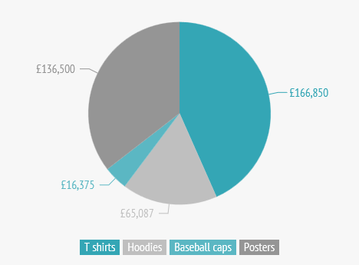
A pie chart
Income from different types of merchandise

Slide 12
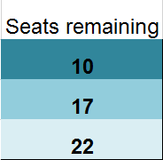
Charting the number of seats remaining
What would be a suitable type of chart?

Slide 13
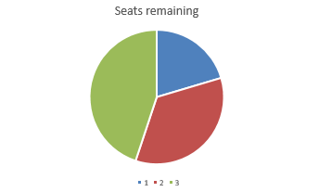
Creating a pie chart
Select the data to be charted, including the heading
Click the Insert tab and select a pie chart

Slide 14
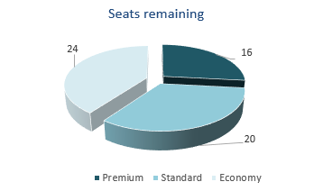
Customising the chart
There’s a lot you can do to customise the chart
Follow the instructions in Task 2 to create a good-looking chart!

Slide 15
What skills have you learned?
How many new things have you learned about spreadsheets?
What other subjects might spreadsheets come in useful for?
What will you do when you can’t remember how to do something like customising a chart or using the COUNTIF function?

