Slide 1
Email scams
Computer crime and cyber security
3rd Edition

Slide 2
Objectives
Identify common types of computer crime
Look at examples of computer crime on the Internet
Learn about different types of email scam
Recognise the signs of fraudulent emails

Slide 3
Types of crime
List different types of crime that are committed without the use of a computer
Which of these crimes could be committed with the use of a computer? How?

Slide 4
Smartphones
Former City of London Police Commander Chris Greany, the national police lead for cyber protection, said:
“People who carry a mobile phone are actually carrying a mobile computer.
It’s not a phone with a computer attached. It’s a computer with a phone attached and it is as risky using this as it is using the desktop at home.”

Slide 5
Tackling crime
Many types of crime be carried out with the aid of a computer
The victims can be governments, companies and organisations and you as individuals

Slide 6
Cybercrime
Cybercrime is crime committed using a computer or a network. Which of these three statements do you think is true?
“It makes more money for criminals than illegal drug trafficking”
“Someone’s identity is stolen every 10 minutes as a result of cybercrime”
“An unprotected PC can become infected within four minutes of connecting to the Internet”

Slide 7
Answers:
“It makes more money for criminals than illegal drug trafficking” TRUE
“Someone’s identity is stolen every 10 minutes as a result of cybercrime” FALSE – it’s every 2 seconds, not every 10 minutes!
“An unprotected PC can become infected within four minutes of connecting to the Internet” TRUE

Slide 8
Email scams
There are many types of email scam, here are four common types:
Phishing
Trojan Horse / Malware
Fraudulent requests for money or advance fees
Virus-generated email

Slide 9
Phishing – what’s this?
A phishing email is one that tricks you into handing over sensitive or personal information (login details, bank details, etc.)
You receive what looks like a legitimate email, for example from a bank or an organisation such as PayPal or eBay
The website urges you to visit a bogus website and enter your personal details, which are then captured by the Phishers

Slide 10
Does it work?
Phishers send out hundreds of thousands of emails that look as though they are from legitimate companies
For phishing to be successful, the criminals must get you to click on a link in the email to go to a website
A successful phishing campaign has around a 5% response rate – meaning 5% of recipients are conned!

Slide 11
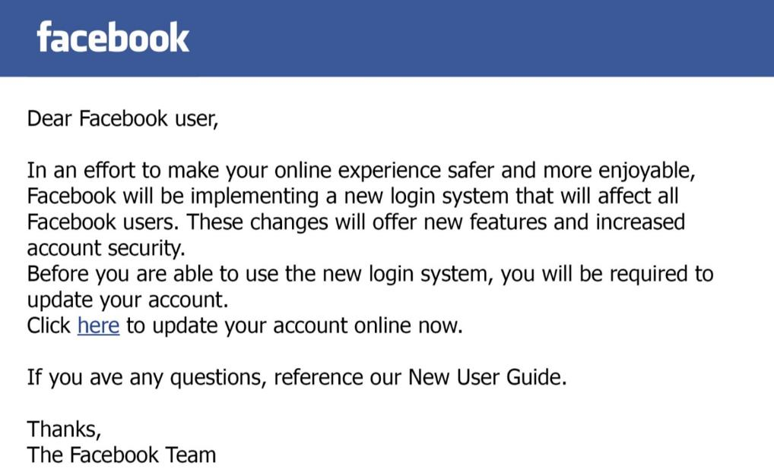
A typical phishing email
Links to: http://www.facebook.com.pioateeiili.com/usersdirectory/LoginFacebook.php?ref=4813491358245886&

Slide 12
What to look out for
Greeting. The phishers don’t know your name – just your email address, so the greeting is not personalised
The sender’s address is often a variation on a genuine address
Forged link. The link looks genuine, but it may not link to the website given. Roll your mouse over it to check
Request for personal information. Genuine organisations never do this
Sense of urgency. Criminals try to persuade you that something bad will happen if you don’t act fast
Poor spelling and grammar

Slide 13
Worksheet 1
Look at the emails in the worksheet. Decide which are genuine and which are fraudulent
What should you do with emails you think may possibly not be genuine?

Slide 14
Trojan Horse and malware
Offers something tempting to look at, either an attachment or link – for example a funny video
When you open the attachment or click the link, it installs a virus on your computer
The virus might
Record your keystrokes and send them to the attacker
Provide someone else with access to your files
Use your computer to send spam to everyone in your address book

Slide 15
Example Trojan Horse email
Subject: You just received an E-Greeting! Hello , A Greeting Card is waiting for you at our virtual post office! You can pick up your postcard at the following web address: http://www.allyours.net/u/view.php?id=a0190344376667 visit E-Greetings at http://www.all-yours.net/ and enter your pickup code, which is: a0190344376667 (Your postcard will be available for 60 days.)
Fake link! Link is disguised using HTML, so doesn’t actually go to the web address as it appears in the email.

Slide 16
Advanced fee fraud
Usually a long and desperate plea for help
The sender will claim to need cash from you, in return they will send you millions of pounds
If it sounds too good to be true, it usually is!

Slide 17
Virus generated email
Will appear to be sent from a friend
Usually means your friend’s email has been infected with a virus and has sent the email to their whole address book
Typically includes a product or shop recommendation, or asks for emergency cash
Encourages you to click a link to a sales website or transfer cash

Slide 18
Example virus generated email
From: James Miller
From a friend’s genuine email address
Subject: Amazing cheap electronics!
Hi, Just had to share this – I just bought a super cheap mobile phone from this website – take a look!
http://www.amazingcheap deals11611.com/k
Link may download a virus, or lead you to a bogus website selling fake or non-existent products
Asks you to visit a website

Slide 19
Protecting yourself against email scams
Use a SPAM filter to prevent common scams ever reaching your inbox
Be suspicious! If you aren’t completely certain it’s genuine, NEVER click any links or download attachments.

Slide 20
Plenary
You have learned:
the different types of computer crime that exist
about examples of computer crime on the Internet
about different types of email scams
how to recognise the signs of fraudulent emails

