Slide 2
Objectives
Understand how to use percentages and apply to a variety of design and technology contexts

Slide 3
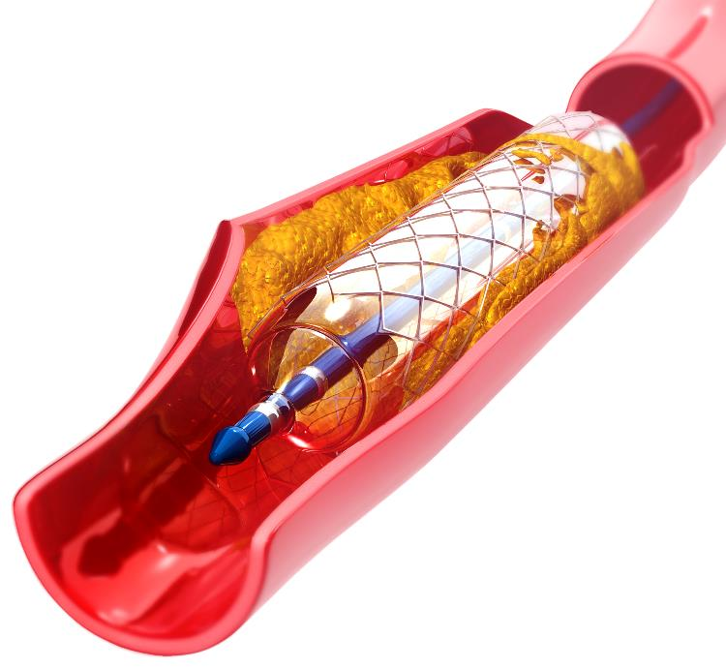
Starter
Nitinol is a shape memory alloy of 50 to 55% nickel and the remainder is titanium
It is used for making stents that can open clogged arteries
The stent is compressed and placed into a vein
The stent ‘remembers’ its original shape and expands, allowing blood to pass unrestricted
What is the percentage range of titanium in nitinol?

Slide 4
Jazzy alloys
This trombone is made of yellow brass, an alloy of two thirds copper and one third zinc
If the trombone has a mass of 2.4 kg, what weight is due to zinc?

Slide 5
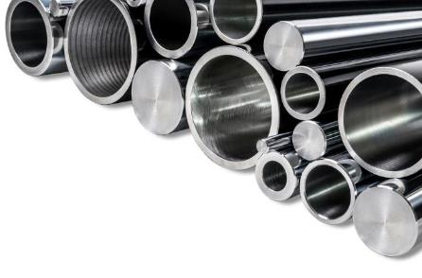
Percentages
A percentage is a fraction where the total number of equal parts is 100
A stainless steel bar has a mass of 11.0 kg and contains 24% chromium, by mass
Work out the mass of chromium in the bar
24% means ‘24 out of every 100’, that is, $\frac{24}{100}$ as a fraction
$\frac{24}{100}$ = 0.24 as a decimal; find 0.24 of 11.0 kg 0.24 × 11.0 = 2.64 kg
If the metal bar contained 70% iron, what is the mass of iron?

Slide 6
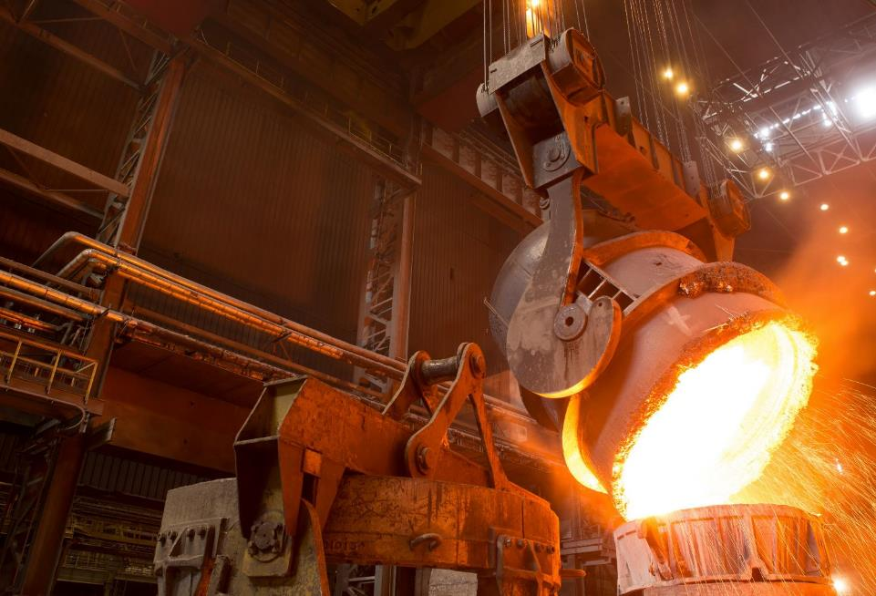
Molten metal
Making iron using a blast furnace uses a vast amount of energy
The resulting pig iron contains around 4% carbon
A full crucible contains 880 kg of pig iron
How many kg of carbon are in each full load of pig iron?

Slide 7
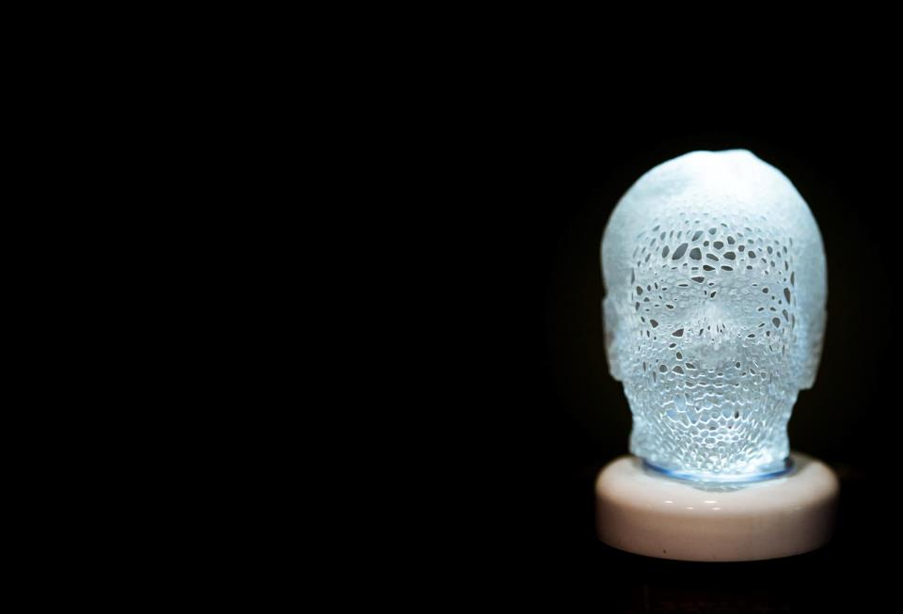
3D printing
A 3D printer creates a sculpture of a human head which sits on an ceramic plinth
The plastic used is polylactic acid or PLA
The sculpture and plinth have a combined mass of 950 g
The mass of the plinth is 589 g
What is the mass of the PLA as a percentage of the complete sculpture?

Slide 8
3D printing
The total mass is 950 g
The ceramic plinth is 589 g therefore, 950 g − 589 g = 361 g of PLA
To work out the percentage of PLA, divide the mass of the PLA by the total mass × 100: $\frac{361}{950}$ × 100 = 38%

Slide 9
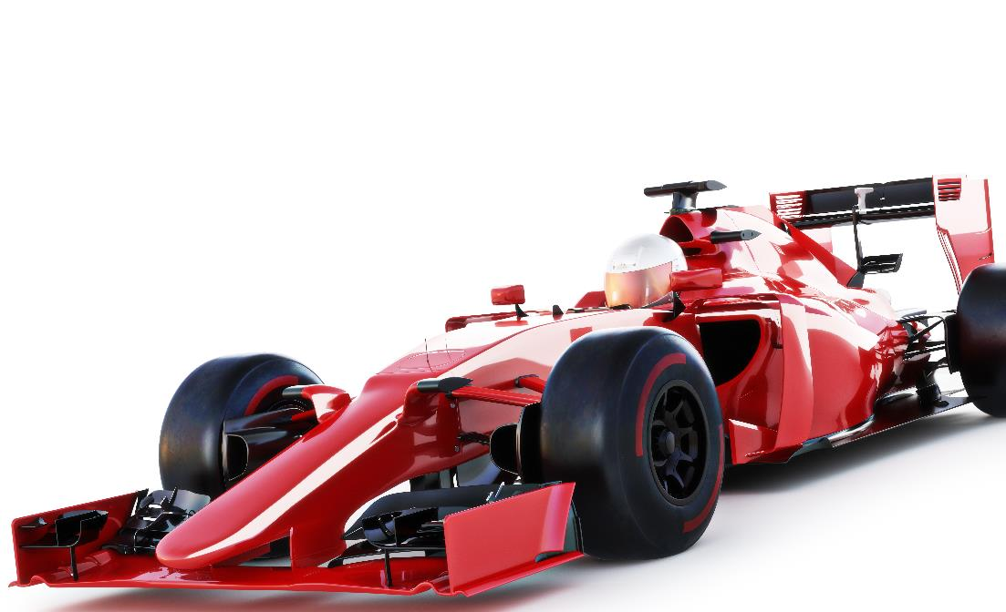
The 107% rule
In Formula 1 racing, a driver is not allowed through to the next round if they fail to lap the track within 107% of the fastest recorded lap time
If the fastest qualifying lap was 60 seconds, what was the time that cars must beat in order to qualify?
In another race the 107% qualifying time was 70 seconds – what was the fastest recorded lap time?

Slide 10
The 107% rule
107% is $\frac{107}{100}$, or 1.07 as a decimal
The fastest qualifying lap was 60 seconds, therefore 107% of 60 seconds is 1.07 × 60 = 64.2 seconds%
70 s is 107% of the fastest lap time (call this f )
Fastest lap time |  | Qualifying time
f |  | 70
65.4 s (1 d.p.) |  | 70
× 1.07
÷ 1.07

Slide 11
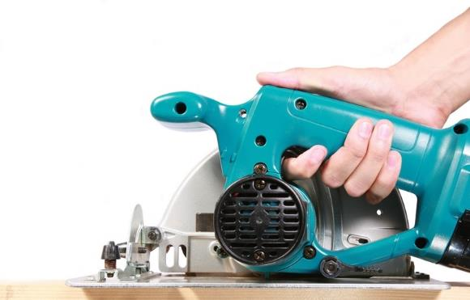
Wood wastage
A furniture maker buys a piece of plywood for a table top
The piece of plywood is 1.5 m² in area and costs £5.30
They cut out a 1.2 m² piece for the table top
The rest is wasted
What percentage of the wood has been used?
What is the cost of the wood that has been wasted?

Slide 12
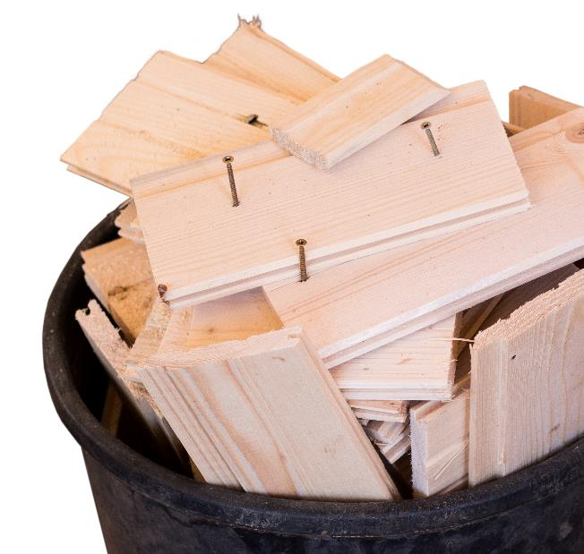
Wood wastage
Percentage of wood used = $\frac{1.2 m2}{1.5 m2}$ × 100 = 80%
Wasted percentage of wood = 100 − 80 = 20%
20% of £5.30 = 0.2 × 5.30 ⇒ £1.06

Slide 13
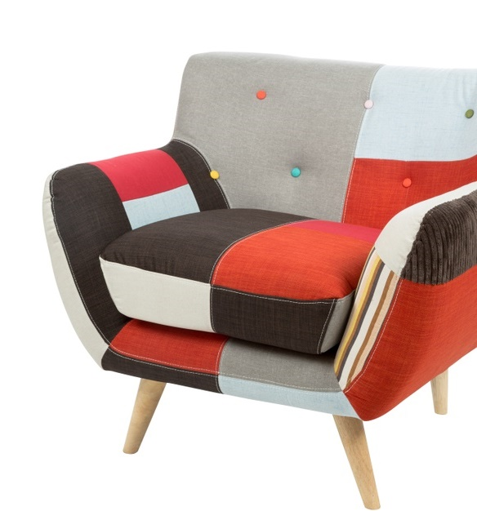
Patchwork
A patchwork chair uses various coloured fabrics
A piece of red fabric that measures 100 cm × 100 cm is used
The red squares needed are cut to 30 cm × 30 cm
What is the maximum number of squares that can be cut from the piece of red fabric?
What is the percentage of fabric that is wasted?

Slide 14
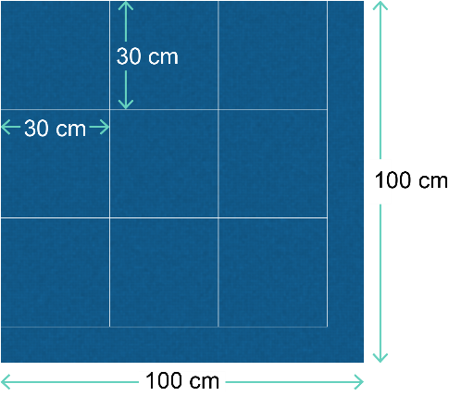
Patchwork
If the 30 cm × 30 cm squares are placed as close as possible, then 9 squares can be cut from the fabric
As the shape of the fabric is a square, the area of the fabric is 100 × 100 = 10,000 cm²
The area of the squares used = 30 × 30 × 9 = 8,100 cm²
So, the area of waste = 10,000 – 8,100 = 1,900 cm²
This, as a percentage of total area, = $\frac{1,900}{10,000 }$ × 100 = 19%

Slide 15
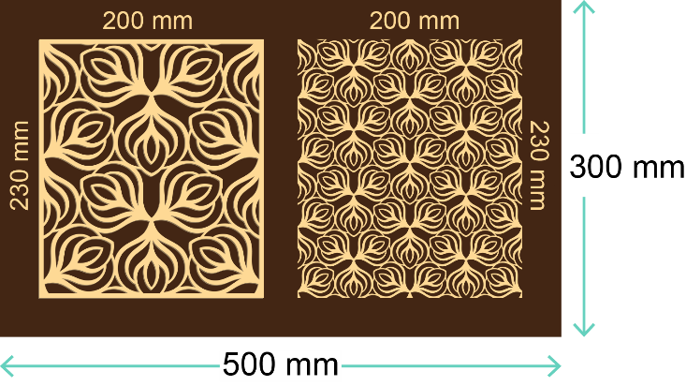
Laser engraving
A student wants to laser cut and engrave the two designs shown on a plywood sheet which is 500 mm × 300 mm
Using the dimensions of the panels in the diagram, work out the total area of the two panels being engraved
Work out the percentage of wastage to 1 d.p.

Slide 16
Laser engraving
The total area of the two panels being engraved by the laser = (200 × 230) + (200 × 230) = 92,000 mm²
The plywood has an area of 500 mm by 300 mm, so its area = 500 × 300 = 150,000 mm²
The area of plywood not used = 150,000 − 92,000 = 58,000 mm²
The percentage of wastage = $\frac{58,000}{150,000 }$ × 100 = 38.7% wastage (to 1 d.p.)

Slide 17
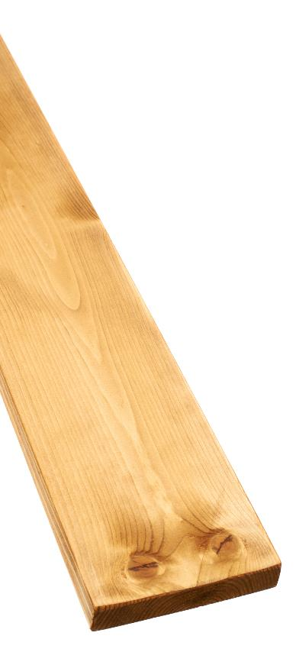
Percentage change
Sometimes it is necessary to work out the percentage change in a number, e.g. when a price increases
A useful formula is:
If the price of pine timber increased from £200 per m³ to £230 per m³, what is the percentage change?
Actual change: 230 − 200 = £30; Original: £200
What would be the percentage change if the new pine timber price was £250 per m³?
Percentage change = $\frac{Actual change}{Original amount}$ × 100
Percentage change = $\frac{30}{200}$ × 100 ⇒ 15%

Slide 18
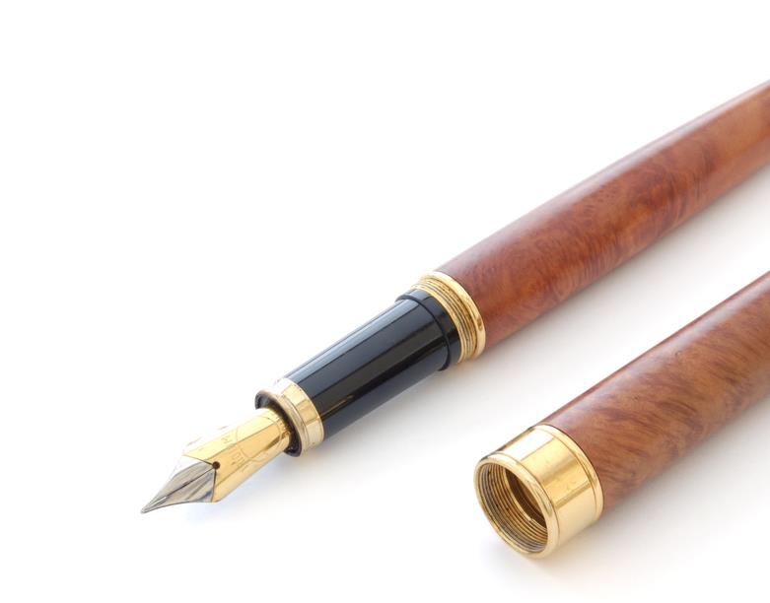
Gold plating prices
The price of gold changes daily
This can cause problems for companies that specialise in gold-plating
The price of gold yesterday was £30.94 per gram
The price today is £31.03 per gram
Work out the percentage change in the price of gold from yesterday to today
A wholesaler who prepares gold for plating buys 100 kg at a time
Work out how much more it would cost buying it today rather than yesterday

Slide 19
Gold plating prices
Percentage change = $\frac{Actual change}{Original amount}$ × 100
Actual change: 31.03 − 30.94 = £0.09
Original amount = £30.94
Yesterday: 1 g cost = 30.94 1 kg cost 30.94 × 1,000 = £30,940 100 kg cost 30,940 × 100 = £3,094,000
Today: 100 kg cost 31.03 × 1000 × 100 = £3,103,000
Difference: 3,103,000 − 3,094,000 = £9,000
Percentage change = $\frac{0.09}{30.94}$ × 100 = 0.29% to (2 d.p)

Slide 20
Investing in a start-up
Investing in a start-up company can be very profitable but it is quite high risk
A new company making compostable polymer toothbrushes is offering a share for £3,000
If the share is worth £2,900 after one year, what is the percentage change in the investment, to 2 significant figures?

Slide 21
Investing in a start-up
The share has decreased in price from £3,000 to £2,900, a decrease of £100
Actual change = £100; Original amount = £3,000
Note: This is 3.3% to 2 s.f. and a decrease, so percentage change = −3.3%
Percentage change = $\frac{Actual change}{Original amount}$ × 100
Percentage change = $\frac{100}{3,000}$ × 100 = 3.3%

Slide 22
Buying in bulk
A fashion house wants to buy some fabric from a supplier
The supplier’s pricing structure is as follows:
The fashion house considers buying 15 m² of fabric at £10 per square metre Work out the price they would pay
They reconsider, and decide to buy 30 m² of the same fabric How much money do they save per square metre?
Up to 10 m² | No discount
Between 10 m² and 20 m² | 5% discount on total
Greater than 20 m² | 10% discount on total

Slide 23
Buying in bulk
Up to 10 m² | No discount
Between 10 m² and 20 m² | 5% discount on total
Greater than 20 m² | 10% discount on total
15 m² at £10 per m² = £150
5% off leaves 95%: Find 95% of £150 so, 0.95 × 150 = £142.50
Cost per m²: 142.50 ÷ 15 = £9.50 per m²
30 m² at £10 per m² = £300
10% off leaves 90%: Find 90% of £300 so, 0.9 × 300 = £270
This makes £270 ÷ 30 = £9.00 per m², saving 50p per m²

Slide 24
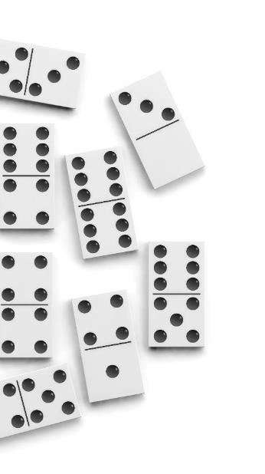
Percentage confusion
A common percentage problem:
A manufacturer makes sets of 1,000 dominos and increases their number by 10%, this becomes 1,100 sets of dominoes
If they now decrease the 1,100 sets by 10%, should they end up back with 1,000?
Here is some working out to consider: 10% of 1,100 is 110 sets, so then 1,100 − 110, gives 990, but not 1,000!
Where is the error in the calculation?

Slide 25
Percentage confusion
The manufacturer starts with 1,000 sets of dominoes and increases their number by 10%; they then have 1,100 sets
However, when they take 10% off, they are working out 10% of 1,100 (this is 110 sets), not 10% of the original 1,000 (100 sets)
It is easy to become confused, remember 10% of 1,000 is smaller than 10% of 1,100
Adding a certain percentage and then taking the same percentage away from the new total does not end up at the same number
This problem can cause many issues when calculating the VAT (value added tax) on purchases

Slide 26
Worksheet 3
Complete Task 1 and 2 on the Worksheet

Slide 27
Plenary
Work independently or in pairs
A heavy duty refuse sack uses 62% recycled polymer content. One packet of 200 sacks has a mass of 5.2 kg and costs £5.75. There is a 30% discount if you buy 3 packets
How much does the recycled content of one packet weigh in kg to 2 d.p.?
How much would 3 packets cost to the nearest penny?
600 people are surveyed about the future of the planet 360 people felt that air quality was the biggest threat 200 felt that water quality was more important
What percentage of people thought neither of these were important factors?

Slide 28
Plenary
A heavy duty refuse sack uses 62% recycled polymer content. One packet of 200 sacks has a mass of 5.2 kg and costs £5.75. There is a 30% discount if you buy 3 packets
How much does the recycled content of one packet weigh in kg to 2 d.p.?
Find 62% of 5.2 kg ⇒ 0.62 × 5.2 = 3.224 kg = 3.22 kg (to 2 d.p.)
How much would 3 packets cost to the nearest penny?
3 packets cost 3 × 5.75 = £17.25
30% discount leaves 70%
Find 70% of £17.25: 0.7 × 17.25 = £12.08 to the nearest penny

Slide 29
Plenary
600 people are surveyed about the future of the planet. 360 people felt that air quality was the biggest threat 200 felt that water quality was more important
What percentage of people thought neither of these were important factors?
The number of people thinking that neither of these were a factor: 600 − (360 + 200) = 40
Find what percentage 40 is of 600:
$\frac{40}{600}$ × 100 = 6.7% (to 1 d.p.)

