Slide 1
A Level Politics

Slide 2
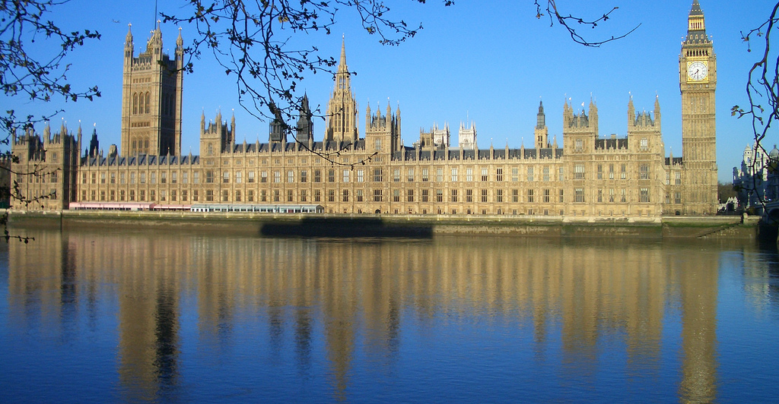
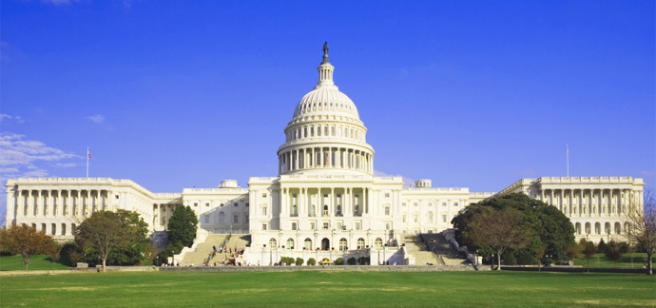
Why should I study A Level Politics?
It provides a lively and relevant insight into the workings of British and American political systems and an understanding of the different ideologies that has shaped them.
Covering news and current affairs from the UK and US, it helps you understand how these these two countries are run and develops research, written communication and debating skills.
It is ideal if you are considering studying politics, sociology, ethics, advertising or journalism at university and is highly regarded by employers in industries including politics, international organisations, the media, government and the civil service.

Slide 3
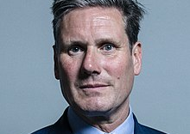
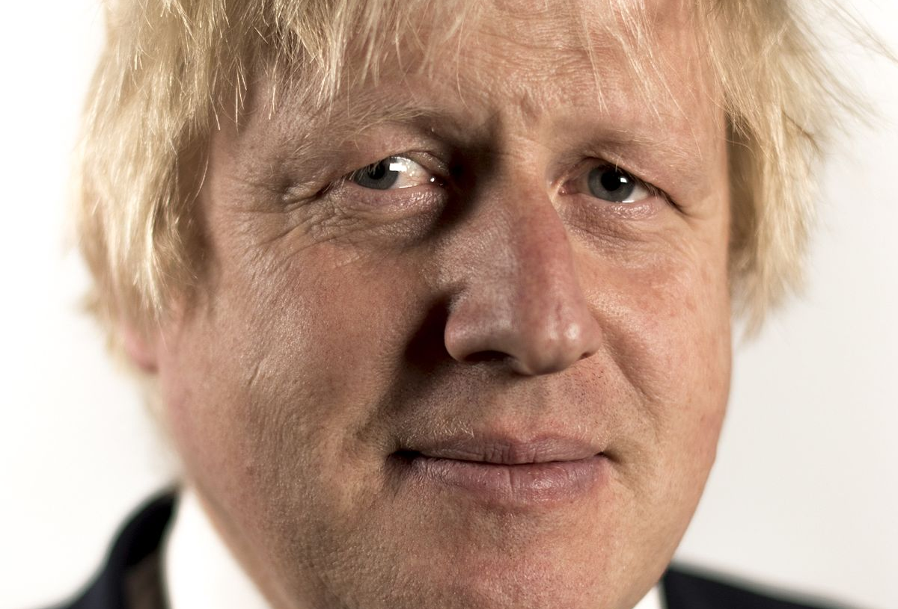
The Government and Politics of the UK
The nature and sources of the British Constitution;
The structure and role of Parliament;
The Prime Minister and Cabinet;
The Judiciary;
Devolution;
Democracy and participation;
Elections and Referendums;
Political Parties;
Pressure Groups;
The European Union.

Slide 4
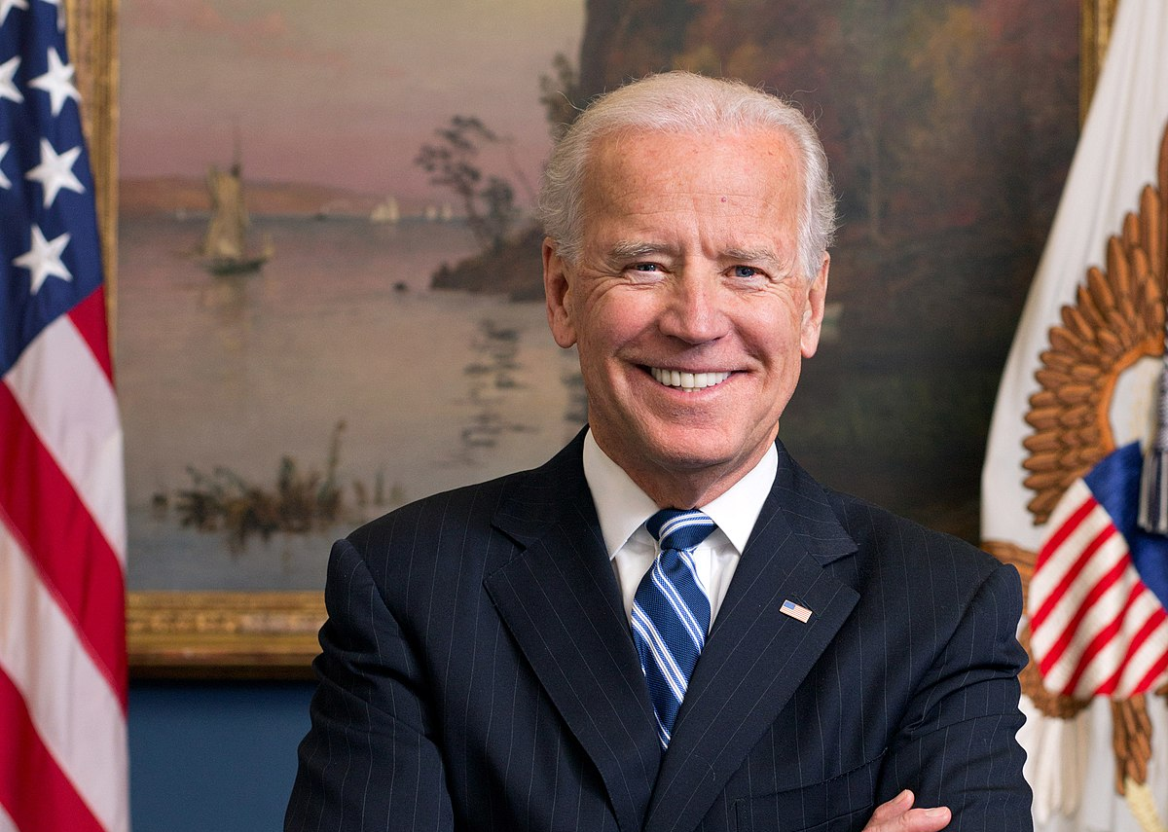
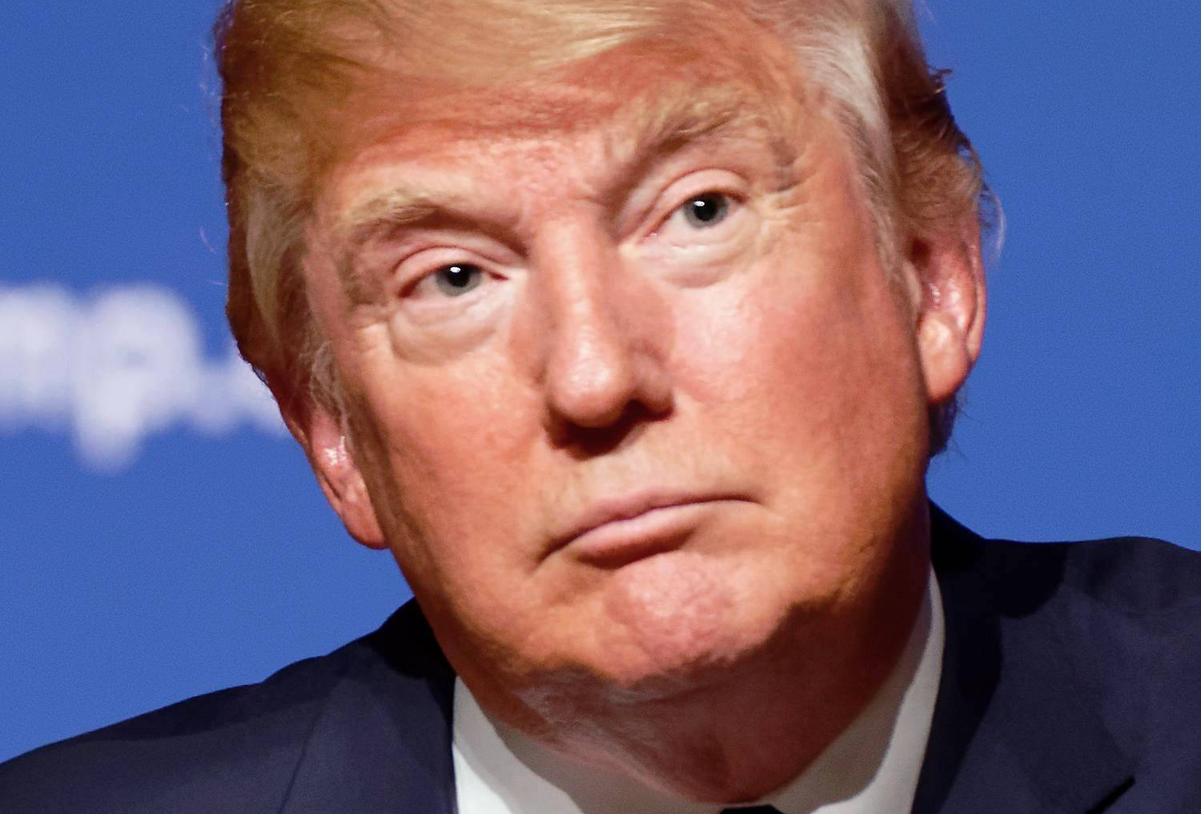
The Government and Politics of the USA and Comparative Politics
The Constitutional Framework of US Government;
Congress, the President and the Supreme Court;
The electoral process and direct democracy;
Political Parties;
Pressure Groups;
Civil Rights;
Comparisons with the British political system.

Slide 5
Political Ideas and Core Ideologies
Liberalism;
Conservatism;
Socialism;
Nationalism;
Feminism;
Multi-culturism;
Anarchism;
Ecologism.

Slide 6
What are we looking for in pupils looking to study A Level Politics?
Enthusiasm and a keen interest in current affairs and politics are essential!
Good writing skills with the ability to analyse and evaluate.
There is no NEA (non-examined assessment) for A Level Politics. It is a two-year linear course that culminates in three examinations, each lasting 2 hours. Question styles are based around explanation and essays questions.

Slide 7
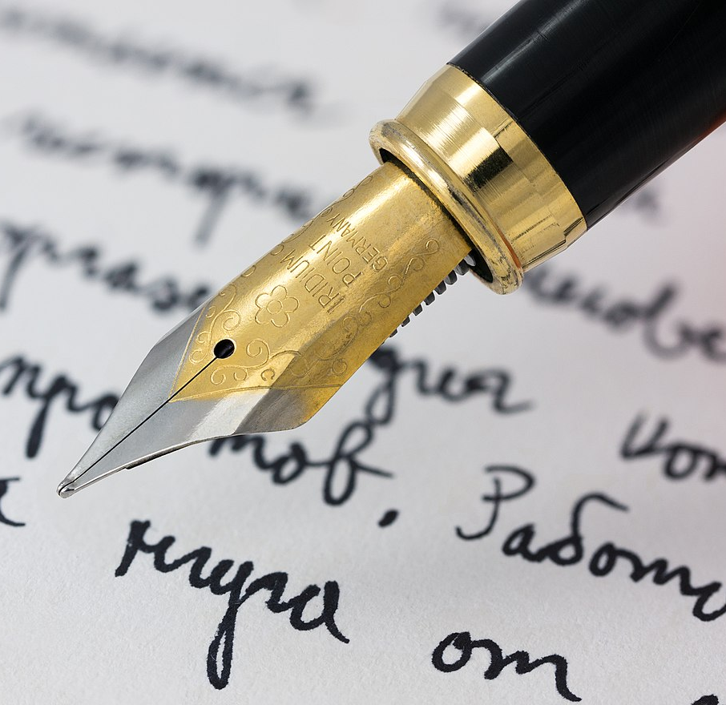
Any questions?
If you have any questions about the A Level Politics course, please do not hesitate to contact me via the Firefly Forum or directly on the email address below:
jwalker@warminsterschool.org.uk
Mrs. J. Walker, Head of History and Politics

