Slide 1
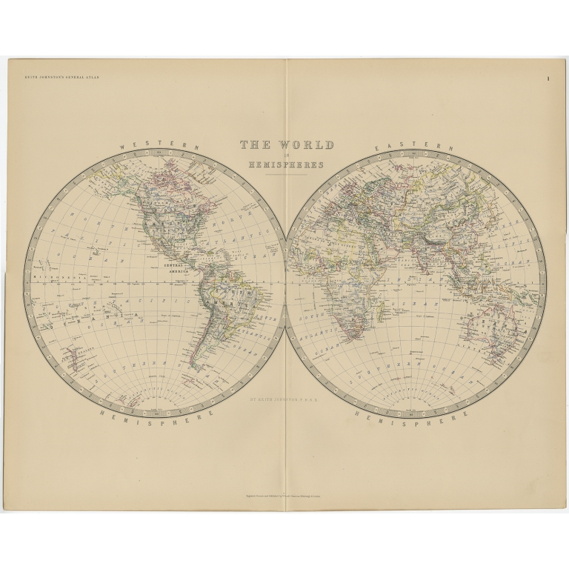
GEOGRAPHY IB
WHY EVERYONE SHOULD STUDY GEOGRAPHY AT IB

Slide 2
The Guardian newspaper states:
Studying geography arms graduates with a mix of skills employers want to see: Geography students generally do well in terms of their relatively low unemployment rates. You could attribute this to the fact that the degree helps develop a whole range of employability skills including numeracy, teamwork through regular field trips, analytical skills in the lab and a certain technical savviness through using various specialist computing applications. Also, the subject area in itself cultivates a world view and a certain cultural sensitivity. These all potentially help a geographer to stand out in the labour market

Slide 3
THE MAIN INGREDIENTS
The IB course is split into 7 topics.
These are assessed in 3 exams for higher level and 2 exams for standard level.
The exams are predominantly essay based.
There is also an internal assessment which is fieldwork based and usually on a physical geography topic.

Slide 4
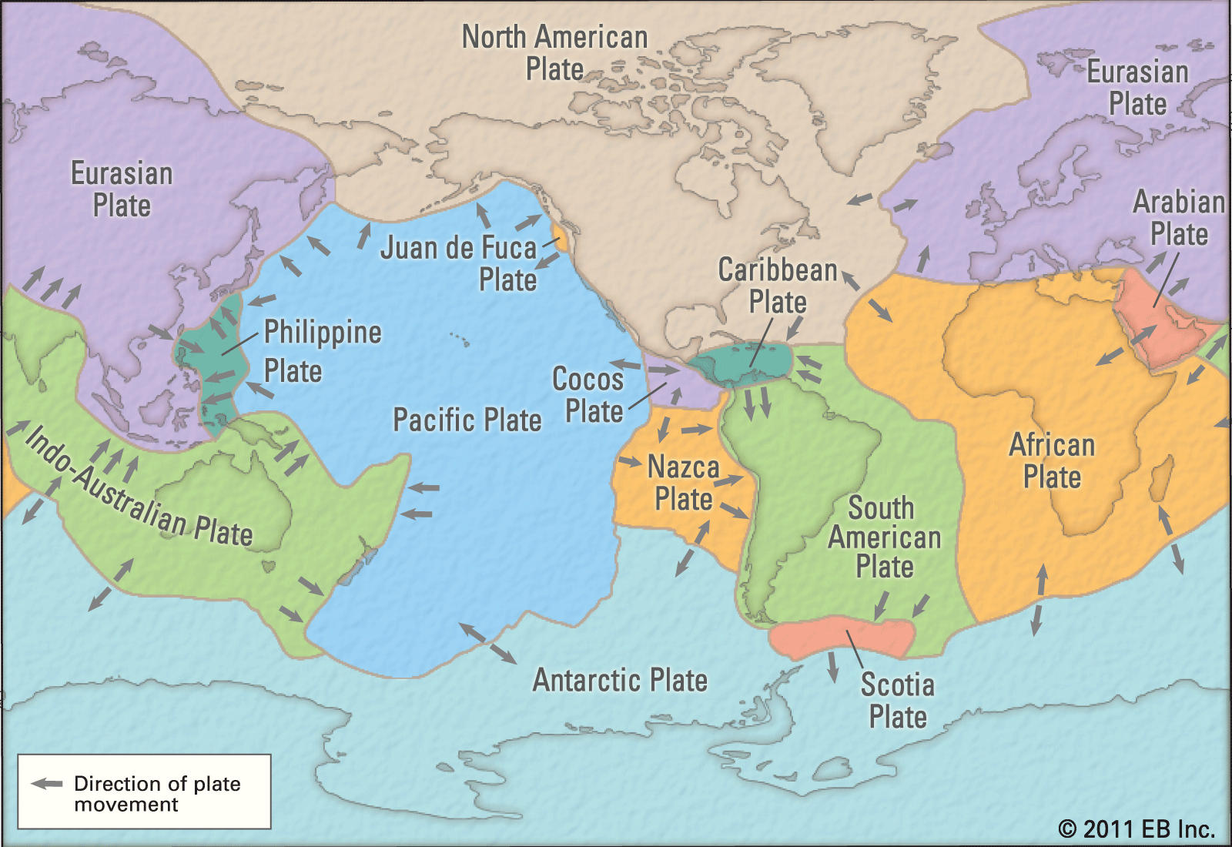
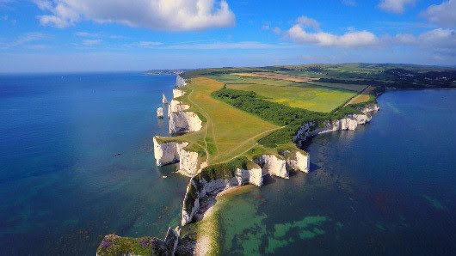
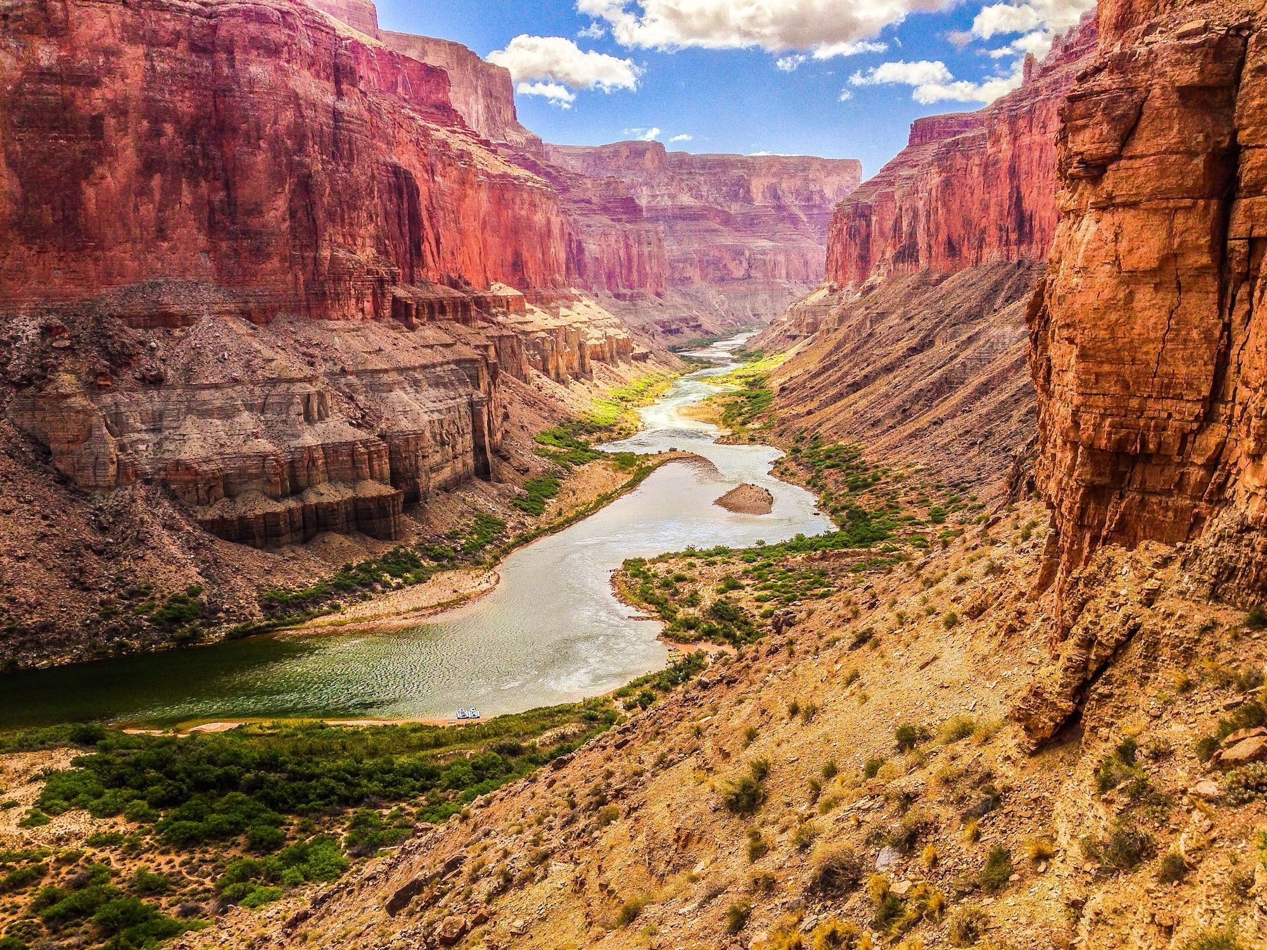
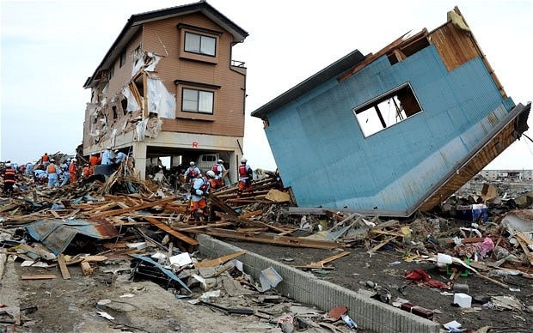
PAPER 1 – ‘GEOGRAPHICAL THEMES’
Leisure, Tourism and Sport
Oceans and coastal margins
Geophysical hazards

Slide 5
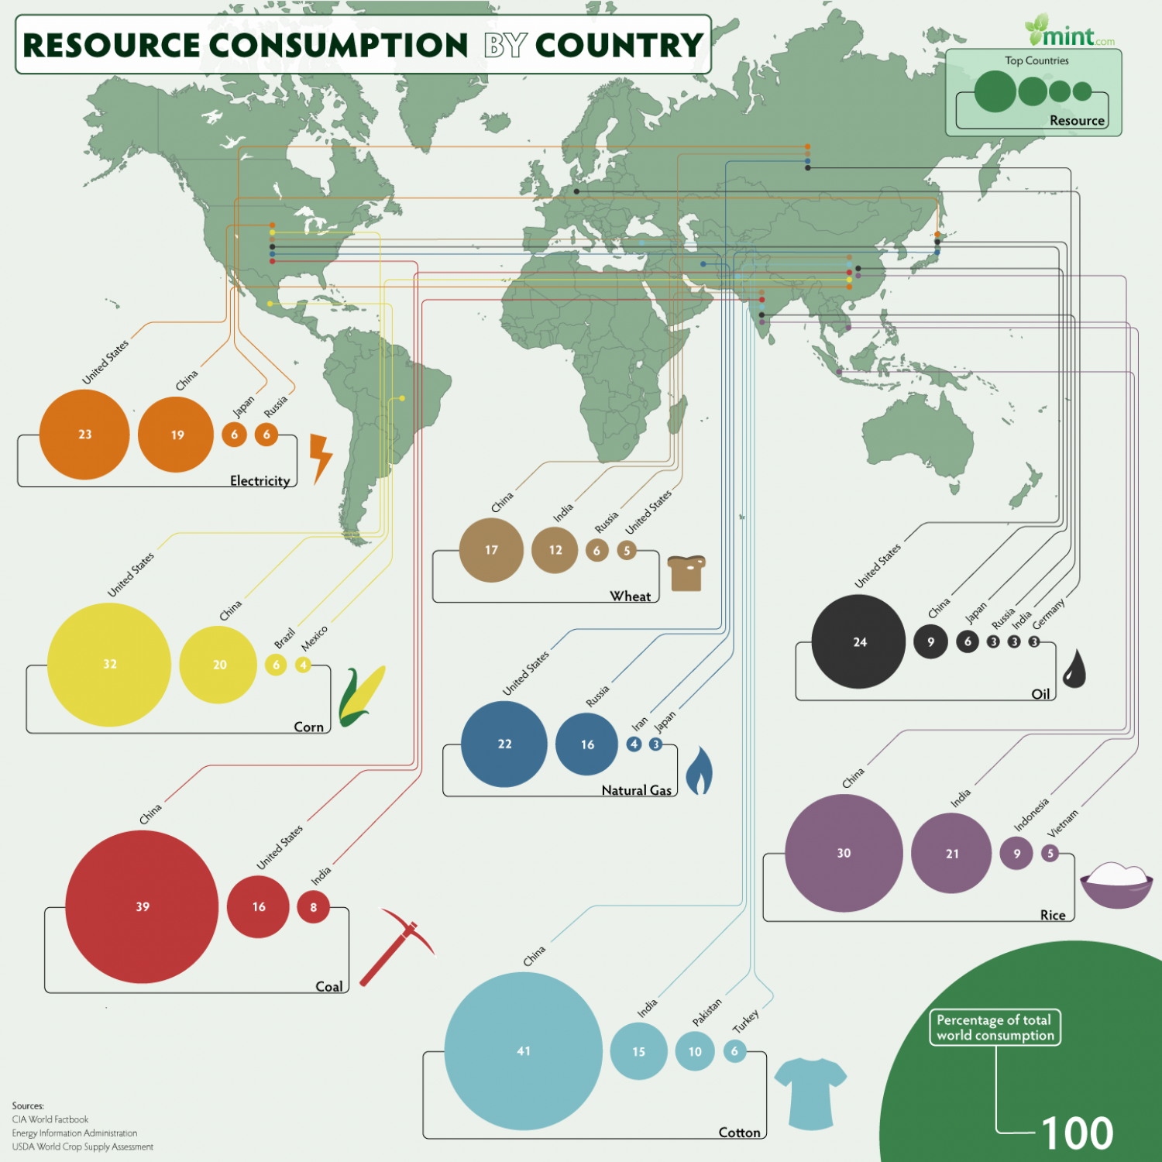
PAPER 2 – ‘GEOGRAPHIC PERSPECTIVES AND CHANGE’
Population change
Climate vulnerability and resilience
Resource consumption

Slide 6
PAPER 3 –GLOBAL INTERACTIONS
Power
Development
Risk and resilience

Slide 7
SKILLS THAT ARE INTERTWINED
Maths
Literacy
Problem solving
Decision making skills
Computer literacy
Group work and team work
GIS skills

Slide 8
So, why should everyone study Geography IB?
“The study of geography is about more than just memorizing places on a map. It's about understanding the complexity of our world, appreciating the diversity of cultures that exists across continents. And in the end, it's about using all that knowledge to help bridge divides and bring people together.”
Barack Obama, 2012

