Slide 1
Data Types and Maths
Programming Guides

Slide 2
Data Types and Maths
There are several different types of data that your programs will need to work with.
Here are some of them:
Integer
This means any whole number. If the computer knows the data is an integer it can do maths with the data
String
This means any combination of keyboard characters (letters, numbers symbols)
Real / Float
This means any decimal (fractional) number
Character
This means any single character that you might find on a keyboard.
Boolean
This data type has just two values:
True & False.

Slide 3
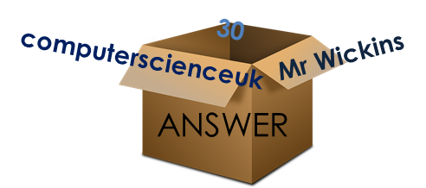
Data Types and Maths
Computers store values in variables
In order for the computer to understand our inputs, it needs to know what type of data our input is.
If a variable is to hold a word, we must tell the computer that the variable is to contain a string.
If a variable is to hold a whole number, we must tell the computer that the variable is to contain an integer – so it can do calculations.
If we don’t do this the program will not be able to perform the correct operations on the data.

Slide 4
Data Types and Maths
If we want our program to work with numbers we must tell the program that certain variables will hold numbers.
When we input a number into our program
num1 = input(“please enter a number”)
python automatically sets the variable as a string (think of it as if python reads the input as twenty instead of 20).
If we want to do maths with the ‘inputs’ we need to tell the computer that the variable contains a number (integer).

Slide 5
Data Types and Maths
To do this we need to convert the variable to an ‘integer’ or ‘real’ data type.
Above you can see that two numbers have been entered and stored in variables num1 and num2.
As python stores inputs as strings we need to convert these variables into integers.

Slide 6
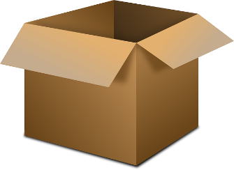
What’s going on?
User types in 29 but python reads it as a string (so think of it like python reading 29 as twenty nine).
Twenty Nine
Num1
I’m telling the computer that this variable contains a number not a string!
29
29
Twenty Nine
Variable
Variable
Mr Int.

Slide 7
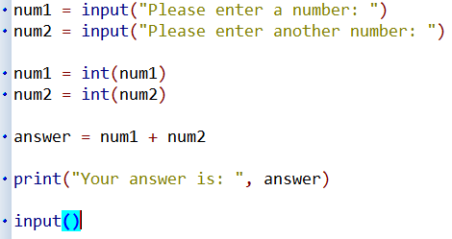
Data Types and Maths
Visualisation of the Process:
Five
Nine
Num1
Num2
5
9
Five
Nine
Num1
Num2
14
Answer
5
+
9
14
14
Answer

Slide 8
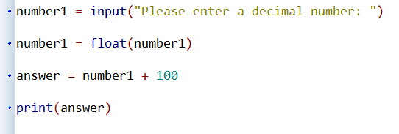
Data Types and Maths
What if we want python to read our inputs as decimal numbers instead of integers?
Instead of using the int() function to convert a string to an integer, we can use the float() function to convert a string to a decimal number, so that python can perform maths on the number correctly.

