Slide 1
AQA
AS Level
Computer Science
Paper 2
Communication and privacy
Unit 6
Communication: Technology and consequences

Slide 2
Objectives
Understand how developments in digital technologies enable organisations to monitor behaviour, amass and analyse personal information
Understand the potential for individual computer scientists and software engineers to produce great good, but also great harm
Be able to discuss the challenges facing legislators in the digital age

Slide 3
Collecting personal information
Name some organisations that collect information about you
What information are they collecting?
What is this information used for?
Does it bother you?
Can you stop these organisations from collecting the information?

Slide 4
Communications and privacy
Consider the following companies or organisations and find out about recent news articles regarding data collection and privacy
GCHQ
Facebook
Google
Apple

Slide 5
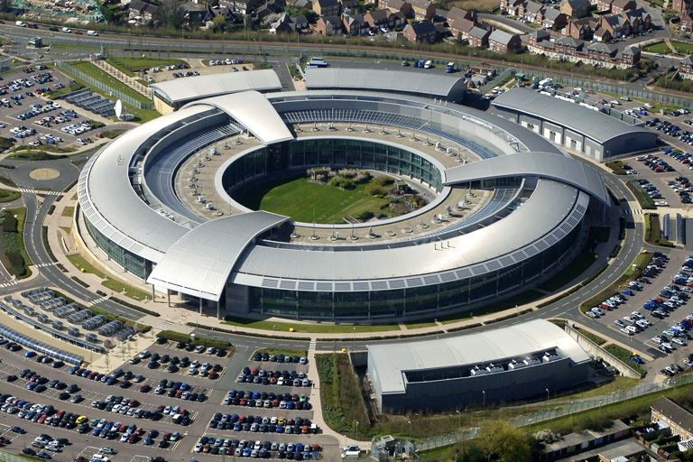
GCHQ

Slide 6
Privacy issues
Developments in communications technology mean that organisations can:
Monitor behaviour
Collect and analyse personal information
Distribute, publish, communicate and disseminate personal information

Slide 7
Worksheet 5
This worksheet has six case studies
In groups, research one of the scenarios and make notes
You will be asked to give a short presentation on your findings

