Slide 1
Solving problems with flowcharts
Control systems with Flowol
3rd Edition

Slide 2
Objectives
Identify control flowchart symbols and understand how they are used to describe systems
Develop a control flowchart solution for a simple problem

Slide 3
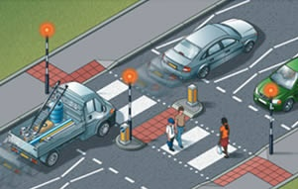
Starter
This is a Zebra Crossing. This crossing is on a wide road and has an island in the middle
Correctly order instructions to help pedestrians use this crossing safely

Slide 4
Ordering instructions
Instruction | Order
Walk to the island looking both ways and listening
Step onto the second half of the zebra crossing
Stop at the island
Step onto the first half of the zebra crossing
Stop at the side of the road looking to the other side of the Zebra crossing
Look right
Look left
Wait until traffic from the right has stopped or the road is clear
Walk to the other side of the road looking both ways and listening
Stay on the island until traffic from the left has stopped or the road is clear

Slide 5
Ordering instructions Answers
Instruction | Order
Walk to the island looking both ways and listening | 5
Step onto the second half of the zebra crossing | 9
Stop at the island | 6
Step onto the first half of the zebra crossing | 4
Stop at the side of the road looking to the other side of the Zebra crossing | 1
Look right | 2
Look left | 7
Wait until traffic from the right has stopped or the road is clear | 3
Walk to the other side of the road looking both ways and listening | 10
Stay on the island until traffic from the left has stopped or the road is clear | 8

Slide 6
What system do these flowcharts describe?
Start
Start
Yes
Turn heater on
Yes
Turn fan on
Is Temp < 15?
Is Temp > 20?
No
No
Turn heater off
Turn fan off

Slide 7
Flowchart symbols
Start and Stop
Use this symbol at the beginning and end of flowcharts
The symbols in flowcharts are connected using arrows. Start and Stop symbols have only one connecting arrow going into or out of them
The examples below show Start and Stop symbols at the beginning and end of a flowchart
Start
Stop

Slide 8
Flowchart symbols
Start
Process
This symbol is used to show a single step that is part of a bigger problem
Process symbols may have only one line going into and one line going out of them
In this example the problem of how to water plants in a garden has been broken down into three steps
Get watering can out of garden shed
Fill watering can with water
Pour water on plants
Stop

Slide 9
Flowchart symbols
Start
Decision
This symbol is used when a question must be asked to decide what to do next
Decision symbols have one YES and one NO arrow going out of them to show what must happen next, depending on the answer to the question
This flowchart describes the problem of how to cross the road
Stand at the kerb
Look left and right for vehicles
No
Is the road clear?
Yes
Cross to other side of road
Stop

Slide 10
Flowchart symbols
Output
Output symbols have only one line going in and one line going out of them
This flowchart describes the problem of how to keep a room cool with a fan
Start
Is it hot?
No
Turn fan off
Yes
Turn fan on

Slide 11
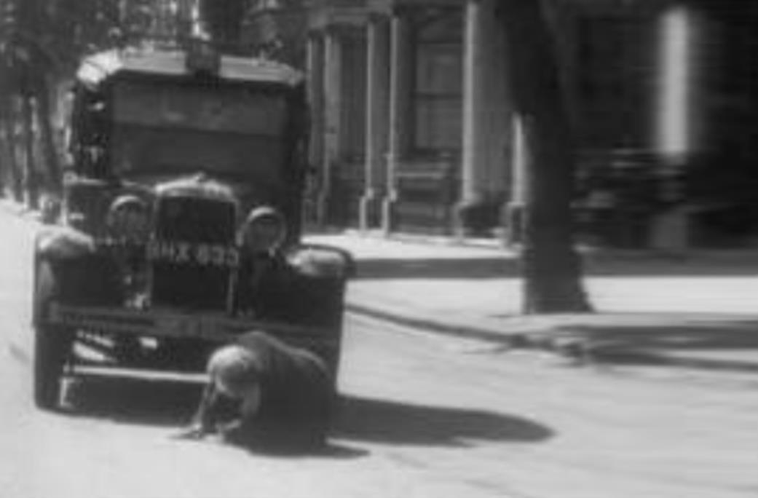
The Zebra Crossing
In 1934 pedestrian crossings consisting of parallel rows of metal studs in the road and Belisha beacons (orange globes on top of black and white posts) were introduced to reduce the number of road accidents.
In 1949 red and white stripes, and black and white stripes, were used on the road at experimental crossings.
By 1951 the black and white stripes, with Belisha beacons on either side of the road, were approved as ‘Zebra’ crossings.

Slide 12
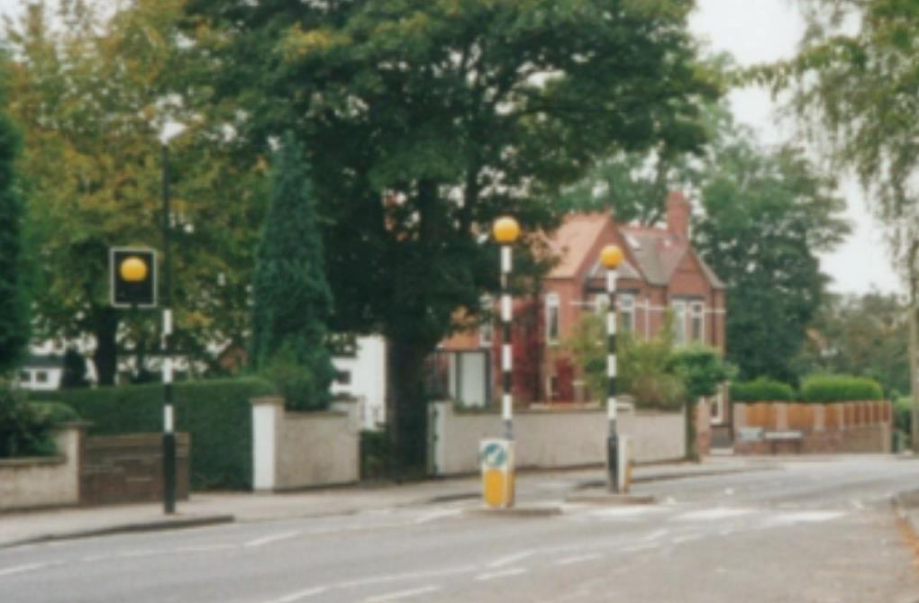
Flowol: Zebra crossing mimic

Slide 13
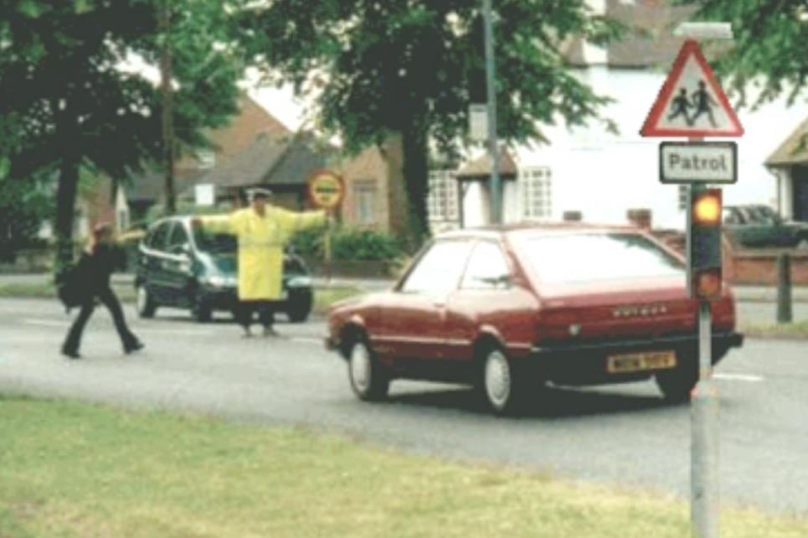
Flowol: School crossing patrol mimic

