Slide 1
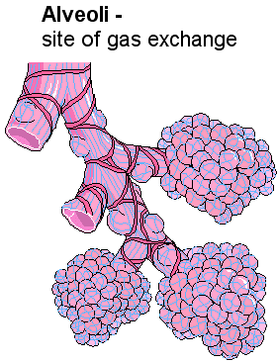
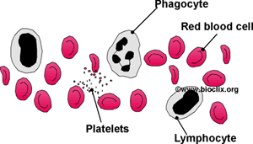
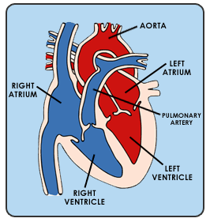
Biology Topic 8 Summary Sheet
CB8a - Efficient Transport and Exchange
Your body has to excrete substances out of it e.g. CARBON DIOXIDE
It also has to move substances into it e.g. OXYGEN and GLUCOSE
Many substance move into and out of parts of the body by DIFFUSION. This is the movement of particles from an
area of high concentration to an area of low concentration. We say they move ‘down a concentration gradient’.
To make sure particles diffuse quickly e.g.in the ALVEOLI of the lungs, the surfaces through which they move have to be :
Thin – so that particles do not need to diffuse very far
Have a large surface area – so that there is more room for particles to diffuse.
CB8a - Surface area : volume ratio
We can see how well substance can diffuse into a cell by calculating its SURFACE AREA : VOLUME RATIO.
Surface area ÷ volume
The bigger this value is the easier a cell can get substances into the centre of the cell.
Thin walls
Big surface area
CB8b – Blood
Blood is made up of:
EYTHROCYTES (red blood cells)
PLATELETS (help blood to clot)
PLASMA (carries substances e.g. water, hormones)
WHITE BLOOD CELLS
PHAGOCYTES (engulf pathogens)
LYMPHOTCYTES (make antibodies)
Red blood cells are specialised cells
with certain adaptations:
Biconcave shape for larger volume
No nucleus
Contain red haemoglobin which carries oxygen as oxyhaemoglobin.
CB8d – Cellular Respiration
AEROBIC RESPIRATION: Glucose + oxygen → carbon dioxide + water ANAEROBIC RESPIRATION: Glucose → lactic acid
CB8c - The Heart
The heart is an ORGAN as it is a group of tissues.
It pumps OXYGENATED blood to the body and receives DEOXYGENATED blood from the body.
The two sides of the heart are separated by the SEPTUM and VALVES keep blood flowing one way only.
CB8c – Cardiac Output
This is the volume of blood pushed into the aorta each minute.
Cardiac output = stroke volume x heart rate
(litres/min) (litres/beat) (beats/min)
Pathway of blood through the heart
V Vein (vena cava)
A Atrium (right
V Ventricle (right)
A Artery (pulmonary)
LUNGS
V Vein (pulmonary)
A Atrium (left)
V Ventricle (left)
A Artery (aorta)
BODY
How to remember it!
deoxygenated
CB8b – The Circulatory System
ARTERIES – carries blood away from the heart. They have strong, thick muscular walls
CAPILLARIES – substance diffuse through thin walls (one cell thick).
VEINS - carries blood away to the heart. They have thin walls and valves to stop backflow.
oxygenated

Slide 2
Core practical : Measuring the rate of respiration at different temperatures
Biology Topic 8 Summary Sheet
Task: To use a simple respirometer to measure the oxygen consumption of some small organisms and to find out how the rate of respiration depends on temperature.
METHOD
Small organisms e.g. maggots or seeds are placed into the boiling tube.
Soda lime has been added below them to absorb any carbon dioxide that the organisms produce.
The capillary tube is connected. A blob of coloured liquid is added.
As oxygen is used up in the boiling tube by the organisms the level of coloured liquid will move towards the boiling tube.
This was repeated at different temperatures.
FINDINGS
As the temperature is increased to 30ºC the rate of respiration increases so oxygen is used up quicker. This means that the blob of ink moves further towards the boiling tube in the same period of time.
The dependent variable ( what we are measuring) was the distance moved by the ink blob in 5 minutes.
The independent variable (what we were changing ) was the temperature.
Some control variables (factors to be kept the same) were: same mass of organisms, same size of tube.
Equipment Used:
An example set-up of a simple respirometer

