Slide 1
Starch and amylase

Slide 2
The enzyme amylase catalyses the breakdown of starch to simple sugars.
Starch reacts with yellow iodine solution, turning it blue-black. Simple sugars don’t react with iodine solution. So we can use iodine solution to identify the point when all the starch in a solution has been digested by amylase.
This presentation describes an experiment using iodine solution to track the digestion of starch by amylase.

Slide 3
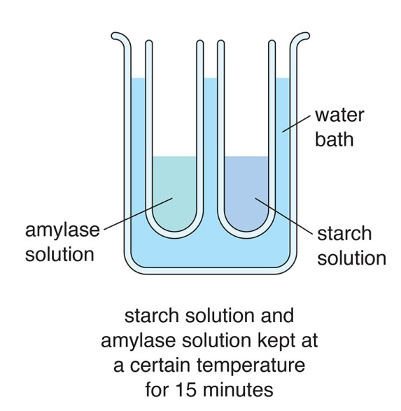
Before the experiment, a tube containing amylase solution and a tube containing starch solution are placed in a water bath. The solutions are given time to reach the temperature of the water bath.
Why do the solutions need to start at the same temperature?
Temperature can affect enzyme activity, so this variable must be controlled.

Slide 4
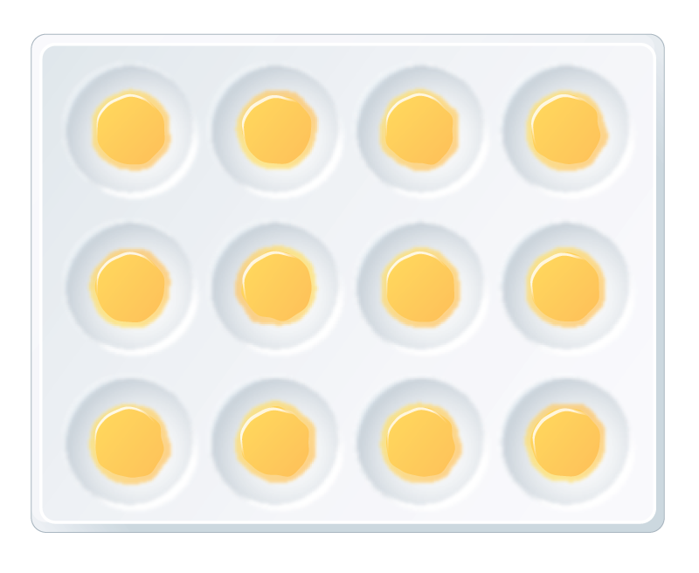
A spotting tile is prepared with a drop of iodine solution in each dimple.

Slide 5
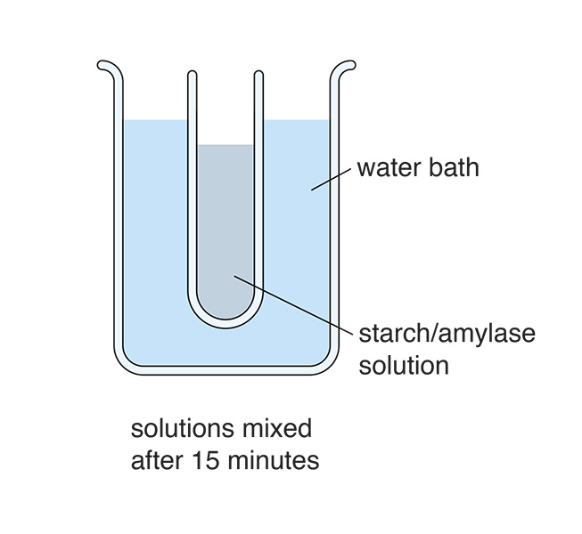
The starch solution and enzyme solution are then mixed in one tube, and the tube is placed back in the water bath for the rest of the experiment.
Why is the starch/amylase solution kept in the water bath?
To control temperature so that it doesn’t affect the results.

Slide 6
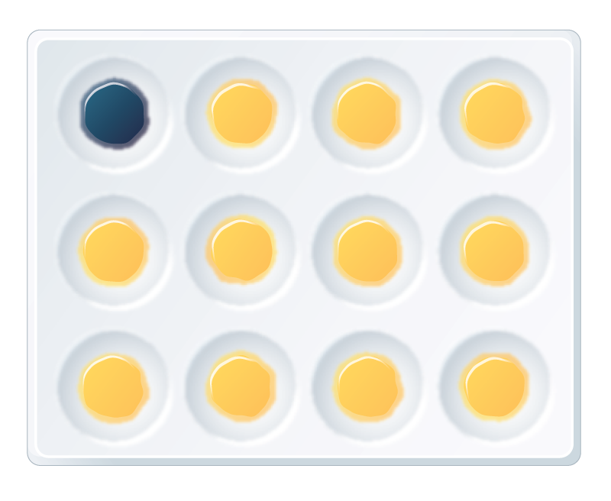
Every few minutes a drop of starch/amylase solution is taken from the tube in the water bath and added to the iodine solution in one dimple on the spotting tile.
The first drop of starch/amylase solution shows that the mixture still contains starch, because it turns the iodine blue-black.

Slide 7
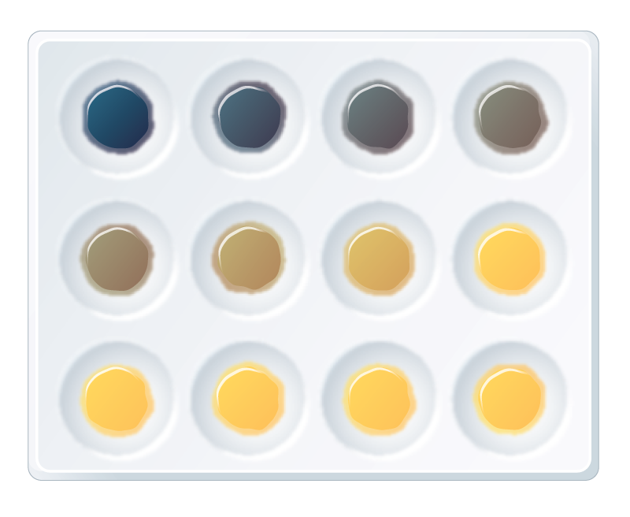
The numbers show the minutes after mixing the starch and amylase together. A dash (–) shows indicator solution that wasn’t mixed with starch/amylase solution.
0
2
4
6
8
10
12
14
16
18
20
–

Slide 8
When was the digestion of starch by amylase complete? Explain your answer.
Between 12 and 14 minutes – at 12 minutes there is a slight change in colour (indicating a little starch), but at 14 minutes the iodine didn’t change colour (indicating all starch has been broken down).
0
2
4
6
8
10
12
14
16
18
20
–

