Slide 2
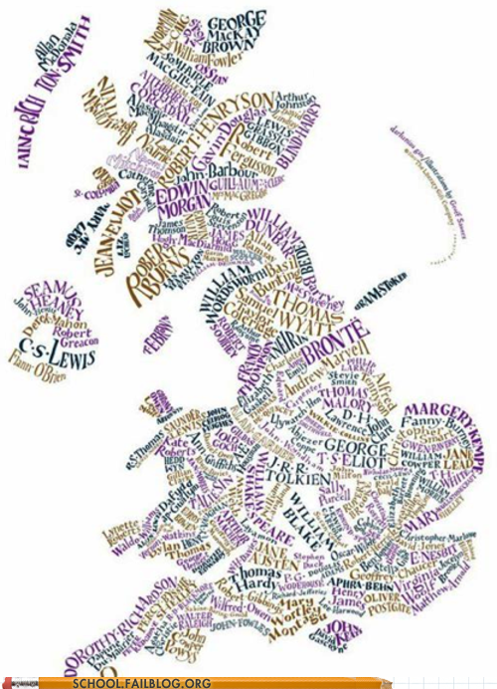
What is A-Level English Literature about?
Pupils will be required to familiarise themselves with subject knowledge from plays, novels and poems emerging from distinct genres and spanning across many centuries. With this comprehensive exploration of characters and themes will come the awareness of how traditions and culture have shaped literature over the years.

Slide 3
