Slide 1
Documentary Photography
Pre – A Level Photography

Slide 2
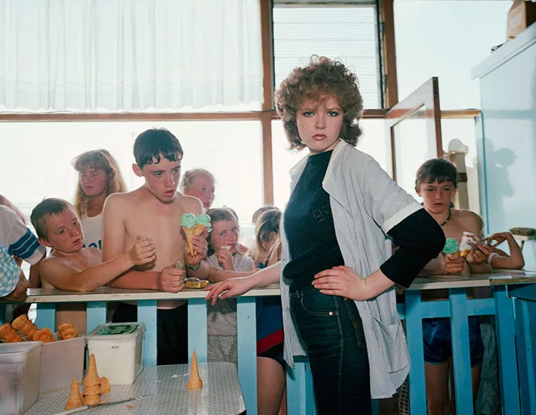
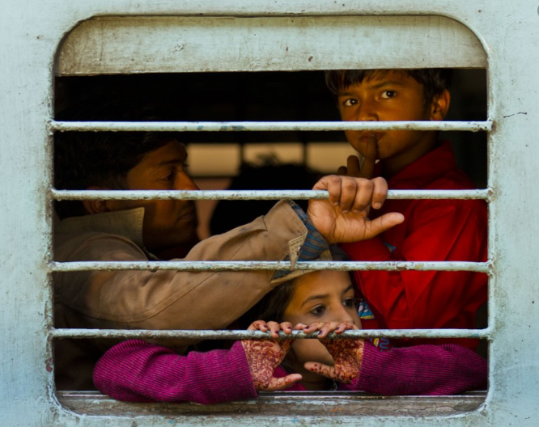
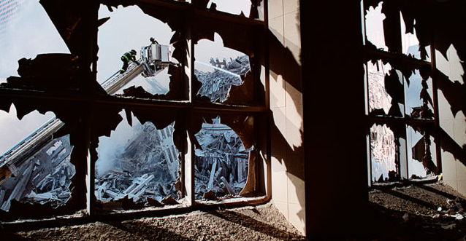
Documentary photography usually refers to a popular form of photography used to chronicle events or environments both significant and relevant to history and historical events as well as everyday life.
Martin Parr
Unknown
Steve Mccurry

Slide 3
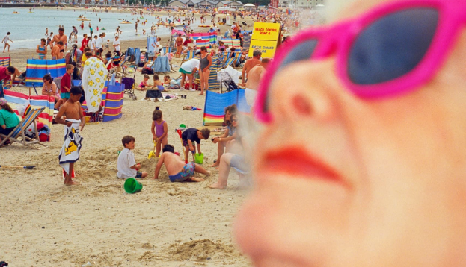
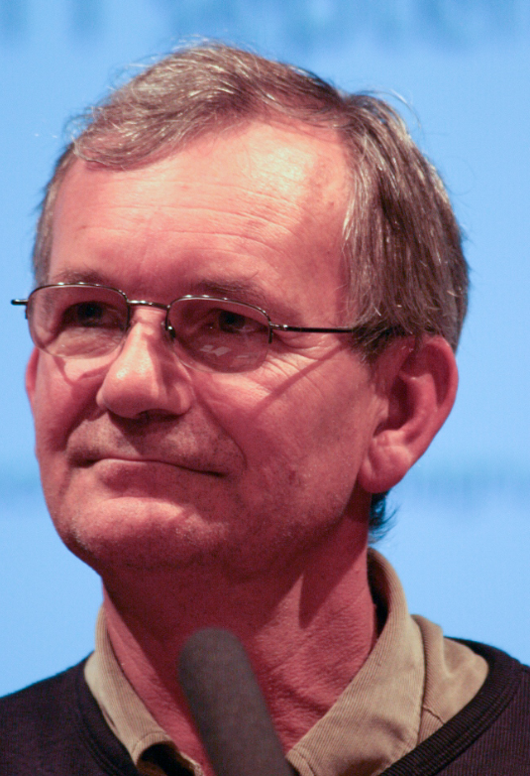
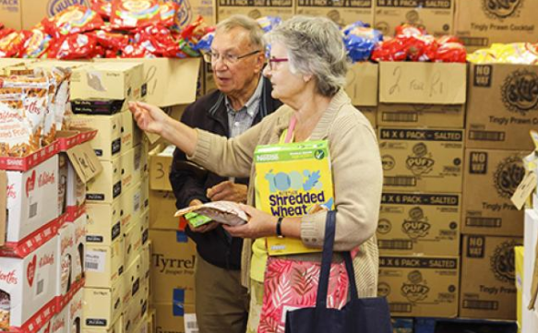
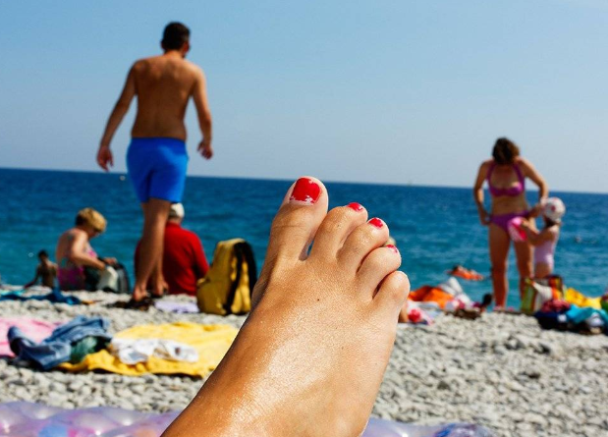
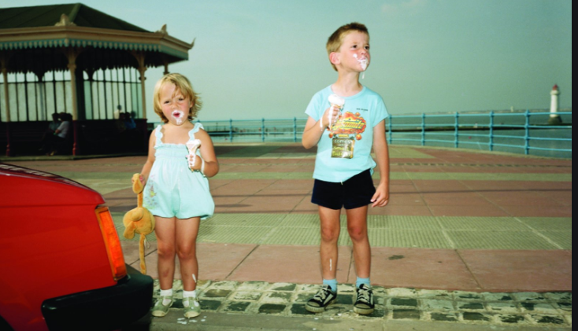
Martin Parr
Examples of Parr’s work
Martin Parr’s unmistakable eye for the quirks of ordinary life has made him a distinctive voice in visual culture for more than 30 years. He is well known for his use of garish colours and unusual composition.
Research starting points;
https://www.magnumphotos.com/photographer/martin-parr/
https://www.martinparr.com/
https://www.tate.org.uk/art/artists/martin-parr-2750
Martin Parr

Slide 4
1. Don’t be an art director
Documentary photography is about honesty above all else, which means being truthful to the scene in front of you and the moment you are capturing. If you direct any aspect of the photo, then it is no longer a documentary photograph.
2. Be open to life
A big part of being able to take a good documentary photograph is being open to what unfolds in front of you. Don’t become fixated on carrying out a vision in your head.
3. Step back
A good documentary photograph will often include a sense of place, which means you need to back up! Let more of the setting into a photo to give the moment context. When shooting indoors this often means backed up against a wall to get as much of a room into the photo as possible. Another way to get more of the setting in a photograph is to use wider lenses.
4. Watch edges
When composing your picture, don’t just look at the center of the frame or where the action is located. Always be scanning your edges. Decide if you want objects to be in the frame or outside of it and move your camera accordingly.
5. No Photo editing
In true documentary work you cannot manipulate the photo. That means no removing items or cleaning up a background. Embrace the flaws in your work, one day people will look back at our images and identify them as a sign of our times.

Slide 5
Task1.
Create a new Power-Point, using the Biography starter questions help sheet write a Biography for Martin Parr
Task2.
What are you going to document?
Write a plan;
-What?
-Where?
-How?
Task3.
Take a series of photography's – using the Contact sheet help guide record your images.
Using Text boxes – write notes explaining intensions and record if you feel the images were successful and why.
Task4.
Select your best photographs (3-4images)
Why have you chosen these pictures – explain why they are successful.
Task4.
Reflection – answer these questions
Name the 3 most interesting things you have learned
How well do you feel you have approached this task
How will you improve the way you work in the future
Pre-A Level Photography Success Criteria
ALL | Write a basic biography Write a basic plan of what you intend to document Take a series of Images Select and present the best
MOST | Write a biography using a number of sources Plan what you what to document and how you intended to achieve this. Take a series of images showing how you are exploring the subject. Select and present the best – adding notes to explain why. Reflect on your work.
SOME | Write a biography using a number of sources Plan what you what to document and how you intended to achieve this. Take a series of images showing how you are exploring the subject & demonstrating an influence from Martin Parr Select and present the best – adding notes to explain why. Detailed reflect on your work.

