Slide 1
Lesson 6: Problem-solving
Year 7 – Programming essentials in Scratch: part I
Notes:
Last updated: 08/03/2021
This resource is licensed under the Open Government Licence, version 3. For more information on this licence, see ncce.io/ogl.

Slide 2
Beat the teacher
Starter activity
Write down as many of the key words that you have learn about in this unit.
You will have 60 seconds to complete this by yourself.
Now swap your sheet with the person next to you.
Notes:
The aim of this task is for the learners to write down as many of the key words from the unit that they can think of. At the end of the 60 seconds, they should swap papers with the person next to them. You, the teacher, will also have 60 seconds to verbally list as many of the key words from the unit that you can think of. As you go along, the learners tick off the words if they are on the sheet in front of them. At the end of the 60 seconds, if any learner still has any valid words on their sheet that you haven’t said, they win.
Image source: https://pixabay.com/illustrations/school-teacher-professor-students-1019989/

Slide 3
Key words
Starter activity
Sequence
Subroutines
Variables
Selection
If/else
Condition
Comparison operator
Logic operator
Iteration
Loop
Count-controlled
Notes:
The learners may have come up with other words. Use your judgement as to whether or not they are valid words.

Slide 4
Lesson 6: Problem-solving
Objectives
In this lesson, you will:
Independently design and apply programming constructs to solve a problem (subroutine, selection, count-controlled iteration, operators, and variables).

Slide 5
Moves like Jim
Activity 1
Moves like Jim is a dance game that requires the user to make Jim perform a dance move by pressing keys on the keyboard at the right time.
Your end of unit task is to complete a partially-built program that allows the user to play the game and to make Jim perform some smooth moves.

Slide 6
Moves like Jim
Activity 1
Before you start the task, spend some time looking at the code and running it to see what happens.
You will need:
Activity sheet
Starter program (ncce.io/moveJim)

Slide 7
Reminder: Independent problem-solving
Activity 1
When working on solving coding problems, there might be times where you feel stuck.
Here is what you can do:
Carefully read over the instructions again. Stop and think through the problem.
Read the support tips and look at your work from previous lessons/tasks
Ask your classmate to prompt you (not do it for you)
Only when you have taken these three steps, should you ask your teacher

Slide 8
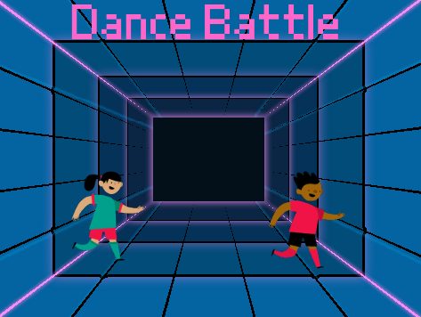
Level up
Plenary
A games development company has seen your ‘Moves like Jim’ game and want to hire you to create a new game called ‘Dance battle’.
The company wants to help you develop your skills by giving you more training.
Complete the worksheet to assess your programming skills.

Slide 9
Next unit
Summary
In this lesson, you…
Solved a problem using the skills that you have developed throughout this unit.
Next unit, you will…
Develop your confidence in applying the skills you have learnt throughout this unit.
Learn how to make your own subroutines and variables.
Learn new constructs, such as condition-controlled iteration and lists.
Notes:
In this unit, although learners used subroutines and variables, they didn’t create them. In the next unit they will learn how to make their own subroutines and variables.

