Slide 2
Objectives
Understand how abstractions are used in everyday life
Be able to create abstractions for different purposes
Understand how networks are used to make an abstraction of a maze
Understand network (graph) theory terms including:
Nodes
Edges

Slide 3
Starter
You are going to play a game of Pictionary with a partner
Player 1: Turn away from the whiteboard
Player 2: Get a pen and paper ready. The next slide will have the objects to draw. Draw these as quickly as possible so that your partner can guess them
You have 1 minute

Slide 4
Starter
Draw as many of these as you can
How many did your partner guess correctly?
Fox
Train
Sun
Boat
Zebra
House
Shark
Tortoise
Rabbit
Flower
Tree
Space Shuttle

Slide 5
Abstraction
The pictures that you drew were an abstraction of the real thing
Abstraction is where unnecessary details are removed or hidden
This allows the most important details to be considered
For example, this image shows an abstraction of a woman’s face
What details have been removed?

Slide 6
Abstraction
Some details that have been removed:
Face colour
Hair
Teeth/lips
Contours of the face
Any freckles, spots, wrinkles or blemishes

Slide 7
Room plans
The following child’s bedroom is to be placed onto a floor plan for a house sale
What will be included in the plan?
What unimportant details will be left out?

Slide 8
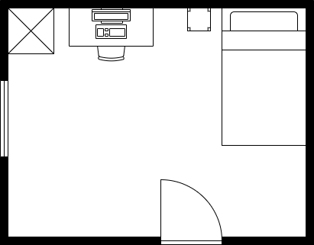
Room plans
For a house floor plan, we only need to know where objects are and how much space is available
We can ignore the following:
Type of computer
Carpet
Wallpaper
Bedding and cushions
Colours
3D representations

Slide 9
Worksheet 5
Complete Task 1 on Worksheet 5

Slide 10
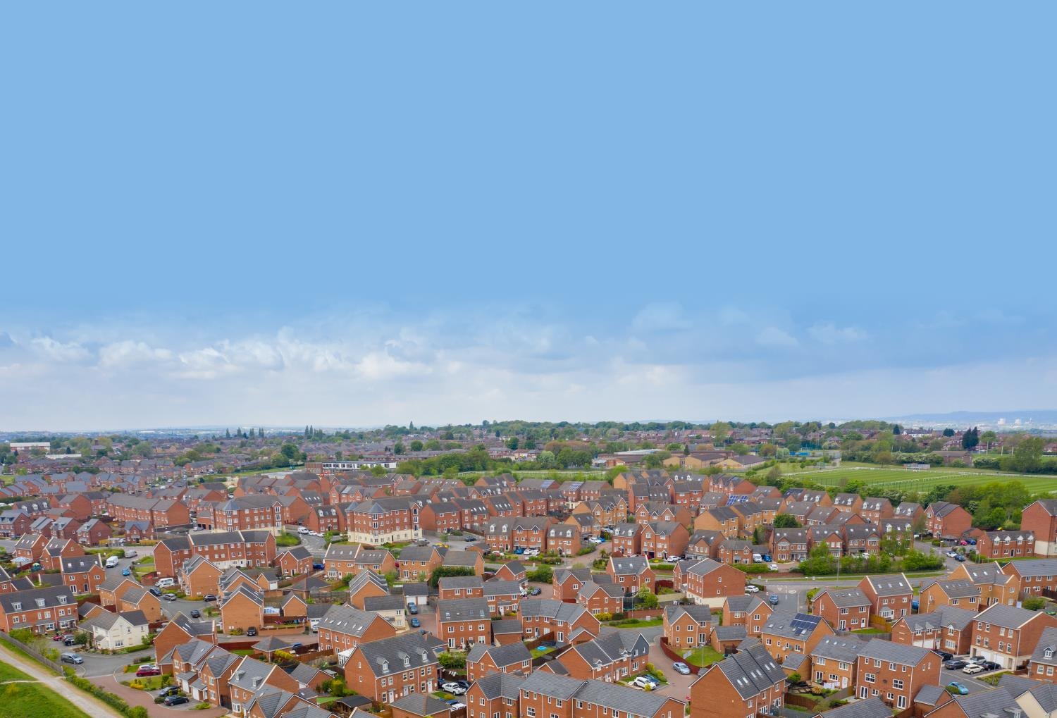
Abstraction for purpose
Look at the housing estate and roads below
We make different abstractions of this depending on how it will be used
What would you include and not include if an abstraction was made for software in a delivery van?

Slide 11
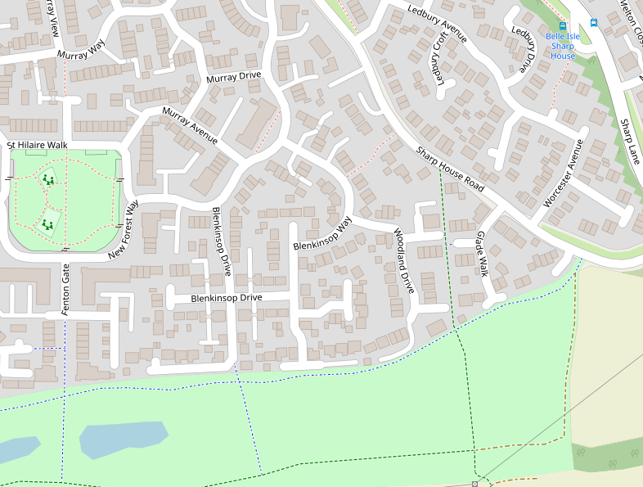
Abstraction for purpose
Abstraction for a delivery vehicle
Don’t include:
Building height
Colour of the buildings
Where cars are located
Include:
Road names
Houses and buildings
Roads
Road names

Slide 12
Worksheet 5
Complete Task 2 on Worksheet 5

Slide 13
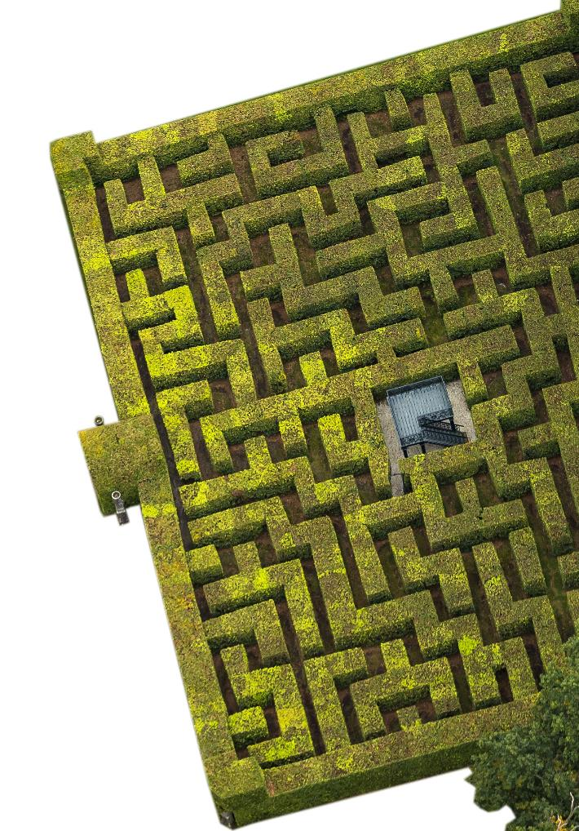
Maze abstraction
A photo of a maze contains a lot of information that isn’t required to solve it
What information can be ignored?
What is the key information required to solve the maze?

Slide 14
Maze abstraction
What information can be ignored?
Many aspects can be ignored, such as: height of the maze, the material the maze is made of, the thickness of the walls
What is the key information required to solve the maze?
First we need to simplify the maze
A line can represent a wall
The walls can be placed onto a grid to make it easier to understand

Slide 15
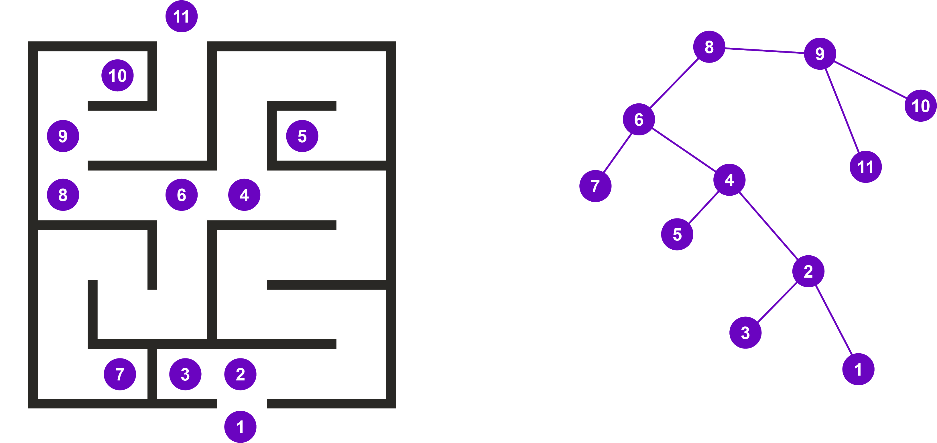
Maze abstraction
Computer Scientists go further in their abstraction
We are only interested in the start, the finish, dead ends and junctions where you make a choice where to turn
The maze can be represented by the network on the right
Which is easier to find the route through?

Slide 16
Maze abstraction
Which is easier to find the route through?
The network is easier to find the route
We just ignore any routes that don’t have a way of getting to circle (node) 11
The solution is easily found as 1, 2, 4, 6, 8, 9, 11

Slide 17
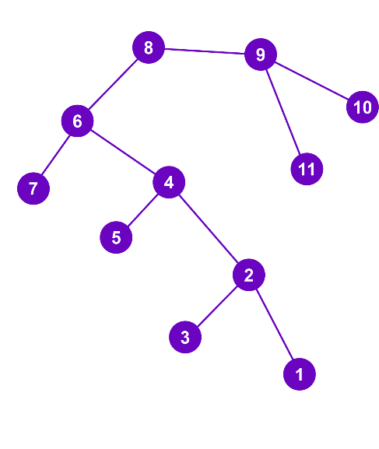
Network terms
Just to confuse you, Computer Scientists and Mathematicians often like to use harder words
The diagram shows a network or a graph
The circles are known as nodes or vertices
The lines that join the nodes are known as edges or arcs
For this graph:
How many nodes are there?
How many edges are there?

Slide 18
Network terms
For this network:
How many nodes are there? 11
How many edges are there? 10

Slide 19
Worksheet 5
Complete Task 3 on Worksheet 5

Slide 20
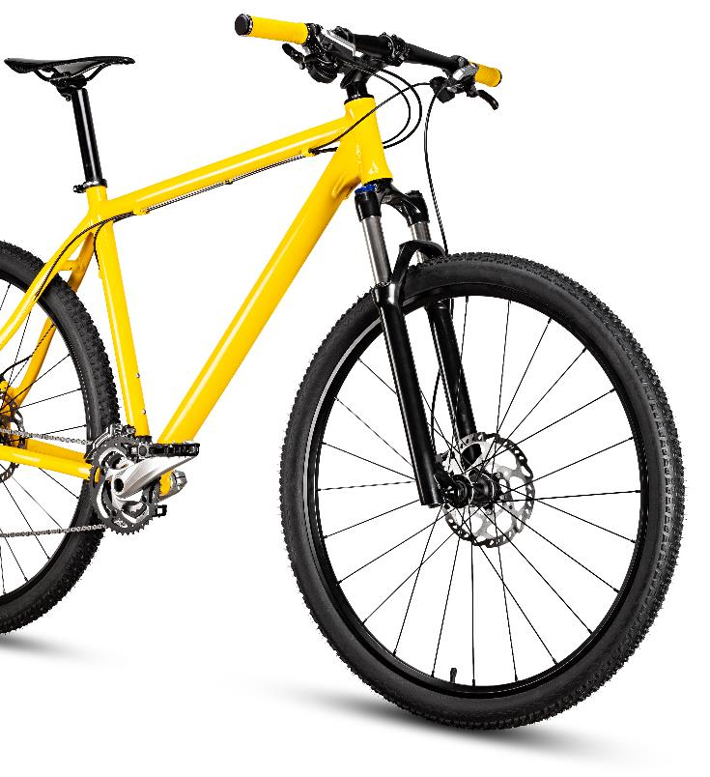
Plenary
In pairs, answer the following questions:
Describe an abstraction that would be used to show cycle routes in your local area
Describe how a maze can be abstracted to make it easier for a computer to solve
What does a node mean?
What does an edge mean?

Slide 21
Plenary
In pairs, answer the following questions:
Describe an abstraction that would be used to show cycle routes in your local area Show cycle paths and roads/road names, show where they connect, show key places so it’s easy to find where you are
Describe how a maze can be abstracted to make it easier for a computer to solve Show the start/end and each decision or dead-end as a node with edges showing the connections
What does a node mean? A circle in a network
What does an edge mean? A connection between two nodes in a network

