Slide 1
Lesson 5: Count-controlled iteration
Year 7 – Programming essentials in Scratch: part I
Notes:
Last updated: 01-07-20
This resource is licensed under the Open Government Licence, version 3. For more information on this licence, see ncce.io/ogl.

Slide 2
What patterns can you spot?
Starter activity
What is the program going to output?
Can you spot any repetition and/or any patterns?
think/write/pair/share
Notes:
Have this slide on the board as the learners enter the classroom. Ask them to write down their answer before discussing it with the person next to them.
The program will output the numbers one to ten. They might notice that the same ten blocks have been used with the only difference being the number that is specified. There is a pattern in that the numbers increment by one each time.

Slide 3
Lesson 5: Count-controlled iteration
Objectives
In this lesson, you will:
Define iteration as the process of repeatedly executing instructions
Describe the need for iteration
Identify where count-controlled iteration can be used in a program
Implement count-controlled iteration in a program
Detect and correct errors in a program (debugging)

Slide 4
Iteration
Activity 1
Iteration in computing is the process of repeatedly executing instructions
Being able to repeatedly execute instructions is commonly referred to in computing as iteration.
Can you think of any repetitive tasks that computers or humans might be able to perform?
Notes:
Mention to the learners that they may hear iteration referred to as a loop.
Use example on lesson plan to describe a real-world scenario where commands are executed repeatedly.

Slide 5
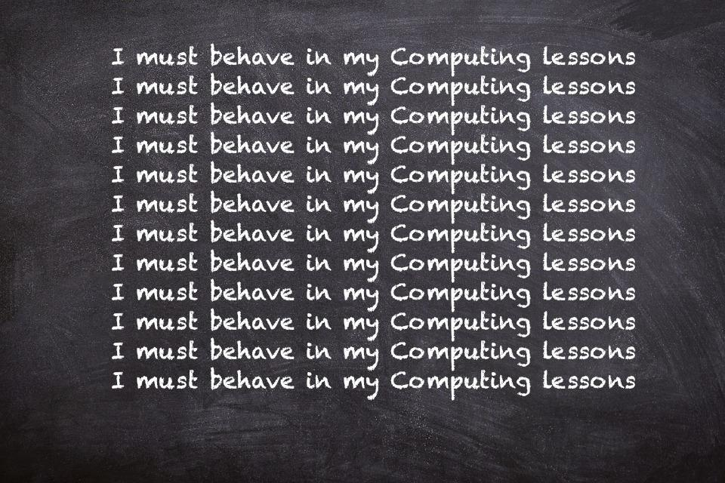
The repetitive task
Activity 1
Think about if a teacher tells you to write lines as a punishment. What instructions would they give?
What to write
That they want you to write this repetitively
How many times to do this or when to stop
Notes:
This is a real-world example of a repetitive task that could be executed by a computer. It highlights that when you write code to instruct the computer to iterate, you need to tell it what command you want it to carry out as well as how many times, or when to stop.
Blackboard image source: https://pixabay.com/photos/black-board-chalk-traces-school-1072366/

Slide 6
Count-controlled or condition-controlled
Activity 1
Count-controlled
Count-controlled iteration will execute the commands a set number of times
Example: “Write out lines 100 times”
Condition-controlled
Condition-controlled will execute the commands until the condition you set is no longer being met
Example: “Write out lines until 4pm”
Notes:
Keeping with the real-world example of writing lines for a punishment, highlight the differences between the two types of iteration. The learners should be familiar with the term ‘condition’ from previous lessons. Ask the learners to identify the condition in the example “write out lines until 4pm”.

Slide 7
The counting cat
Activity 2
Let’s work on the counting program from the beginning of the lesson.
Together we will work through the steps of how to add iteration to this program to make it more ‘elegant’.
Watch the demonstration and when instructed, complete the steps you have just seen.
ncce.io/CountingCat
Notes:
Briefly discuss the term ‘elegant’ with the learners. By adding iteration, the number of lines of code needed to solve a problem is reduced. The common programming term for this is that it makes the code more elegant. There is a misconception that this will make the code more efficient. It will be more efficient for the programmer to write, but not in terms of processing by the computer.

Slide 8
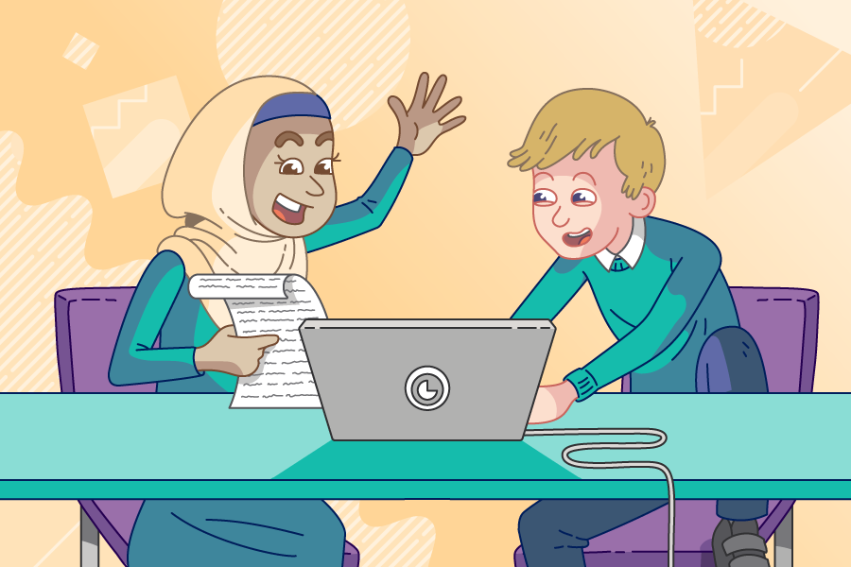
Ten green bottles
Activity 3
Your task is to use Scratch code to make a version of the nursery rhyme Ten Green Bottles.
Open the program and place the blocks together to play the first verse of the nursery rhyme
Modify the program so that it uses iteration to play the full nursery rhyme
ncce.io/10GreenBottles
Pair programming: driver/navigator swap roles every five minutes

Slide 9
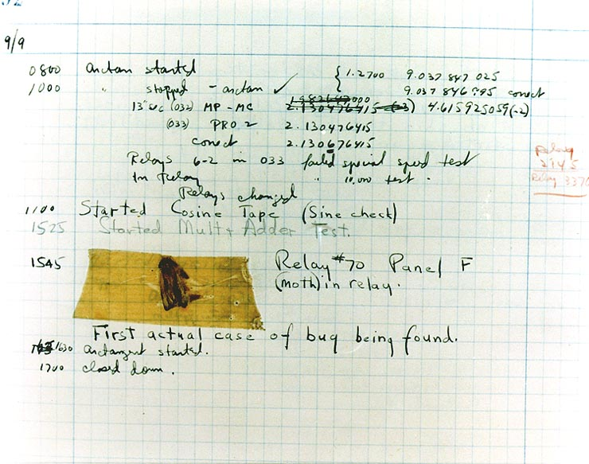
Computer bugs
Plenary
A bug in a computer system is code that causes your program to behave unexpectedly.
The first recorded bug in a computer system was part of work done by famous computer scientist Grace Hopper.
Notes:
The term bug refers to a malfunction and was a common term with engineers before computers were used. This example relates to Grace Hopper when the computer system she was working on (Mark II) malfunctioned. When her team investigated why it had malfunctioned, they came across a moth in the system which Grace took and stuck in her notebook. The error described was actually a hardware error, whereas hardware is now assumed to be so reliable, the term bug now refers to a problem with the code/software. More information can be found here: https://en.wikipedia.org/wiki/Software_bug
Image source: by Courtesy of the Naval Surface Warfare Center, Dahlgren, VA., 1988. - U.S. Naval Historical Center Online Library Photograph NH 96566-KN the image available here., Public Domain, https://commons.wikimedia.org/w/index.php?curid=165211

Slide 10
Debugging
Plenary
Debugging is the process of finding an error in your code and taking steps to fix the problem.
The code to the right has a problem that needs debugging.
Use your worksheet to help you find the bug and suggest a solution.
Notes:
When the learners execute this code they will see the cat on screen seemingly ‘stuck’ saying the number that was inputted. They must follow the worksheet and add lines of code to help them trace the value of the variables to lead them to the problem.
Image source: https://pixabay.com/illustrations/scan-system-bug-virus-malware-3963099/

Slide 11
Next lesson
Summary
In this lesson, you…
Learnt the term iteration
Looked specifically at count-controlled iteration
Learnt techniques to help debug code
Next lesson, you will…
Solve a problem by combining all of the new programming skills that you have developed over the past five lessons

