Slide 2
Objectives
Understand what an algorithm is
Create a sequence of instructions to achieve a goal
Understand how loops can be used to reduce the amount of code required for a solution
Understand how nested loops can be used to improve solutions further
Be able to refine algorithms to reduce the number of instructions required

Slide 3
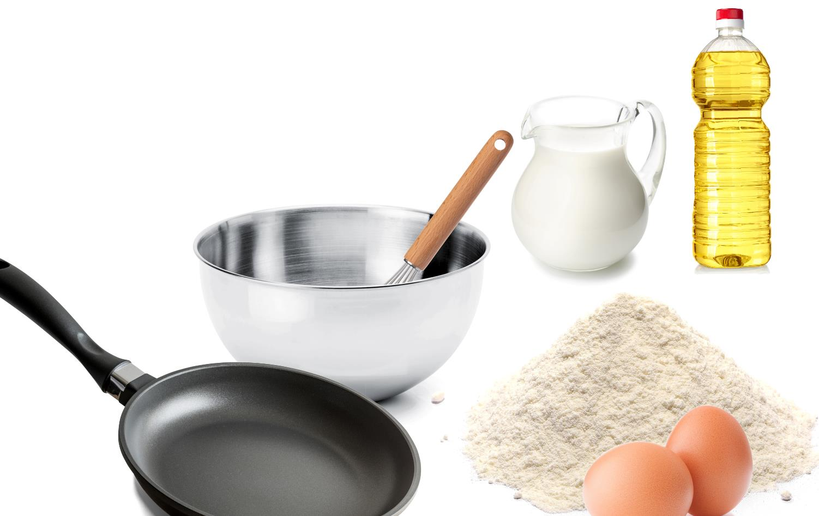
Starter
What are the steps needed to make pancakes?
If you don’t know how to make pancakes, then have a best guess at the answer

Slide 4
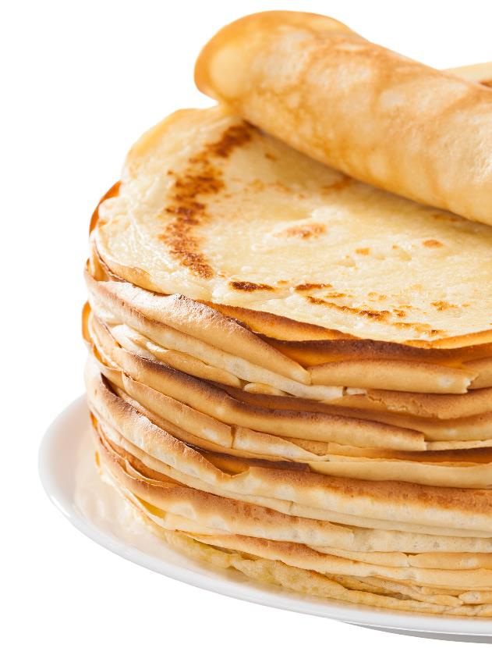
Starter
Instructions:
Algorithms show how to solve a problem with a computer
They give step by step instructions, just like a recipe
Put flour, eggs and milk into bowl
Whisk
Heat frying pan
Add oil
Add pancake mix
Cook for 1 minute
Toss the pancake
Cook for 1 minute
Serve

Slide 5
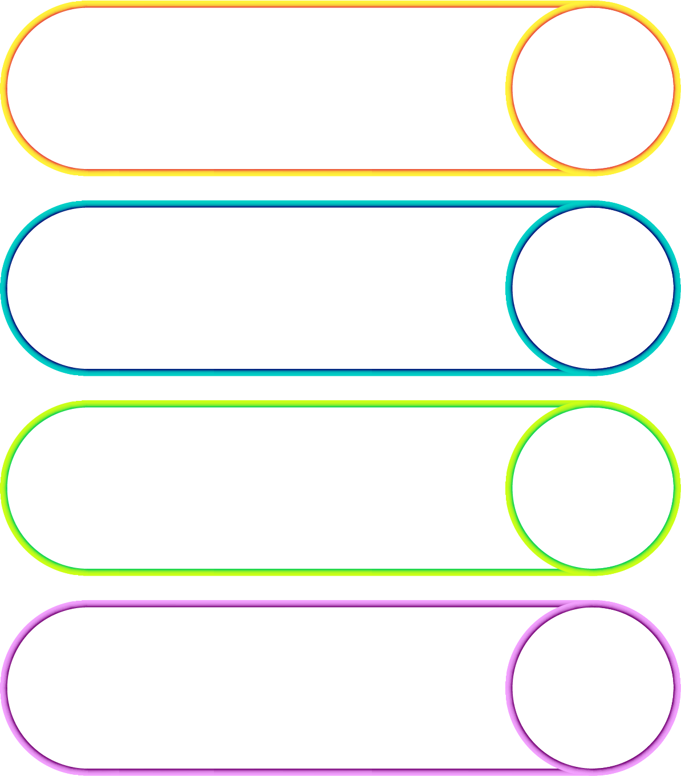
Algorithms
An algorithm is a sequence of steps which solve a problem
It is like the method in a recipe
If we have an algorithm to solve a problem, then programmers can make a program so that a computer can solve the problem
The computer will run each of the instructions in order

Slide 6
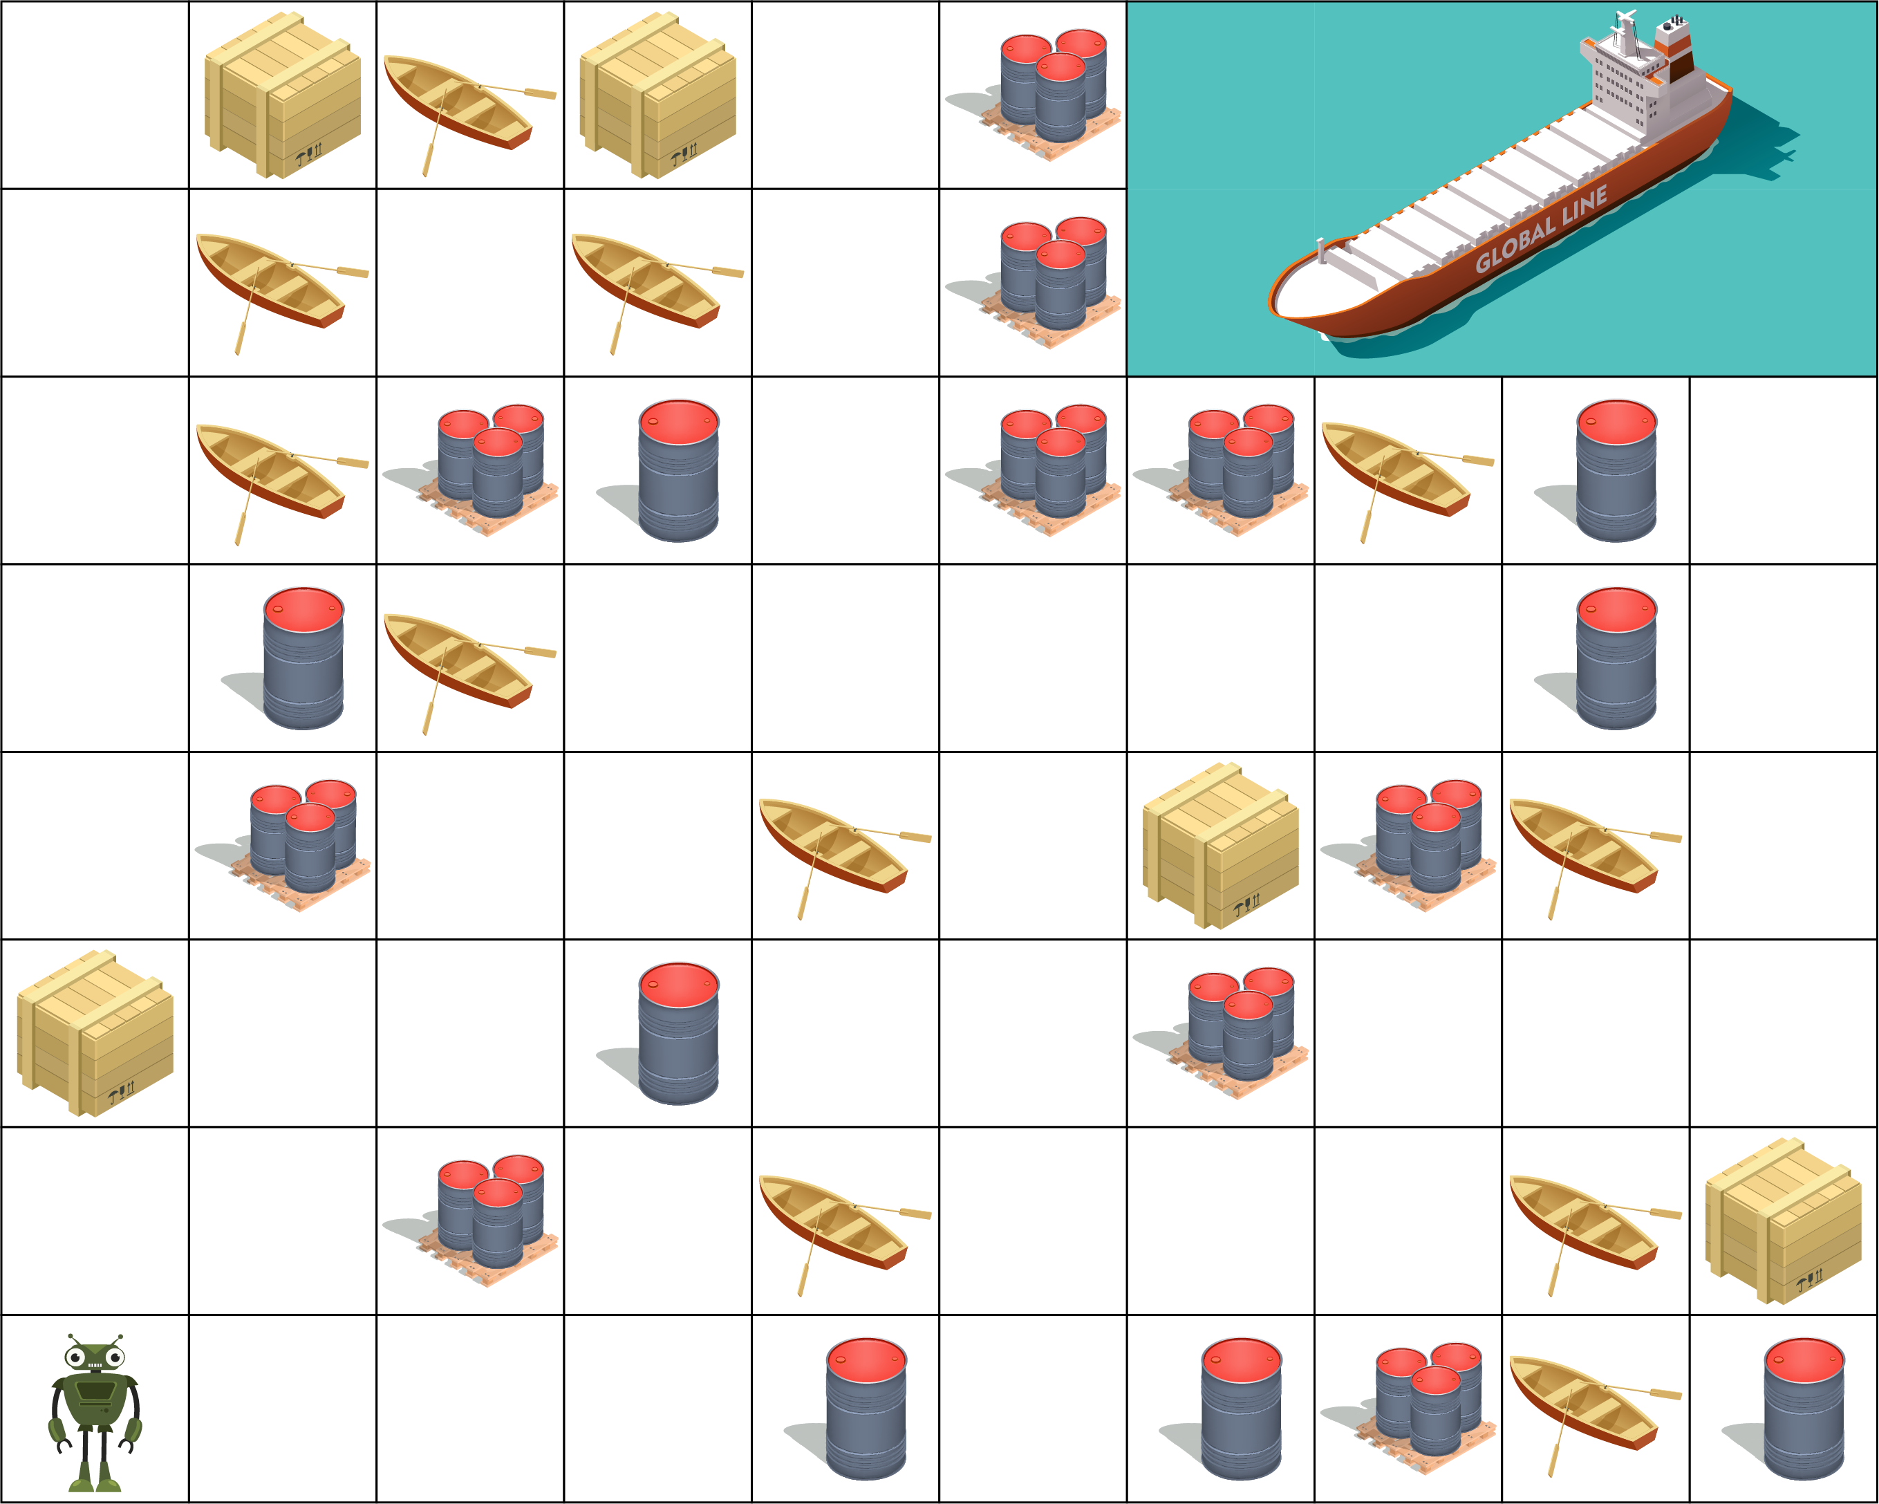
Navigation algorithm
Navigate the robot to pick up all the crates and take them to the ship
The robot can hold many crates at a time
Barrels and boats are obstacles
Instruction set
Right | Left | Up | Down | PickupCrate | LoadShip

Slide 7
Navigation algorithm
Up, Up, PickupCrate, Up, Up, Up, Up, Up Right, PickupCrate, Left, Down, Down, Down, Down, Down, Right, Right, Up, Right, Up, Right, Right, Right, Down, Left, Down, Down, Right, Right, Up, Right, Right, Up, Up, Up, Up, LoadShip
Instruction set
Right | Left | Up | Down | PickupCrate | LoadShip

Slide 8
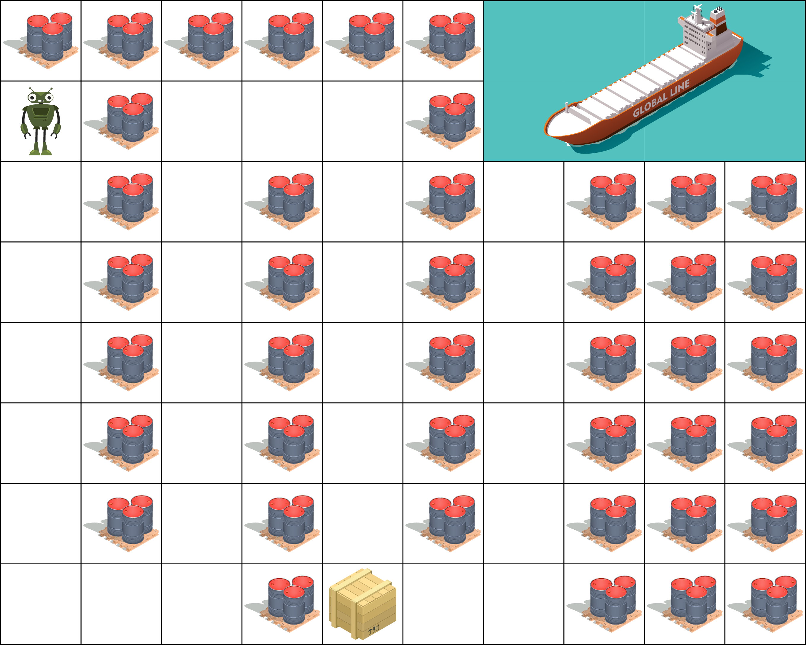
Repetition
Look at the following solution:
Down, Down, Down, Down, Down, Down, Right, Right, Up, Up, Up, Up, Up, Up, Right, Right, Down, Down, Down, Down, Down, Down, PickupCrate, Right, Right, Up, Up, Up, Up, Up, Up, LoadShip
What repetition do you see in the solution?
Instruction set
Right | Left | Up | Down | PickupCrate | LoadShip
REPEAT number

Slide 9
Repeat
A repeat structure saves writing so many instructions
REPEAT 6, Down REPEAT 2, Right REPEAT 6, Up REPEAT 2, Right REPEAT 6, Down PickupCrate REPEAT 2, Right REPEAT 6, Up LoadShip
Down, Down, Down, Down, Down, Down, Right, Right, Up, Up, Up, Up, Up, Up, Right, Right, Down, Down, Down, Down, Down, Down, PickupCrate, Right, Right, Up, Up, Up, Up, Up, Up, LoadShip

Slide 10
Worksheet 3
Complete Task 1 on Worksheet 3

Slide 11
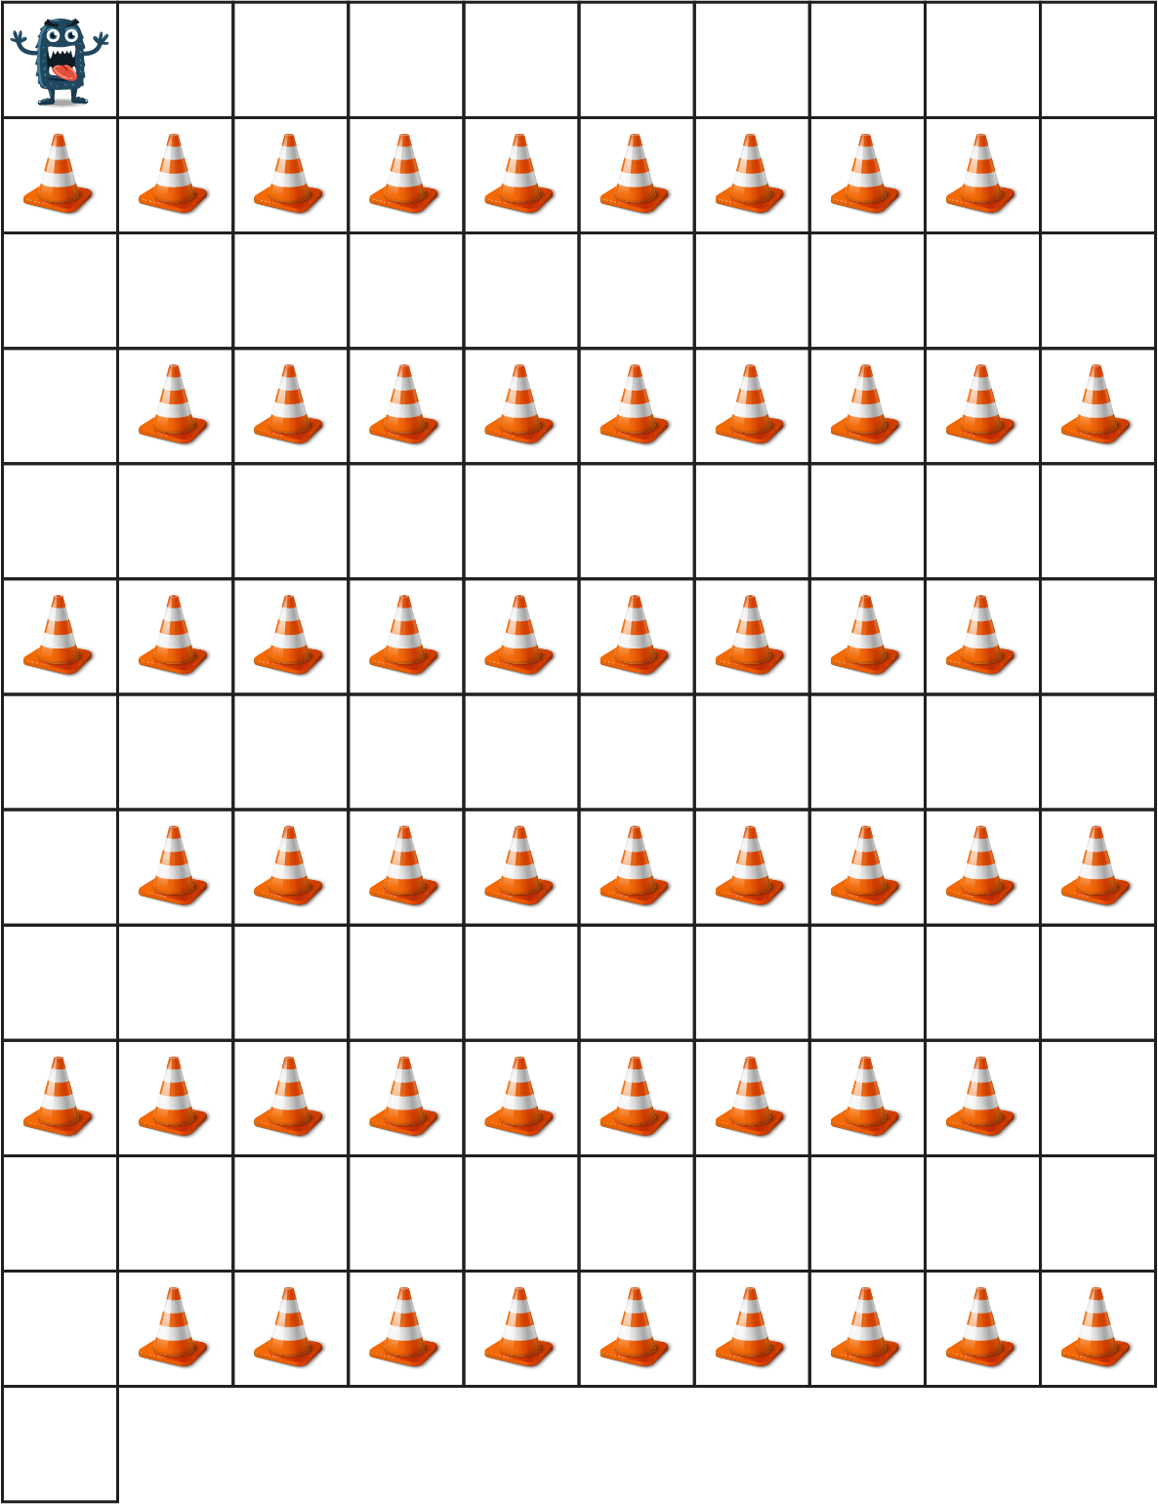
Repetition
Here is a solution to move the monster to the exit
REPEAT 9, Right REPEAT 2, Down REPEAT 9, Left REPEAT 2, Down REPEAT 9, Right REPEAT 2, Down REPEAT 9, Left REPEAT 2, Down REPEAT 9, Right REPEAT 2, Down REPEAT 9, Left REPEAT 2, Down
What repeated instructions are in the above algorithm?

Slide 12
Nested loops
What repeated instructions are in the above algorithm?
REPEAT 9, Right REPEAT 2, Down REPEAT 9, Left REPEAT 2, Down REPEAT 9, Right REPEAT 2, Down REPEAT 9, Left REPEAT 2, Down REPEAT 9, Right REPEAT 2, Down REPEAT 9, Left REPEAT 2, Down
Four instructions can be repeated three times
A loop inside another loop is known as a nested loop
REPEAT 3,
REPEAT 9, Right REPEAT 2, Down; REPEAT 9, Left REPEAT 2, Down

Slide 13
Worksheet 3
Complete Task 2 on Worksheet 3

Slide 14
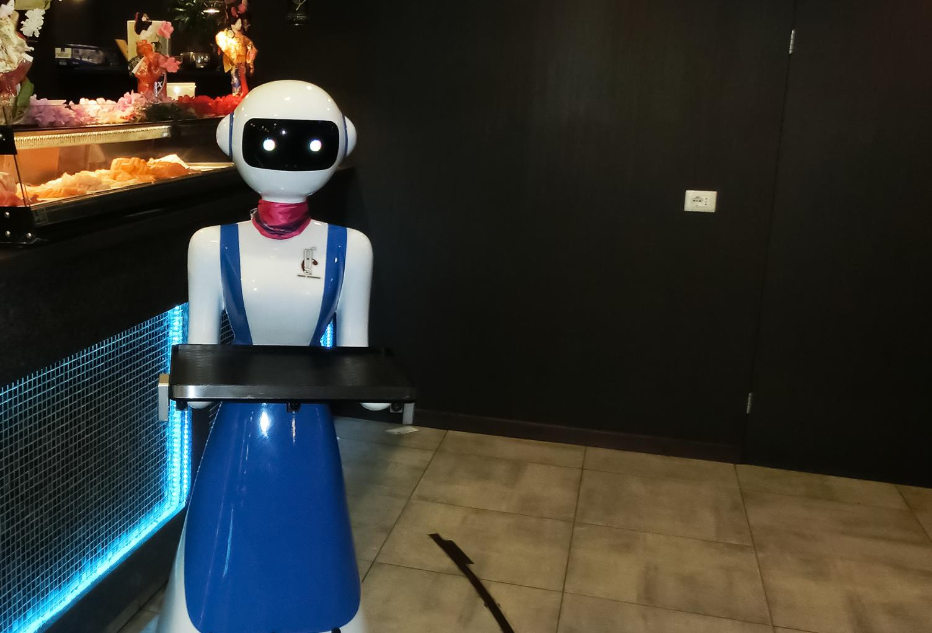
Robot waiters
Some cafes use robots as waiters
This robot is in The Gran Café Rapallo, Italy
Note the black line on the floor which the robot uses to move between each table

Slide 15
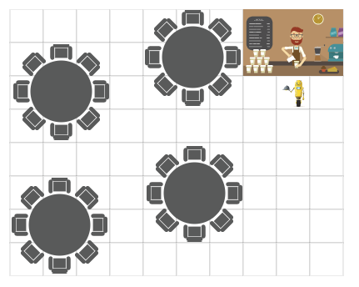
The waiting game…
A robot needs to serve all three tables, but can only take one order at a time from the counter.
The robot starts with the first order
The robot can serve one table at a time
Discuss with a partner an algorithm to serve all the tables
Assume that the waiter moves one block at a time

Slide 16
Worksheet 3
Complete Task 3 on Worksheet 3

Slide 17
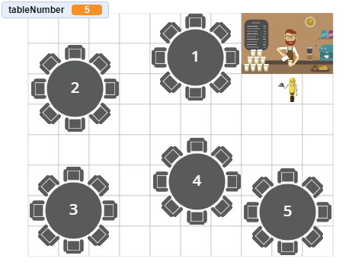
The waiting game…
The café is becoming very popular and due to demand another table is installed
How does this affect the instructions your algorithm needs to use to serve all the tables?

Slide 18
Alternative algorithm
At the moment, if the robot has food to take to a table, it must visit every single table which is inefficient
How could the algorithm be improved?

Slide 19
Alternative algorithm
How could the algorithm be improved?
The chef could say which table the food is for
The instructions in the algorithm could then direct the robot to the correct table depending on which table has been selected
In programming we would use an IF statement
IF sendTo = “Table 1” THEN instructions to go to table 1
IF sendTo = “Table 2” THEN instructions to go to table 2 …and so on…

Slide 20
Worksheet 3
Complete Task 4 on Worksheet 3

Slide 21
Plenary
The following are some instructions for a dance group to follow:
Step forward Step back Step back Clap Step forward Step back Step back Clap
In pairs, rewrite the instructions using REPEAT statements

Slide 22
Plenary
Rewrite the following instructions using REPEAT statements
Step forward Step back Step back Clap Step forward Step back Step back Clap
REPEAT 2
Step forward
Step back Step back Clap
REPEAT 2
Step forward
REPEAT 2
Step back Clap

