Slide 1
Lesson 2: Tappy Tap App
Year 8 – Programming – Mobile app development
Notes:
Last updated: 10-05-2021
Resources are updated regularly — the latest version is available at: ncce.io/tcc.
This resource is licensed under the Open Government Licence, version 3. For more information on this licence, see ncce.io/ogl.

Slide 2
Lesson 2: Tappy Tap App
Objectives
In this lesson, you will
Recognise that events can control the flow of a program
Use a block-based programming language to create a sequence
Use user input in an event-driven programming environment
Use variables in an event-driven programming environment
Develop a partially complete application to include additional functionality
Notes:
Secondary – objectives slides

Slide 3
What do all these blocks have in common?
Starter activity
Notes:
They are all events. The learners should recognise that they are all Scratch blocks, but the link is that they all require the user to interact in some way with the program to trigger a sequence of code to be executed.
The Scratch blocks that are found under the Event menu.

Slide 4
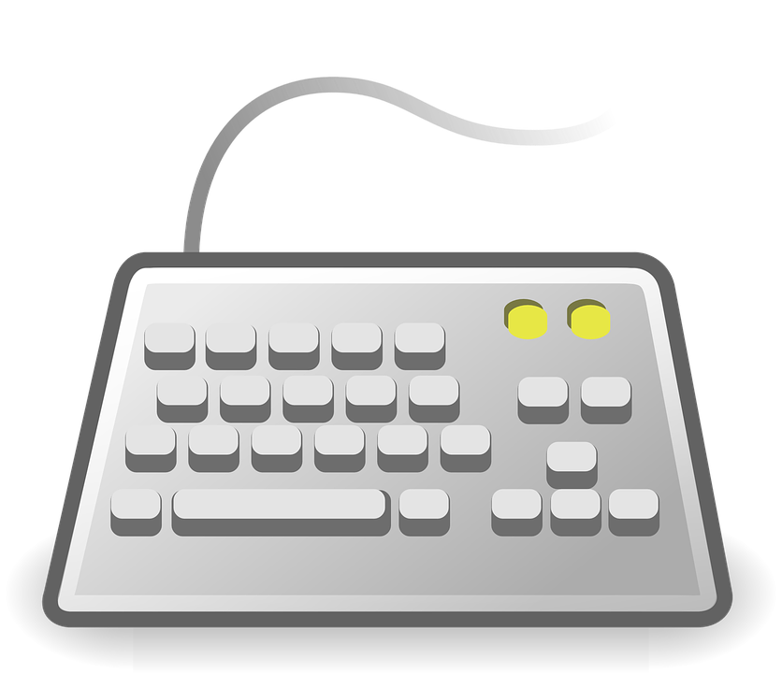
Event-driven programming
Starter activity
In event-driven programming, the flow of the program is controlled by events.
Events can be user actions such as:
Mouse clicks (or the touchscreen equivalent)
Key presses
Hovering over a picture
Voice input (“OK Google…”)
Events can also be also be triggered by:
Sensors (e.g. if movement is sensed, turn the light on)
Messages from other programs
Notes:
Keyboard image source: https://pixabay.com/vectors/keyboard-input-input-device-98410
Voice icon image source: https://pixabay.com/vectors/microphone-audio-micro-recording-2104091
Finger press image source: https://pixabay.com/illustrations/the-mouse-cursor-click-icon-shown-3184905

Slide 5
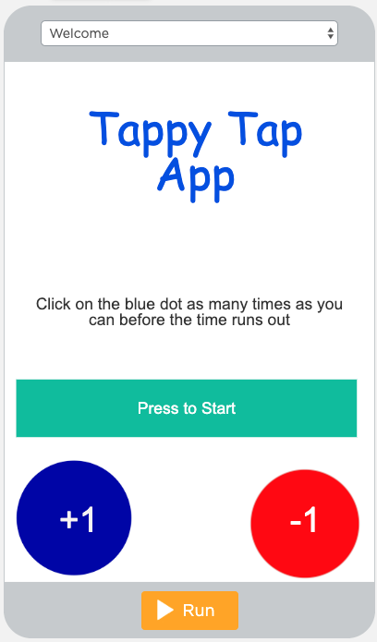
Event-driven programming
Starter activity
Code execution is triggered
Result of code being executed
The event

Slide 6
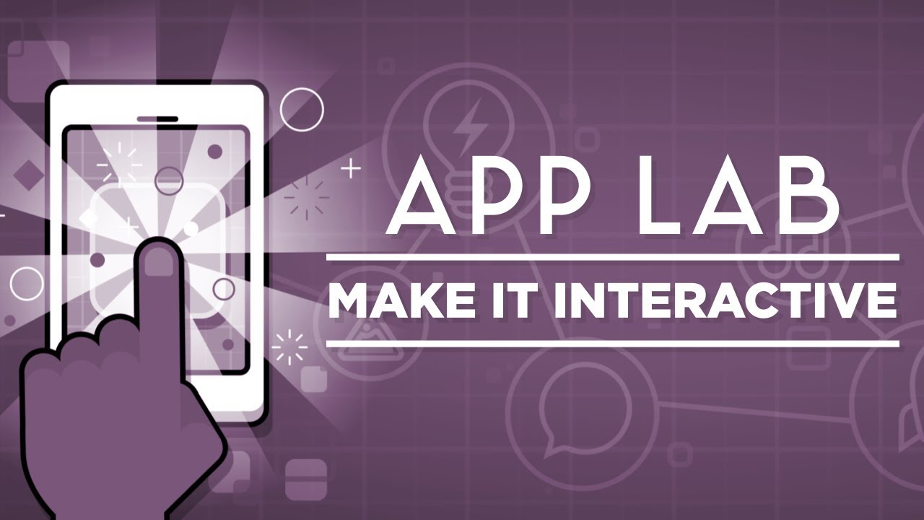
Events in App Lab
Activity 1
Watch this video

Slide 7
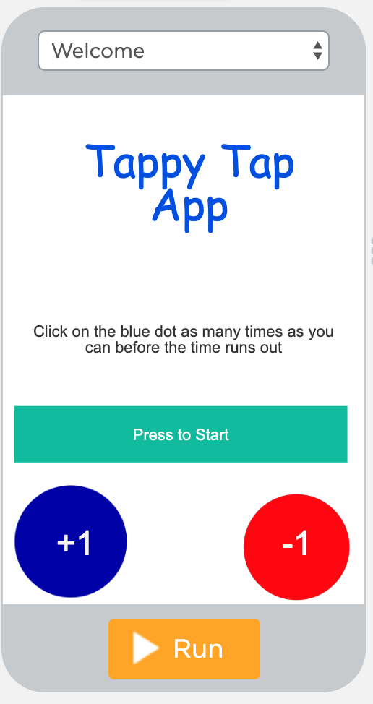
Live coding
Activity 2
Sign into your account from last week.
Together we will now complete the following:
Add the game and score screens
Add an event that will move to the game screen when the Startbutton is clicked
Add code that will automatically switch the screen to the score screen after five seconds

Slide 8
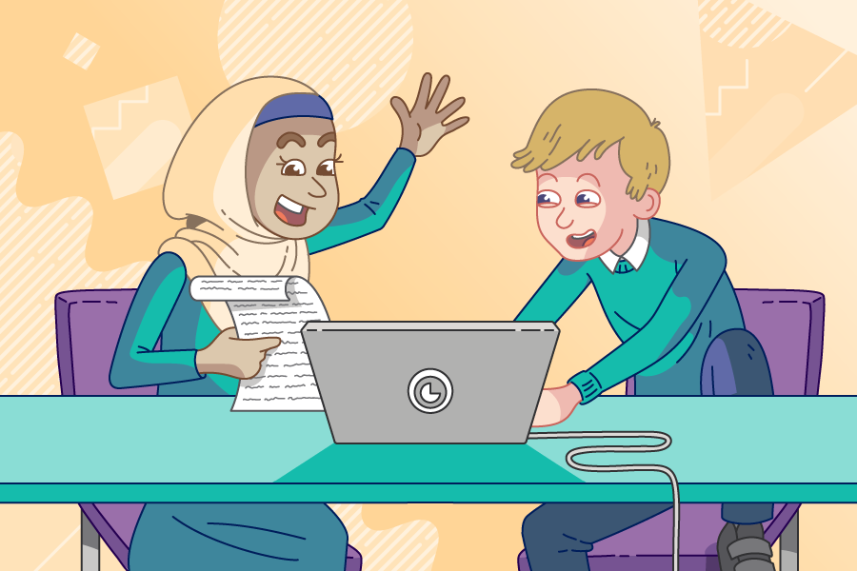
Pair programming
Activity 3
You will be placed into pairs to complete the next activity. You will take turns to be the driver and the navigator.
The driver: Your role is to control the keyboard and mouse and place the code blocks into the correct places.
The navigator: Your role is to help support the driver by watching for any mistakes, reading instructions to the driver, and seeking support if needed.

Slide 9
Game development
Activity 3
Follow the instructions and challenges on the worksheet to develop your game further.
How to be successful with this task
Teamwork
Driver: focus on the code and workspace
Navigator: read the instructions to the driver, watch the code being entered by the driver, and look at the work of others to help with problem-solving

Slide 10
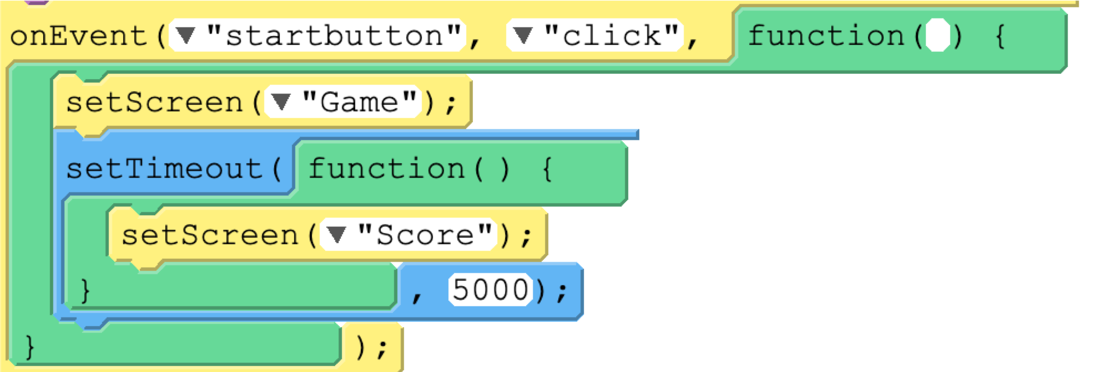
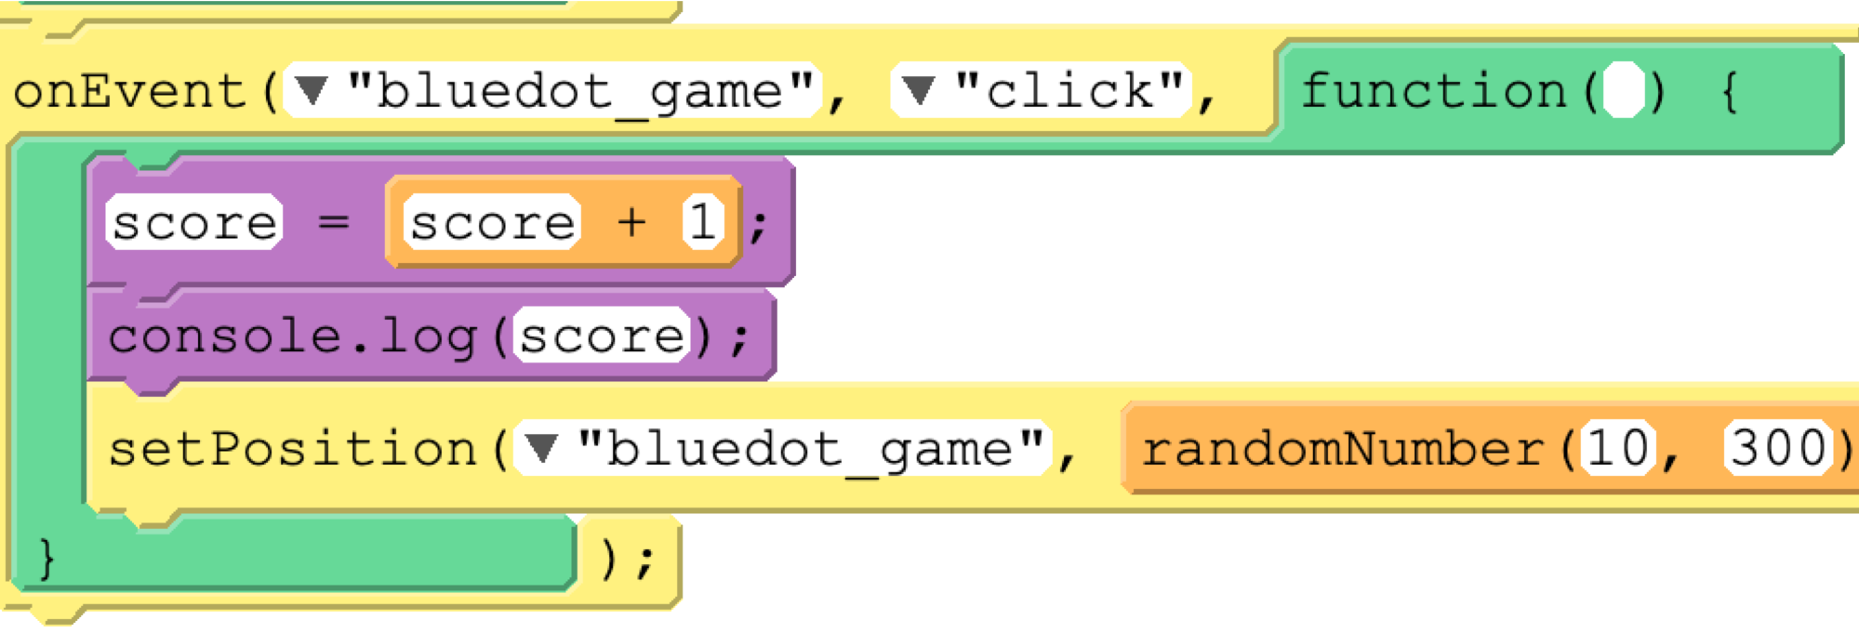
Ordering events
Plenary
1
What sequence should the two events be in?
Does it matter?
Justify your answer
Think/pair/share.
2

Slide 11
Next lesson
Summary
In this lesson, you…
Learnt about event-driven programming
Used coding techniques to develop your mobile app further
Next lesson, you will…
Look at how to debug common errors
Develop the score screen of your app
Start planning a project where you will develop your own app

