Slide 1
LIGHT & SHADOW

Slide 2
Lesson Objective:
To understand how light and shadow can be used effectively.
Able to use effective composition in your images.

Slide 3
There is a lot more to photography than simply picking up a camera, pointing it toward something, and tripping the shutter.
Achieving a great photograph requires thought and preparation, an understanding of the photographic process, and a firm grasp of how light and composition affect a photo.
There must be experimentation, with the recognition that only a small percentage of experiments end successfully.
The Essence of Photography: Seeing and Creativity Paperback – 11 Jun. 2015
by Bruce Barnbaum (Author)

Slide 4
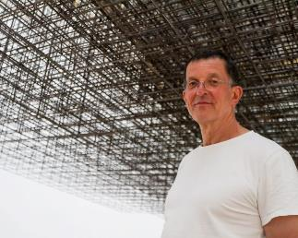
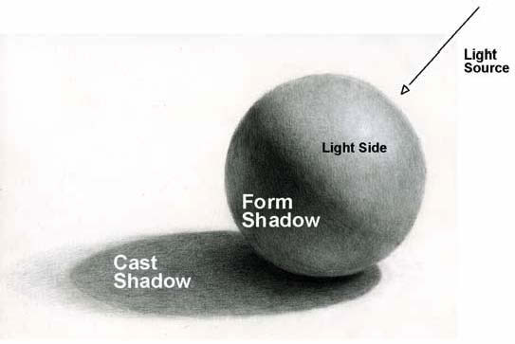
This piece of work is based on a project created by Anthony Gormley, the purpose is to make you think about form, light & shadow.
Form – what you are capturing (the shape)
Light – How you illuminate the object.
Shadow – Created by the object blocking the lights path.
http://www.antonygormley.com/
https://firstsite.uk/content/uploads/2020/04/Firstsite_Art-is-where-the-home-is.2020-04-14.pdf

Slide 5
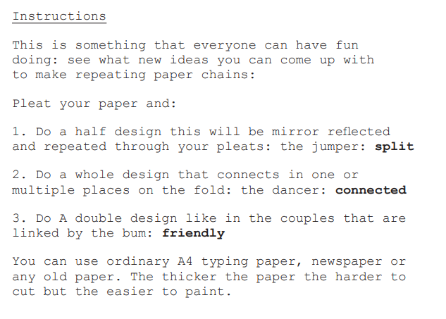
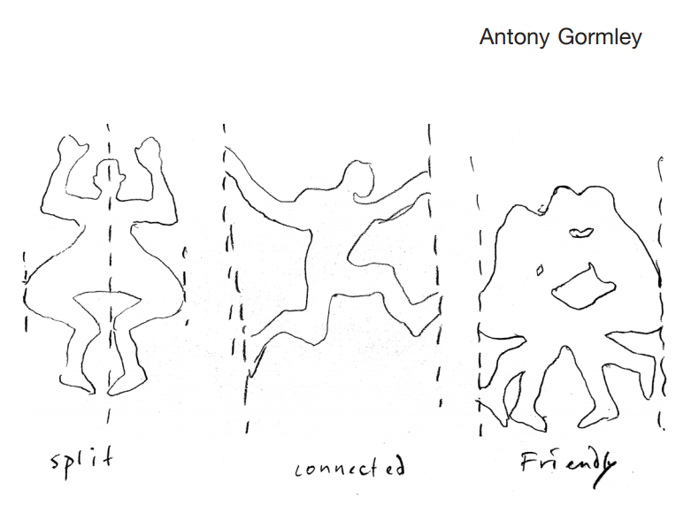

Slide 6
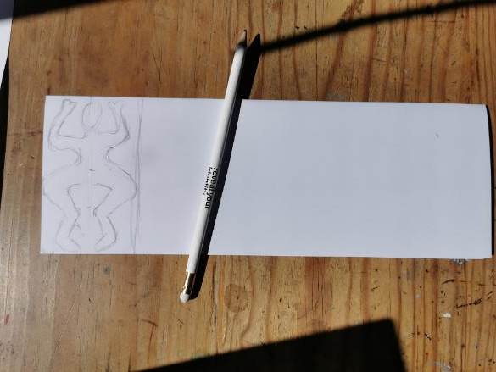
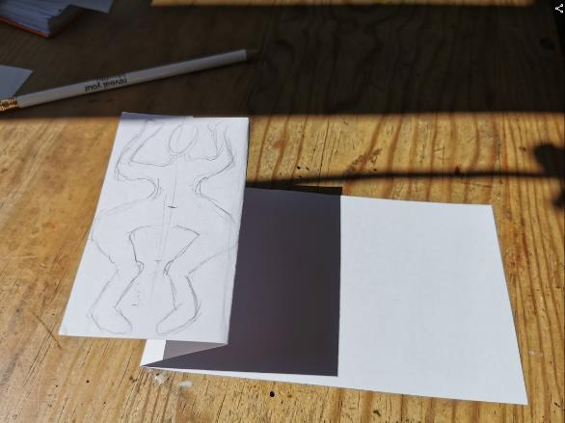
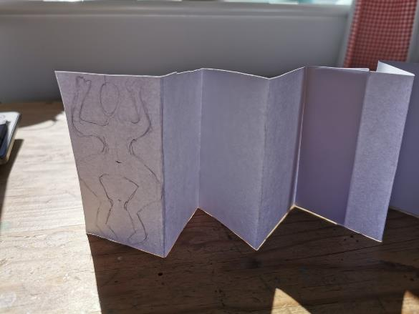
1. Blank piece of paper
2. Cut in half
3. Mark your work area
4. Draw your person – the knees go to the edges
5. Concertina fold
6. Glue your two pieces of paper together and continue folding

Slide 7
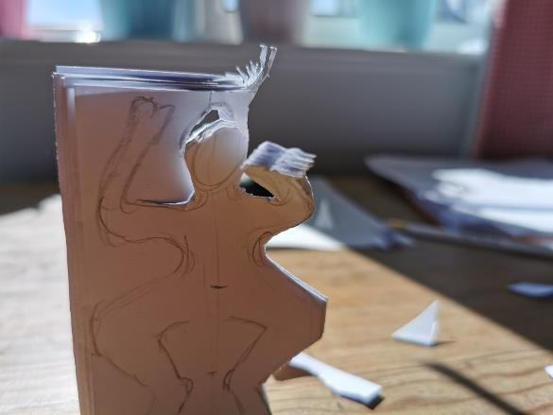
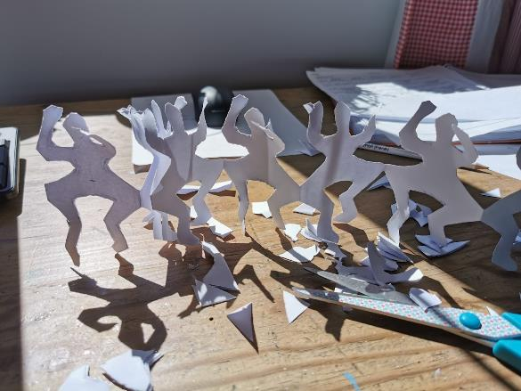
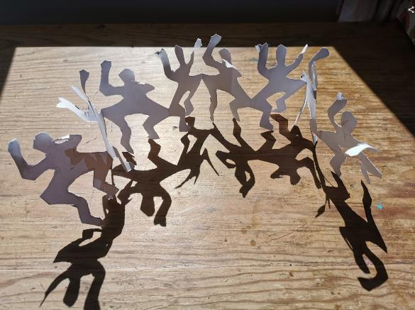
7. Cut out – don’t cut out around the knees!
8. Unfold
9. Setup ready for your photoshoot
Play this video

Slide 8
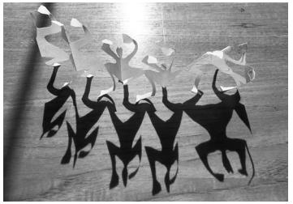
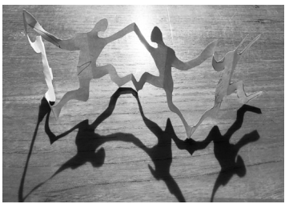
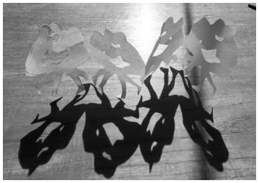
Using a single light source – sun, table lamp, torch or mobile phone, light your figures and take a series of photographs
https://firstsite.uk/content/uploads/2020/04/Firstsite_Art-is-where-the-home-is.2020-04-14.pdf

Slide 9
Photography Success Criteria
ALL | Create a single set of paper persons. Only the minimum number of pictures taken (15) Basic recoding of process and images.
MOST | Create a single set of paper persons. Takes a range of images exploring the effects different light sources has on the final outcomes. Some recording of the process and outcomes. Final images presented and reflection completed
SOME | Creates multiple sets of paper persons. Takes a range of images exploring the effects different light sources has on the final outcomes. Detailed recording of the process and outcomes including annotation of thoughts and ideas. Final images presented and detailed reflection completed.
Task 1. Create your paper people cutouts.
Task 2 . Create a Power-Point to record your work and images.
Task 3. Using a single light source take a series of images (15 minimum)
Task 4. Select the best 3-5 images
Task 5. Reflection
- What have you done?
- What have your learned?
- What was successful?
- What would you do differently in the future?

Slide 10
Photography Success Criteria
ALL | Create a single set of paper persons. Only the minimum number of pictures taken (15) Basic recoding of process and images.
MOST | Create a single set of paper persons. Takes a range of images exploring the effects different light sources has on the final outcomes. Some recording of the process and outcomes. Final images presented and reflection completed
SOME | Creates multiple sets of paper persons. Takes a range of images exploring the effects different light sources has on the final outcomes. Detailed recording of the process and outcomes including annotation of thoughts and ideas. Final images presented and detailed reflection completed.

