Slide 2
Objectives
Understand what ethics is
Consider some simple ethical hypothetical problems
Understand and discuss ethical issues as they relate to AI
Understand how jobs can be affected by AI and automation
Understand how bias can be introduced into AI algorithms and machine learning

Slide 3
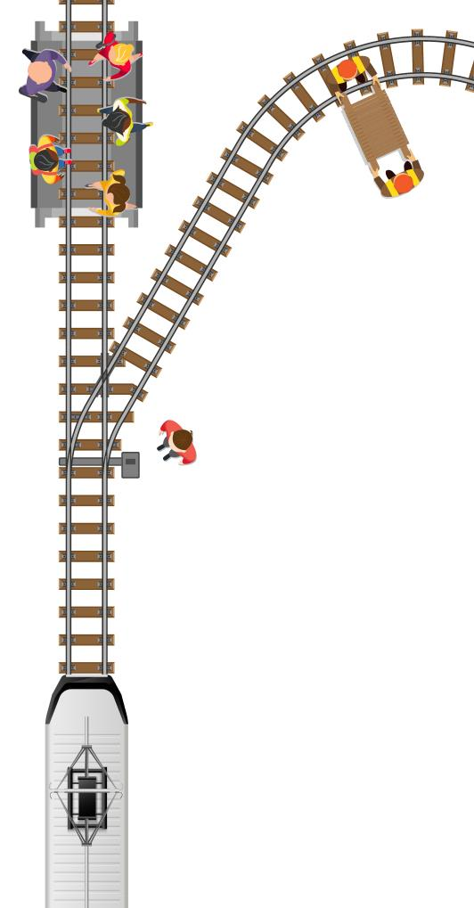
Starter
A train’s brakes have failed
It is currently travelling towards five people crossing the railway
All five may be hit by the train
You are standing at the points and can switch the train to turn to a different track
But this may result in an engineer working on the track being hit
Would you change the direction of the train?

Slide 4
Starter
There is no right or wrong answer to this
How does your class feel about changing the train direction?
Does how seriously they are injured affect your decision?
Many people want to reduce the overall harm
This is called utilitarianism
But would you change your mind if it was a young child on the tracks rather than an engineer?
If you needed to hurt or injure someone in order to switch the points would this change your decision?

Slide 5
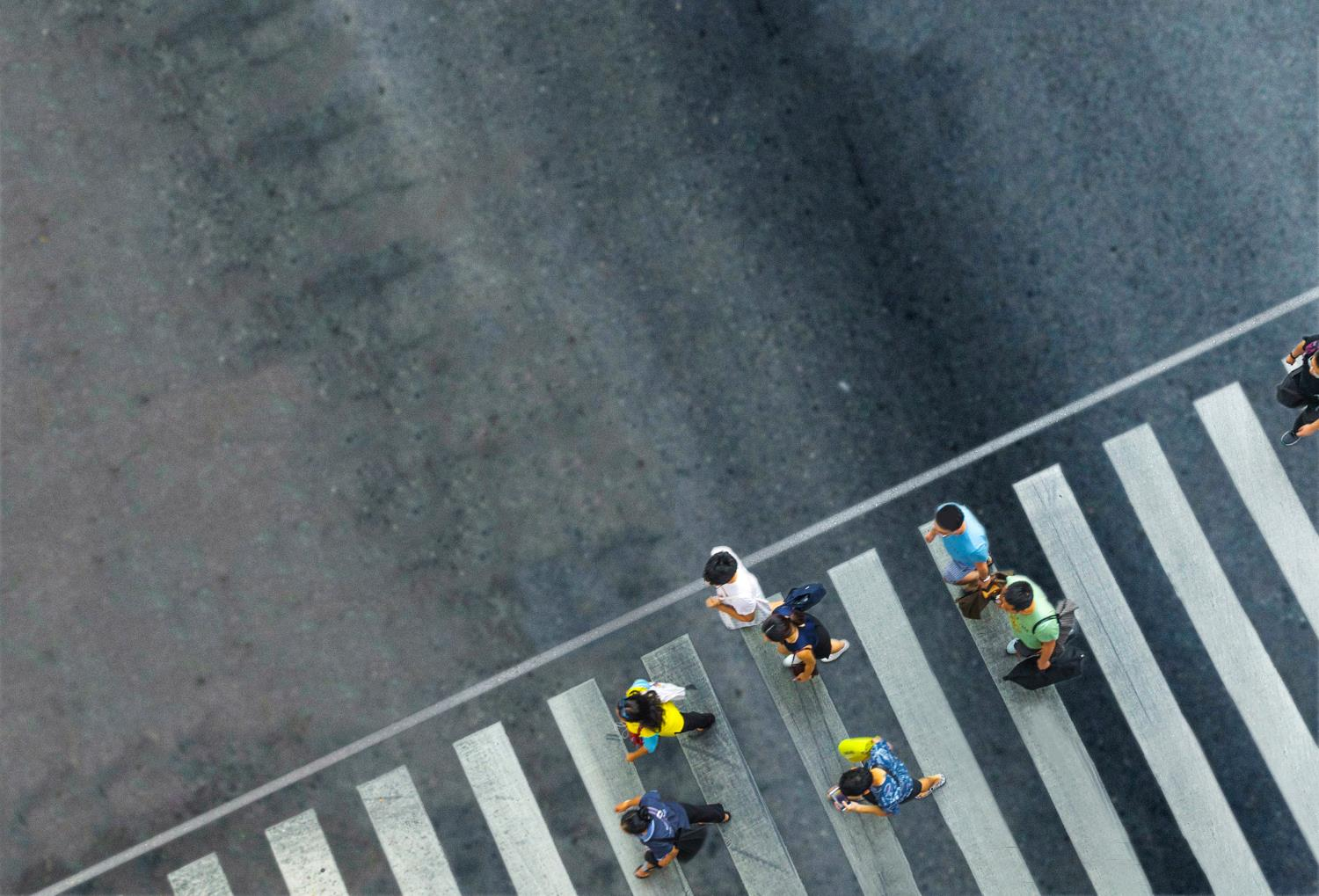
Autonomous vehicles
AI is used in self driving cars
These cars will often come up against ethical dilemmas
They may have to choose between an accident with a cyclist or an accident with many pedestrians
Moral or ethical rules will need to be programmed into the machines

Slide 6
Ethics
‘Ethics’ is a significant aspect of philosophy. At its simplest, ethics is about what is right, or wrong
When crossing a road with moving traffic you should use a pelican or zebra crossing where available
Crossing anywhere else is known as ‘jaywalking’
Do you think there should be a punishment for ‘jaywalking’?
How severe a punishment would be appropriate?

Slide 7
Ethics of AI
Ethical questions can be very difficult to answer
It is important to consider the possible negative effects of new technologies by asking questions such as:
How reliable is the technology? Will there be cases of mistaken identity?
How secure is the system? Could evidence be tampered with?
Is it fair to be fined by a machine?
What happens if the AI is programmed to follow rules that aren’t in the interests of the majority of people?

Slide 8
Worksheet 3
Complete Task 1 and Task 2 on Worksheet 3

Slide 9
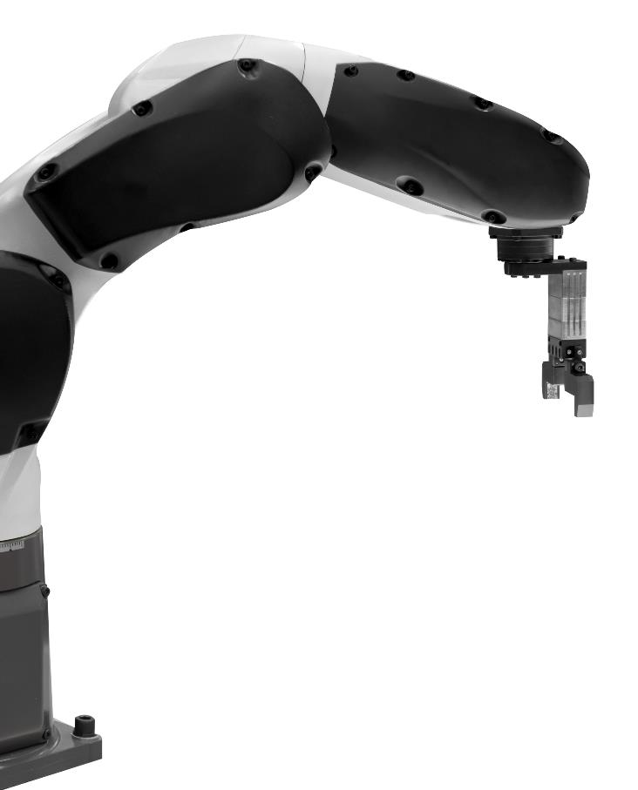
AI and jobs
Robots have already replaced many jobs in:
Car manufacturing
Electronics production
AI is used in ways that can replace jobs
For instance, online shopping can use AI to determine the best way to advertise and sell products
This leads to job losses on the high street
What other jobs could be replaced by AI?

Slide 10
AI and jobs
Up to 40% of jobs could be replaced by automation and AI by 2035
Many jobs could be lost including:
Telemarketing
Taxi drivers and transportation
Receptionists
Proof reading
Retail sales

Slide 11
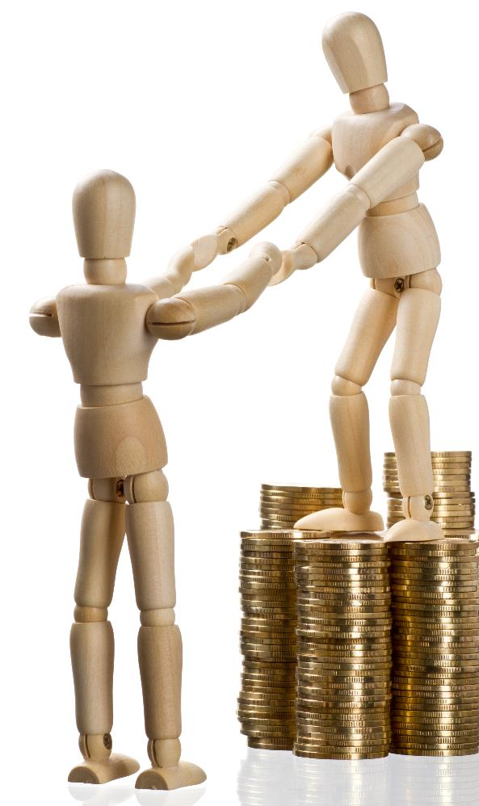
Wealth differences
If a job is lost to AI or automation, then a company may get richer, whilst other companies or people may become poorer
However, technology revolutions, such as electricity and IT have often created many new jobs
Discuss the problems that AI could have to the differences of wealth in society
What could be done to reduce these problems?

Slide 12
Wealth differences
Wealth differences in a population can lead to:
Poor health in those less well off
Stress and anxiety for those who cannot afford their basic costs of living such as food and housing
Resentment towards those who have lots of wealth
An unfair society
These problems can be reduced by:
Having a strong support system in society whilst the transition to a new technology takes place
Support and training for new jobs that are created

Slide 13
Worksheet 3
Complete Task 3 on Worksheet 3

Slide 14
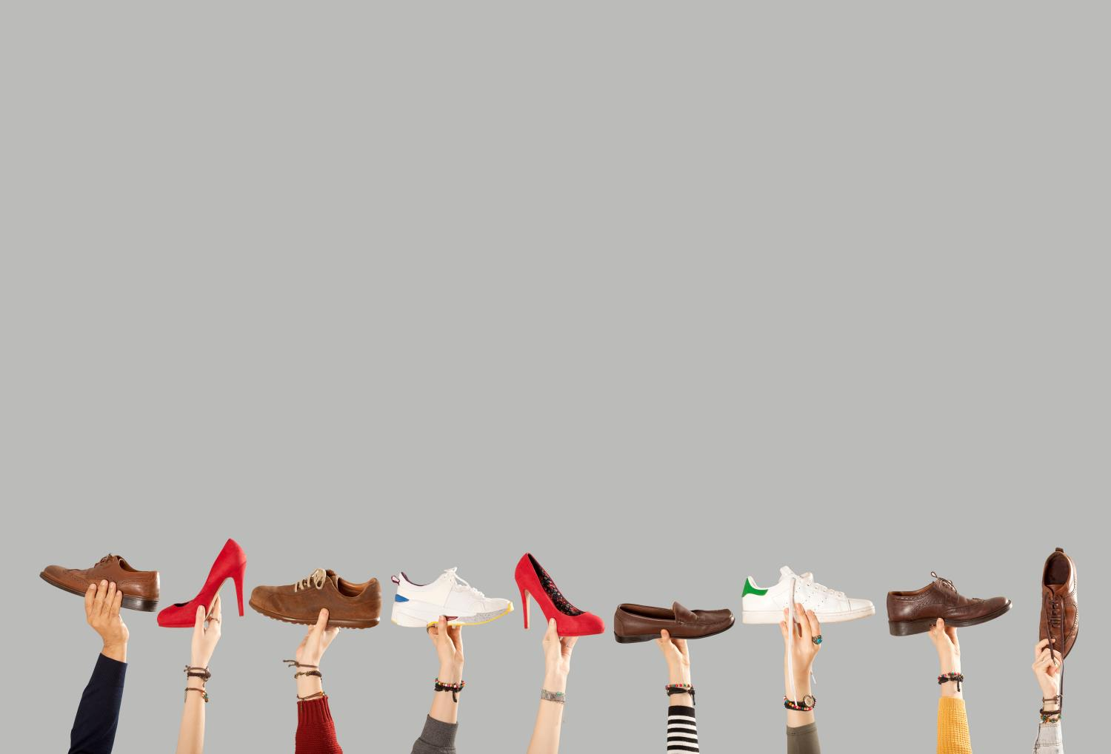
Bias in AI
When using AI, it is important to consider bias
If the training data is bias, the AI may exclude certain minority groups or views
Imagine that we are training an image search engine to understand what a shoe is
If the training data mostly has flat soled shoes, it may decide that high heels are not actually shoes
What problems could bias create in other areas?

Slide 15
Bias in AI
Bias could occur in any area of AI
Some areas that may be affected could be:
People tend to prefer sweeter fruit and vegetables, so AI could only pick or produce the very sweetest. This would affect people who don’t like these
AI could use training data for job applications that makes it biased – for instance, if the training data was all from people with European names, it may reject someone who has a non-European name even though they could be very good at the job

Slide 16
Worksheet 3
Complete Task 4 on Worksheet 3

Slide 17
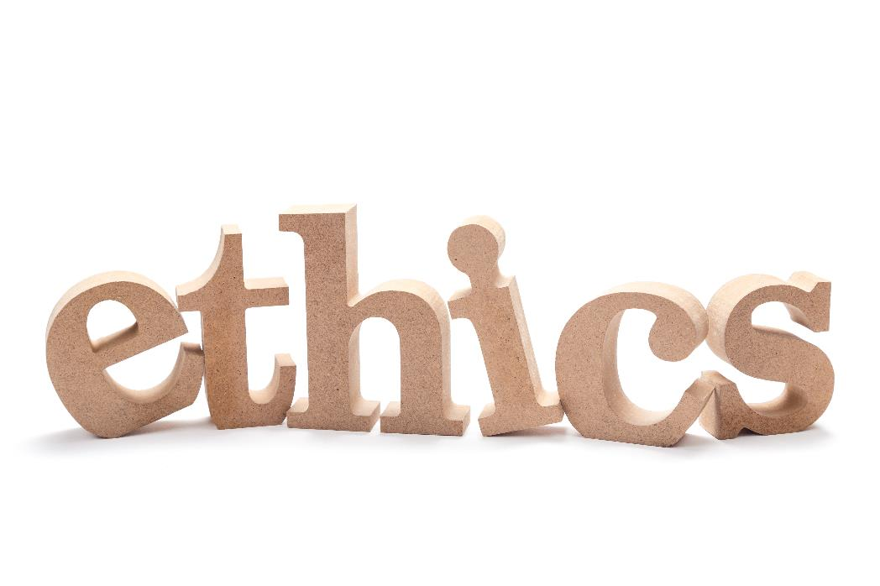
Plenary
AI creates a number of ethical issues
Briefly explain to a partner the ethical issues that AI creates in:
Self driving cars
Jobs
Bias

Slide 18
Plenary
Self driving cars
Decisions must be taken that can harm people or damage property. These must be carefully considered before programming or training the car
Jobs
AI and automation will replace many jobs. They may need training and support to obtain new jobs that are created
Bias
If the training data is not carefully considered, then machine learning may become biased towards minority groups or opinions

