Slide 2
Objectives
Understand how decomposition can be used to break down problems into more manageable components
Be able to break down a large Computing problem into its parts and understand:
how images are converted to binary using pixels
how text is converted to binary using ASCII
how data is broken up into packets
how data is sent through a network

Slide 3
Starter
In order to take a selfie and send it to a friend, many processes happen behind the scenes
What do you think happens inside phones in order to send a selfie with a caption to a friend?
How could this all happen with just 1s and 0s?

Slide 4
Decomposition
Sending a photo might be easy for a user, but there are many problems that need to be solved by the computer
Decomposition is breaking down a problem into smaller parts that are more manageable
Send photo
Convert image to binary
Restore image
Send data
Split up data into packets
Send packets
Restore data

Slide 5
Converting the image
To convert a black and white image to binary we first split the image into boxes called pixels
Black is represented by 0
White is represented by 1
What is the binary that would represent the first row of pixels?

Slide 6
Converting the image
What is the binary that would represent the first row of pixels?
001100001100
The data for the whole image would be:
0 | 0 | 1 | 1 | 0 | 0 | 0 | 0 | 1 | 1 | 0 | 0
0 | 1 | 0 | 0 | 1 | 0 | 0 | 1 | 0 | 0 | 1 | 0
1 | 0 | 1 | 1 | 0 | 1 | 1 | 0 | 0 | 0 | 0 | 1
1 | 0 | 1 | 0 | 0 | 0 | 0 | 0 | 0 | 0 | 0 | 1
1 | 0 | 0 | 0 | 0 | 0 | 0 | 0 | 0 | 0 | 0 | 1
1 | 0 | 0 | 0 | 0 | 0 | 0 | 0 | 0 | 0 | 0 | 1
0 | 1 | 0 | 0 | 0 | 0 | 0 | 0 | 0 | 0 | 1 | 0
0 | 0 | 1 | 0 | 0 | 0 | 0 | 0 | 0 | 1 | 0 | 0
0 | 0 | 0 | 1 | 0 | 0 | 0 | 0 | 1 | 0 | 0 | 0
0 | 0 | 0 | 0 | 1 | 0 | 0 | 1 | 0 | 0 | 0 | 0
0 | 0 | 0 | 0 | 0 | 1 | 1 | 0 | 0 | 0 | 0 | 0
001100001100 010010010010 101101100001 101000000001 100000000001 100000000001 010000000010 001000000100 000100001000 000010010000 000001100000

Slide 7
Worksheet 6
Complete Task 1 on Worksheet 6

Slide 8
Adding a caption to the image
We also need to convert any caption text to binary
How could each letter of the caption be converted to binary?
HAPPY BIRTHDAY!

Slide 9
ASCII
ASCII is used to convert letters to a binary sequence
Each letter has a corresponding sequence of 8 binary digits
Convert “HAPPY” to ASCII
Letter | ASCII |  | Letter | ASCII |  | Letter | ASCII |  | Letter | ASCII
A | 01000001 |  | H | 01001000 |  | O | 01001111 |  | V | 01010110
B | 01000010 |  | I | 01001001 |  | P | 01010000 |  | W | 01010111
C | 01000011 |  | J | 01001010 |  | Q | 01010001 |  | X | 01011000
D | 01000100 |  | K | 01001011 |  | R | 01010010 |  | Y | 01011001
E | 01000101 |  | L | 01001100 |  | S | 01010011 |  | Z | 01011010
F | 01000110 |  | M | 01001101 |  | T | 01010100 |  | ! | 00100001
G | 01000111 |  | N | 01001110 |  | U | 01010101 |  | <space> | 00100000

Slide 10
ASCII
Convert “HAPPY” to ASCII
H = 01001000
A = 01000001
P = 01010000
P = 01010000
Y = 01011001
So HAPPY will be: 01001000 01000001 01010000 01010000 01011001

Slide 11
Worksheet 6
Complete Task 2 on Worksheet 6

Slide 12
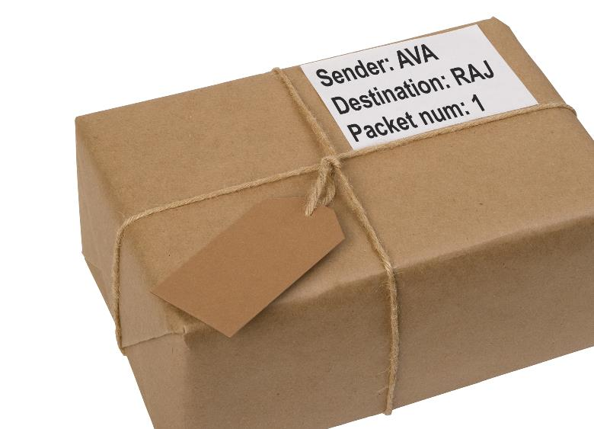
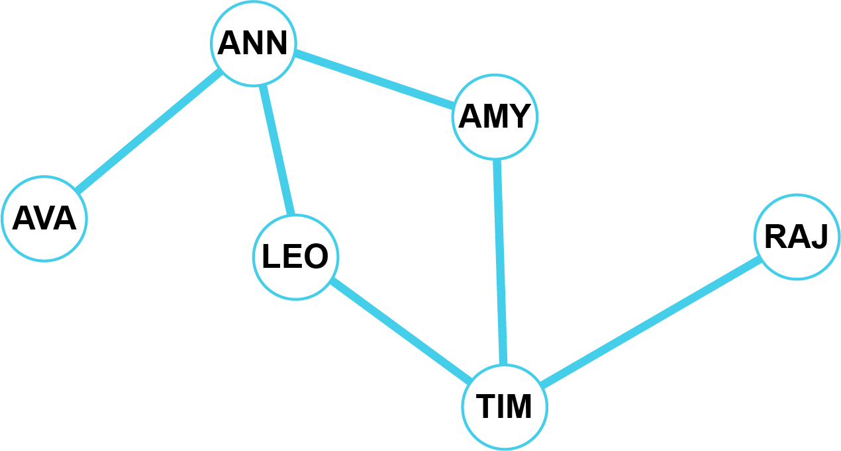
Transmitting data
When sending data through a network, the computer will split it down into smaller amounts that are put into packets
Packets can be sent through different routes through the network
How could packets get from AVA to RAJ?

Slide 13
Transmitting data
How could packets get from AVA to RAJ?
The packets could take either of the following routes: AVA → ANN → AMY → TIM → RAJ AVA → ANN → LEO → TIM → RAJ
Packets need the destination name
They also need the packet number so they can be reassembled

Slide 14
Worksheet 6
Complete Task 3 on Worksheet 6

Slide 15
Putting it all together
To send a photo and caption from one phone to another we use the following process:
How do we rebuild the image and caption at the other end?
Convert image
Convert to pixels
Convert to binary
Convert caption
Translate text to ASCII
Send binary through network
Add destination and packet number
Send packets through the network
Split data into packets

Slide 16
Putting it all together
The same process is used to put the image and caption back together at the other end of the network
The process is very complicated, but by using decomposition and decomposing the problem we can make each part of the process much easier to solve
Reconstruct packets
Put packets into order
Get binary data
Build image
Convert binary data to image
Build caption
Convert binary in ASCII to caption

Slide 17
Worksheet 6
Complete Task 4 and Task 5 on Worksheet 6

Slide 18
Plenary
When you take a photo or write a text message and send it to someone, explain how this process works inside the phone and phone network

Slide 19
Plenary
When you take a photo or write a text message and send it to someone, explain how this process works inside the phone and phone network
The photo is made into a grid of pixels
These pixels are converted into binary
The text is converted into ASCII binary
The binary data is split up and put into packets which have a destination and packet number
The packets are sent through the network
The packets are put back into order and the data is converted to the original message or image

