Slide 1
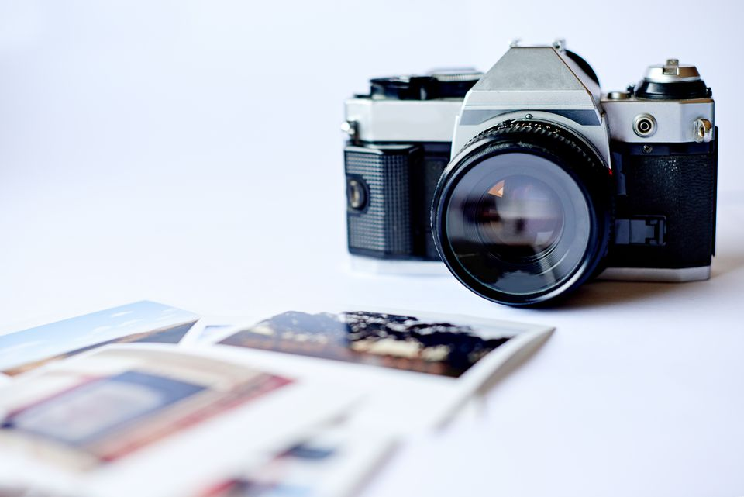
The History of Photography
Pre-A Level Photography

Slide 2
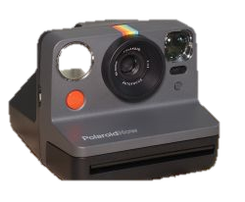
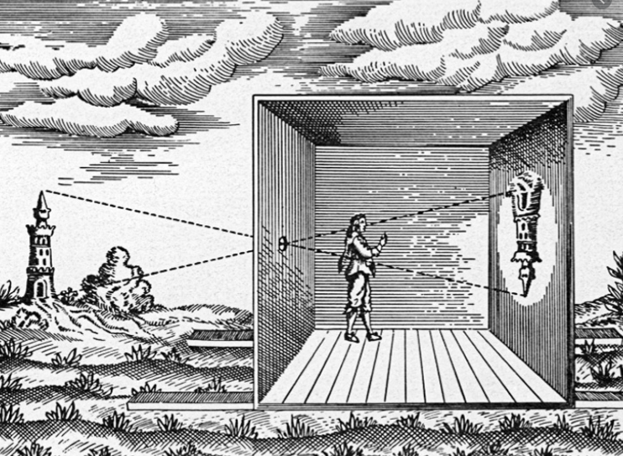
The information must be in a date order:
Camera Obscura
Thomas Wedgwood
Nicephore Niepce
Louis Daguerre - Daguerreotype
Henry Fox Talbot
Kodak (Brownie)
First commercial Colour - Autochrome plate
Polaroid
First digital camera
First Camera Phone
What cameras do you have now!
History of the Camera
Create a power-point documenting the timeline of Photography
The Camera Obscura – first documented in…
http://www.photographyhistoryfacts.com/photography-development-history/timeline-of-photography/

Slide 3
Pre-A Level Photography Success Criteria
ALL | Basic timeline and information All 11 date points covered Use of basic images
MOST | Detailed timeline, more than the 11 starter dates In-depth notes detailing both important development & historical figures Extensive use of images to enhance work
SOME | Detailed timeline, more than the 11 starter dates and using multiple reference sources In-depth notes detailing both important development & historical figures Extensive use of images to enhance work Examples of own photography
Task1.
Using the link on the previous page as a starting point you need to research the history of photography.
Task2.
Create a power point documenting the history of photography, each page can contain between 1 and 2 dates points (3 Maximum)
Task3.
Reflection – answer these questions
Name the 3 most interesting things you have learned
How well do you feel you have approached this task.
How will you improve the way you work in the future

