Slide 1
Lesson 1: App for that
Year 8 – Programming – Mobile app development
Mr Thorne ICT
Notes:
Last updated: 10-05-21
Resources are updated regularly — the latest version is available at: ncce.io/tcc.
This resource is licensed under the Open Government Licence, version 3. For more information on this licence, see ncce.io/ogl.

Slide 2
Lesson 1: App for that
Objectives
In this lesson, you will
Identify when a problem needs to be broken down
Implement and customise GUI elements to meet the needs of the user
Notes:
Secondary – objectives slides

Slide 3
What is your ‘app for that’?
Starter activity
You have five minutes to work in pairs.
Think of an idea for an app that could have a positive impact on the world.
Think about how the user will interact with the app.
Write your ideas on a sticky note and bring it to the front.
Notes:
Image source: https://pixabay.com/illustrations/smartphone-app-news-web-internet-1184883

Slide 4
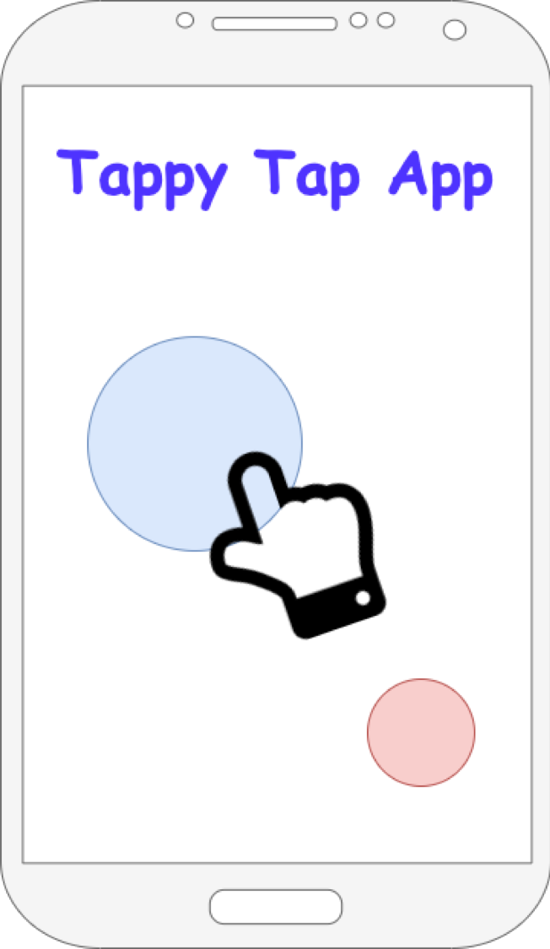
The Tappy Tap App
Activity 1
Over the next two and half lessons we will develop a new app called the Tappy Tap App. It will:
Get users to click a moving blue dot as many times as they can within a time limit
Give the user a point for each accurate click on the blue dot
Move the blue dot each time it is clicked

Slide 5
Decompose the problem
Activity 1
Decomposition is breaking a problem down into more manageable chunks.
Programming an app for a mobile device can be a daunting task to undertake.
Decomposing the problem helps us make the task less daunting and more achievable.

Slide 6
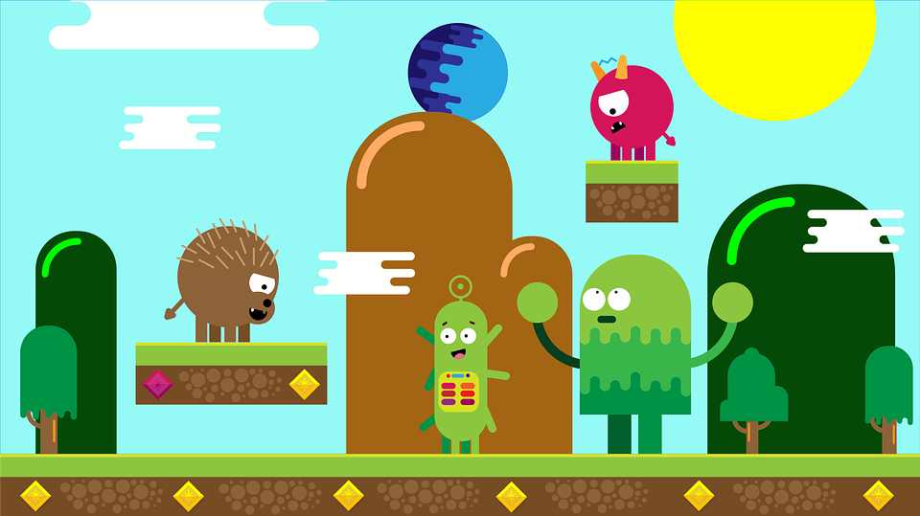
Decompose the problem
Activity 1
Imagine that your job is to make the first level of a new platform game.
You might start by decomposing the problem in the following way:
Create the layout of the level
Add a user-controlled character
Add enemies
Add score, timer, and power-ups
Notes:
Discuss this as a possible solution with the learners. They don’t need to come up with the list themselves at this stage. Some might put their hands up and suggest other steps.; this wouldn’t be a problem, as it would help highlight that there are no real right or wrong ways to decompose, but it is advisable not to decompose into too many stages at the beginning.
Image source: https://pixabay.com/illustrations/illustration-videogame-graphics-1736462

Slide 7
Continue decomposing
Activity 1
When you arrive at each decomposed step, you can now decompose it further.
How might you decompose the ‘player movement’ step further?
Add left and right movement
Add a gravity effect
Add the ability to jump
Notes:
Ask learners to discuss briefly with a classmate how the task could be decomposed further. Take answers and display the suggestions. Again, learners might come up with answers that aren’t on the slide. As long as they relate to actions that the player might perform, this is OK.
Image source: https://pixabay.com/illustrations/illustration-videogame-graphics-1736462

Slide 8
Success criteria
Activity 2
Welcome screen:
Must show logo and instructions on how to play
Must have a button that activates the game play once clicked
Game play:
The game must last 15 seconds before automatically moving to the final score screen
There must be a blue dot and a red dot that the user can press
When the blue dot is pressed, the score must increase by one
When the blue dot is pressed, the dot should move to a different place on the screen
The red dot must also move to a different place on the screen when pressed, but the score will decrease by one
Final score:
Must display the user’s score at the end of the game
Must have a button to allow the user to return to the welcome screen
Notes:
Highlight that success criteria are used at the end of a project to help judge its success. Success criteria should allow for factual yes or no answers. They should not be subjective (based on opinion); ‘Must be easy to use’ would be an example of a subjective success criterion. Learners don’t need to read the success criteria from this slide, as they have it on their worksheet. This is a prompt for the teacher so that you can discuss them with the learners.

Slide 9
Decompose the Tappy Tap App
Activity 2
Look at the requirements of the Tappy Tap App on your worksheet.
How would you decompose the problem?
Think/write/pair/share.

Slide 10
Activity 2
How did you decompose the problem?
Notes:
Take answers from one pair. Write down their answers on a whiteboard and ask the class to discuss.

Slide 11
App Lab
Activity 3
Watch this video

Slide 12
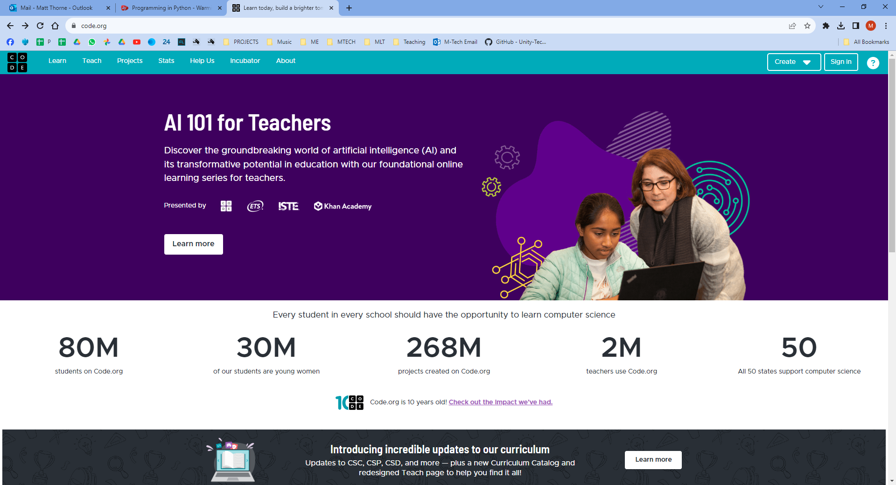
Login to the App Studio
Go to: code.org and then Sign In

Slide 13
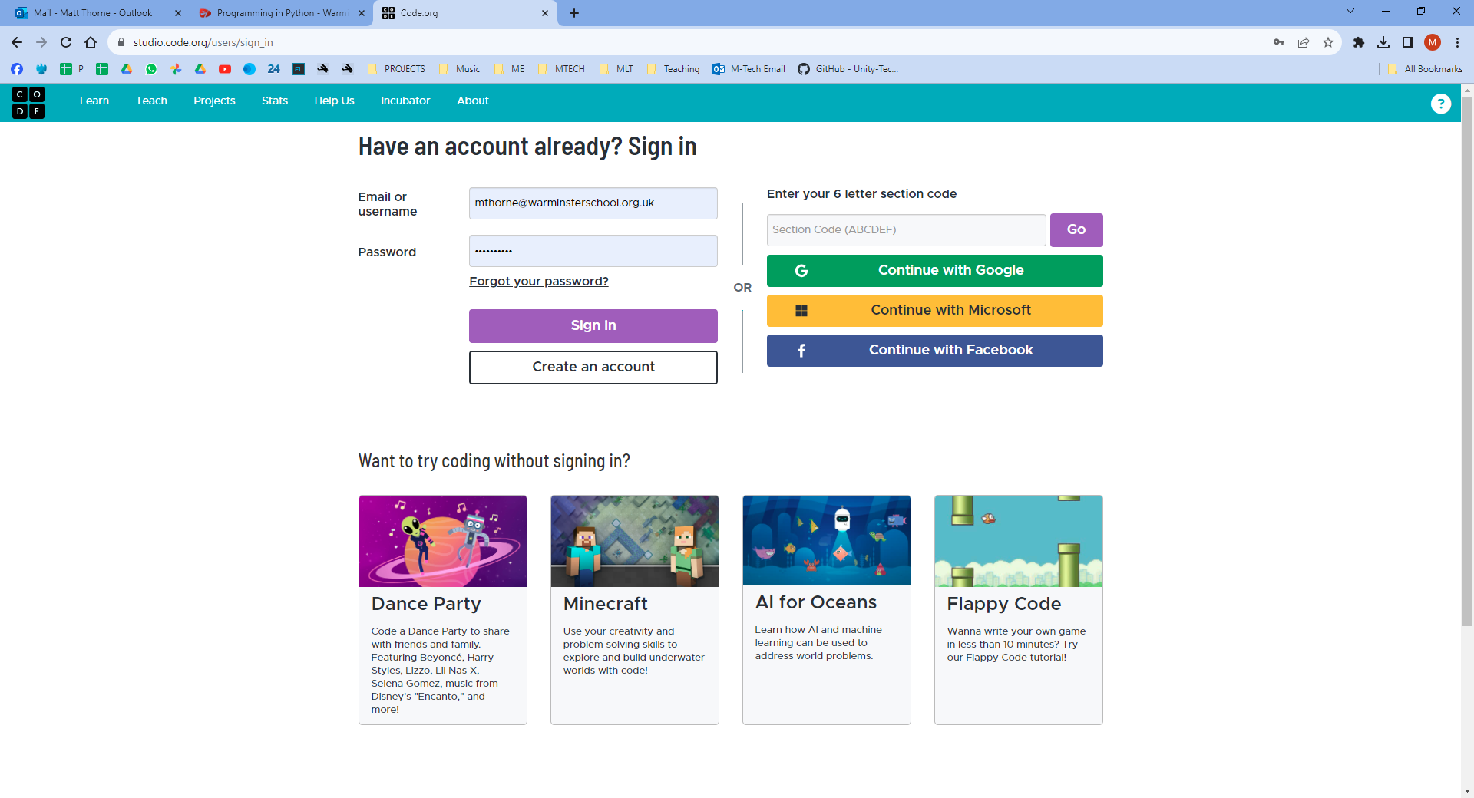
Enter the code LHZGLB in “section code”

Slide 14
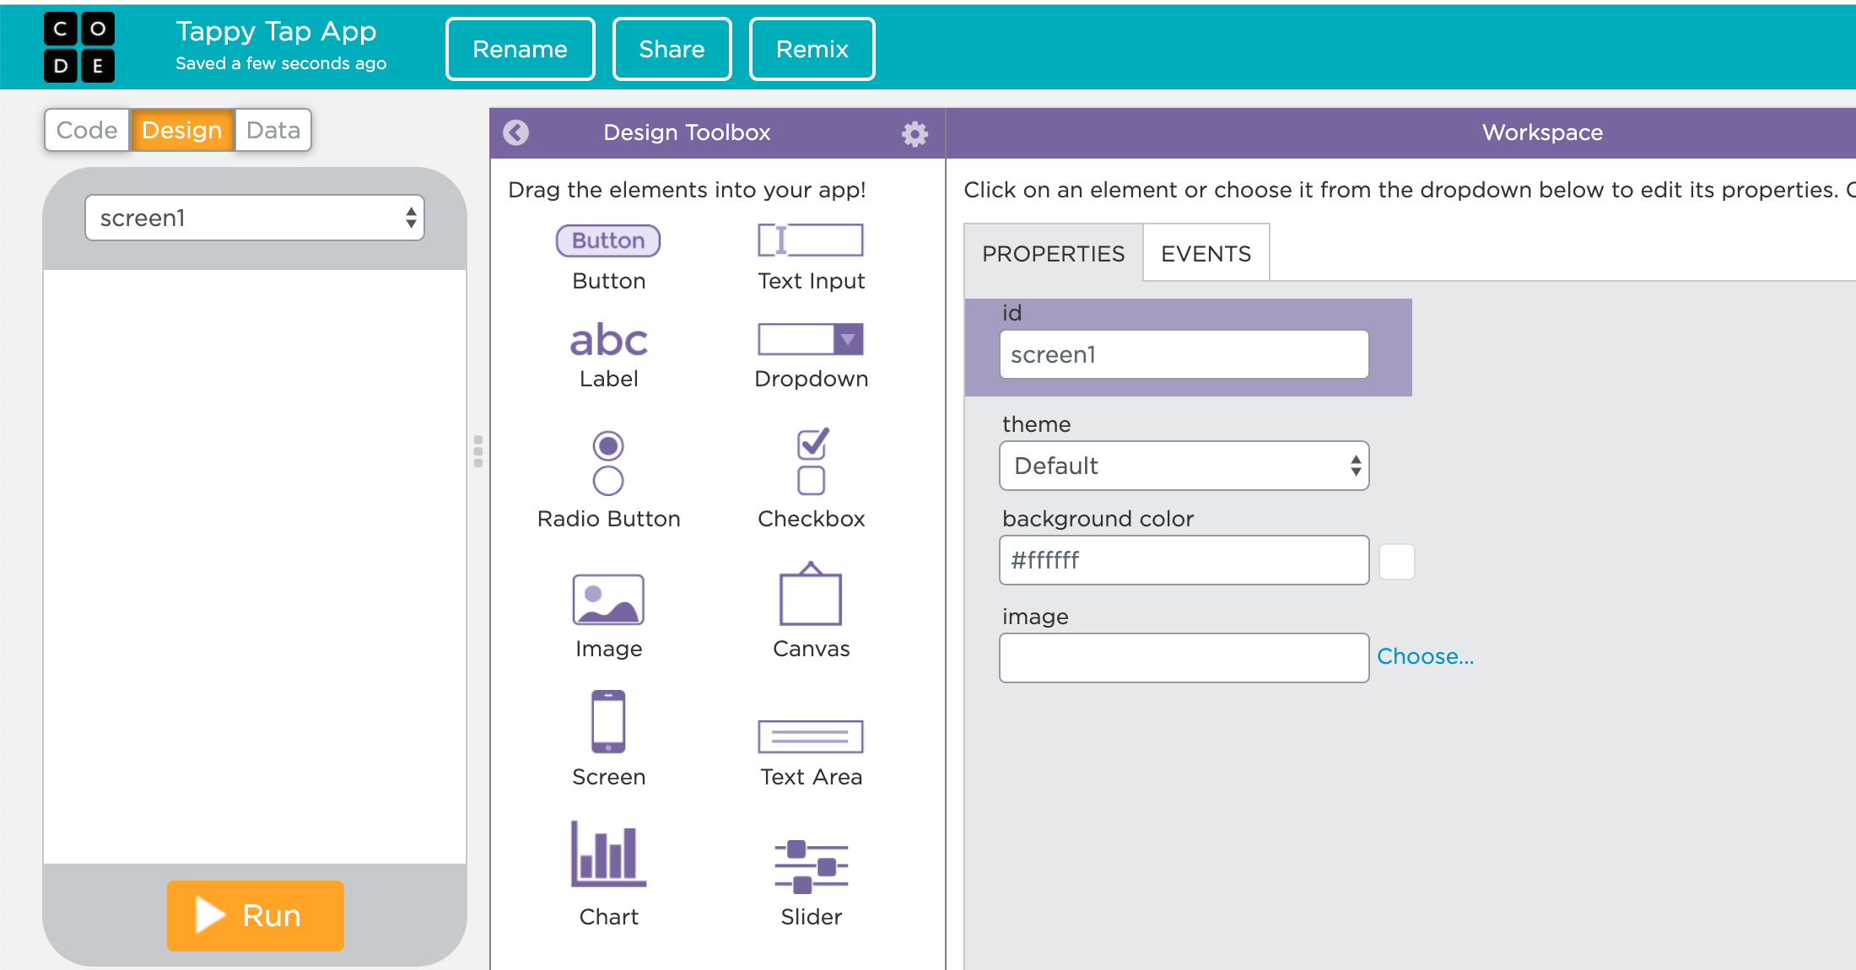
App Lab demonstration
Activity 3
Log into App Lab using the login details given to you
Browse to ‘Start a new project’
Select App Lab
Rename your project ‘Tappy Tap App’
Add a button to the screen
Notes:
Demonstrate the login process and how to create and rename a new project, add a button, and customise the properties. It’s not essential that the learners complete all five tasks. Once everyone has at least successfully logged in and created a new project, you can move onto the next slide.

Slide 15
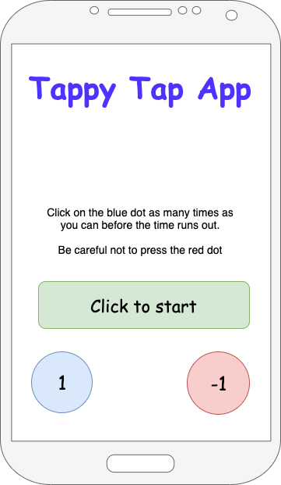
Design the home screen
Activity 4
Your task is to implement the design of the welcome screen (don’t forget to rename ‘screen1’ as ‘welcome screen’).
Use your success criteria to help, as well as the sketched design on the right.
Explorer tasks:
Add a new game screen
Watch the following video (ncce.io/AppLabA4)
Code the button to open the game screen

Slide 16
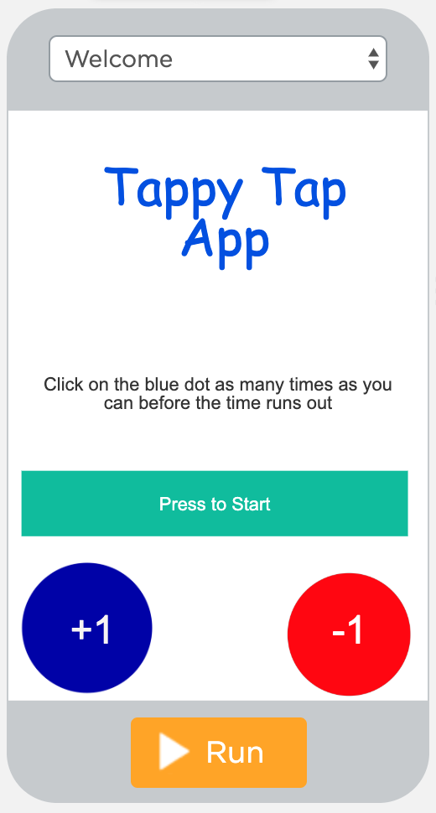
Play your future Tappy Tap App
Plenary
Visit the following URL to play the game:
ncce.io/TappyTapAppL1
After a couple of goes, look at your success criteria and ask yourself whether or not the game meets all the criteria.

Slide 17
Next lesson
Summary
In this lesson, you…
Learnt why decomposition is important and how to apply it to your project
Designed the welcome screen for your app and customised the properties
Next lesson, you will…
Develop your app further by using code to add functionality to the objects the user interacts with on the screen

