Slide 1
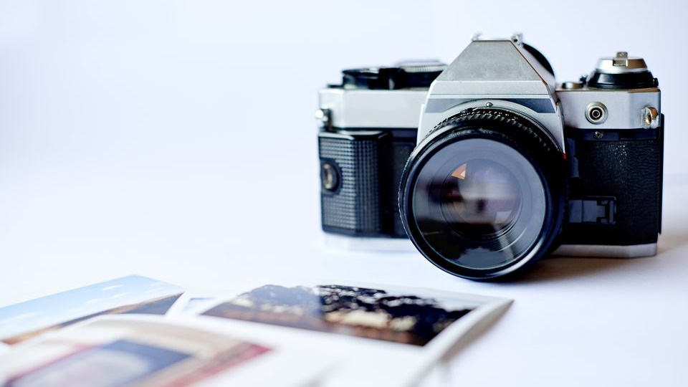
Photomontage
Pre-A Level Photography

Slide 2
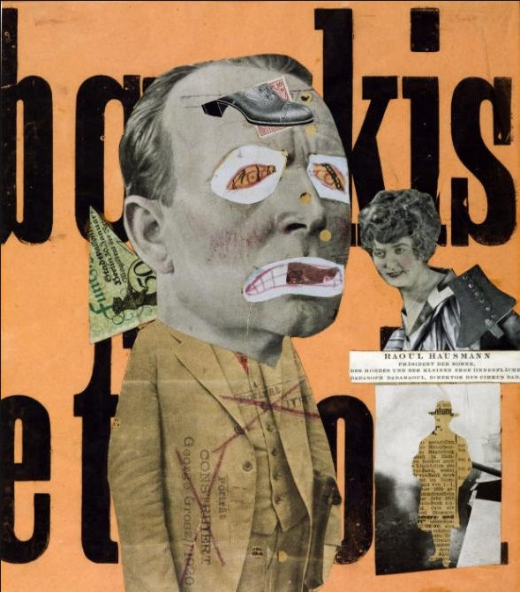
PHOTOMONTAGE
A photomontage is a collage constructed from photographs.
Art Terms
A montage is an assembly of images that relate to each other in some way to create a single work or part of a work of art.
Collage describes both the technique and the resulting work of art in which pieces of paper, photographs, fabric and other items are arranged and stuck down.
Mixed media is a term used to describe artworks composed from a combination of different media or materials

Slide 3
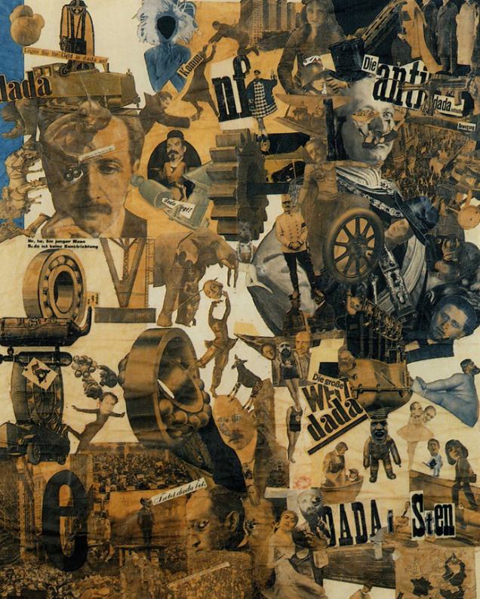
It was first used as a technique by the dadaists in 1915 in their protests against the First World War. It was later adopted by the surrealists who exploited the possibilities photomontage offered by using free association to bring together widely disparate images, to reflect the workings of the unconscious mind.
In 1923 the Russian constructivist Aleksander Rodchenko began experimenting with photomontage as a way of creating striking socially engaged imagery concerned with the placement and movement of objects in space.
Other key exponents of the medium are John Heartfield, the German artist who reconstructed images from the media to protest against Germany’s Fascist regime and Peter Kennard; whose photomontages explored issues such as economic inequality, police brutality and the nuclear arms race between the 1970s and the 1990s.

Slide 4
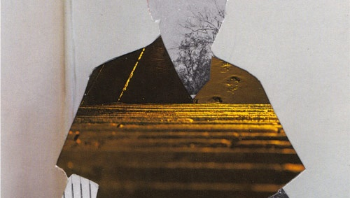
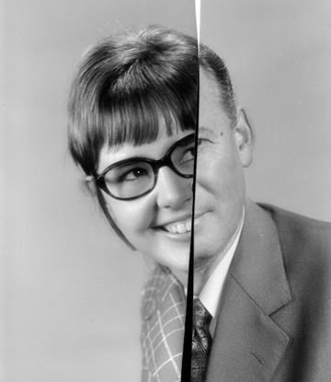
Techniques
Cut
Slice
Trim
Slide
Join
Add
Stick
Combine
Match
Mix
Tear
Scrunch
Fold

Slide 5
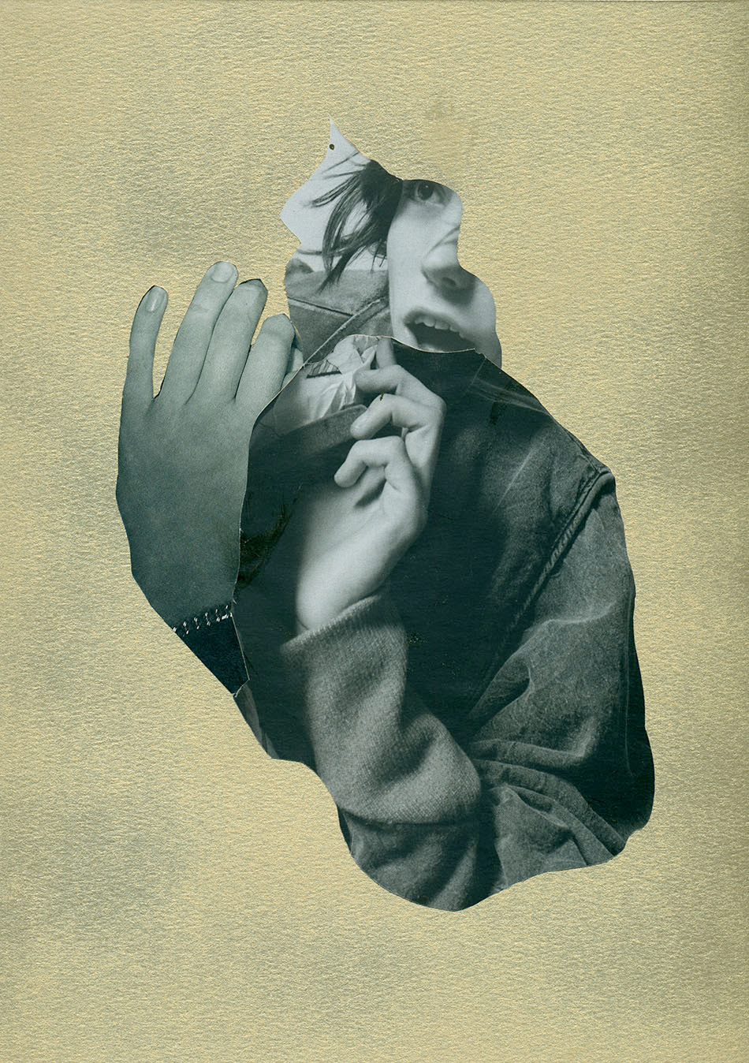
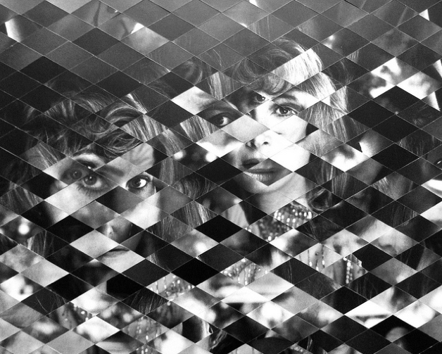
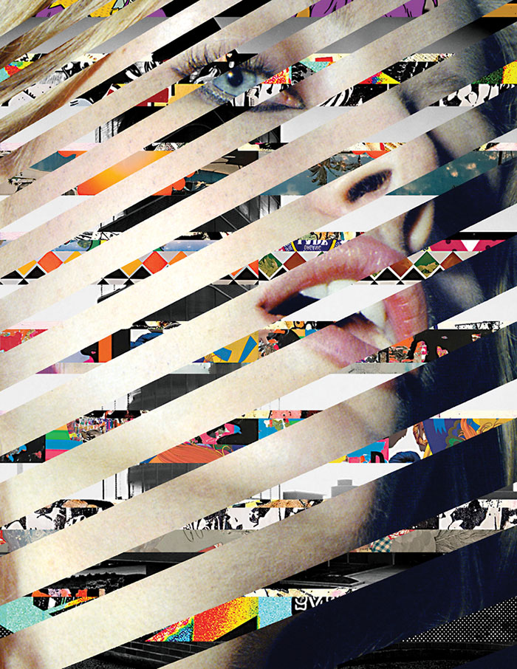
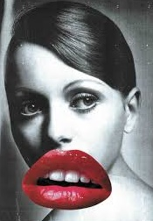

Slide 6
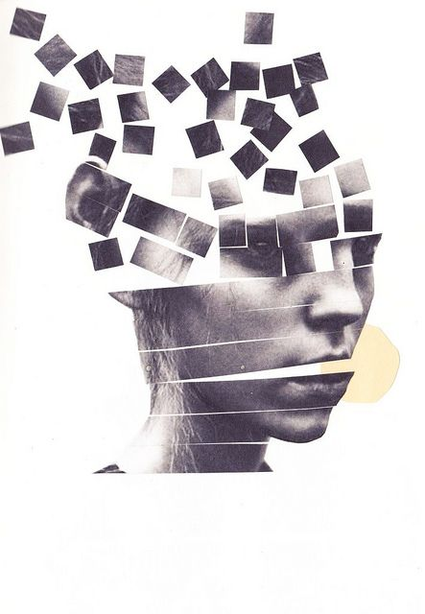
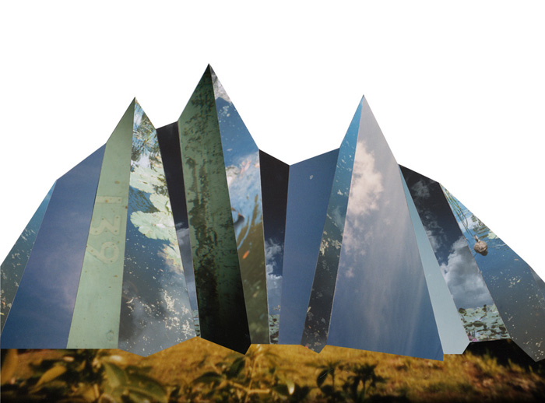
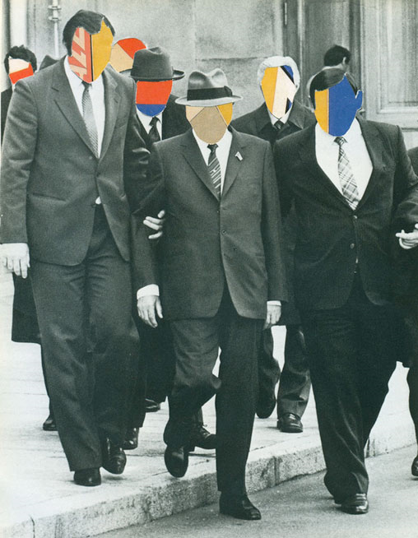
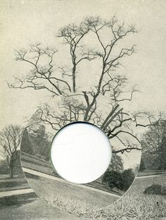

Slide 7
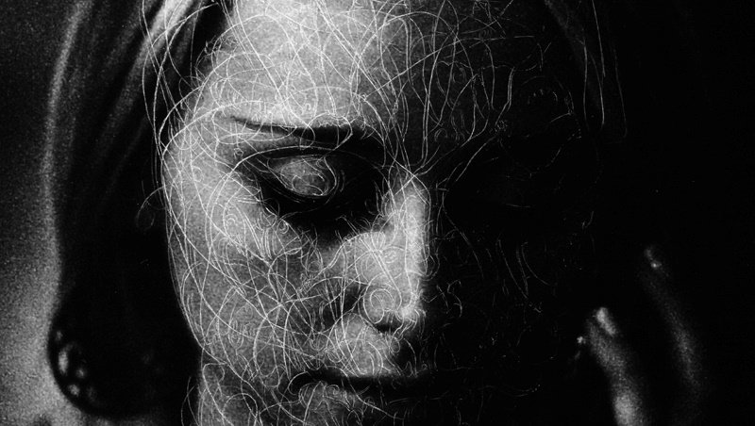
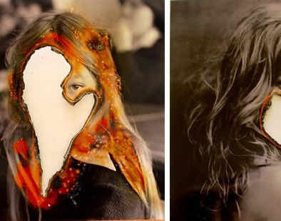
Techniques
Burn
Scratch
Stitch
Punch
Weave

Slide 8
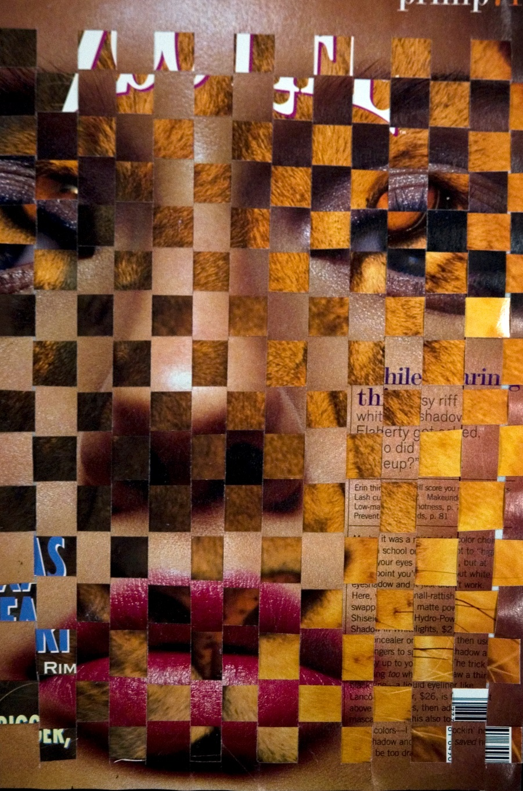
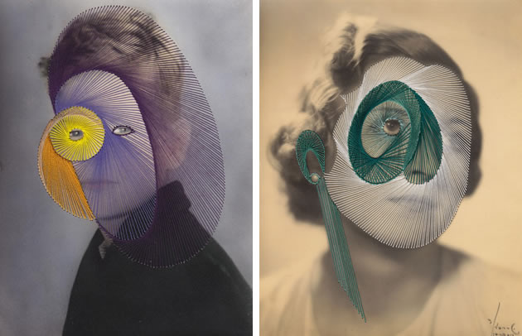
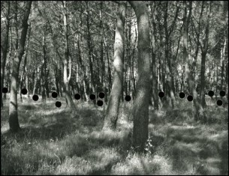
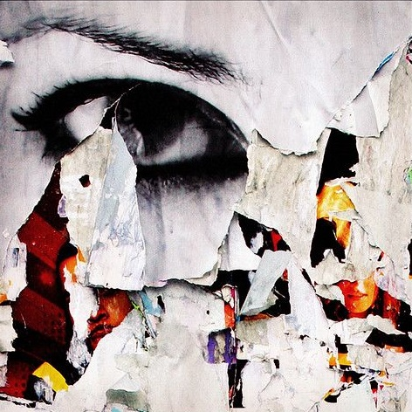

Slide 9
Artists to investigate
John Stezaker
Bobby Neal Adams
Linder Sterling
Johanna Goodman
Max-o-matic
Luis Dourabo
Joe Castro
Bela Borsodi

Slide 10
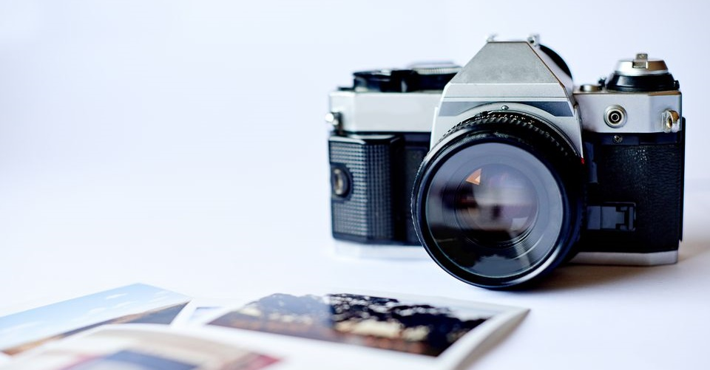
Pre-A Level Photography Success Criteria
ALL | Have attempted 4 different techniques. Have written a basic biography about your chosen artist. Created a photomontage with some links to your chosen artist.
MOST | Have successfully used 4 different techniques. Have written a detailed biography about your chosen artist. Created a photomontage with influence to your chosen artist. Have reflected on your own work.
SOME | Have successfully used 4 or more different techniques. Have written a detailed biography about your chosen artist, including cultural or historic references. Created a photomontage with clear influence to your chosen artist. Have reflected on your own work.
Task1.
Using your own images, magazines, papers, flyers, junk mail etc. You are to create 4 different Photomontage each showcasing a different technique.
Task2.
Investigate one of the artists on page 9, create a biography with examples of their work.
Task3.
Create a photomontage inspired by your chosen artists
Task4.
Reflection – answer these questions
Name the 3 most interesting things you have learned
How well do you feel you have approached this task
How will you improve the way you work in the future

