Slide 1
Lesson 3: School Lab Studios
Year 8 – Programming – Mobile app development
Notes:
Last updated: 10-05-2021
Resources are updated regularly — the latest version is available at: ncce.io/tcc.
This resource is licensed under the Open Government Licence, version 3. For more information on this licence, see ncce.io/ogl.

Slide 2
Lesson 3: School Lab Studios
Objectives
In this lesson, you will
Update the Tappy Tap App to display the user’s score
Start your app project:
Establish user needs and apply success criteria to help evaluate the success of your project
Start to design the solution to a real-world problem

Slide 3
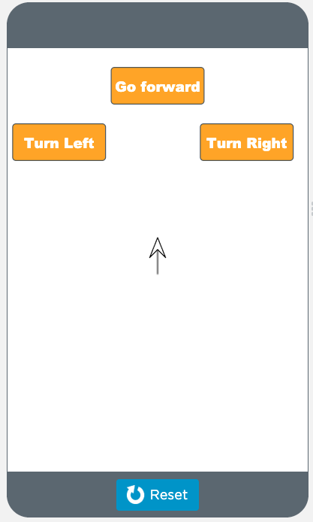
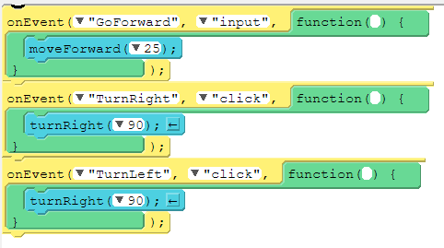
Spot the errors
Starter activity
The Turtle Draw App
The purpose of this app is for the user to click the buttons on the screen to move the arrow on the screen and draw shapes.
Unfortunately, there are errors in the app and it is not working as the developer intended.

Slide 4
Spot the errors
Starter activity
Debug the app
There are three errors in this program
Sign into your code.org account
Follow this link: ncce.io/AppLabL3S
Click View code and Remix
See if you can find and fix all the errors

Slide 5
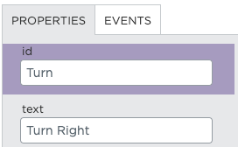
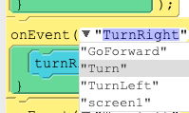
Did you spot and fix all the errors?
Starter activity
Error 1
Error 2
Error 3
Notes:
Error 1: When the TurnLeft button is clicked the code instructs the object to turn right. This can be fixed by changing the block of code inside the event to ‘turnLeft(90)’.
Error 2: The onEvent to move the object right is linked with something with the id ‘TurnRight’. There is no object with that id. This can be fixed by either changing the id of the Turn button to ‘TurnRight’, or by changing the onEvent to be linked with the id ‘Turn’ and not ‘TurnRight’.
Error 3: The onEvent is waiting for an input and not a click. This can be fixed by changing the ‘input’ to ‘click’.

Slide 6
User score
Activity 1
We’re now going to apply the final touches to our Tappy Tap App by doing the following:
Designing the score screen
Adding code to pass the score to the score screen
Instructions
Get into your pairs from the last lesson
Open the app that you developed in the previous lesson
If you were absent from the last lesson, open and remix this app:
ncce.io/AppLabL3a1

Slide 7
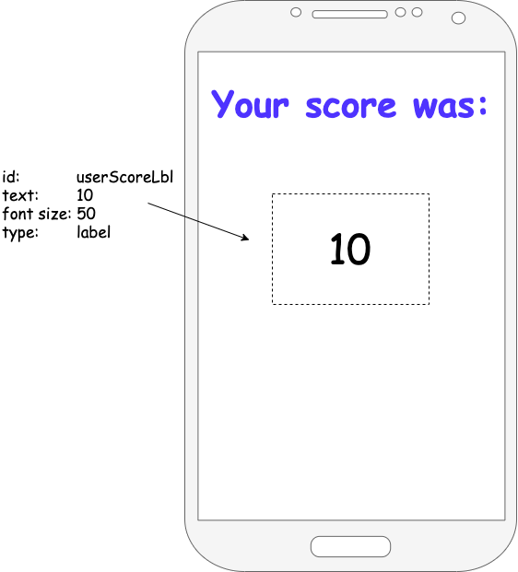
Score screen design
Activity 1
Enter design mode and select the score screen.
Add a label and place it where you would like the score to appear.
Change the id to userScoreLbl.
Format the font, size, and position (change the text property to an example score, such as 10).

Slide 8
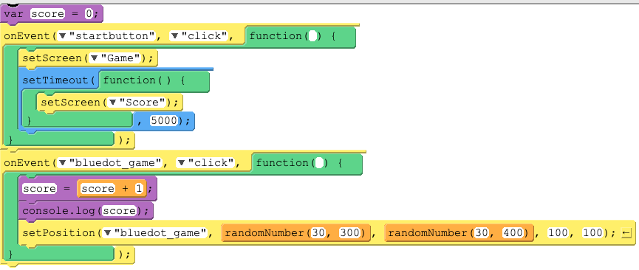
Passing the score into userScoreLbl
Activity 2
We’re going to add code to our app, to tell our program to:
Set the text of the userscore label to the value being held by our score variable.
Where should we place this code?
Think/pair/share.
▹
A
B
C
Notes:
The answer is A. We want the value of score after the five seconds are up. We also want it to have changed the userscore label before it moves to the score screen.

Slide 9
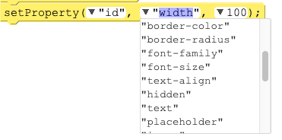
Passing the score into userScoreLbl
Activity 2
Add the following block of code into the correct position.
Customise the properties so that it changes the text to the value of the score variable.
▹
A
Explorer: Add and code a Play again button.

Slide 10
School Lab Studios
Activity 3
School Lab Studios is a company that specialises in mobile apps.
You and your partner have been hired to develop a prototype for one of the new apps that they would like to build.
Notes:
Image source: https://pixabay.com/illustrations/smartphone-app-news-web-internet-1184883

Slide 11
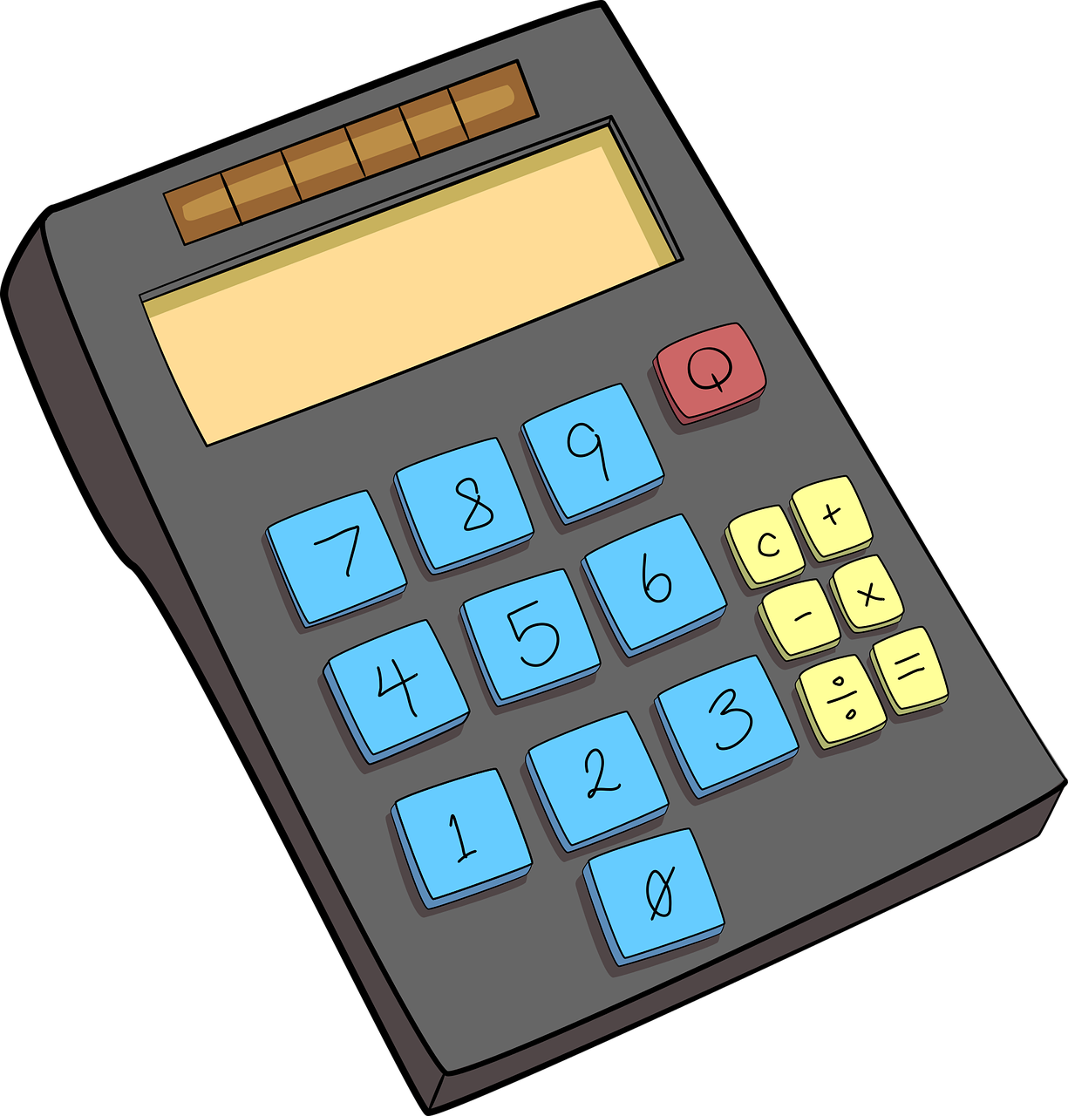
School Lab Studios: App Choices
Activity 3
KS2 Maths App
Your Weight in Space
Clicky Biscuits
Virtual Pet
Notes:
Calculator: https://pixabay.com/vectors/school-school-supplies-education-1555910
Space: https://pixabay.com/illustrations/sketch-cartoon-space-set-3045125/
Cookie: https://pixabay.com/vectors/cookie-chocolate-chip-blurred-307960/

Slide 12
Choose your project
Activity 3
You and your partner can now choose your project.
Open the project diaries for each project
Spend time reading the options and the requirements of each program
Make a copy of the project that you are going to work on
Share the project diary with your partner and your teacher so both have full access
Notes:
Image source: https://pixabay.com/illustrations/smartphone-app-news-web-internet-1184883

Slide 13
Success criteria
Activity 4
Success criteria are used at the end of a project to help judge its success, for example:
Each round must ask 10 questions.
Success criteria should allow for factual yes/no answers.
What is wrong with the following criterion?
Must be easy to use.
Notes:
Image source: https://pixabay.com/illustrations/checklist-clipboard-questionnaire-1622517

Slide 14
Success criteria for your app
Activity 4
Discuss with your partner what you think the app should do.
Write down in your project diary success criteria that reflect what you intend your app to be able to do.
Remember that success criteria should only allow for factual yes/no answers.
Notes:
Image source: https://pixabay.com/illustrations/checklist-clipboard-questionnaire-1622517

Slide 15
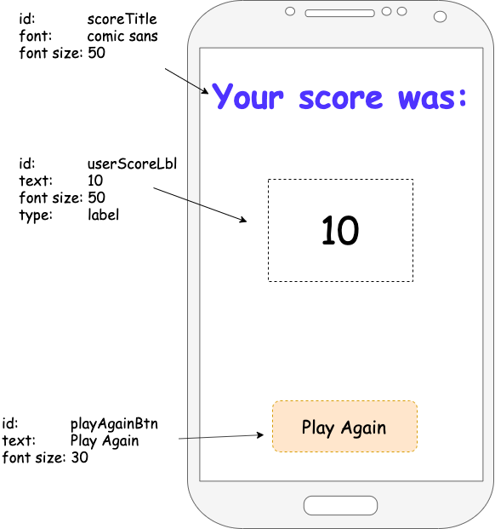
Homework
Homework
Provide designs for any two of the screens that will be part of your app.
The screens must be annotated with:
The id name you intend to use
Whether each item is a button, label, text input, image, etc.
An indication of font and/or colour
Due: Next lesson

Slide 16
Next lesson
Summary
In this lesson, you…
Identified and resolved some common errors using App Lab
Passed the value of a variable into a label
Chose a project to create and developed success criteria
Next lesson, you will…
Learn how to handle user input
Use decomposition to help break down the task of building the app into more manageable steps
Start making your app

