Slide 1
AQA
AS Level
Computer Science
Paper 2
Social, legal and cultural issues
Unit 6
Communication: Technology and consequences

Slide 2
Objectives
Understand the current capacity to distribute, publish, communicate and disseminate personal information
Understand that software and their algorithms embed moral and cultural values
Understand that computer scientists and software engineers have power, as well as the responsibility that goes with it, in the algorithms that they devise and the code that they deploy

Slide 3
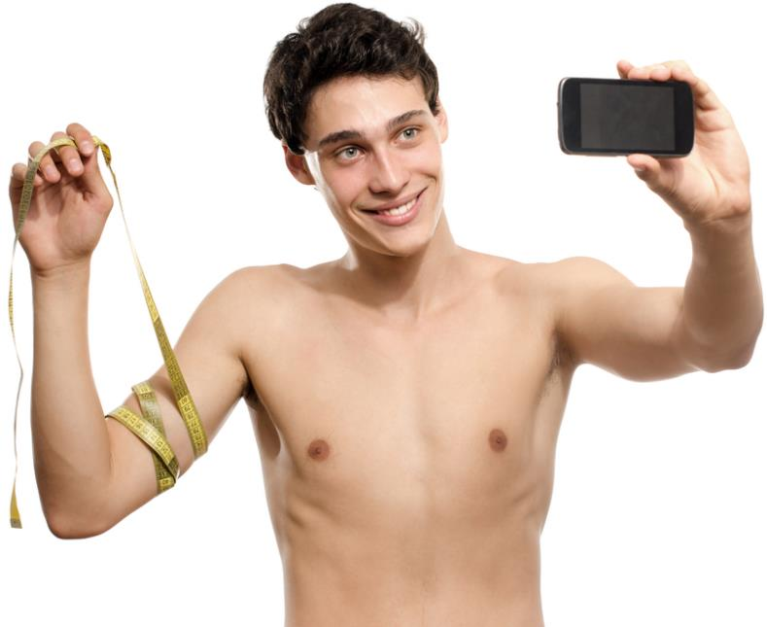
Private information and the web
How has our connected, online world enabled us to publish and distribute personal information?
Do you post personal information about yourself online?
Do you post personal information about other people online?
Is this ethical?

Slide 4
Social media sites – good or bad?
How many people in different countries use social networking sites such as Facebook, Twitter, Instagram, Snapchat, WhatsApp, Tumblr?
Who are they? What do they use these sites for?
What are some of the negative aspects of social media sites?

Slide 5
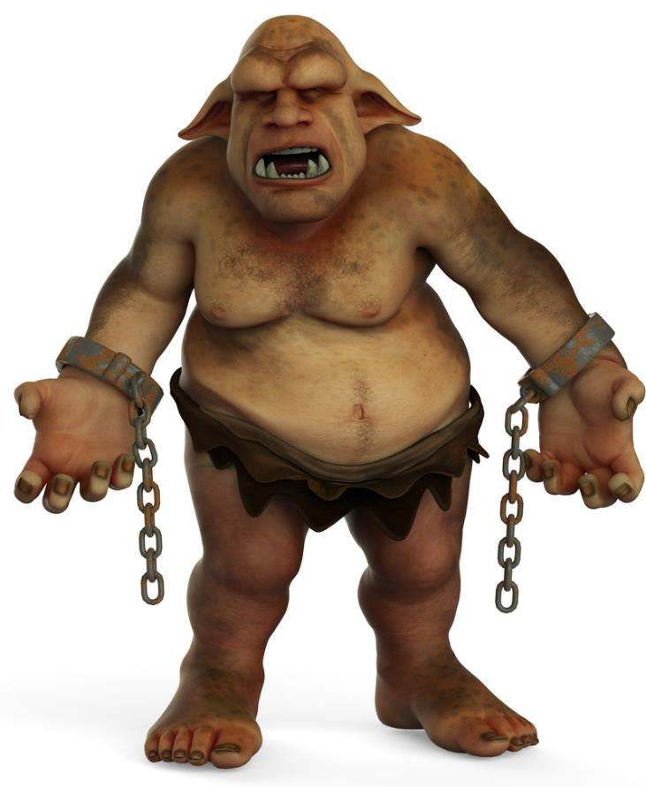
Negative aspects
Internet trolling
Cyberbullying
Anonymous blogs
Hate sites

Slide 6
Freedom of information
Should all information be easily and freely accessible to all online?
Should access to some material be restricted or monitored by governments?
Where would you draw the line?

Slide 7
Worksheet 6
Try Task 1

Slide 8
Software serving humanity
Tim Berners-Lee invented the World Wide Web in 1989 and made it freely available to all
He is a Founding Director of the World Wide Web Foundation, which seeks to ensure the Web serves humanity by establishing it as a global public good and a basic right.

Slide 9
Software and morality
Technology is a formidable force which can be used to make the world a better place
However, it can also do great harm
Should moral and ethical considerations should be a part of technological design, research and development?
How can this work in practice?

Slide 10
The effect of ICT applications
ICT has come to influence the way we do things
The ICT applications that software designers and engineers develop will partially determine what health care, public administration, education, science and transport will be within twenty years
Our ICT systems must be just, fair and safe and morally desirable

Slide 11
A double-edged sword
Any product, however useful or benign its original purpose, can also cause harm in the wrong hands
A razor blade, syringe, pillow, car or aeroplane can all be used to kill
Can the inventor be blamed?
Can a software engineer be blamed for the manner in which his software is used?

Slide 12
Strong encryption
Encryption algorithms are a vital tool for keeping data safe from hackers
Any website which has an address starting with https:// and which displays the padlock symbol uses encryption to keep data secure

Slide 13
Public key cryptography
This method of encrypting communication is based on two separate keys, a public key and a private key
It provides very strong encryption – typically it would take current computers 0.65 billion years to crack a private key!
Although it can be used to protect law abiding citizens’ communications, it can equally be used by criminals

Slide 14
Downside of strong encryption
Why would some governments not allow the use of strong encryption to keep private communications secure?
Recipient’s public key (made publicly available)
Plaintext
Message
Ciphertext sent to recipient
Message encoded
Message deciphered
Recipient’s own private key

Slide 15
Bitcoins
What are they?
What are the issues and implications of a totally virtual, almost untraceable online currency?
Bitcoins are not produced, managed or owned by any central government, royal mint or federal reserve which exist today!

Slide 16
Worksheet 6
Research and answer the questions in Task 2

Slide 17
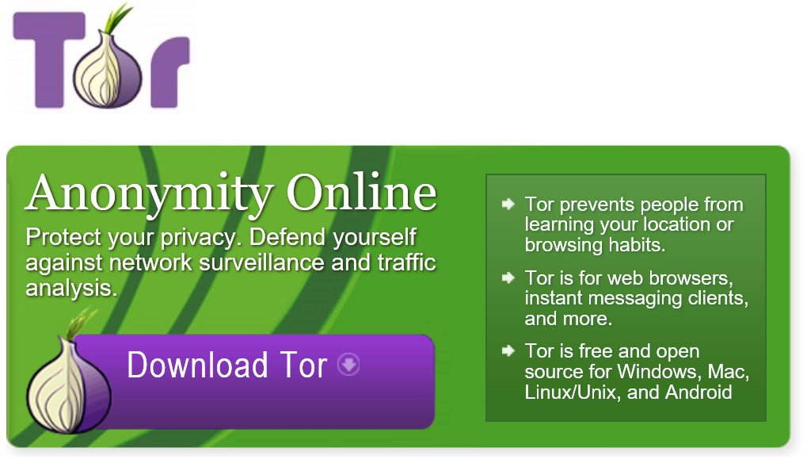
The Tor onions browser

Slide 18
The Tor onions browser
Tor makes some wonderful claims about the benefits of its software
Encouraging and supporting, safe, secure, private and untraceable communications and activities for:
Family & Friends
Businesses
Activists groups
Journalists operating in dangerous locations
Military
Law enforcement

Slide 19
The Tor onions browser
What is the flip side to this picture?
Who else do you think uses Tor software?
For what purposes?
What problems does this pose for law enforcement?

Slide 20
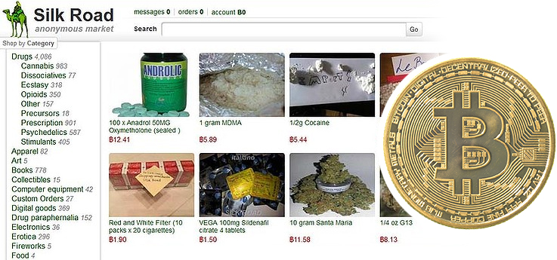
The ‘Dark Web’ – Narcotics
Illegal sites can operate for years before being closed

Slide 21
Worksheet 6
Research and answer the questions in Task 3

