Slide 1
Lesson 3: Selection
Year 7 – Programming essentials in Scratch: part I
Notes:
Last updated: 08/03/2021
This resource is licensed under the Open Government Licence, version 3. For more information on this licence, see ncce.io/ogl.

Slide 2
This statement is false
Notes:
Have this slide on the board as the learners enter the classroom.
The statement is a paradox as it is similar to saying “I am always a liar (everything I say is false)”. If the statement is true, it’s false, if the statement is false, it is true.
This is to get learners thinking about true and false conditions and how computers evaluate statements. (Learning objective: define a condition as an expression that will be evaluated as either true or false.)

Slide 3
Lesson 3: Selection
Objectives
In this lesson, you will:
Define a condition as an expression that will be evaluated as either ‘true’ or ‘false’
Identify that selection uses conditions to control the flow of a sequence
Identify where selection statements can be used in a program
Modify a program to include selection

Slide 4
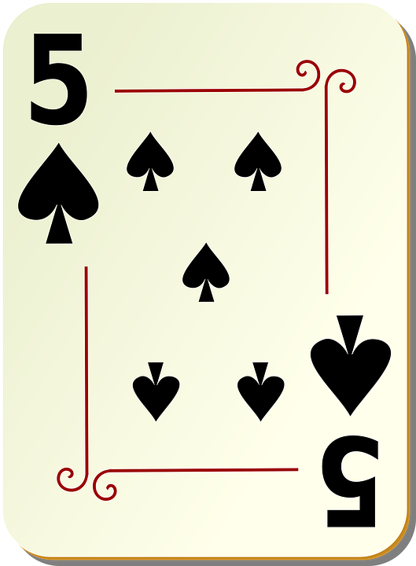
True or false?
Starter activity
Stand in the appropriate area of the classroom
The colour of this card is black
Notes:
Ask the learners to go and stand in one area of the classroom if they think the statement is true and another area of the classroom if they think the statement is false.
Answer = true
Card image source: https://pixabay.com/vectors/spades-five-5-poker-playing-spade-28367/

Slide 5
True or false?
Starter activity
Stand in the appropriate area of the classroom
The suit of this card is hearts
Notes:
Ask the learners to go and stand in one area of the classroom if they think the statement is true and another area of the classroom if they think the statement is false.
Answer = false
Card image source: https://pixabay.com/vectors/spades-five-5-poker-playing-spade-28367/

Slide 6
True or false?
Starter activity
Stand in the appropriate area of the classroom
The value of this card is greater than 5
Notes:
Ask the learners to go and stand in one area of the classroom if they think the statement is true and another area of the classroom if they think the statement is false.
Answer = false
Card image source: https://pixabay.com/vectors/spades-five-5-poker-playing-spade-28367/

Slide 7
Conditions and expressions
Starter activity
You evaluated an expression to ‘true’ or ‘false’ and then performed an action depending on the outcome.
If “the card is a heart” is true:
Stand next to true
Else:
Stand next to false
A selection statement in programming allows a computer to evaluate an expression to ‘true’ or ‘false’ and then perform an action depending on the outcome.
Notes:
The expression is “if the card is a heart” — if it evaluates as true then it will perform the action beneath it, else (i.e. otherwise) it will perform the action under the ‘else’ heading.
We are introducing the term ‘selection’ here. Link the word selection to the ‘if’ statement example they see on the screen.

Slide 8
Conditions and expressions: guess who?
Activity 1
If “the character has a hat” is true:
Remove from game
Else:
Keep in game
Notes:
Cartoon characters image source: https://pixabay.com/illustrations/chibi-kids-sports-chibi-boy-ball-4156788/

Slide 9
Conditions and expressions: guess who?
Activity 1
Notes:
This is another conditional expression, but this time we’re looking at it as if it was made within Scratch. There is no ‘true’ after the “If character is male then” which tells us that the ‘if’ statement is checking if that statement is true. If it is, it will do what is underneath, if the statement is false, it will move to the next instruction which is the ‘else’.
Cartoon characters image source: https://pixabay.com/illustrations/chibi-kids-sports-chibi-boy-ball-4156788/

Slide 10
Conditions and expressions: guess who?
Activity 1
Notes:
Ask the learners what they think will happen. This time, both characters remain. Ask the learners if there is anything different about this if we were to compare it to the previous ‘if’ statement that we used. Notice this time that there is no ‘else’. What will the program do if there is no else? The answer is nothing, unless it is told do. The program will not assume that you want the other players to disappear because the statement did not evaluate as ‘true’.
Cartoon characters image source: https://pixabay.com/illustrations/chibi-kids-sports-chibi-boy-ball-4156788/

Slide 11
Conditions and expressions: guess who?
Activity 1
Notes:
Cartoon characters image source: https://pixabay.com/illustrations/chibi-kids-sports-chibi-boy-ball-4156788/

Slide 12
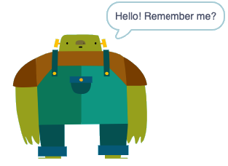
More chat with Big Ed
Activity 2
We’re now going to build on our chat with Big Ed.
Work in pairs, but complete your own worksheet.
Follow the link on your worksheet to the ‘Selection chat with Big Ed’ and use it to help you answer the questions on the worksheet.
ncce.io/biged2

Slide 13
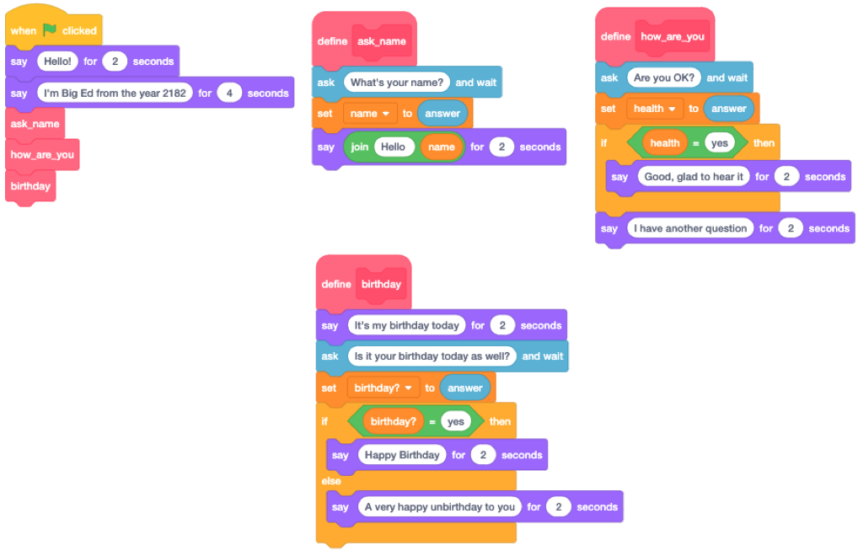
Predict
Activity 2
With a partner, spend time reading the code on the right. Predict what you think will happen.
Run the Scratch code at the link provided.
Were your predictions correct?
Did anything surprise you about the code?
Did you miss anything out?
ncce.io/biged2

Slide 14
Investigate and modify
Activity 2
Continue with the worksheet
Work in pairs, and discuss each question together, but you must fill in your own worksheet in your own words
Follow the instructions and investigate how the code works
Don’t wait for your teacher to instruct you to move on to the next section
ncce.io/biged2

Slide 15
Investigate answers
Activity 2
What is the purpose of the following three blocks of code?
They call the three subroutines in the specified sequence

Slide 16
Investigate answers
Activity 2
Explain what the following block of code does?
If the data linked to the variable ‘health’ evaluates to ‘true’, then Big Ed will say “Good, glad to hear it” for 2 seconds
(i.e. if the user has responded “yes” to the question)

Slide 17
Investigate answers
Activity 2
What happens if you say “No” when asked “Are you OK?”
Big Ed will say “I have another question”
As there is no Else and the answer isn’t “yes”, there is no instruction for how to respond to that answer
The final line is not the Else
Notes:
This question addresses misconception M21: using ‘else’ is optional (the next statement is always the ‘else’ branch)

Slide 18
Investigate answers
Activity 2
What happens if you say “No” when asked if it is your birthday?
What happens if you say “Yes” when asked if it’s your birthday?
Big Ed says “A very happy unbirthday to you”
Big Ed says “Happy Birthday”
Note: The Else is not always executed
Notes:
This question addresses misconception M22: ‘else’ branch is always executed

Slide 19
Investigate answers: If statements
Activity 2
As we have discovered, an If block allows us to check a condition and perform an operation if the condition evaluates to ‘true’.
If the condition evaluates to ‘false’, the operation will not be carried out.

Slide 20
Investigate answers: ‘if/else’ statements
Activity 2
An If block with an Else allows us to perform a different operation should the condition evaluate to ‘false’, before the program continues.

Slide 21
Investigate answers
Activity 2
What is the difference between the following two blocks of code?
If block 1 evaluates as ‘false’, then it will say “Have a nice day”
If block 2 has an Else meaning that it evaluates as ‘false’, then it will say “Put your coat on” before saying “Have a nice day”
Notes:
This question addresses misconception M21: using ‘else’ is optional (the next statement is always the ‘else’ branch).

Slide 22
Investigate answers
Activity 2
From which menu on the left-hand side of your Scratch window would you find the If blocks?
Control
Notes:
This question addresses misconception M21: using else is optional (the next statement is always the else branch)

Slide 23
Investigate answers
Activity 2
From which menu on the left-hand side of the screen would you find the following blocks?
Operators
Notes:
This question addresses misconception M21: using else is optional (the next statement is always the else branch)

Slide 24
Parson’s Problem
Plenary
I want a program that asks a single quiz question “What is the capital city of Spain?”
If the user gets the answer correct (Madrid), then it should add 1 to the score and say “That is correct”.
If the user doesn’t answer correctly, the program should say “Incorrect”.
Your challenge is to rearrange the blocks to form a working program.
ncce.io/biged3

Slide 25
Next lesson
Summary
In this lesson, you…
Learned that a condition is an expression that will be evaluated as either ‘true’ or ‘false’
Used selection in a program to control the flow of the sequence
Next lesson, you will…
Learn about using logical and comparison operators in selection statements

