Slide 1
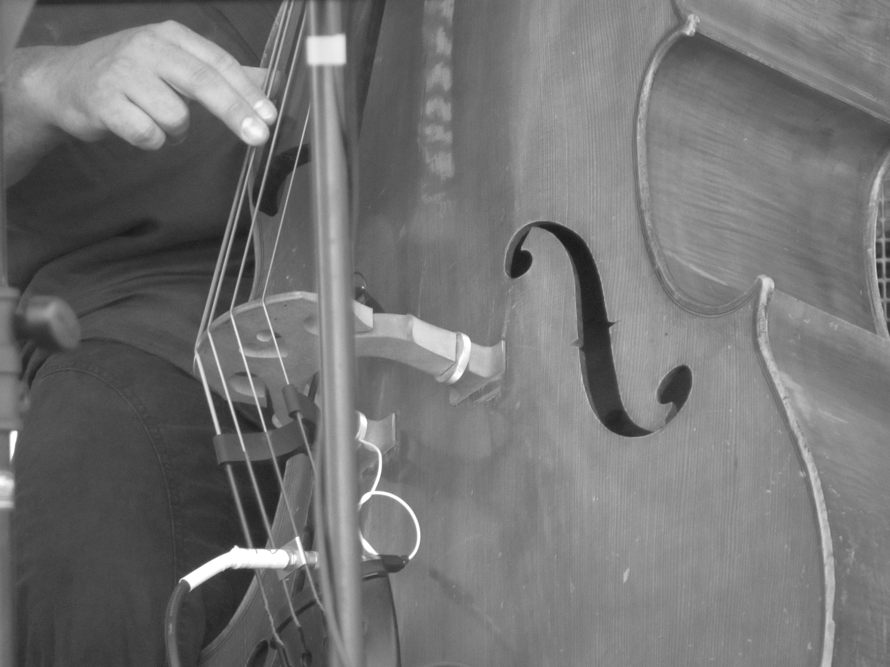
GLOSSARY TERMS give e.g for each
Bossa Nova
Samba
Glissando/Portamento
Double Stopping
Harmonics
Mordent
Acciacatura
Pause
Diminished 7th
Sylabbic
Counterpoint
Broken Chord
Rubato
Texture (H, M, P)
Structure
1-3 | Solo in Free tempo for acoustic bass guitar
4-22
23-54
55-87
88-103
104-114
COOL JAZZ
Light Tone
Relaxed Tempo
Behind Beat
Effortless Flow
Rich Harmonic Vocabulary
BOSSA NOVA
NEW TREND
Slower & more lyrical than SAMBA
Rich, Complex Harmonies
e.g Girl from Ipanema
Samba em Preludio
Commentary
Melody
Harmony
Tonality
Metre, Tempo & Rhythm
Performing Forces
Texture

