Slide 1
Inputs and Variables
Programming Guides

Slide 2
Inputs and Variables
In python, to display a message on the screen and wait for the user to type in a response to the message, we use the input statement:
input()
But we also need to store what the user types in, otherwise the input will be lost.

Slide 3
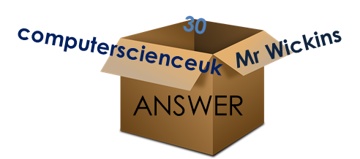
Inputs and Variables
In programming, inputs and data are stored in something called a variable
It can simply be thought of as a storage box.
The box may be given a name, and it may hold various different things.
Variable called ‘ANSWER’
Contents is anything we type in

Slide 4
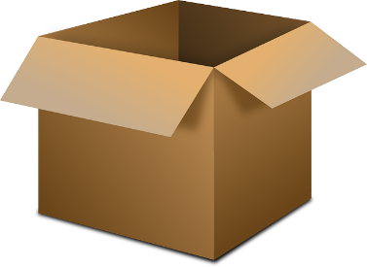
Inputs and Variables
Problem with the above is that whatever the user types in, it doesn’t actually go anywhere
We need to STORE IT…
answer = input(“what is your name?”)
What the user types in (e.g. their name)
ANSWER
Now, whatever’s typed in is now stored in a variable called answer.

Slide 5
Inputs and Variables
Example of an input followed by the outputting of what was typed in:

Slide 6
Inputs and Variables
PRINT Just displays a message!
INPUT Displays a message and waits for a user input!
So, it needs to equal a variable if we want to store what the user types in…

Slide 7
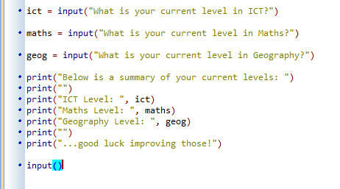
Inputs and Variables
This input statement asks the user a question and waits for their input
The input is then stored in a variable called ict
This is repeated for the other subjects
Finally each print statement outputs different lines of text
Here the text in speech marks is output… and the contents in variables too!
Speech marks aren’t needed here otherwise it would output the text ‘ict’ instead of the variables contents.

