Slide 2
Objectives
Understand and apply the additional maths skills required for A Level Design and Technology courses

Slide 3
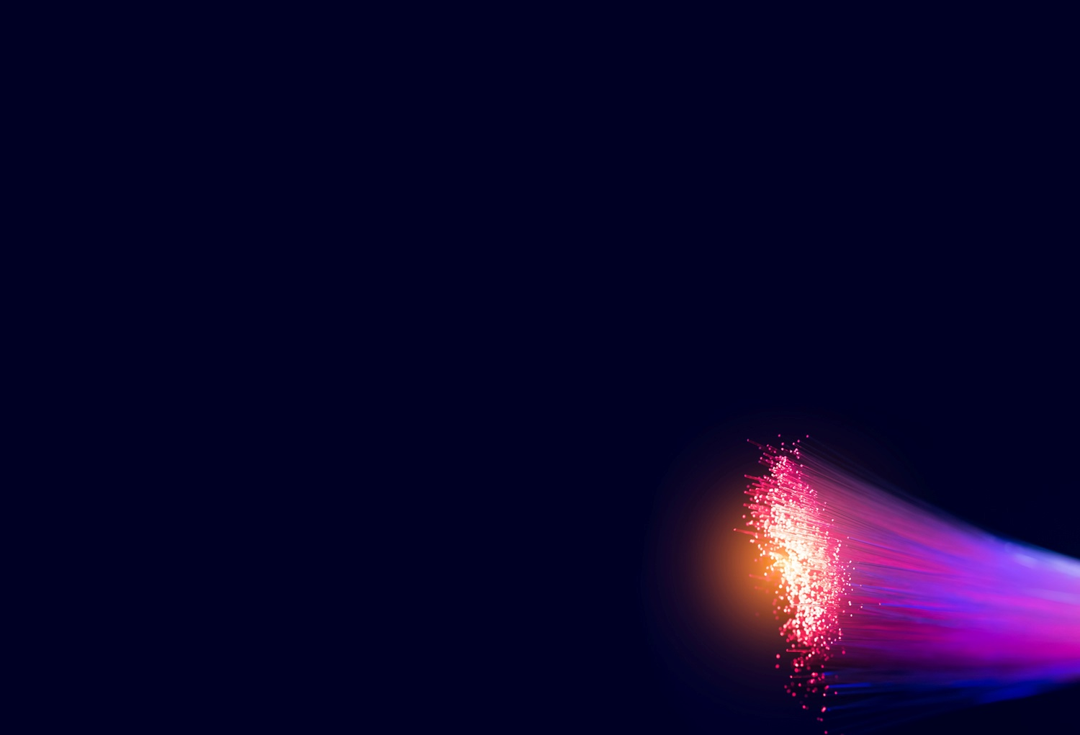
Starter
The speed of light in a vacuum is 299,792,458 ms⁻¹
In silica glass optical fibres, light travels 31% slower
Write the speed of light in a vacuum in standard form and to 3 significant figures (s.f.)
A fibre optic cable is laid across the Atlantic (5,600 km)
Calculate how long would it take a light signal take to travel this distance Give your answer to 3 s.f.

Slide 4
Starter
Write the speed of light in a vacuum in standard form and to 3 significant figures: 299,792,458 ms⁻¹
3.00 × 10⁸ ms⁻¹ (to 3 s.f.)
Calculate how long would it take a light signal to travel this distance 5,600 km travelling 31% slower to 3 s.f.
31% slower means the speed is 69% of the speed in a vacuum
69% of 299,792,458 ms⁻¹: 0.69 × 299,792,458 = 206,856,796 ms⁻¹
Convert km to m: 5,600 km = 5,600,000 m
Time taken to travel = $\frac{distance}{speed}$ : ⇒ $\frac{5,600,000}{206,856,796}$ = 0.02707187 s = 0.0271 s (to 3 s.f.)

Slide 5
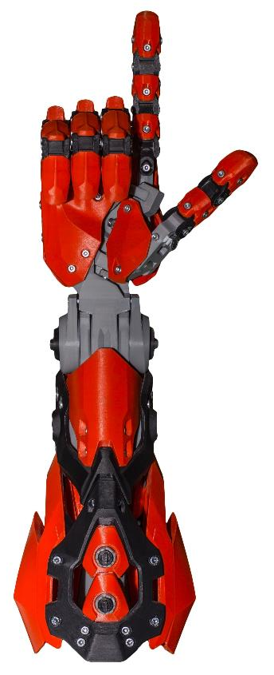
Robotic arm
3D printing is used to create this robotic arm
ABS is used as the polymer filament for the black components
It has a density of 1.09 g per cm³
The mass of the black components is 24.6 g
Calculate the volume of ABS needed to make the arm, give your answer in: a) cm³ b) m³ give both to 3 s.f.

Slide 6
Robotic arm
This is the method:
Use the formula, density (in g cm⁻³) = $\frac{mass}{volume}$
Rearranging this formula gives:
volume (in cm³) = $\frac{mass}{density}$
So, volume of ABS: $\frac{24.6}{1.09}$ = 22.568... cm³ = 22.6 cm³ (3 s.f.)
To convert units from cm³ to m³, imagine a cube of side 1 m: 1 m³ = (100 cm)³, so 1 m³ = 1,000,000 cm³, or 1 × 10⁶ cm³
$\frac{22.568...}{1×10⁶}$ = 0.0000226 m³ or 2.26 × 10⁻⁵ m³

Slide 7
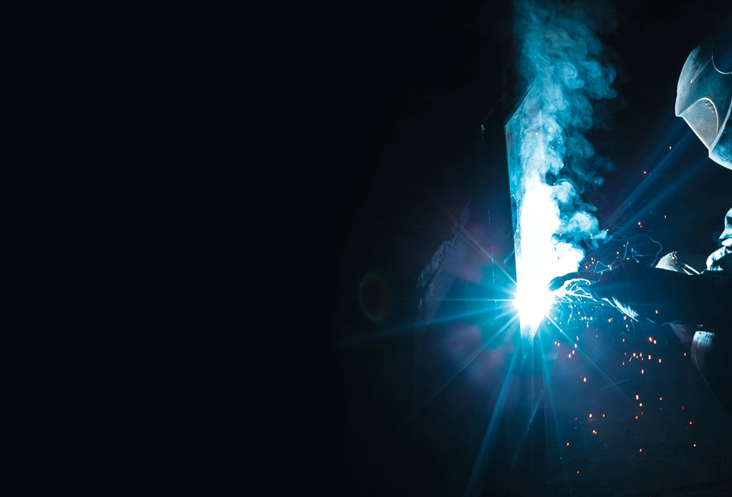
Arc welding
The temperature of an electrical arc can reach 10,000°F (Fahrenheit)
To convert between Celsius, °C, and Fahrenheit, °F, temperatures, this formula is used:
F $= \frac{9}{5}$ C + 32
Calculate the temperature of the arc in °C, to the nearest °C
To weld mild steel, it must melt to fuse, which happens at about 1,370°C – Calculate this temperature in °F

Slide 8
Arc welding
The temperature of the arc in °C:
Rearrange F = $\frac{9}{5}$ C + 32
To C = $\frac{5}{9}$ (F − 32)
C = $\frac{5}{9}$ (10,000 − 32)
= $\frac{9,968}{9}$ × 5
= 5,537.77.. so 5,538°C, to the nearest °C..
The temperature in °F to weld mild steel:
F = $\frac{9}{5}$ C + 32
= $\frac{9}{5}$ ×1370 + 32
= 2,498°F

Slide 9
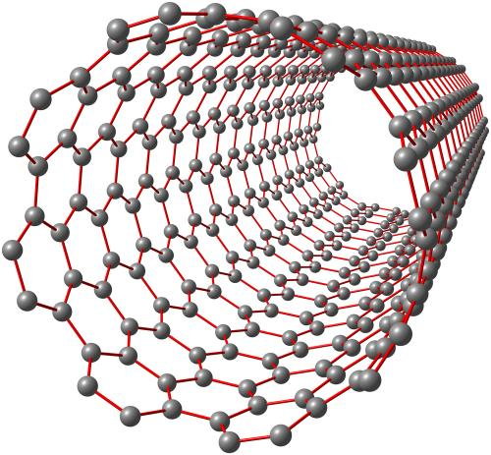
Nanotubes
Nanotubes have important applications in technology
They are made of millions of carbon atoms bonded together to form a cylinder
The volume, V, of a cylinder is given by: V = $π$r² × L where r is the radius of the cylinder, and L is the length
The thinnest nanotube yet made has a radius of 0.15 nanometres (nm)
Calculate the length of a 0.15 nm nanotube if the enclosed volume is 1,000 nm³. Give your answer to 3 s.f. in: a) nm b) mm

Slide 10
Nanotubes
This is the method:
Use the formula: V = πr² × L
Rearranging this formula gives: L = $\frac{\text{V}}{\text{p}\text{r}\text{²}}$
L = $\frac{1,000}{\text{p} × \left(\text{0.15}\right)²}$ = 14,147.1060.. nm = 14,100 nm (to 3 s.f.)
To convert nm to mm: 1 nm = 10⁻⁹ m and 1 mm = 10⁻³ m Therefore there are $\frac{{10}^{−3}}{{10}^{−9}}$ = 10⁶ nm in one mm 14,100 nm = $\frac{14,100}{{10}^{6}}$ = 0.0141 mm

Slide 11
Worksheet 7
Complete Task 1 on your Worksheet

Slide 12
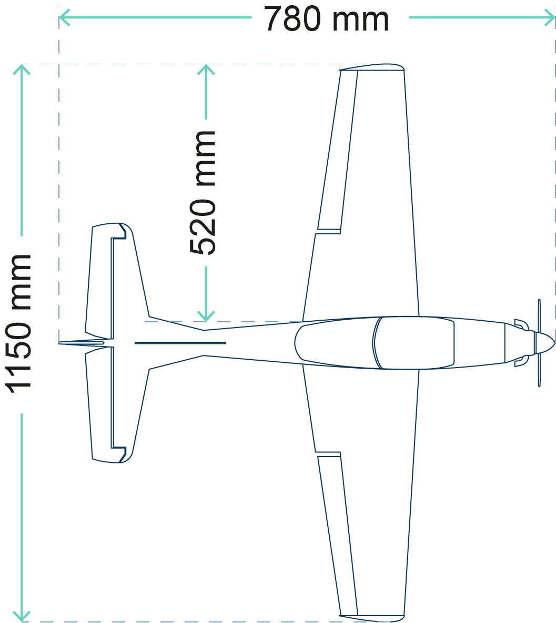
Ratio
This is a scale drawing showing a plan elevation of a light aircraft
The wing span of the actual aircraft is 11.00 m
Use the measurements and the drawing to calculate:
The length of the fuselage
The length of a wing

Slide 13
Ratio
The ratio of the corresponding lengths will all be equal
$\frac{Wingspan of model}{Actual wingspan}$ = $\frac{Fuselage on model}{Actual fuselage length}$
$\frac{1,150}{11,000}$ = $\frac{780}{Actual fuselage length}$
Rearranging:
Actual fuselage length = $\frac{780 × 11,000}{1,150}$ = 7.46 m
$\frac{Wingspan of model}{Actual wingspan}$ = $\frac{Wing length on model}{Actual wing length}$
$\frac{1,150}{11,000}$ = $\frac{520}{Actual wing length}$
Rearranging:
Actual wing length = $\frac{520 × 1,000}{1,150}$ = 4.97 m

Slide 14
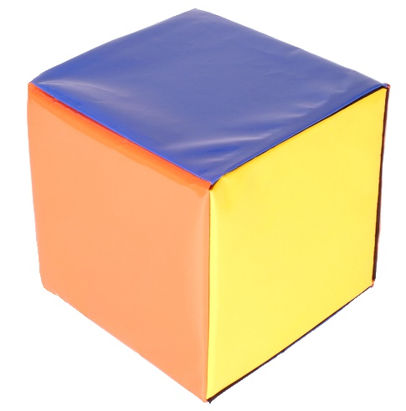
Soft play
Here is an image of a soft play cube with an actual side length 20 cm
A designer want to make a larger version for seating with a side ratio of 2 : 1
Calculate the area of one of the square faces on each of the cubes
Calculate the simplest ratio of these areas
Calculate the volumes of each of the cubes
What is the ratio of these volumes?
How are the ratios of lengths, areas and volumes related?

Slide 15
Soft play
Calculate the area of one of the square faces on each cube Small cube: 20 × 20 = 400 cm² Large cube: (20 × 2) × (20 × 2) = 1,600 cm²
Calculate the simplest ratio of these areas 1600 ÷ 400 = 4 ⇒ Ratio of large to small is 4 : 1
Calculate the volumes of each of the cubes Small cube: 20 × 20 × 20 = 8,000 cm³ Large cube: 40 × 40 × 40 = 64,000 cm³
What is the ratio of these volumes? 64,000 ÷ 8,000 = 8 ⇒ Ratio of large to small is 8 : 1
How are the ratios of lengths, areas and volumes related? Doubling the side length means the area is multiplied by a factor of 22 and the volume by a factor of 2³

Slide 16
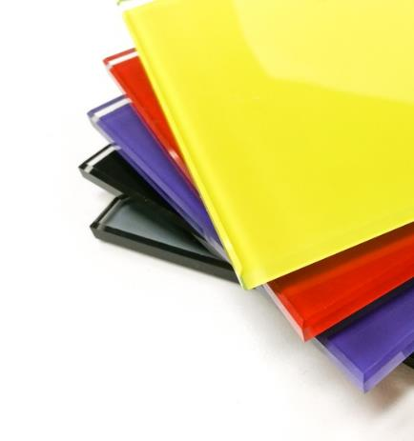
Discounts
A design student wishes to buy 100 sheets of coloured glass
Supplier A offers a fixed price of 52p per sheet
Supplier B quotes a price of 60p per sheet, but offers a 15% discount off any sheets over 50
Calculate which supplier is offering the best deal – show your workings

Slide 17
Discounts
Supplier A Price paid = (100 × 52 p) = £52.00
Supplier B Price paid = (50 sheets at 60p each) + (15% discount on the remaining 50 sheets)
A 15% discount means that the amount being paid is 85% of the original value, that is: 0.85 × 60 = 51p The total price = (50 × 60) + (50 × 51) = £30.00 + £25.50 = £55.50
Supplier B is more expensive by £3.50 so, supplier A is offering the best deal

Slide 18
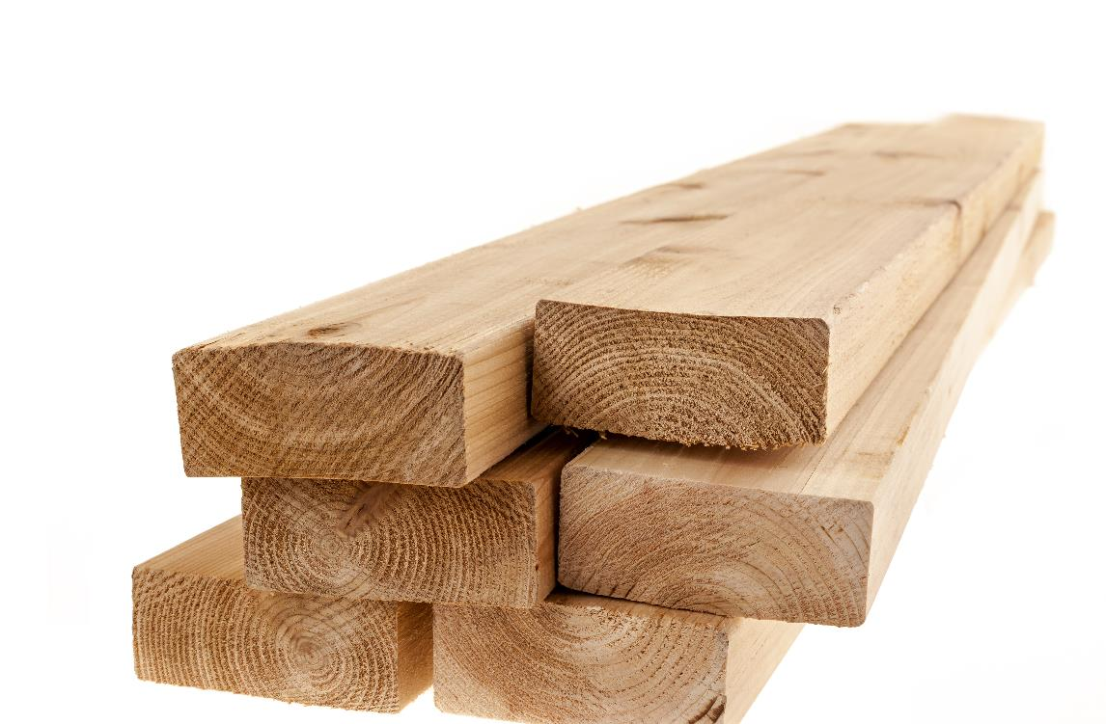
Timber stock
A furniture maker buys a variety of timber for £252, and this is after a 10% discount
What was the price of the timber before the discount?
What would have been the discounted price if the reduction was 20%?

Slide 19
Timber stock
What was the price of the timber before the discount? Let P = the original timber price With a 10% discount, the price paid is 90% of the original 0.9 × P = 252 Rearranging gives P = 252 ÷ 0.9
= £280
What would have been the discounted price if the reduction was 20%? A 10% reduction meant a saving of 280 − 252 = £28
A 20% reduction will be twice this, at (2 × 28) = £56 therefore, 280 − 56 = £224

Slide 20
Cost of outsourcing
A clothing designer is re-evaluating their costs
The cost of outsourcing tailoring has increased by 41% in just 3 years
Which of these would give the price before the increase? Let P = today’s price
A. P × $\frac{41}{100}$
B. P × $\frac{100}{41}$
C. P + 1.41
D. P × $\frac{100}{141}$
E. 41 P

Slide 21
Worksheet
Complete Task 2 on Worksheet 7

Slide 22
Sine and Cosine rules
Labelling the triangles:
Angles are always A, B and C
Opposite lengths are the corresponding small letters a, b and c
Note: If other letters are used in the question, cross them out and re-label your triangle
B
Sine rule: $\frac{\text{a}}{\sin{A}}$ = $\frac{\text{b} }{\sin{B}}$ = $\frac{\text{c} }{\sin{C}}$
c
a
Cosine rule (to find a length)
a² = b² + c² − 2bc cos A
Cosine rule (to find an angle) cos A = $\frac{b^{2} + c^{2} − a²}{2bc}$
A
b
C

Slide 23
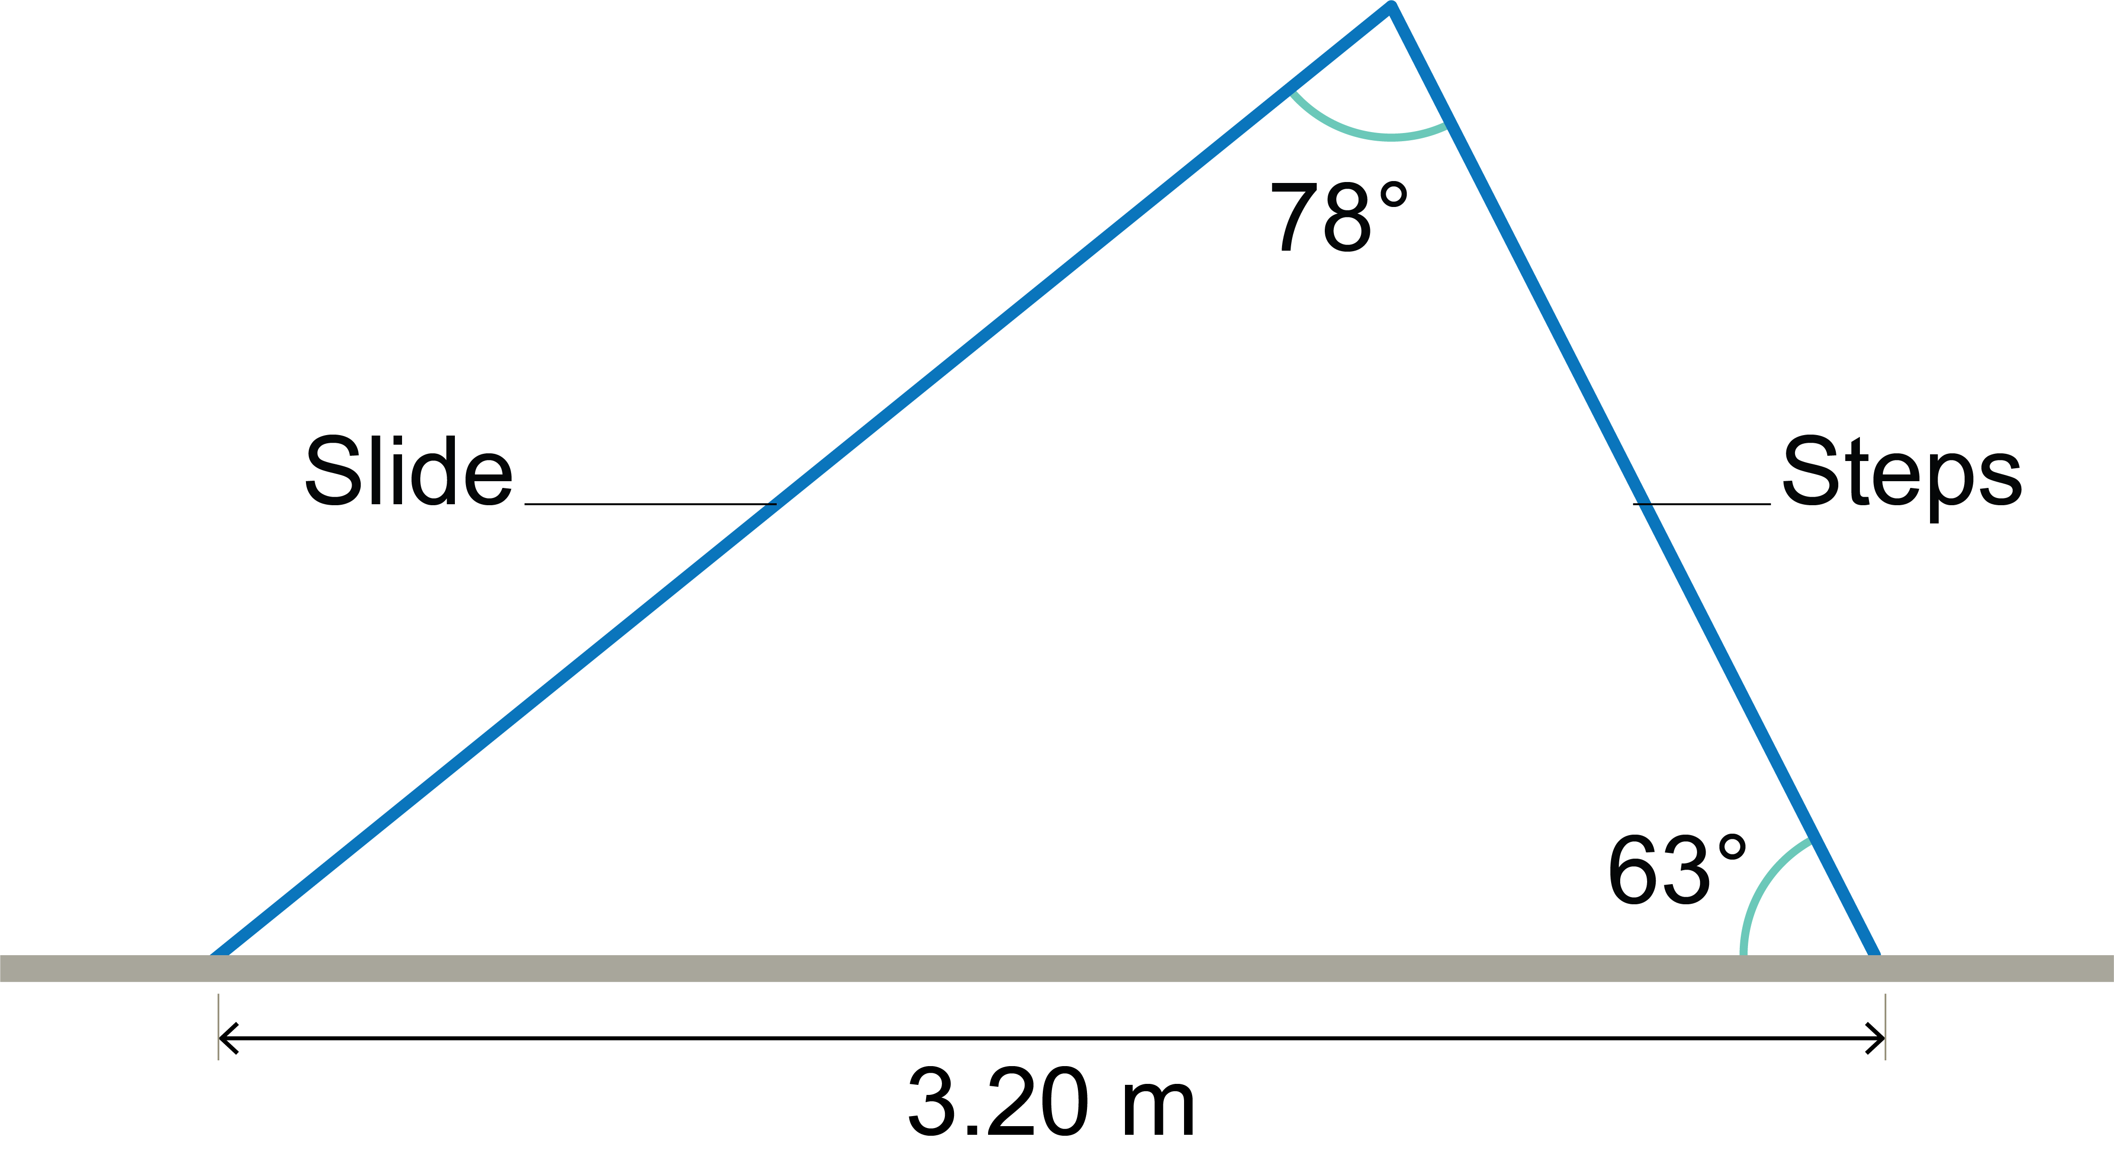
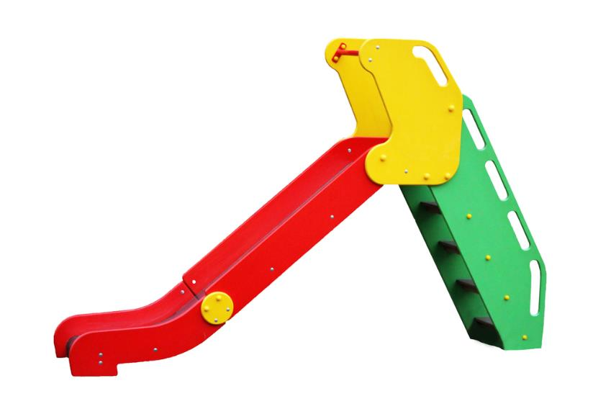
Children’s slide
The design for this slide has been simplified
Giving your answers in mm, calculate:
a) the length of the slide,
b) the length of the steps incline

Slide 24
Children’s slide
Here is the method:
We know a side and its opposite angle, so we use the sine rule: $\frac{Slide length}{\sin{63°}}$ = $\frac{3.20 }{\sin{78}}$ ⇒ Slide length = $\frac{3.20 × \sin{63}}{\sin{78}}$ Slide length = 2.9149… m or 2,915 mm (to the nearest mm)
Similarly, $\frac{Steps incline}{\sin{39}}$ = $\frac{3.20}{\sin{78}}$ , so steps incline = $\frac{3.20 × \sin{39}}{\sin{78}}$ = 2.0588.. m or 2,059 mm (nearest mm)

Slide 25
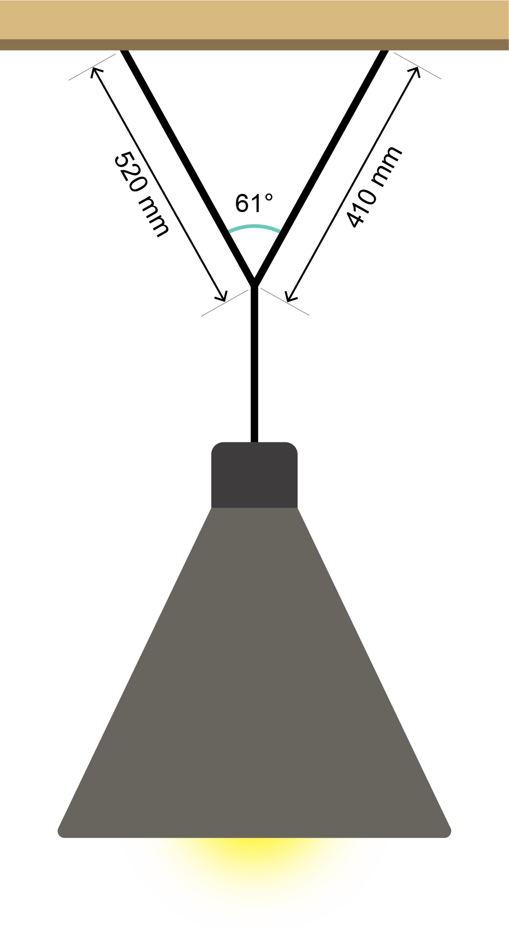
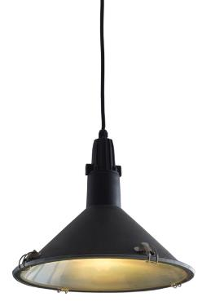
Pendant light
The picture shows a pendant light
It is suspended from two support wires to make it hang in the correct position
Calculate the shortest distance between the ceiling fixings – Give your answer to 1 d.p. Hint: We know two sides and the angle between them – this is not the sine rule

Slide 26
Pendant light
The cosine rule is used:
Let d = distance between the fixings
d² = 520² + 410² − (2 × 520 × 410 × cos 61°)
d² = 438,500 − 206,722...
d² = 231,777...
Remember to keep all of the numbers on the calculator display – do not round during a calculation
Square rooting both sides gives: d = $\sqrt{231,777...}$ = 481.4 mm (to 1 d.p.)

Slide 27
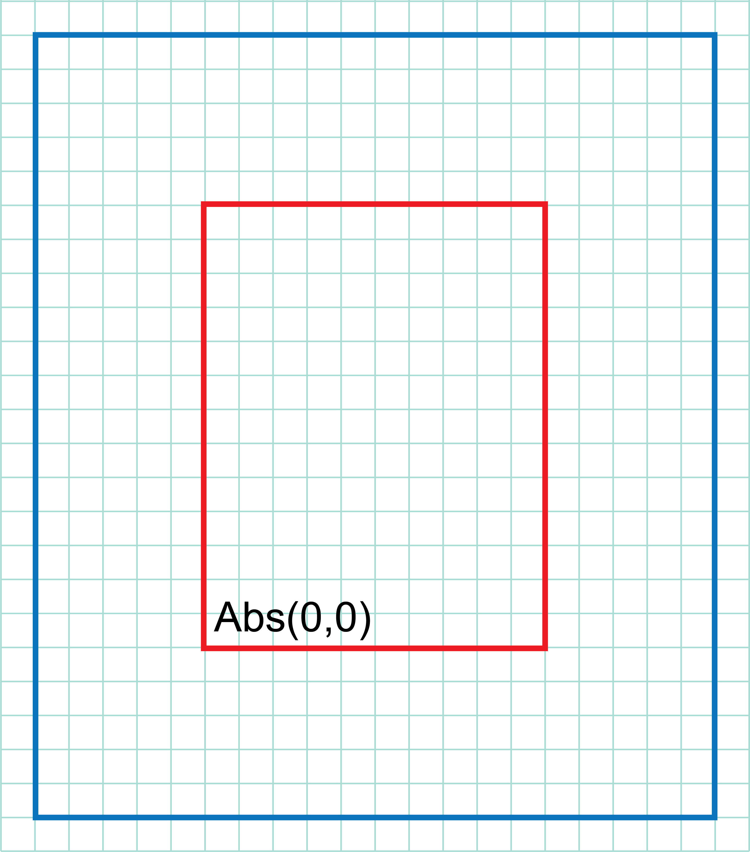
Table top
Coordinates may be used to represent a design
The blue shape is a teak table top, and the red inner shape is a leather inlay
Each square represents 50 mm
Give the dimensions of: a) the inlay b) the teak surround
The red point x has an absolute coordinate (Abs) of (0,0). What are the relative coordinates of the remaining 7 corners?
x

Slide 28
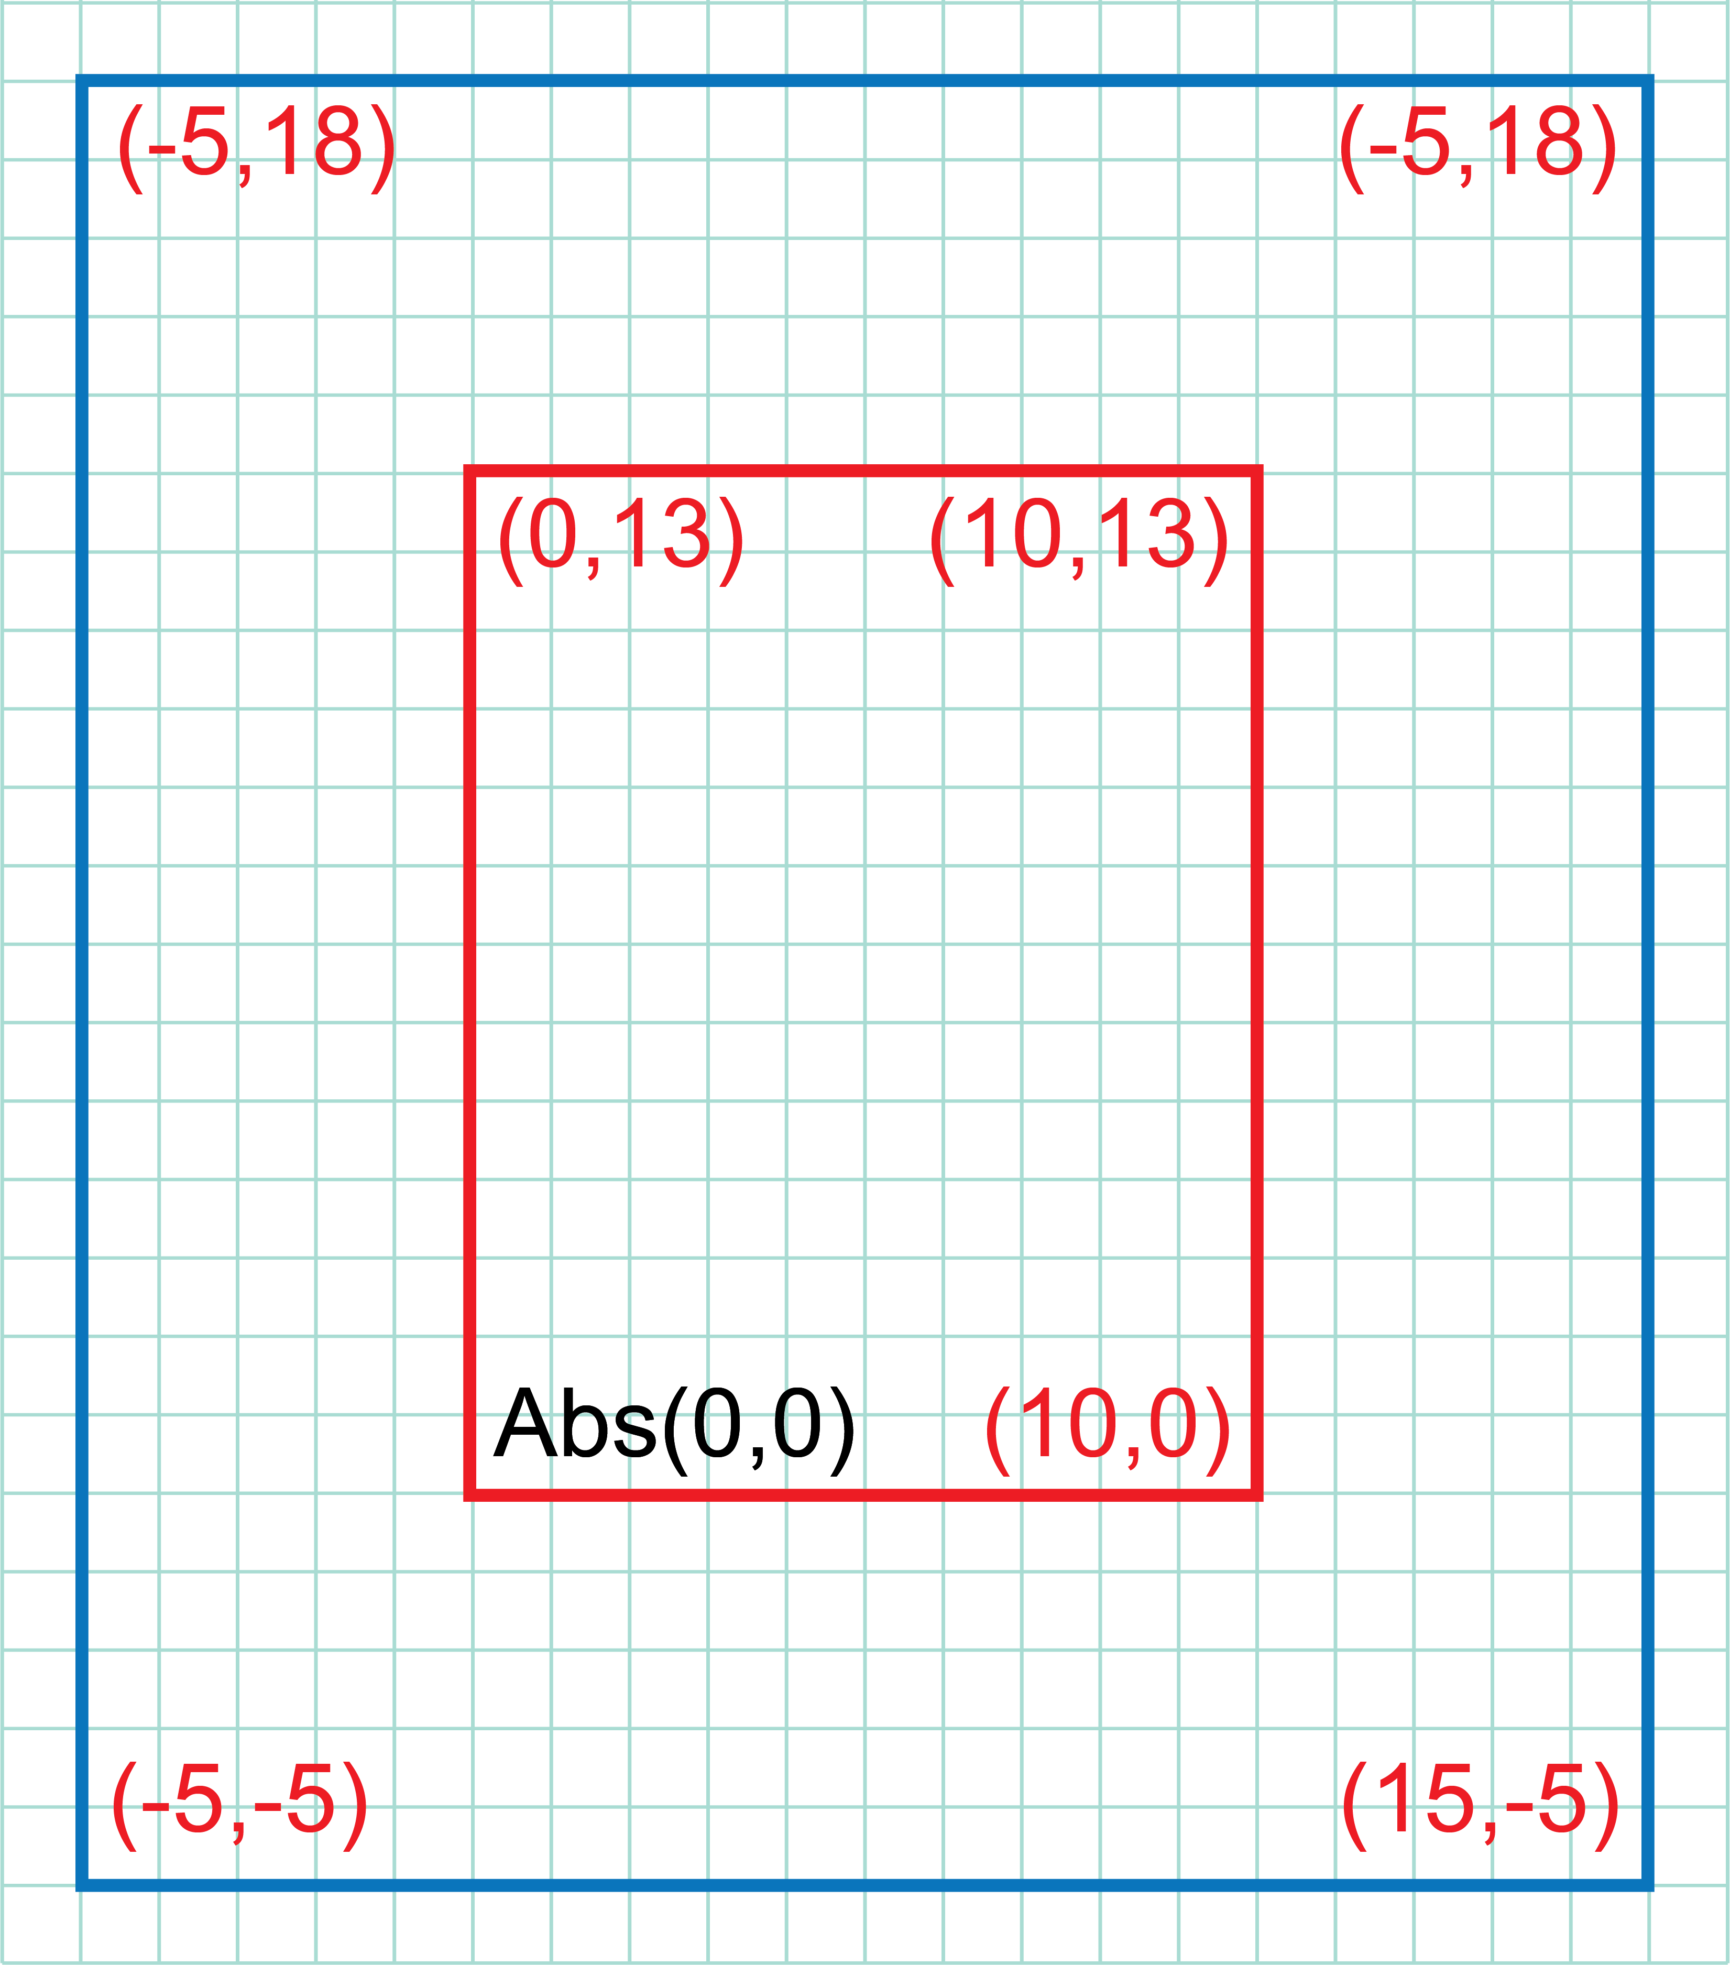
Table top
The dimensions of: a) the inlay = 500 mm × 650 mm b) the teak surround = 1,000 mm × 1,250 mm
Coordinates are on the grid
Calculate the area of the leather inlay
Calculate the percentage of the table top surface due to leather

Slide 29
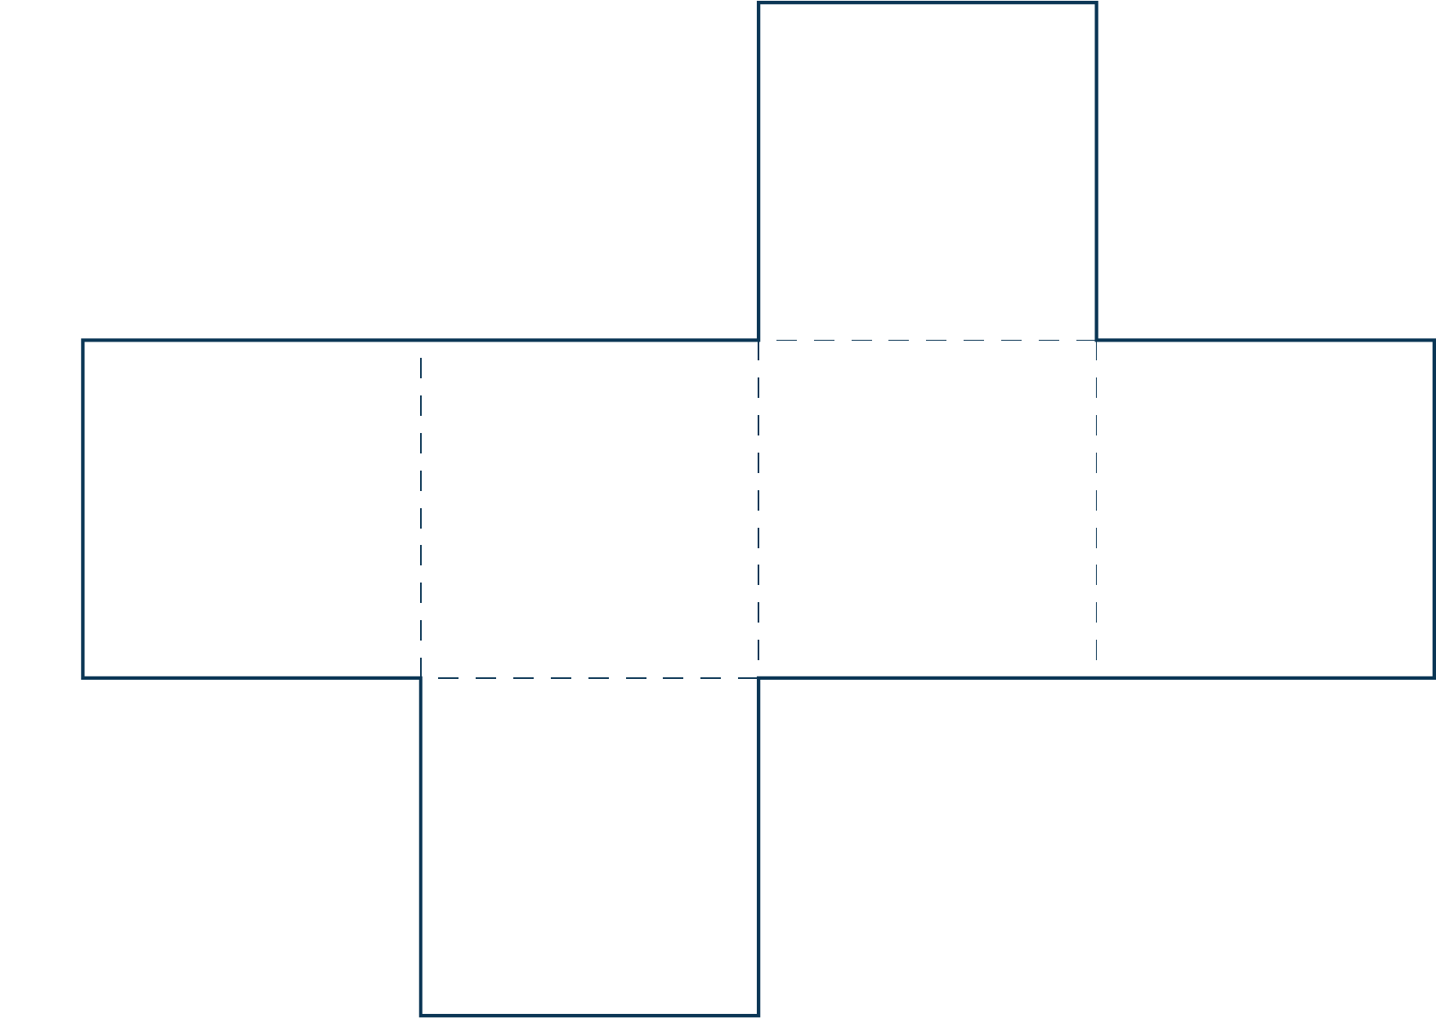
Nets
Make the largest cube possible from a piece of A4 paper, using this net
A sheet of A4 paper is 210 mm × 297 mm
Calculate the volume of the cube formed
Calculate the percentage of paper that is waste to 1 d.p.

Slide 30
Nets
Draw a simple diagram to show what is happening:
3 squares fit into the 210 mm width, so each square is 70 mm Volume of the cube will be 70 × 70 × 70 = 343,000 mm³
A4 area = 210 × 297 = 62,370 mm² Net area = (70 × 70) × 6 = 29,400 mm² Area of = 62,370 mm² − 29,400 mm² = 32,970 mm²
Percentage area of waste:
$\frac{32,970}{62,370}$ × 100 = 52.861.. = 52.9% waste
210 mm
297 mm

Slide 31
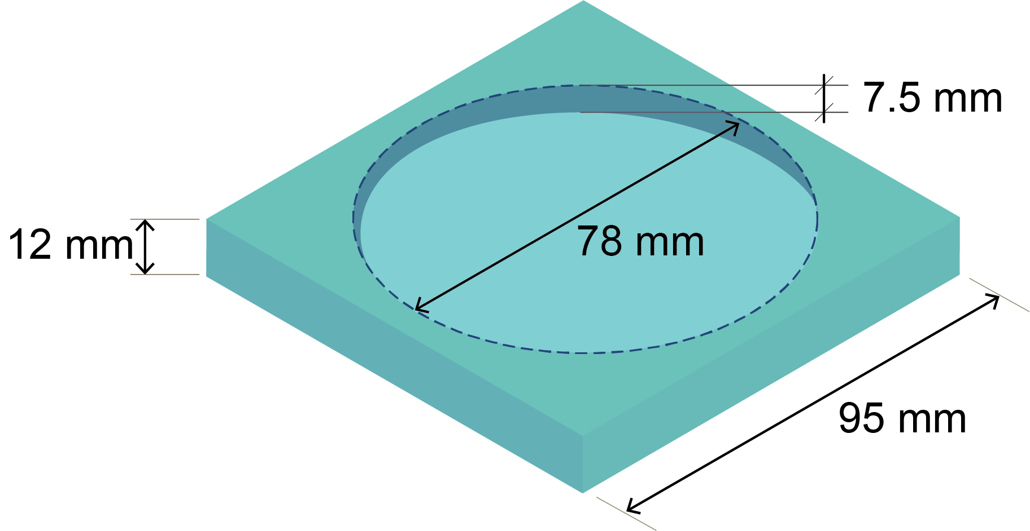
Cup holder
A student makes square cup holders from 12 mm thick acrylic sheet measuring 900 mm × 600 mm
The diameter of the circular recess for the cup is 78 mm, and is 7.5 mm deep
Calculate the volume of one cup holder to 1 d.p.
What is the maximum number of holders that can be cut from the acrylic sheet?
Calculate the total volume of wastage, to the nearest cm³

Slide 32
Cup holder
Volume of one cup holder: Volume of cuboid − volume of cylindrical recess = (95 × 95 × 12) − (π × 39 × 39 × 7.5) = 108,300 − 35,837.71… = 72,462.2818… mm³ = 72.5 cm³ (to 1 d.p.)
The acrylic sheet is 900 mm x 600 mm Maximum number of whole cup holders = 900 ÷ 95 = (9 length); 600 ÷ 95 = (6 width); 9 × 6 = 54 in total
Volume of wastage Volume of whole sheet = 900 × 600 × 12 = 6,480,000 mm³ Volume of cup holders = 54 × 72,462.2… = 3,912,963.217… mm³ 6,480,000 − 3,912,963.217 = 2,567,036 mm³ or 2,567 cm³

Slide 33
Worksheet
Complete Task 3 on Worksheet 7

Slide 34
Seating heights
The bar graph shows the heights of a selection of bar stools, rounded to the nearest 10 mm
What is meant by ‘frequency’?
What is the mode height of stool?
What is the range of the sample?
Explain how the mean height of the stools is calculated

Slide 35
Stool height
What is meant by ‘frequency’? The number of stools of a certain height
What is the mode height of the stools? The most common or popular height is 650 mm
What is the range of the sample? The difference between highest and lowest values: Range: 720 − 580 = 140 mm
Explain how the mean height of the stools is calculated
Mean: $\frac{Total height}{Total number of stools}$ =$\frac{sum of (frequency × height)}{sum of frequencies}$

Slide 36
Histograms
Histograms are used to plot continuous data
The area of each bar represents the total frequency
Frequency density is measured on the vertical axis
Frequency density = $\frac{frequency}{interval width}$
The table shows some lengths of scrap material 10 ≤ x < 40 means the length is 10 or more mm, but less than 40 mm
For the 10 ≤ x < 40 interval: Frequency density = $\frac{12}{30}$ or 0.4
Calculate the remaining frequency densities in the table
Length (mm) | Frequency | Frequency density
10 ≤ x < 40 | 12 | 0.4
40 ≤ x < 50 | 24
50 ≤ x < 55 | 40
55 ≤ x < 60 | 50
60 ≤ x < 70 | 46
70 ≤ x < 80 | 26

Slide 37
Histograms
Here are the missing frequency densities:
Two students plot a histogram in which they plot frequency, not frequency density, against the mark range
State a problem that may arise when interpreting their chart
Suggest why frequency density is used to plot a histogram and not frequency alone
Length (mm) | Frequency | Frequency density
10 ≤ x < 40 | 12 | 0.4
40 ≤ x < 50 | 24 | 2.4
50 ≤ x < 55 | 40 | 8
55 ≤ x < 60 | 50 | 10
60 ≤ x < 70 | 46 | 4.6
70 ≤ x < 80 | 26 | 2.6

Slide 38
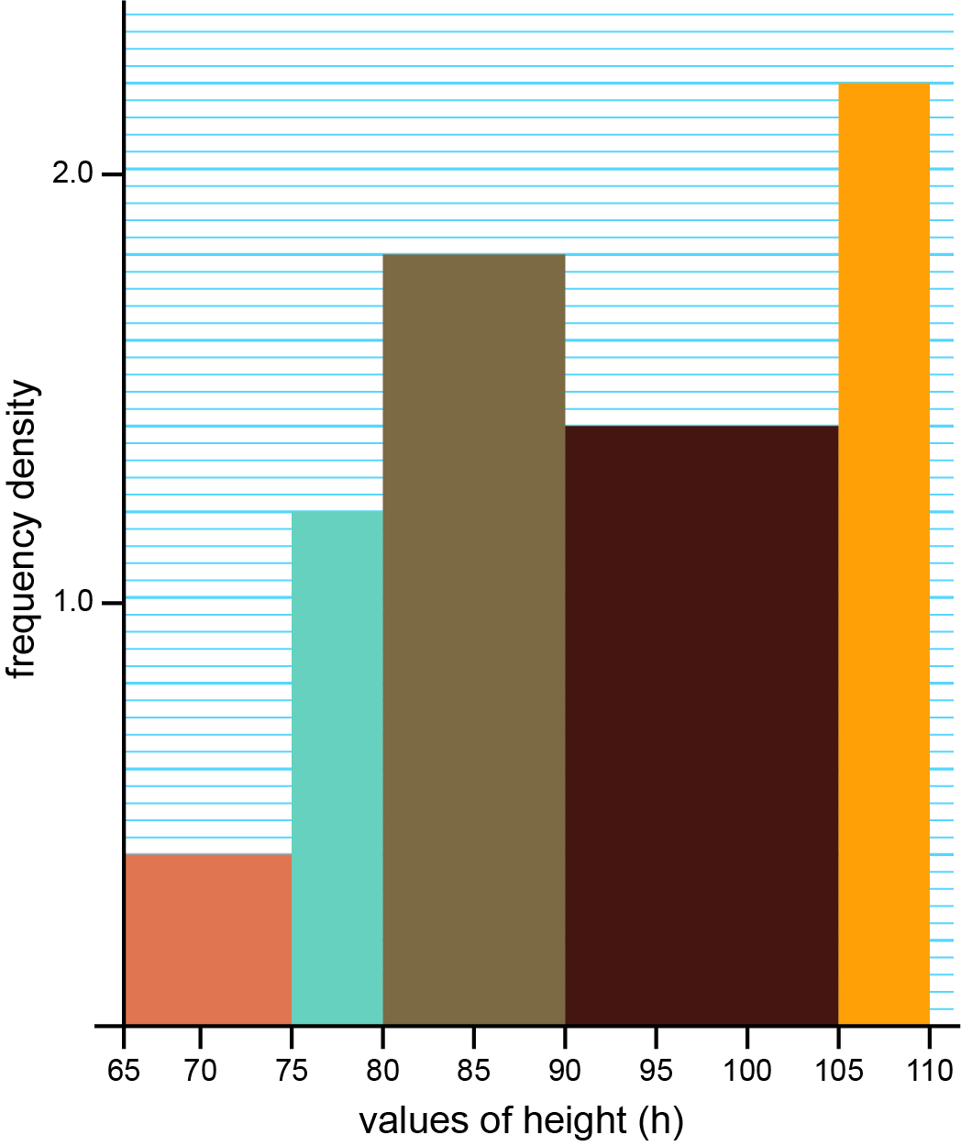
Height of people
Frequency density is measured on the vertical axis
To calculate frequency, frequency density is multiplied by the interval width – this is an area on the chart
Complete the table below using the histogram of people heights
Height range (cm) | 65 ≤ x < 75 | 75 ≤ x < 80 | 80 ≤ x < 90 | 90 ≤ x < 105 | 105 ≤ x < 110
Frequency density |  |  | 1.8
Frequency |  |  | 1.8 × 10 = 18

Slide 39
Height of people
Below is the completed table
Which height range contains the most people (the mode)?
What is the total number of people?
Calculate the percentage of people who have the modal height
Height range (cm) | 65 ≤ x < 75 | 75 ≤ x < 80 | 80 ≤ x < 90 | 90 ≤ x < 105 | 105 ≤ x < 110
Frequency density | 0.4 | 1.2 | 1.8 | 1.4 | 2.2
Frequency | 0.4 × 10 = 4 | 1.2 × 5 = 6 | 1.8 × 10 = 18 | 1.4 × 15 = 21 | 2.2 × 5 = 11

Slide 40
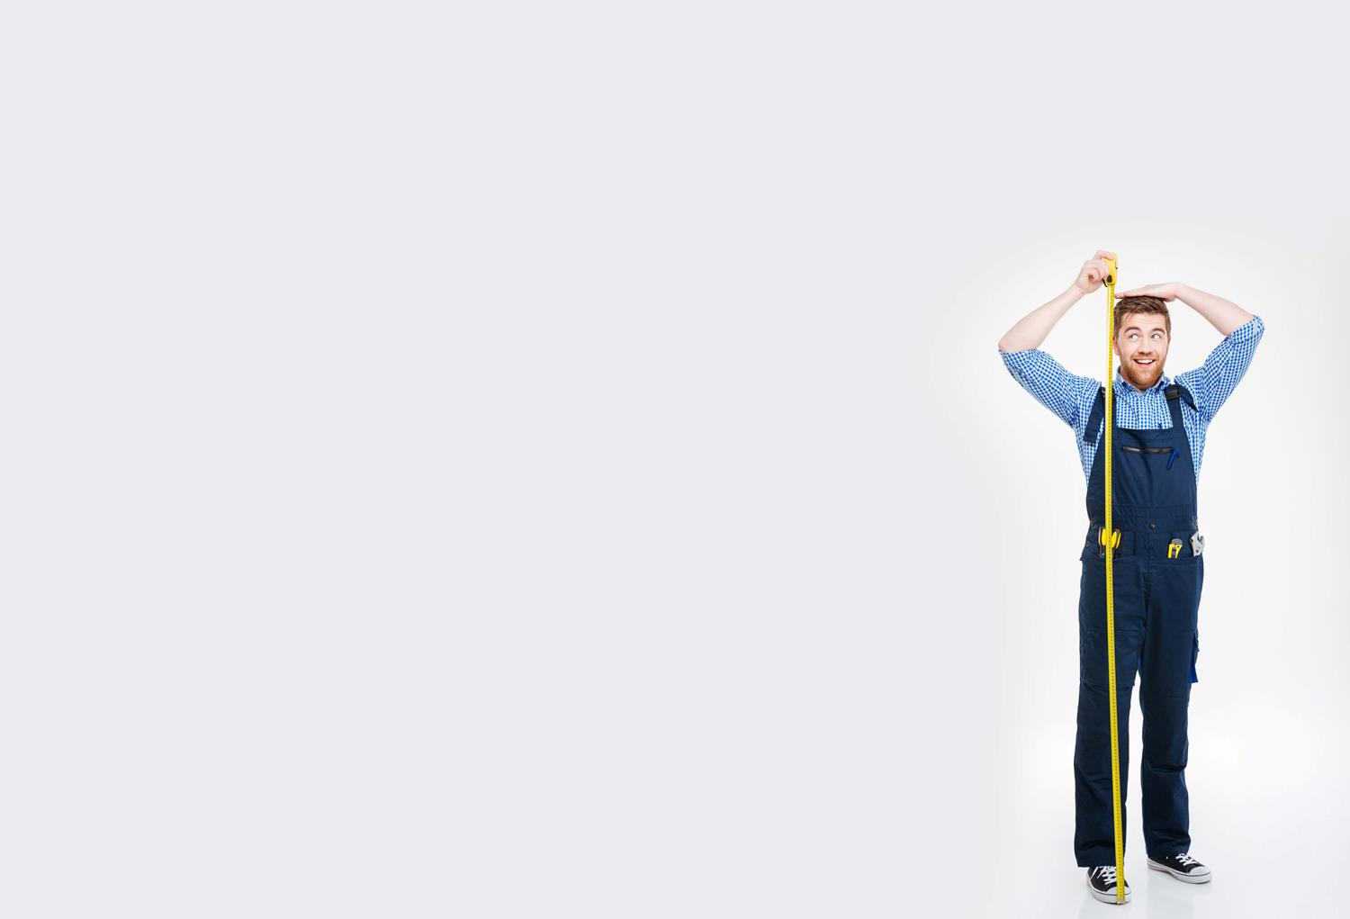
Percentiles
A range of data can be divided into percentiles
If a value is in the 25% percentile, this means that 25% of the sample is below this score
For example, an adult male in the UK who is 183 cm tall is in the 85th percentile
A student is given an end of term school report that states that the term average score was 65% and this was in the 55th percentile
Using these figures, explain the difference between a percentage and a percentile

Slide 41
Door frames
A company designs and makes door frames
They are engineered so that the maximum height is 1,810 mm
The table gives percentile information on the heights of males and females in the UK
Use the information in the table to give any problems that the company are likely to face
In a sample of 600 females and 600 males, estimate the number of people for whom the door frames would be too low
 | 5th percentile | 50th percentile | 95th percentile
Males | 1,600 | 1,710 | 1,810
Females | 1,465 | 1,600 | 1,730

Slide 42
Worksheet
Complete Task 4 on Worksheet 7

Slide 43
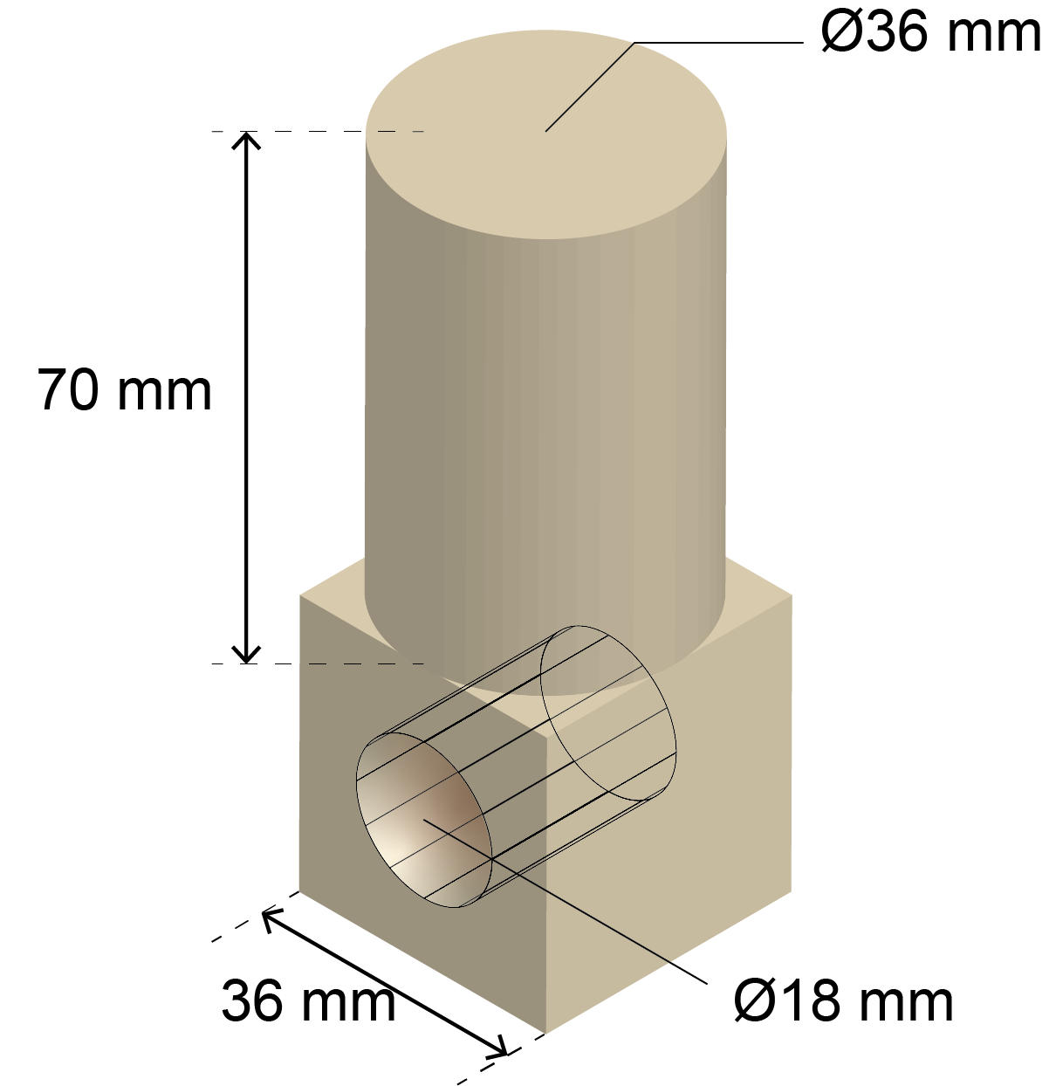
Plenary
This design shown is for a component to be made of a acrylic
The design is a cube with a 36 mm side length into which an 18 mm diameter hole is drilled – the attached cylinder has a diameter of 36 mm and a height of 70 mm
Acrylic has a density of 1.18 g cm⁻³ and costs of £4.52 per kilo
Calculate the volume of this shape, giving your answer to the nearest mm³
Calculate the material cost of manufacturing 12,000 components to the nearest pound

Slide 44
Plenary
The volume of the component:
Volume of cylinder = $π$r²h = $π$ x 18² × 70 = 71,251 mm³
Volume of cube = 36³ ⇒ 46,656 mm³
Volume of drilled hole = $π$ × 9² × 36
= 9,161 mm³
Volume of 3D component = 71,251 + 46,656 − 9,161 = 108,746 mm³ = 108,746 mm³ (to the nearest mm³)

Slide 45
Plenary
The cost of material:
Density = 1.18 g cm⁻³ and volume = 108,746 mm³
The mass of acrylic, in g = 1.18 × $\frac{108,746}{1000}$ = 128.3… g
Converting to kg gives: $\frac{128.3}{1000}$ = 0.128… kg
The cost of 12,000 components = 0.128… × 4.52 × 12,000 = £6,960.1… = £6,960 (nearest pound)
density = $\frac{mass}{volume}$
⇒ mass = density × volume
To convert from mm³ to cm³

