Slide 1
Ch.15
Hardware

Slide 2
15.1 Processors and parallel processing

Slide 3
Objectives
Understand the differences between RISC (Reduced Instruction Set Computer) and CISC (Complex Instruction Set Computer) processors.
Understand the importance and use of pipelining and registers in RISC processors.
Learn about the SISD, SIMD, MISD and MIMD basic computer architectures.
Learn the characteristics of massively parallel computers.
Understand interrupt handling on CISC and RISC computers.

Slide 4
CISC
Makes use of more internal instruction formats than RISC.
The design philosophy is to carry out a given task with as few lines of assembly code as possible.
Processor hardware must therefore be capable of handling more complex assembly code instructions.
Essentially, CISC architecture is based on single complex instructions;
which need to be converted by the processor into a number of sub-instructions;
These sub-instructions carry out the required operation.
This methodology leads to shorter coding (than RISC) but may actually lead to more work being carried out by the processor.

Slide 5
CISC - example
For example, suppose we wish to add the two numbers A and B together, we could write the following assembly instruction:
ADD A, B
This is a single instruction that requires several sub-instructions to carry out the ADDition operation.

Slide 6
RISC
RISC processors have fewer built-in instruction formats than CISC.
This can lead to higher processor performance.
The RISC design philosophy is built on the use of less complex instructions, which is done by breaking up the assembly code instructions into a number of simpler single-cycle instructions.
Ultimately, this means there is a smaller, but more optimised set of instructions than CISC.

Slide 7
RISC - example
Using the same example as with CISC, to carry out the addition of two numbers, A and B (this is the equivalent operation to ADD A, B):
LOAD X, A – this loads the value of A into a register X
LOAD Y, B – this loads the value of B into a register Y
ADD A, B – this takes the values for A and B from X and Y and adds them
STORE Z – the result of the addition is stored in register Z

Slide 8
Main differences between CISC and RISC processors
CISC features | RISC features
Many instruction formats are possible | Uses fewer instruction formats/sets
There are more addressing modes | Uses fewer addressing modes
Makes use of multi-cycle instructions | Makes use of single-cycle instructions
Instructions can be of a variable length | Instructions are of a fixed length
Longer execution time for instructions | Faster execution time for instructions
Decoding of instructions is more complex | Makes use of general multi-purpose registers
It is more difficult to make pipelining work | Easier to make pipelining function correctly
The design emphasis is on the hardware | The design emphasis is on the software
Uses the memory unit to allow complex instructions to be carried out | Processor chips require fewer transistors

Slide 9
Pipelining
Pipelining is one of the less complex ways of improving computer performance.
Due to the inherently simple nature of RISC instructions, their execution times are predictable.
This enables pipelining to be implemented on RISC architecture far easier, than with CISC.
Pipelining allows several instructions to be processed simultaneously without having to wait for previous instructions to be completed.

Slide 10
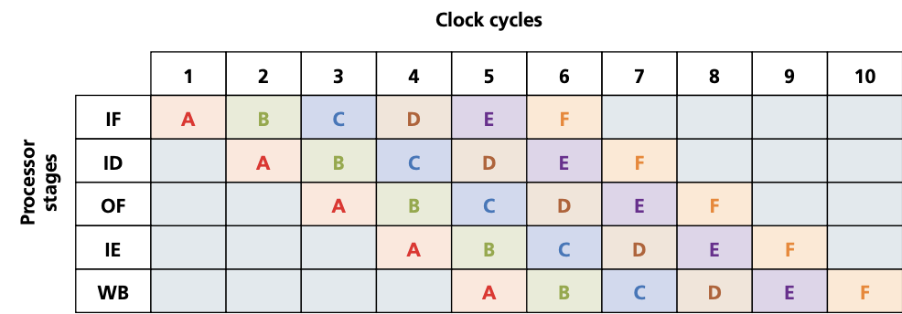
Pipelining
To understand how this works, we need to split up the execution of a given instruction into its five stages
Instruction fetch cycle (IF)
Instruction decode cycle (ID)
Operand fetch cycle (OF)
Instruction execution cycle (IE)
Writeback result process (WB)

Slide 11
Parallel processing

Slide 12
SISD (single instruction single data)
SISD uses a single processor that can handle a single instruction;
and which also uses one data source at a time.
Each task is processed in a sequential order.
Since there is a single processor, this architecture does not allow for parallel processing.

Slide 13
SISD – use cases
It is most commonly found in applications such as early personal computers.

Slide 14
SISD (single instruction single data)

Slide 15
SIMD (single instruction multiple data)
SIMD uses many processors.
Each processor executes the same instruction but uses different data inputs;
they are all doing the same calculations but on different data at the same time.
SIMD are often referred to as array processors.

Slide 16
SIMD – use cases
Any application where a large number of items need to be altered by the same amount;
since each processor is doing the same calculation on each data item.
They have a particular application in graphics cards.
For example, suppose the brightness of an image made up of 4000 pixels needs to be increased.
SIMD can work on many data items at the same time,
4000 small processors (one per pixel) can each alter the brightness of each pixel by the same amount at the same time.
This means the whole of the image will have its brightness increased consistently.
Other applications include sound sampling.

Slide 17
SISD (single instruction multiple data)

Slide 18
MISD (multiple instruction single data)
MISD uses several processors.
Each processor uses different instructions but uses the same shared data source.
MISD is not a commonly used architecture (MIMD tends to be used instead).
However, the American Space Shuttle flight control system did make use of MISD processors.

Slide 19
MISD (multiple instruction single data)

Slide 20
MIMD (multiple instruction multiple data)
MIMD uses multiple processors.
Each one can take its instructions independently, and each processor can use data from a separate data source
(the data source may be a single memory unit which has been suitably partitioned).

Slide 21
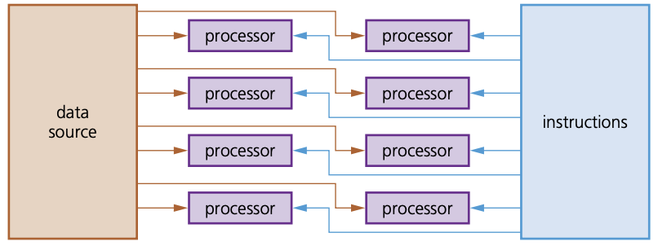
MIMD (multiple instruction multiple data)

Slide 22
MIMD use cases
The MIMD architecture is used in multicore systems;
by super computers,
In the architecture of multi-core chips.

Slide 23
Parallel processing - considersations
When carrying out parallel processing, processors need to be able to communicate.
The data which has been processed needs to be transferred from one processor to another (this is known as context switching).
When software is being designed, or programming languages are being chosen, they must be capable of processing data from multiple processors at the same time.
It is a much faster method for handling large volumes of independent data; any data which relies on the result of a previous operation (dependent data) would not be suitable in parallel processing.
Data used will go through the same processing, which requires this independence from other data.
Parallel processing overcomes the Von Neumann ‘bottleneck’ (in this type of architecture, data is constantly moving between memory and processor, leading to latency; as processor speeds have increased, the amount of time they remain idle has also increased since the processor’s performance is limited to the internal data transfer rate along the buses). Finding a way around this issue processor processor processor processor instructions data source processor processor processor processor processor processor processor processor instructions data source 352 15 Hardware 15 is one of the driving forces behind parallel computers in an effort to greatly improve processor performance. However, parallel processing requires more expensive hardware. When deciding whether or not to use this type of processor, it is important to take this factor into account.

Slide 24
Parallel processing – Von Neumann Bottleneck
Parallel processing overcomes the Von Neumann ‘bottleneck’;
in this type of architecture, data is constantly moving between memory and processor,
leading to latency; as processor speeds have increased,
the amount of time they remain idle has also increased since the processor’s performance is limited to the internal data transfer rate along the buses).
Finding a way around this issue is one of the driving forces behind parallel computers in an effort to greatly improve processor performance.
However, parallel processing requires more expensive hardware.
When deciding whether or not to use this type of processor, it is important to take this factor into account.

Slide 25
Parallel computer systems
SIMD and MIMD are the most commonly used processors in parallel processing.
A number of computers (containing SIMD processors) can be networked together to form a cluster.
The processor from each computer forms part of a larger pseudo-parallel system which can act like a supercomputer.
Some textbooks and websites also refer to this as grid computing.

Slide 26
Parallel computer systems
Massively parallel computers have evolved from the linking together of a number of computers, effectively forming one machine with several thousand processors.
This was driven by the need to solve increasingly complex problems in the world of science and mathematics.
By linking computers (processors) together in this way, it massively increases the processing power of the ‘single machine’.
This is subtly different to cluster computers where each computer (processor) remains largely independent.
In massively parallel computers, each processor will carry out part of the processing and communication between computers is achieved via interconnected data pathways.

Slide 27
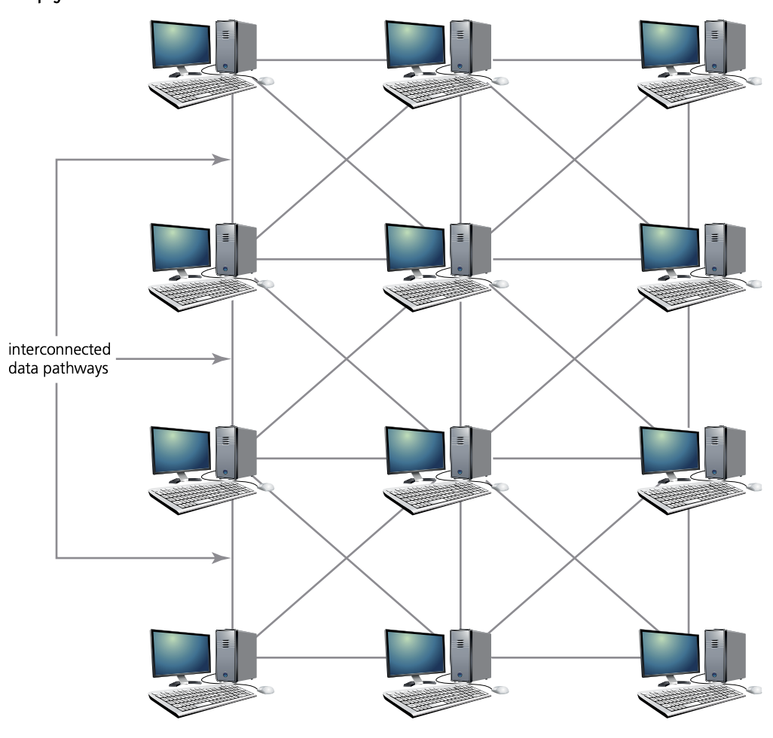
Typical massively parallel computer (processor) system showing interconnected pathways

