Slide 1
AQA
AS Level
Computer Science
Finite state machines
Unit 2
Problem solving and theory of computation

Slide 2
Objectives
Understand what is meant by a finite state machine
List some of the uses of a finite state machine
Draw and interpret simple state transition diagrams for finite state machines with no output
Draw a state transition table for a finite state machine with no output and vice versa

Slide 3
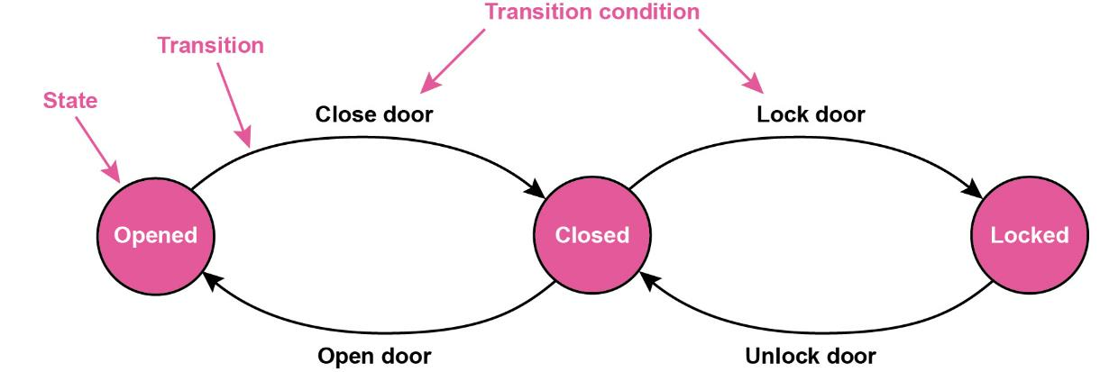
What is a finite state machine?
It is not a “machine” in the sense of some physical, mechanical thing with moving parts
It is an abstract representation of how something changes from one state to another in response to a condition or event

Slide 4
In a finite state machine (FSM):
The machine can only be in one state at a time
It can change from one state to another in response to an event or condition; this is called a transition
The FSM is defined by a list of its states and the conditions for each transition
There can be outputs linked to the FSM’s state, but we will be considering only FSMs with no output

Slide 5
Example: a turnstile
A turnstile is used to control access to a railway platform
It can be in one of two states: locked or unlocked
Inserting a ticket unlocks the turnstile, allowing a single customer to pass through
The arms are locked again until another coin is inserted

Slide 6
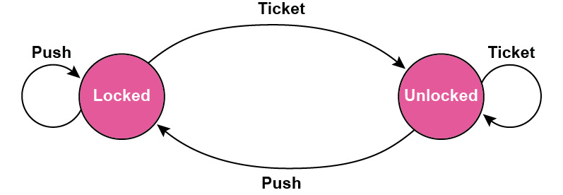
FSM representing a turnstile
Pushing the arm when the turnstile is in the locked state has no effect
Putting another ticket in when in the unlocked state also has no effect

Slide 7
Is the ticket valid?
Suppose the turnstile will not accept any ticket – it has to be a valid one for the journey
Can you draw a new state transition diagram with two extra inputs: valid ticket and invalid ticket?
There will be a third state – ticket inserted

Slide 8
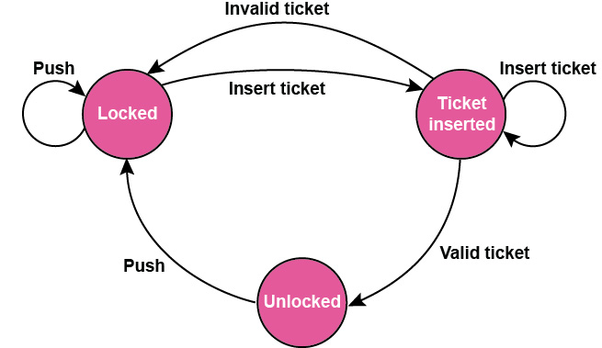
Answer:

Slide 9
Applications of FSMs
Robotics
Video games industry
Design of digital hardware systems
Design of compilers and network protocols
Definition of languages, and to decide whether a particular word is allowed in a language

Slide 10
Finite state automaton
A FSM which has no output is known as a finite state automaton
It has a start state and a set of end or accept states
If the automaton can reach a final state, it is said to accept the input
Starting in an initial state, the automaton processes a sequence of symbols and follows it to the target state
The symbols depend on the application – they usually represent events

Slide 11
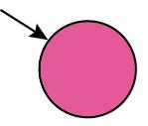
Notation
Symbol | Meaning
 | State
 | Start state
 | End state or accept state
 | Transition

Slide 12
Recognising a language
A finite state system accepts a string
c₁c₂c₃….c_{n}
if there is a path from the start state to the end or accept state labelled by the symbols c_{1,} …., c_{n}
The language recognised by the FSM consists of all strings accepted by it.

Slide 13
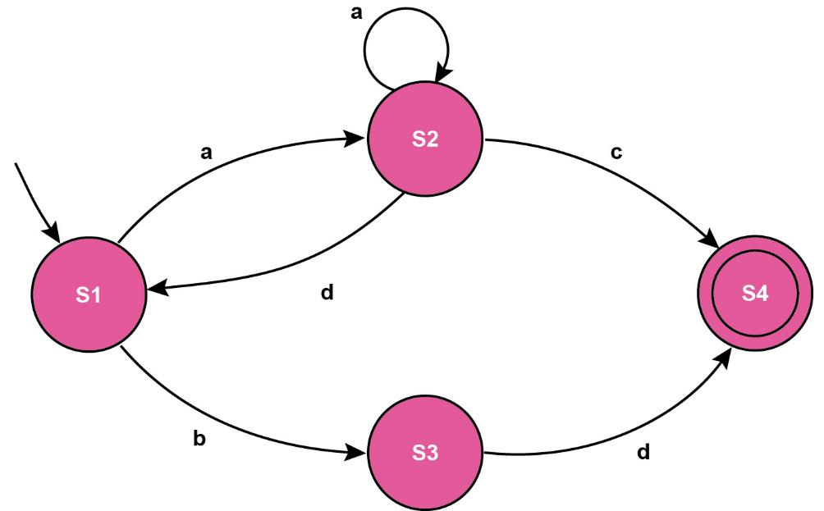
Which of the following strings will be accepted by this finite state automaton?
aaac badc adadbd ac bdaac bd

Slide 14
Worksheet 6
Now try the questions in Task 1 of Worksheet 6

Slide 15
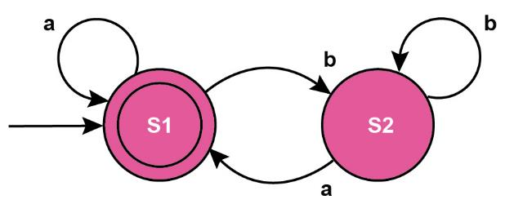
State transition tables
An alternative representation of a FSM is a State Transition Table
The FSM below accepts two inputs a and b
The transition table shows what the next state is for any input. What strings does it accept?
Current state | Next state
 | Input = a | Input = b
S1 | S1 | S2
S2 | S1 | S2

Slide 16
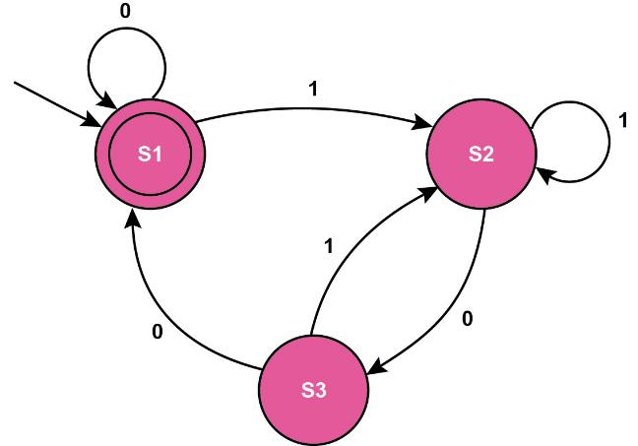
Example
Complete the transition table for the FSM shown
Which of the following strings are accepted?
00100 100 0101 010000
Current state | Next state
 | Input = 0 | Input = 1
S1 | S1 | S2
S2
S3

Slide 17
Worksheet 6
Now try the questions in Task 2

