Slide 1
Data Structures – 1D Lists
Programming Guides

Slide 2
Data Structures – 1D Lists
Programming languages don’t just provide the ability to store single pieces of data in variables …
… they also provide another kind of data type which can hold a number of data items
This type of data structure is known as a LIST

Slide 3
Data Structures – 1D Lists
Lists can be thought of as a table of data:
In Python you could create the above list using the following code:
Index | 0 | 1 | 2 | 3 | 4
List Item | “Train” | “Car” | “Foot” | “Bus” | “Taxi”

Slide 4
Data Structures – 1D Lists
Programmers count from ZERO!
The first item in a list is therefore at position ‘0’.
Don’t forget this!!!

Slide 5
Data Structures – 1D Lists
Notice that we assign the data to the variable in the usual way (‘=’ sign).
But for a list we also use square brackets [ ] and commas to separate our data items.

Slide 6
Data Structures – 1D Lists
Once we have created our list there are lots of things we can do with them.
We can:
Print lists
Reverse the order of the list
Sort the list into alphabetical order or numerical order (if the data is number)
Append the list (add items on to the end)
Remove items from the list
Find the position of certain items on our list
Count how many times a particular item appears in the list
Insert items into a particular position of the list
“Pop” an item out of the list.

Slide 7
Data Structures – 1D Lists
Printing the contents of a list:

Slide 8
Data Structures – 1D Lists
Reversing the contents of a list:

Slide 9
Data Structures – 1D Lists
Sorting the contents of a list:

Slide 10
Data Structures – 1D Lists
Appending to the contents of a list (adding items onto the end of a list):

Slide 11
Data Structures – 1D Lists
Removing an item from a list:

Slide 12
Data Structures – 1D Lists
Locating the index (position) of an item in a list:

Slide 13
Data Structures – 1D Lists
Counting specific items in a list:

Slide 14
Data Structures – 1D Lists
Inserting an item into a list at a particular location (index):

Slide 15
Data Structures – 1D Lists
Popping items out of a list:

Slide 16
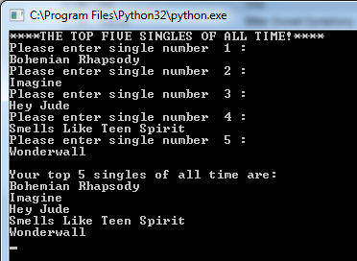
Data Structures – 1D Lists
Often, a program will use a list to record user inputs.
In Python we need to create an empty list and then use the append function to add new items into the list. We could do this in a loop to be more efficient.

