Slide 1
Lesson 6: Project completion
Year 8 – Programming – Mobile app development
Notes:
Last updated: 11-05-2021
Resources are updated regularly — the latest version is available at: ncce.io/tcc.
This resource is licensed under the Open Government Licence, version 3. For more information on this licence, see ncce.io/ogl.

Slide 2
Lesson 6: Project completion
Objectives
In this lesson, you will
Use a block-based programming language to include sequencing and selection
Use user input in a block-based programming language
Use variables in a block-based programming language
Evaluate your the success of your project

Slide 3
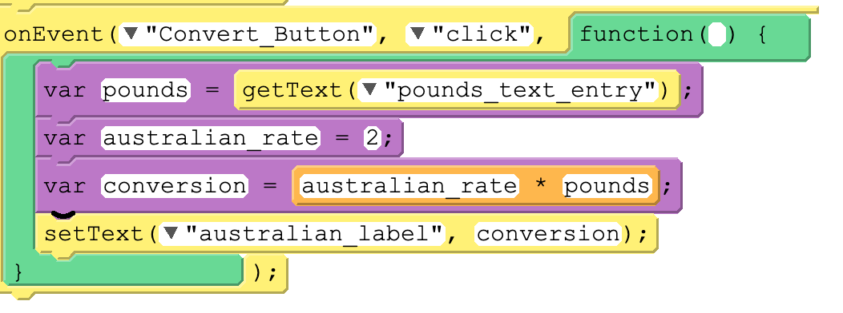
Debug the code
Starter activity
The following code, which is meant to convert currency between British pounds and Australian dollars, is not displaying any value in ‘australian_label’.
Which of the following blocks of code would be most appropriate to help you debug the problem?
1
2
3
4

Slide 4
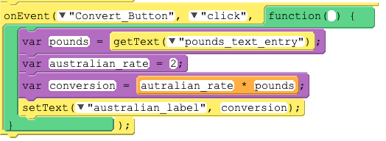
Debug the code
Starter activity
Q1. Where would you place this line of code?
Q2. What would it help you to determine?
2
Notes:
The most appropriate line of code to use would be “console.log(conversion)” as a starting point. Ask the learners what console.log does? It would print to the console the value being held by the conversion variable.
Ask the learners where would be the most appropriate place to put this line of code?
The problem might not be solved by doing this, but it should help determine whether or not the correction conversion has taken place.

Slide 5
Think big! What’s your plan?
Activity 1
Step 1 .
Get into your pairs from last week and open:
Your project on code.org
Your Project Diary at the Milestone 1 slide
Step 2 .
In your pairs, read what you achieved last lesson and what you said you could achieve this lesson
Discuss with your partner your plan of action for how to complete the project in this lesson
Notes:
Image source: https://pixabay.com/photos/office-business-colleagues-meeting-1209640/

Slide 6
App development
Activity 2
How to be successful with pair programming
Teamwork
Driver: focus on the code and workspace
Navigator: watch the code being entered by the driver, look at previous work and examples, and research the problem
Work through your decomposed steps
Keep an eye on the success criteria .

Slide 7
Evaluate
Activity 3
Verb [T]
“To judge or calculate the quality, importance, amount, or value of something”
https://dictionary.cambridge.org/
How can you calculate the quality of your project?
How can you judge the quality of your project?

Slide 8
Success criteria and project evaluation
Activity 3
Tasks: .
Navigate to the Success criteria slide of your Project Diary.
In your pairs, go through each of your success criteria and indicate whether or not you have met each one.
Navigate to the Evaluate slide and answer the questions.

Slide 9
Summative assessment
Activity 4
You will now complete a summative assessment based on what you have learnt about event-driven programming in this unit.

