Slide 1
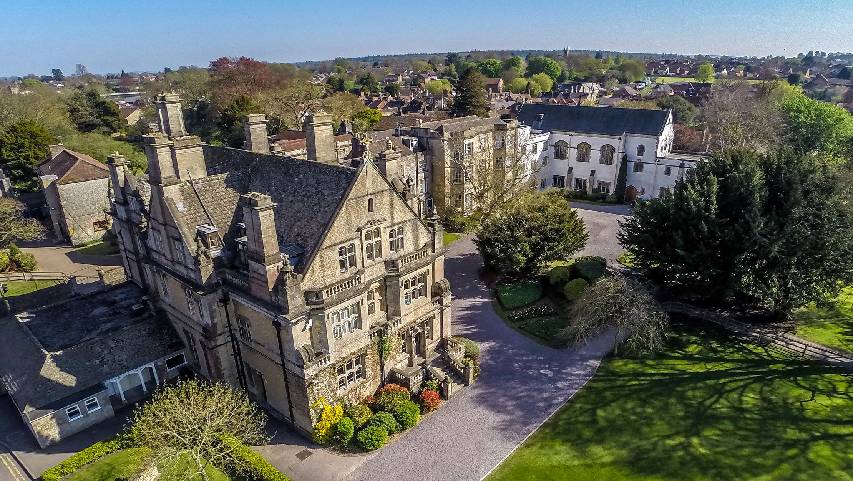

Slide 2
headmaster
Mr Matt Williams

Slide 3
Our Vision
To develop and nurture rounded individuals with a love of learning and strong moral values, within a supportive and inspiring community.

Slide 4
Deputy head (academic)
Mr Mark Sully

Slide 5
Friday 23rd January 2027
University Interview
Why do you want to study this course?
What do you enjoy most about the subject?
Tell me about your work experience?
Why are manhole covers round?

Slide 6
GCSEs
In short, GCSE grades will shape the next few steps, post-Year 11.
They act as entry requirements to the Sixth Form.
They are a good indicator of possible Post-16 success. For example, five Grade 6 (Formerly B grades) and five Grade 5 (Formerly high C grades) at GCSE roughly translates to a predicted CCD at A Level or 26 points in the IB Diploma.
GCSEs determine the qualifications a pupil will take next.

Slide 7
GCSEs and University
The large majority of universities look for at least a Grade 4 in GCSE English, Maths and sometimes a Science. Under the current system there are two levels of “pass”:
A Grade 4 is deemed a ‘Standard Pass’
A Grade 5 a ‘Good Pass’.

Slide 8
GCSEs and University
Conditional offer examples
Management at University of Leeds requires a Grade 6 in English Language and Maths.
Psychology at the University of Bristol requires Maths, English and Science at Grade 6, but Grade 7 is preferred.

Slide 9
GCSEs and University
Universities use GCSE grades more than ever before when deciding whether to accept a pupil or not.
The more competitive the university and course, the higher the number of high-achieving pupils with top GCSE marks applying. Some courses actively state this in the prospectus.

Slide 10
The Future
Infosys predicts that by 2030, automation is likely to displace:
86% of jobs in accommodation and food services
75% of jobs in transportation and warehousing
67% of jobs in real estate and rental and leasing.

Slide 11
Skills
The World Economic Forum believe the top 10 skills of 2025 to be:
Analytical thinking and innovation
Active Learning and learning strategies
Complex problem-solving
Critical thinking and analysis
Creativity, originality and initiative
Leadership and social influence
Technology use, monitoring and control
Technology design and programming
Resilience, stress tolerance and flexibility
Reasoning, problem-solving and ideation

Slide 13
Higher Education/
Employment
A Level/IB
GCSEs
Foundation, KS1, KS2, KS3

Slide 14
A Warminster Sixth Form
A Levels
International Baccalaureate (IB) Diploma Programme
International Baccalaureate (IB) Career-Related Programme
Or …
a bit of everything!

Slide 15
A Levels
Considerable reform to assessment structure began in September 2015.
There have been some changes in content.
All subjects have now been reformed.
All assessment is now at the end of the two year programme taken in the form of two or three examinations.

Slide 16
A Levels
Available subjects:
Art Biology Business
Chemistry Computer Sci. DT
Drama English Lit. French
Further Maths Geography History
Maths Music Music Tech.
Photography Physics Politics
Psychology RS Spanish

Slide 17
Cambridge Technicals
Available subjects:
Business Engineering Sport
OCR Cambridge Technicals are equivalent to an A Level
They have a higher proportion of coursework
There are small formal exams with each
Sport can be taken as a single A Level equivalent or a double equivalence

Slide 18
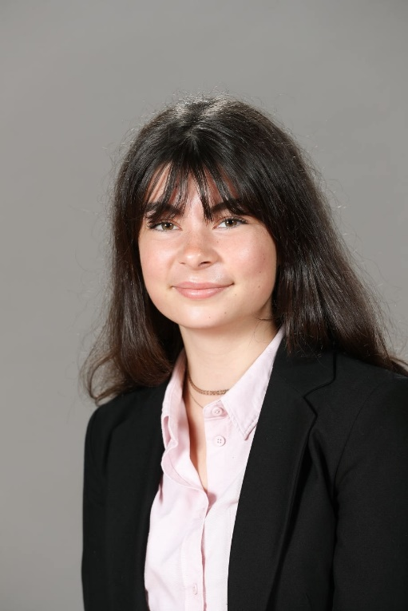
Pupil Profile
Head Girl in 2020-21
Studied A Levels:
French – A*
Spanish – A*
Art – A*
Gained an A* in her EPQ
Studying Art History and Languages at Exeter University

Slide 19
Pupil Profile
Joined the School in 2018
Studied A Levels & Cambridge Technical
RS - B
Business – Distinction*
Sport – Distinction
144 UCAS points (AAA equivalent)
Took a GAP year and will begin a degree in
Philosophy, Politics and Economics at Leeds University in September

Slide 20
IB Diploma (IBDP)
Emphasis on breadth
Six subjects chosen from a minimum of five curriculum groups.
Three taken to Higher Level, three to Standard Level.
Additional extended personal research, reflective study and co-curricular involvement.

Slide 21
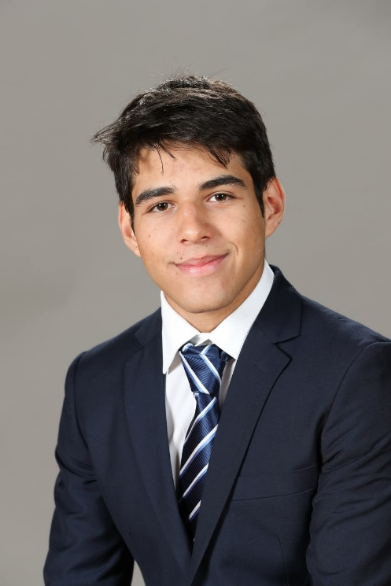
Pupil Profile
Joined the School for AGP in Year 11
Studied IB:
Chemistry
Economics
English A Literature
Spanish B
Maths
Physics
Gained 44 IB points (Max. 45)
Studying Computer Science at Edinburgh University

Slide 22
IB Career-Related Programme (IBCP)
Consists of:
At least two IB Diploma subjects (Either HL or SL)
A vocational (Cambridge Technical) course
A core programme consisting of Personal and Professional Skills, Service Learning, The Reflective Project and Language Development.
The vocational courses on offer will be:
Business, Engineering, Sport and Physical Activity
All of which will follow the OCR Cambridge Technical Diploma specifications.
The IBCP is a fantastic programme which will lead to further/higher education, apprenticeships or employment.

Slide 23
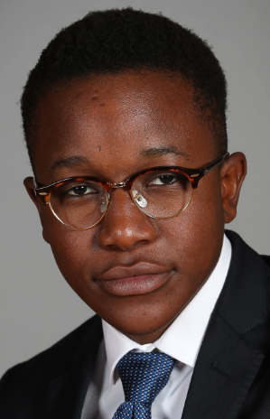
Pupil Profile
Joined the School in 2013 in Year 7
Studyied the IBCP:
CamTech Business – Distinction*
IB Art – Level 5
IB Economics – Level 5
128 UCAS points (Equivalent to AAB)
Head of Denys Boarding House.
Graduated from University of East Anglia having read Business Management with a Year Abroad.

Slide 24
Blended Programme
Pick the bits of each pathway that is most attractive to you.
Within reason most combinations can be accommodated.
Allows pupils to build a programme that matches their needs and ambitions

Slide 25
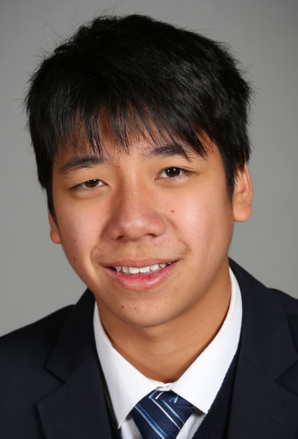
Pupil Profile
Joined the School in 2016 in Year 11
Studied a blended programme (U6):
CamTech Business – Pass
IB Maths Studies – Level 5
A Level Photography – C
UCAS points equivalent of CCC
Graduated from the University of East Anglia having read Accounting and Finance

Slide 26
Director of sixth form and pathways
Mrs Gill Walmsley

Slide 27
Sixth Form Support and Guidance
Helping pupils to decide what subjects they want to take, both to help them succeed in the Sixth Form and to succeed when they leave school.
Dedicated independent study time built in to all academic programmes.
Independent Learning Conference, research seminar training and study advice to help pupils determine how they learn best.
Dedicated study space exclusively for Sixth Form use.
Academic and holistic support for pupils who require.

Slide 28
Preparing for life after school
Preparation for university – in the UK and abroad
Specific preparation for competitive courses, including Oxbridge, Medicine and Engineering
Guidance on Apprenticeships and Employment opportunities
Careers mentoring workshops
Advice and support for structured Gap years
Opportunities for overseas volunteering

Slide 29
Study Skills
Ongoing ‘study skills’ sessions for all Lower Sixth pupils.
At the beginning of their studies, it provides pupils with understanding of:
Research skills
Academic referencing
Critical reading and writing skills
All sessions are delivered on a weekly basis by our dedicated School Librarian and will support all Post-16 courses, but also great preparation for university.

Slide 30
Head girl and head boy 2024-25
Niamh Crinion and Barnaby Craven-Smith

Slide 31
How many piano tuners in Chicago?

