Slide 1
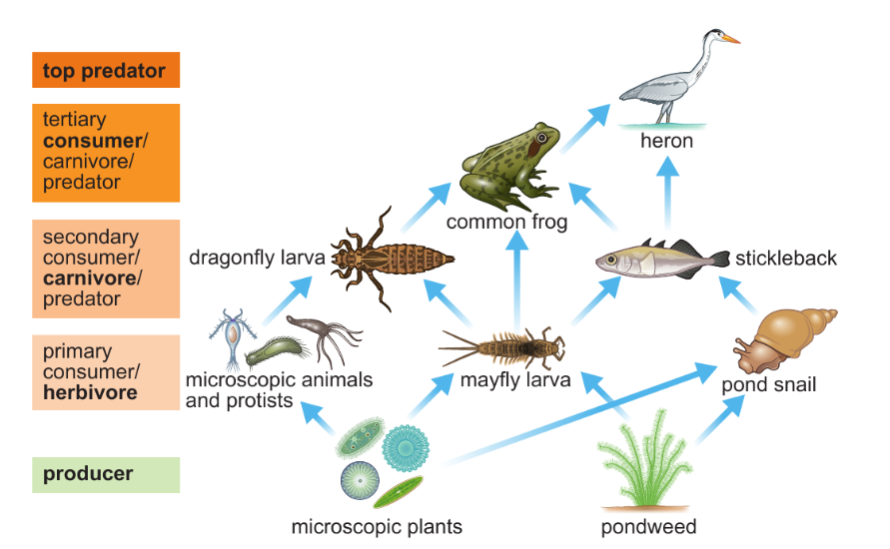
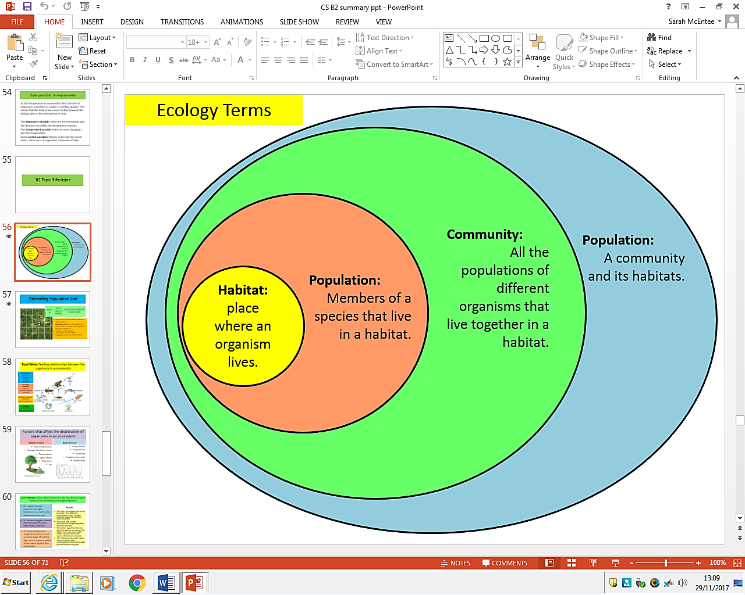
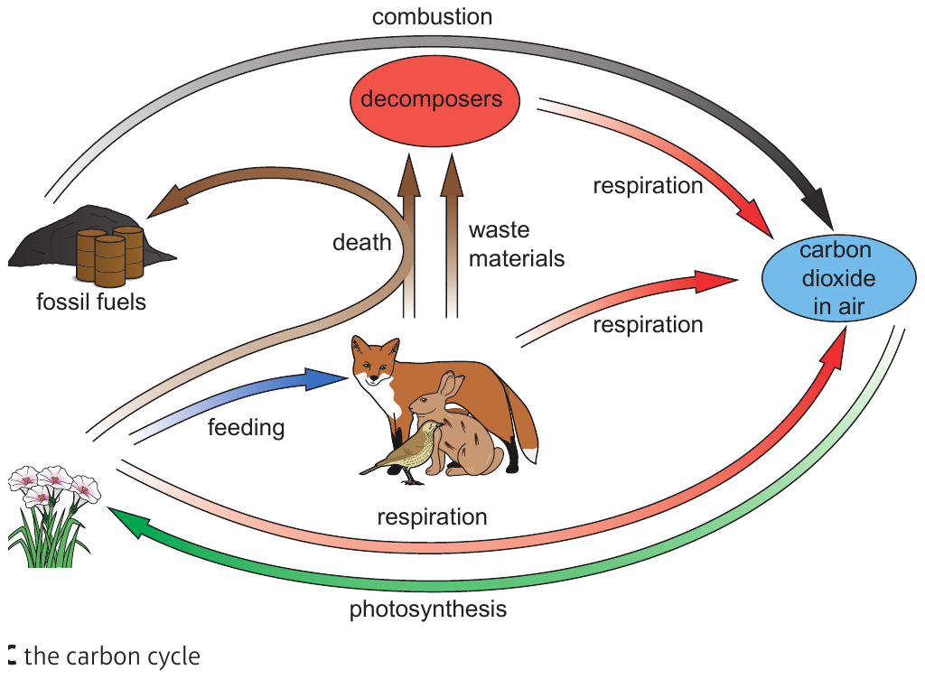
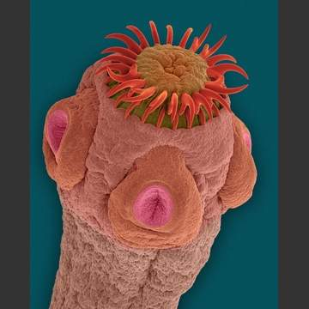
Biology Topic 9 Summary Sheet
CB9b - Factors that affect the distribution of organisms in an ecosystem
CB9a - Food Webs: Feeding relationships between the organisms in a community
TOP PREDATOR-
Carnivore: consumes secondary consumer
Abiotic | Biotic
Non-living factors Drought/Moisture levels Temperature Light/ Shade Pollutants pH | Living factors Competition Predation Predator-prey cycle Biodiversity
SECONDARY CONSUMER- carnivore: consumes primary consumer
PRIMARY CONSUMER- herbivore: consumes producer
PRODUCER- photosynthetic plants or organisms
CB9e/f - Biodiversity
Eutrophication - Farmers over-use fertiliser which runs into rivers. Causes more algae growth, which leads to less light reaching the bottom of the river. Plants die and bacteria feed on the decaying plants. The bacteria multiply and use lots of oxygen. Fish and invertebrates die due to lack of oxygen
BIODIVERSITY
Reforestation Conservation Breeding in captivity BENEFITS OF PRESERVING BIODIVERSITY: Can create more food, medicine and recovery from natural disasters.
BB9d - Parasitism and Mutualism
Mutualist
Two organisms live together
and both benefit.
E.g. Sea anemone sting
predators, protecting
clownfish while obtaining
nutrients from their faeces.
Parasite
Two organisms live together with one feeding off the other.
E.g. Tapeworms living
inside the host’s intestines,
or head-lice living on
hair and skin.
CB9g – The Water Cycle
CB9i – The Nitrogen Cycle
CB9h – The Carbon Cycle

Slide 2
Core practical : Using a belt transect to study the effect of abiotic factors on the abundance of low growing plants
Biology Topic 9 Summary Sheet
METHOD
Measure out a 20m transect line on the ground, starting where there is no shade to where there is heavy shade.
Make measurements at regular intervals along the transect line.
Place the top-left hand corner of the quadrat at each interval.
Measure abiotic factors and record them.
Record abundance of selected plants in quadrat.
Repeat steps 3-5 at each measurement point along the transect.
FINDINGS
The closer the quadrat was to the tree base, the colder the temperature/ lower the light intensity/ lower the moisture levels recorded.
There was also a lower abundance of low growing plants near the tree base.
The further away from the tree base the quadrat was placed, the higher the temperature/ light levels/ moisture levels and species distribution recorded.
This is because more light/more moisture means more photosynthesis which will provide glucose for plants to grow.
Equipment Used:
Control variable – time of day, length of transect
Independent variable – distance along the transect that
measurements were taken at.
Dependent variable – abiotic factors; moisture, pH, light,
temperature, distribution of species.

