Slide 1
Real or Not?
You will be shown 10 different jobs- you need to decide whether the job shown is a real one or not.
Please rate and review on TES.com

Slide 2
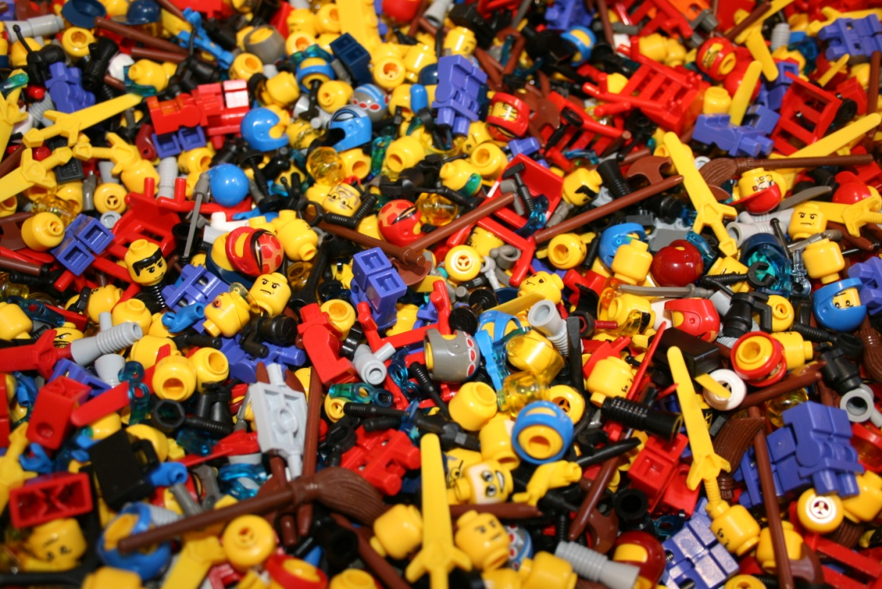
Lego Sculptor
Real?
Not Real?

Slide 3
Lego Sculptor
Real!
There aren’t many of them around- but their job is create Lego sets and build models.

Slide 4
UK Bounty Hunter
Real?
Not Real?

Slide 5
UK Bounty Hunter
Dog the Bounty Hunter was popular in the USA. But due to a difference in law, you can’t legally be a bounty hunter in the UK.
Not Real!

Slide 6
Pet Food Taster
Real?
Not Real?

Slide 7
Pet Food Taster
Real!
That’s right, the pet food is tasted by people.

Slide 8
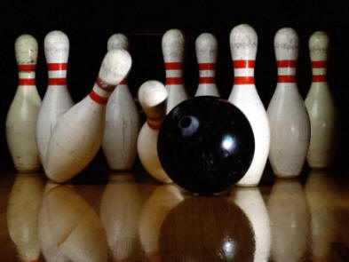
Pin-Setter for Bowling
Real?
Not Real?

Slide 9
Pin-Setter for Bowling
It use to be a real job, but now it’s all done by machines.
Not Real!

Slide 10
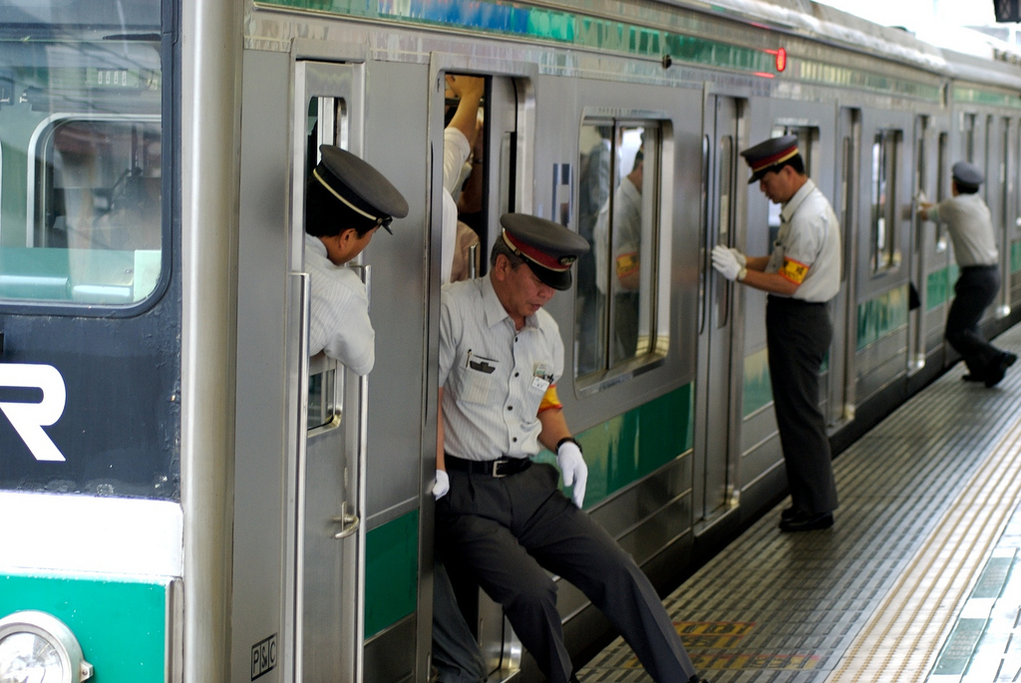
Train Pusher
Real?
Not Real?

Slide 11
Train Pusher
Their job is to push everyone onto a train and get the door closed, you can only do it in Japan though.
Real!

Slide 12
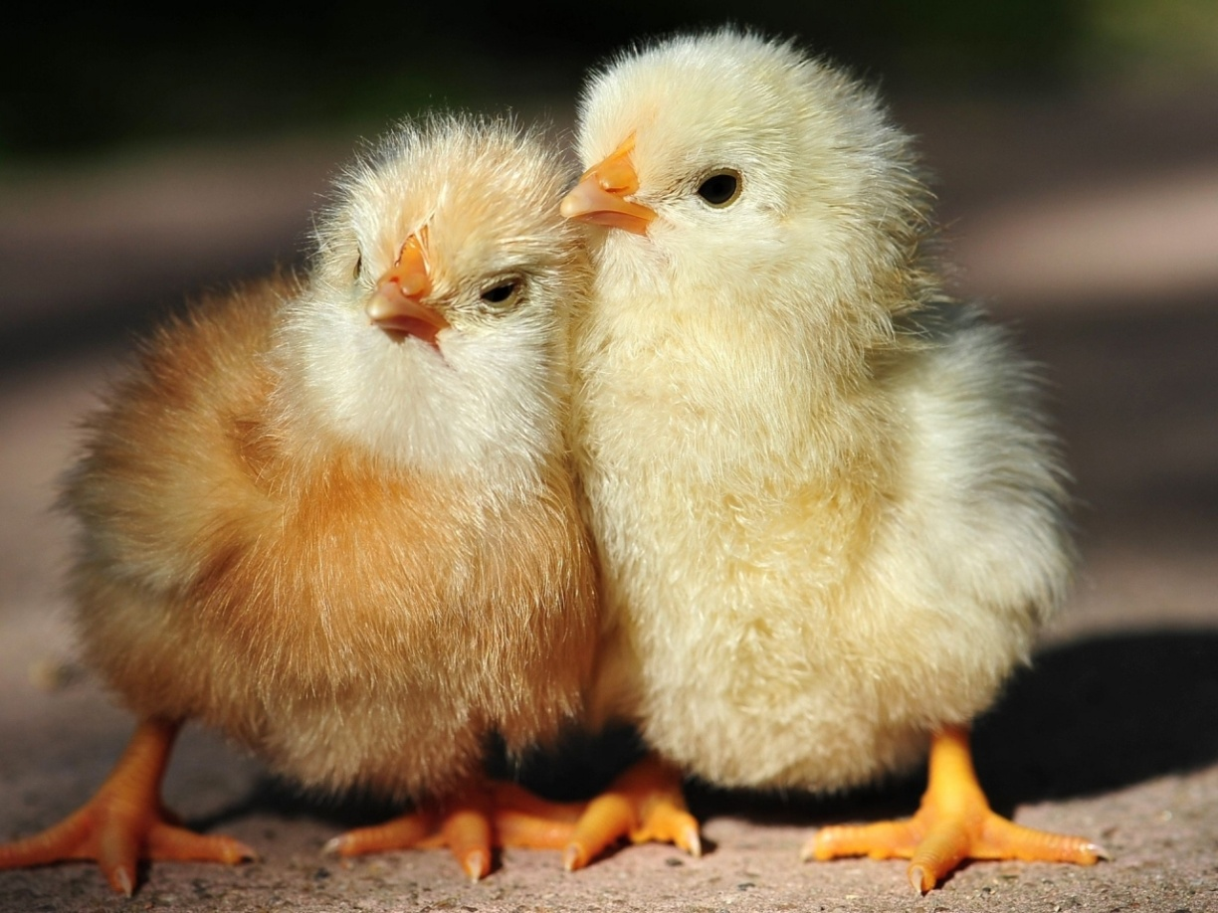
Chicken Sexer
Real?
Not Real?

Slide 13
Chicken Sexer
When the chicks are born it’s someone’s job to identify whether it’s male or female.
Real!

Slide 14
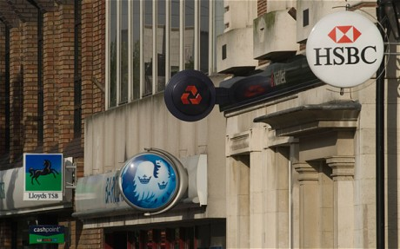
Fake Bank Robber
Real?
Not Real?

Slide 15
Fake Bank Robber
Banks employ people to test them and try to steal money. Most of the work is done electronically.
Real!

Slide 16
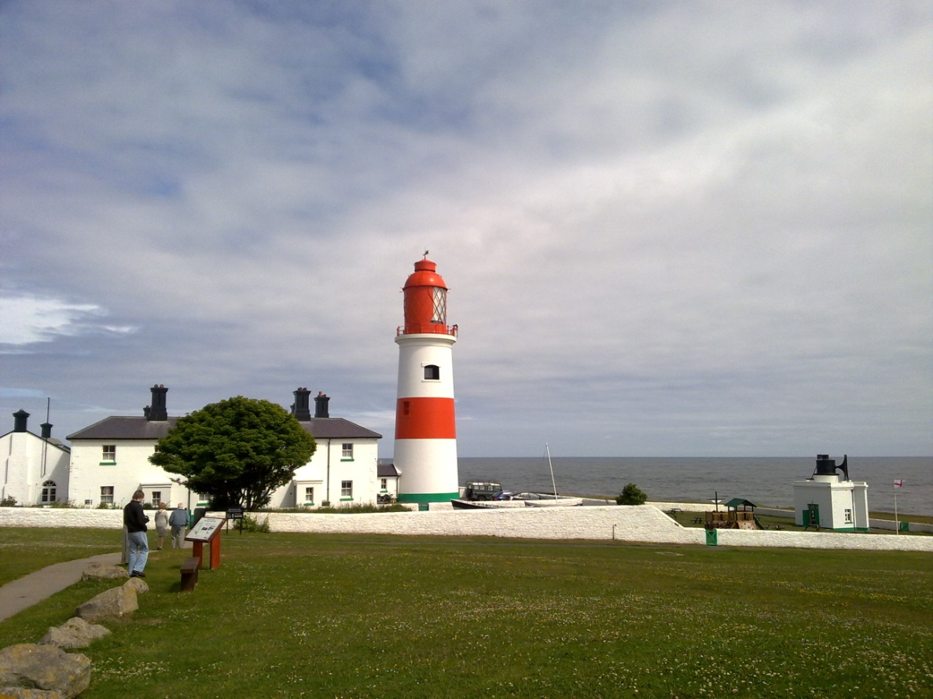
Lighthouse Keeper
Real?
Not Real?

Slide 17
Lighthouse Keeper
It once was a real job, but lighthouses are no longer manned.
Not Real!

Slide 18
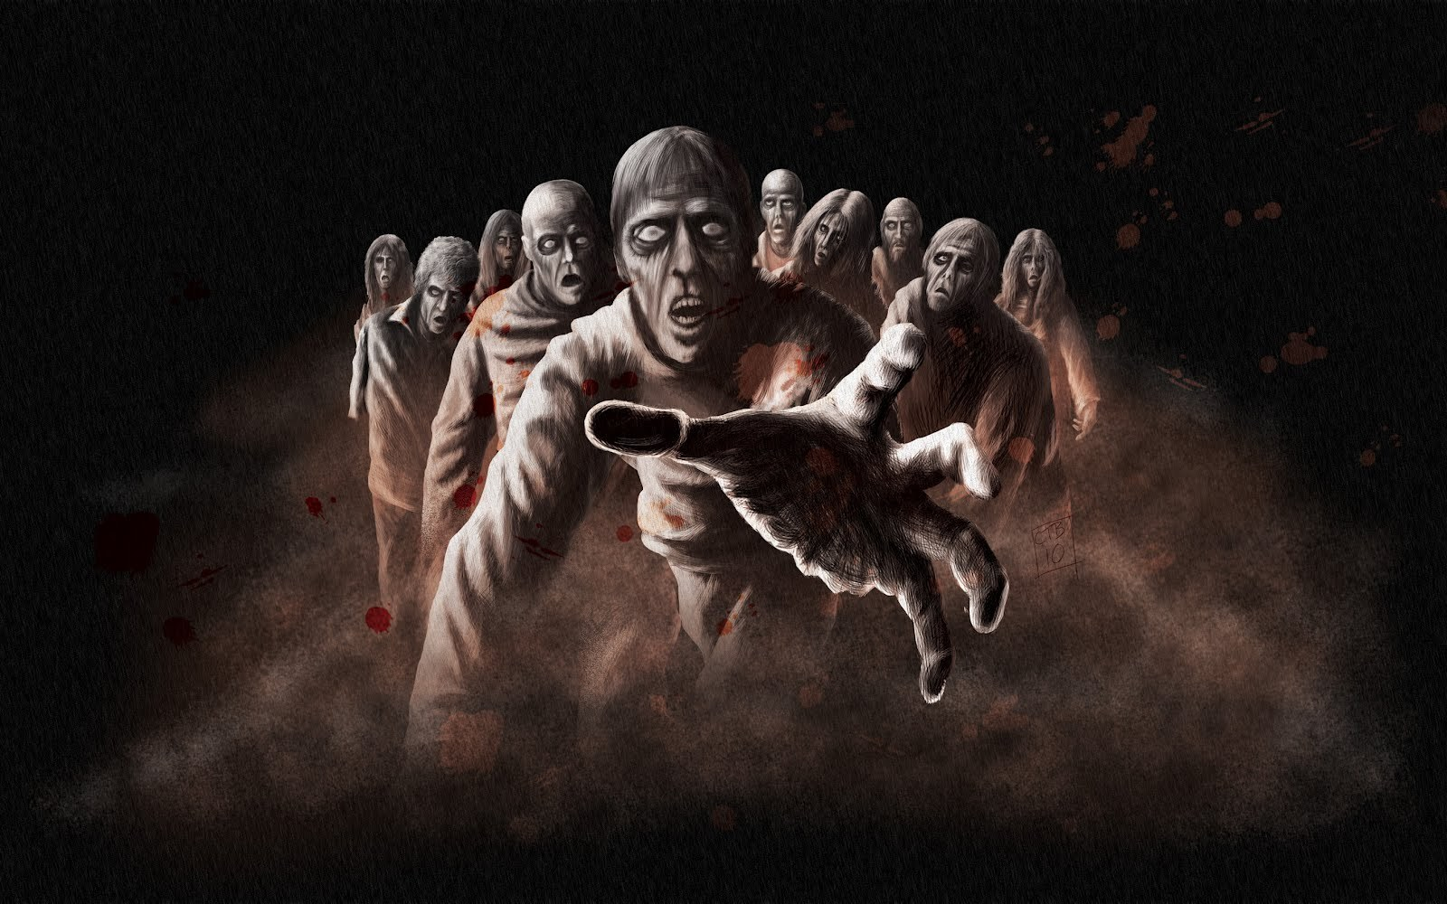
Professional Zombie
Real?
Not Real?

Slide 19
Professional Zombie
It’s really a job as an entertainer and they tend to work in dungeon attractions.
Real!

Slide 20
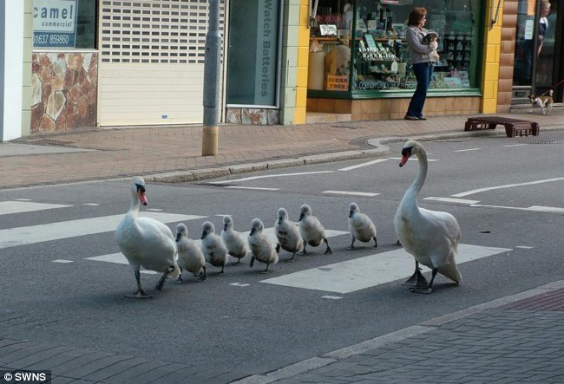
Swan Warden
Real?
Not Real?

Slide 21
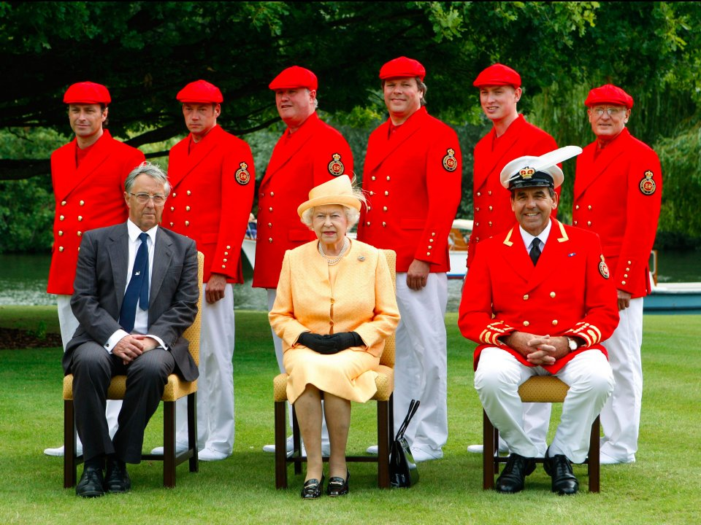
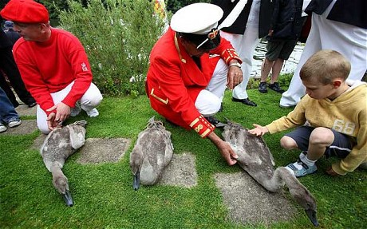
Swan Warden
Real!
They work for the Queen to protect the swan population.

Slide 22
Real or Not?
Hope you enjoyed the presentation!
Please rate and review on TES.com

