Slide 1
Introduction to Word
ICT
MR THORNE
Reports!

Slide 2
STARTER
In pairs, think about what we might use Word (or word processing) for?

Slide 3
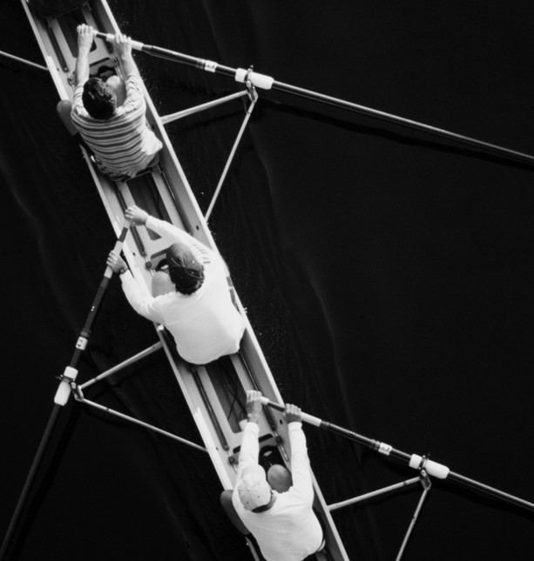
What we will Cover
Basic Formatting
Title Pages
Content Pages
Indexes
Pictures
Word Wrapping

Slide 4
New page in WorkBooks
WORD TIPS 02/11/2023

Slide 5
Follow Along!
Basic Formatting of Text
Adding a Blank page
Adding a Text Box – Title Page
Wordwrapping
Page Numbers
Headers and Footers
Heading Styles
Contents Page
Inserting Images

Slide 6
THINK OF a topic for your rEport
IDEAS!
The war in Ukraine (and why it started)
The origins of Halloween
The origins of Fireworks night
The rise of Hollywood movies from the start of the 20th century
What makes a great football team?

