Slide 2
Objectives
Understand issues that make facial recognition difficult
Understand how images are stored as binary data
Describe a technique for detecting patterns in a grid of pixels
Review program code and adapt it to detect given shapes

Slide 3
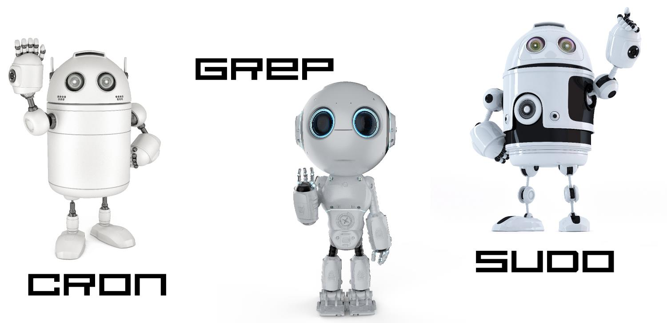
Starter
Are Cron, Grep and Sudo the same robots?
How can you tell?

Slide 4
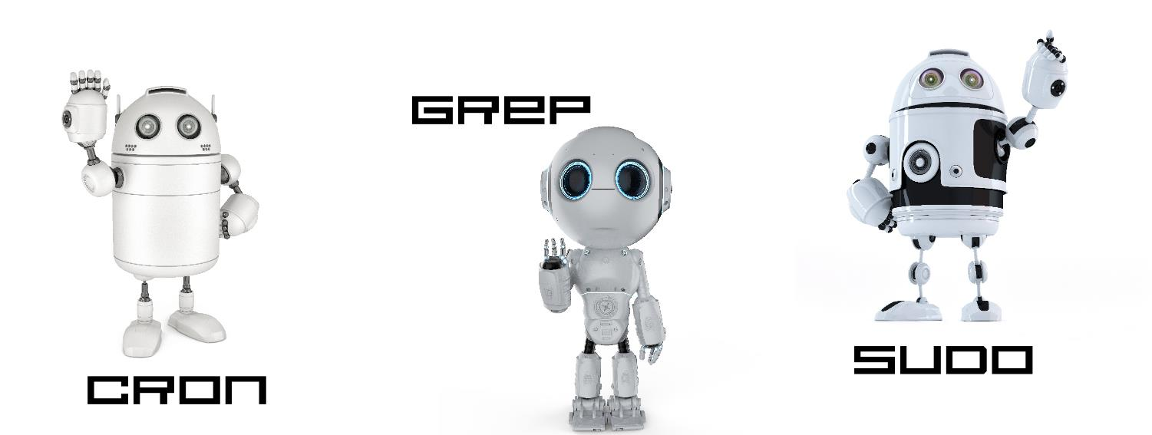
Starter
Cron and Sudo have similar eyes and shape, but cron has two antennae. Cron also has some air vents under the eyes
Grep has larger eyes with an outer halo. It also has a circular head and thinner body
Grep is likely to be a different robot. Cron is likely to be different to Sudo, but Sudo could be in disguise

Slide 5
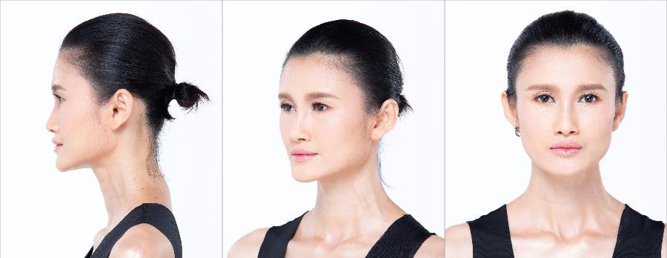
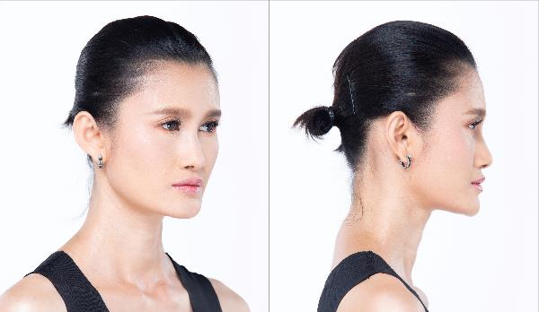
Facial recognition problems
Facial recognition can work by calculating the distances between points on a face
However, this has a problem if the face is not looking directly at the camera
If the head rotates, the distances of all the points will change too
What else could cause a problem for facial recognition?

Slide 6
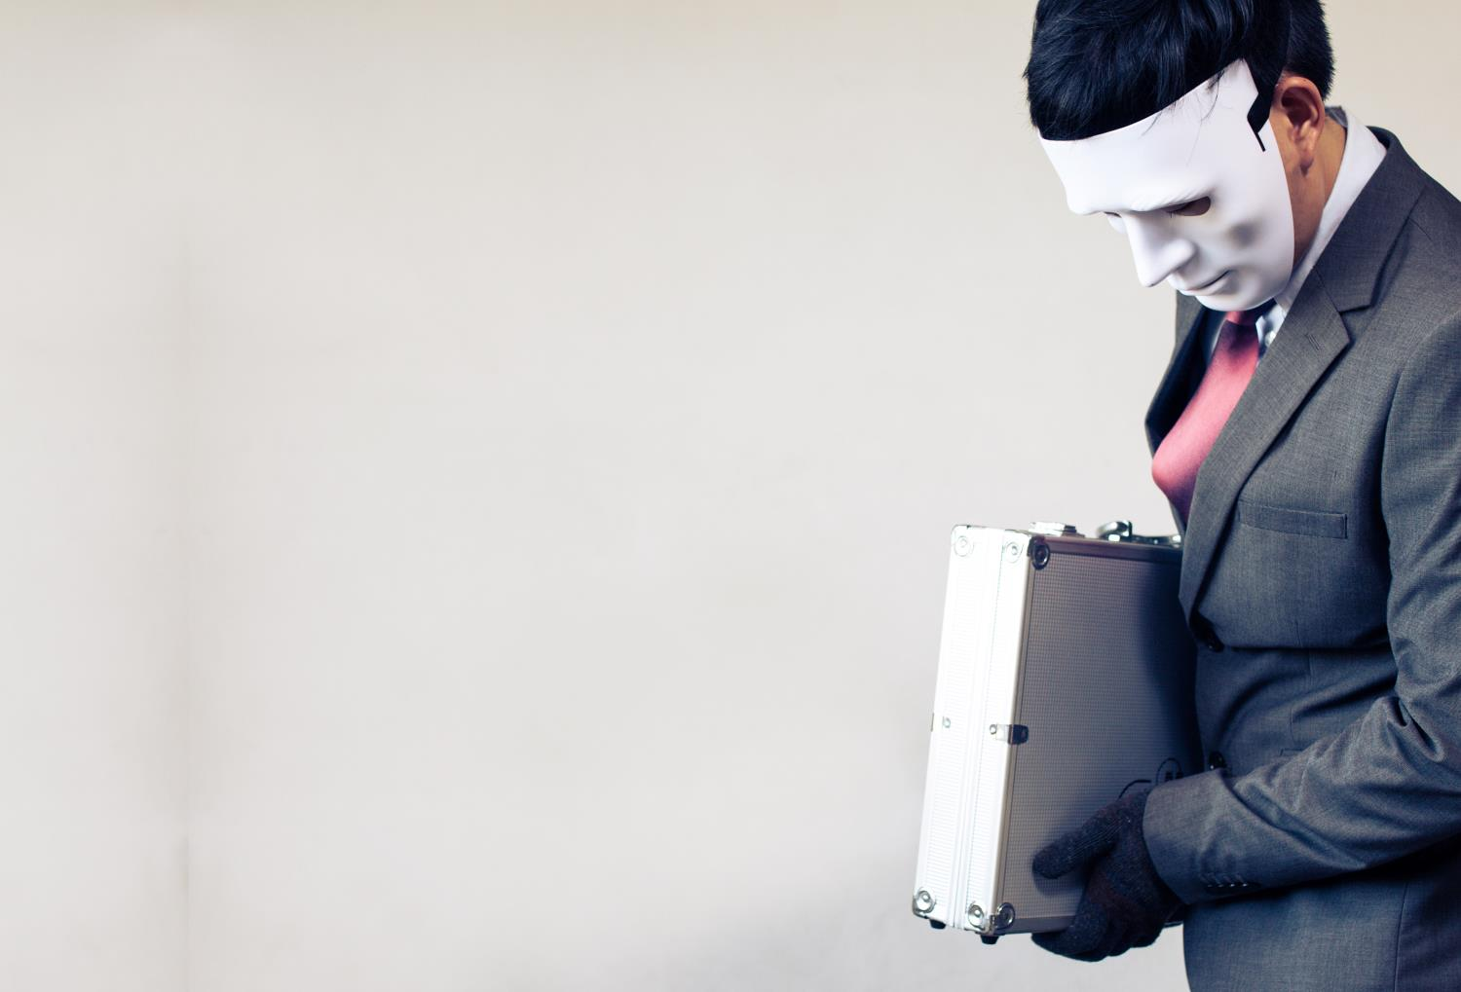
Objects and disguises
Faces can be hidden by:
Objects in front of the face, such as a lamp
A hand or arm
Another person, animal or vehicle
A mask
People can also make themselves look different with:
Makeup
A fake moustache or beard
A wig or haircut

Slide 7
How are images built?
Before analysing an image we need to consider how a computer represents an image
The image is divided up into squares called pixels
Each pixel is given a number in binary
For the image shown, 1 represents white and 0 represents black
What binary data would represent the image?

Slide 8
How are images built?
For the image shown, 1 represents white and 0 represents black
What binary data would represent the image? 1111011101111 1111101011111 1011000001101 1010010100101 1000000000001 1100101010011 1111011101111
How could you represent more colours than just black and white?
1 | 1 | 1 | 1 | 0 | 1 | 1 | 1 | 0 | 1 | 1 | 1 | 1
1 | 1 | 1 | 1 | 1 | 0 | 1 | 0 | 1 | 1 | 1 | 1 | 1
1 | 0 | 1 | 1 | 0 | 0 | 0 | 0 | 0 | 1 | 1 | 0 | 1
1 | 0 | 1 | 0 | 0 | 1 | 0 | 1 | 0 | 0 | 1 | 0 | 1
1 | 0 | 0 | 0 | 0 | 0 | 0 | 0 | 0 | 0 | 0 | 0 | 1
1 | 1 | 0 | 0 | 1 | 0 | 1 | 0 | 1 | 0 | 0 | 1 | 1
1 | 1 | 1 | 1 | 0 | 1 | 1 | 1 | 0 | 1 | 1 | 1 | 1

Slide 9
Colour resolution
2 bits (binary digits) allow you to store four different colours
This could be variations of grey or different colours
The number of options is calculated by: 2 * 2 = 2² = 4
3 bits allow 8 colours
2 * 2 * 2 = 2³ = 8 colours
10 bits allow
2¹⁰ = 1024 colours
00 | 01 | 10 | 11
000 | 001 | 010 | 011
100 | 101 | 110 | 111

Slide 10
Identifying a symbol
A black and white bitmap image is stored on a computer
What rules could be created that would determine whether the image is storing a tick?

Slide 11
Identifying a symbol
What rules could be created that would determine whether the image is storing a tick?
There should be white all around the tick
A long line from bottom left to top right
Thicker at bottom left
Smaller line from bottom left to mid left
By applying the rules, AI can give a probability that we have a tick

Slide 12
Worksheet 4
Complete Task 1 on Worksheet 4

Slide 13
Detecting a monster
Lets imagine that we wanted to do monster recognition
We could create a program that takes the photo and separates it into pixels that should match a pattern that has been created by machine learning
Would the monster on the left match the pattern on the right?
Monster photo
Monster pattern

Slide 14
Detecting a monster
Would the monster on the left match the pattern on the right?
We can compare each pixel of the monster photo with the monster pattern – half or more green matches a black pixel
The grid has 91 pixels and 5 are not matches
The match is therefore (91-5)/91 = 95%
Monster photo
Compare with pattern
Errors

Slide 15
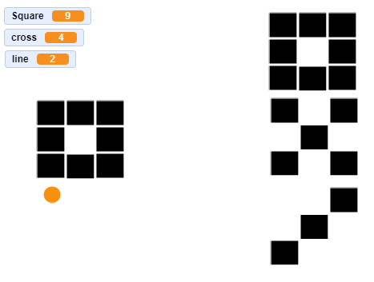
Detecting a shape in Scratch
How can we compare the square shape on the left with the three shapes on the right?
What are the variables Square, cross and line showing?

Slide 16
Detecting a shape in Scratch
How can we compare the square shape on the left with the three shapes on the right?
A comparison can be made of each square/pixel with the example
The shape that is the closest match will be the shape that we have found
What are the variables Square, cross and line showing? These variables are showing how many pixels match the shape we are looking for

Slide 17
Worksheet 4
Complete Task 2 on Worksheet 4

Slide 18
Fuzzy logic
The image shown is heavily pixelated
Which of the following do you think it most likely shows?
A square
Ants eating burnt toast
A rectangle
A time warp
A postage stamp

Slide 19
Fuzzy logic
We cannot be certain what the image shows
Instead, an AI system can give a probability of each option
Option | Probability
Square | 90%
Rectangle | 80%
Postage stamp | 20%
Ants eating burnt toast | 10%
Time warp | 2%

Slide 20
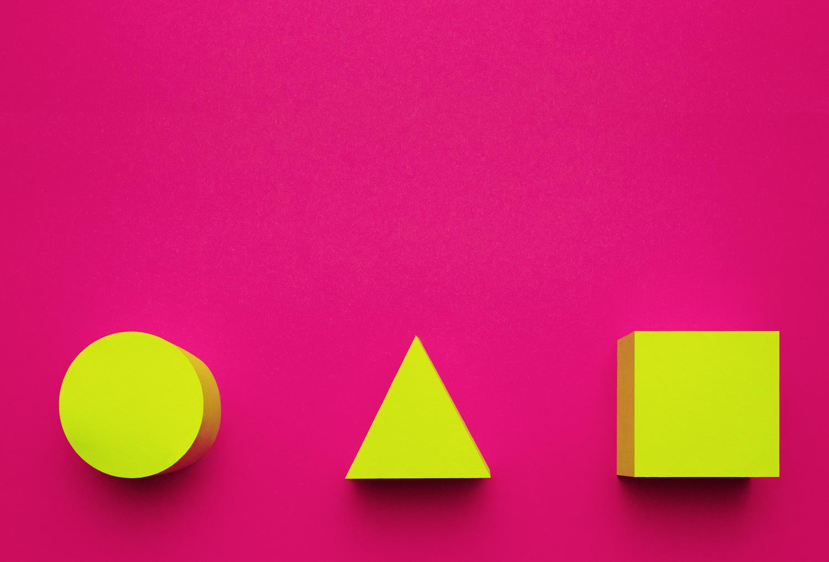
Plenary
Give three issues that facial recognition may have to deal with
Explain to a partner how shapes can be detected by an algorithm

Slide 21
Plenary
Give three issues that facial recognition may have to deal with
Angle of face, objects or people in the way, masks, makeup, lighting, fake beard/moustache, wig, different haircut
Explain to a partner how shapes can be detected by an algorithm
A set of rules can be programmed – e.g. a circle must be a continuous line with a different colour inside and outside
At a simple level, an image can be compared against a pattern

