Slide 1
Subroutines
Control systems with Flowol
3rd Edition

Slide 2
Objectives
Develop a control solution for a system that includes a subroutine
Understand how the use of subroutines can make programs more efficient

Slide 3
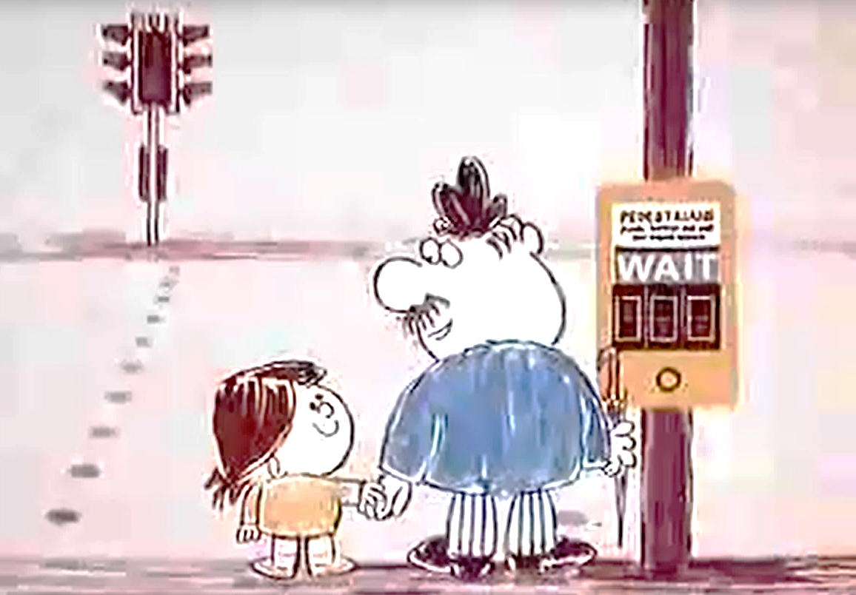
The Pelican Crossing: Pedestrians

Slide 4
The Pelican Crossing: Motorists

Slide 5
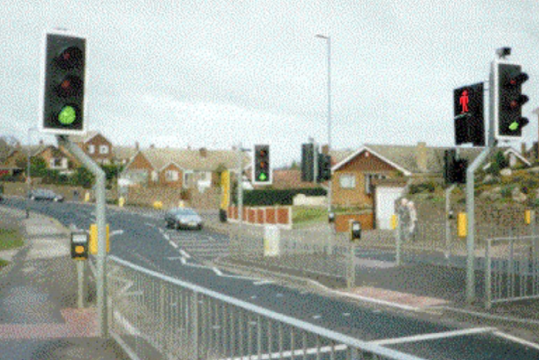
Flowol: Pelican Mimic

Slide 6
What is a Subroutine?
A subroutine is a mini program within another larger program
It does a specific task
The main program ‘calls’ the sub-program

Slide 7
Using a subroutine to make a light flash

Slide 8
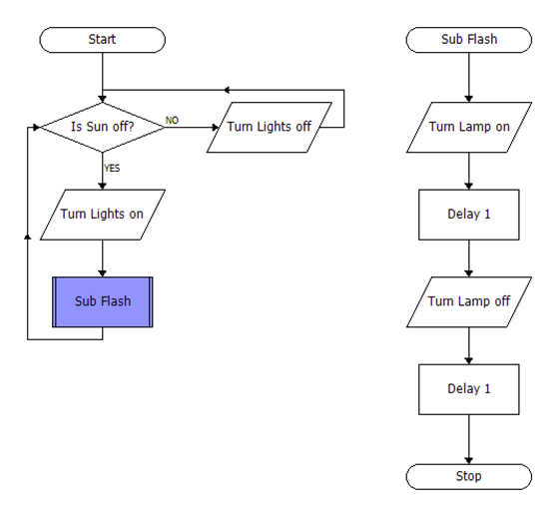
A ‘Flash’ subroutine

Slide 9
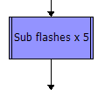
Repeating the same steps several times
You can specify how many times a subroutine is to be performed:

Slide 10
Create a subroutine
Create a subroutine to control only the flashing lights
Use the Sub option with a Start / Stop symbol
Refer to the Zebra Crossing mimic solution
Call the subroutine from the main program

Slide 11
Advantages of modular programming
Each team member can work on a module
Easier to isolate errors
Can create the main program without the detail of the subroutines – they can be written later
Can re-use subroutines in other programs

Slide 12
How video games are made
Video games are created by large teams of programmers
Each team may program one module of the game

