Slide 1
What is online and personal branding?
If you type your name into a search engine what would come up?
The internet is a public place and anyone can search for your information on social media sites.
STARTER:
Today we’re going to learn about online presence or ‘branding’ which is how you are perceived on the internet and through search engines.
Challenge: What can people do to improve their online presence?
More challenging: Once something is communicated online it is there forever. How might this cause problems for people?
Mega challenge: Evaluate how creating an online presence for an employer might be different to a personal online presence.
Notes:
All social media logos listed on Pixabay as creative commons licenses https://pixabay.com/en/service/license/

Slide 2
KEY WORDS:
Online Presence – How an individual or business is perceived on the internet and through search engines
Digital Footprint – The space you occupy online – from your social media posts and your blogs to your comments and your website.
Learning Outcomes –
Identify the key elements of online presence or
‘branding’ and how to improve our own.
Assess the different aspects of our online presence
and how to make improvements for future employability.
Explain how we can confidently construct a positive online presence that will help our future employability.

Slide 3
Online presence – we all leave a ‘digital footprint.’
REVIEW:
Challenge: What can people do to improve their online presence?
Carefully control your digital footprint - all information and files are shared online.
Revisiting older information and files to ensure they promote a positive online presence.
Ensure privacy settings are enabled on social media sites so you can control who can access your information.
More challenging: Once something is communicated online it
is there forever. How might this cause problems for people?
Something you wrote or did many years ago could still be viewed now, even if
your views have changed or you have matured in your personality.
Mega challenge: Evaluate how creating an online presence for an employer might be different to a personal online presence.
Whilst you might be happy to share certain ideas, photos, videos or opinions with friends and family, this might not be the case when looking for potential employers.
You would want to look professional, sensible, careful and enthusiastic. Remember, no employer will ever be able to see your private DMs, but they will be able to track down any public posts.

Slide 4
Online Presence: What does it actually mean?
There are four key steps to creating a positive online presence:
Carefully considering which information to share on social media and websites.
Thinking carefully and how you communicate with others on social media, whether that is publicly or in private messaging.
Revisiting any older posts or information that be harmful to your online presence and deleting them.
Ensure privacy settings are active and secure enough so access to your information is restricted.
Almost everyone now has an online presence, whether it’s through setting up their own social media accounts or even through friends
and family posting photos or videos of them.
Discuss in pairs and be ready to feedback:
If you were an employer searching you online, what would they find?
After today’s lesson what will you do to ensure a more positive
online presence?
In order to follow these four steps, what skills would you need
to use in each? Why?

Slide 5
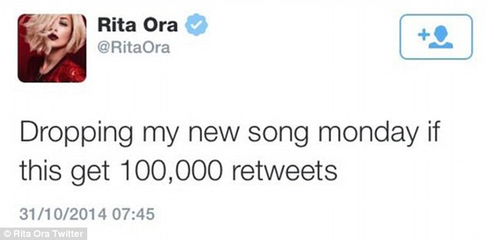
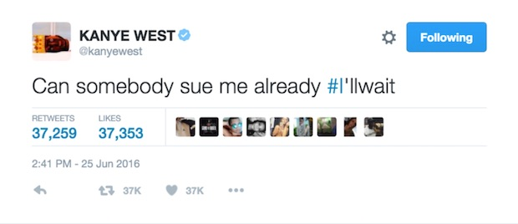
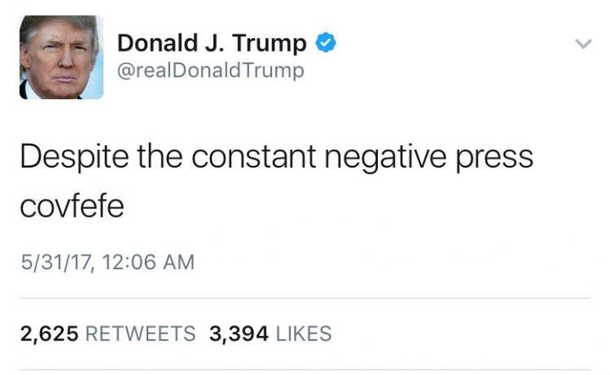
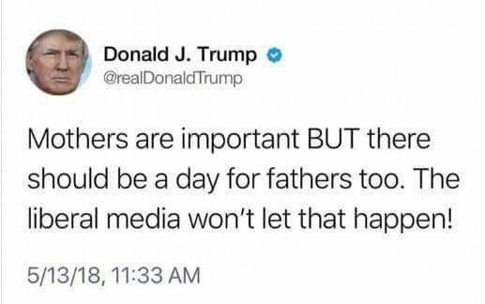
Online Presence: Embarrassing and some there forever!
Challenge: For each tweet, describe the point the celebrity was trying to make and why they may have regretted this soon after.
More challenging: Explain the best way of preventing mass audiences viewing embarrassing social media posts - think about all popular platforms and immediate actions you could take.
Mega challenge: Detail three subjects it’s ok to discuss publicly online, three that should always be kept private and explain why for all, ready to feedback.

Slide 6
So what kind of things would be appropriate for us to post on an online CV or cover letter?
We need to think very carefully about this.
Read part of Charlie’s cover letter:
‘I am very interested in the hospitality industry and aspire to one day be a manager of my own pub or restaurant. I am on target to achieve a level 7 in my Food Technology GCSE. I am very interested in brand development and have a keen interest in the nascent popularity of real ales. In fact a actually have a YouTube Channel called, ‘how many real ales can Charlie-Boy drink in one hour.’ The vlog has a competitive element, with many subscribers. I feel this experience has given me to skills required to handle social media promotion of any hospitality business.’
ALL: Where has Charlie gone wrong here? What impression is he giving employers? What could he do to turn his profile around and how should Charlie amend his digital footprint before he even thinks about approaching employers? Rewrite Charlies cover letter to make him sound like a potentially successful employee.

Slide 7
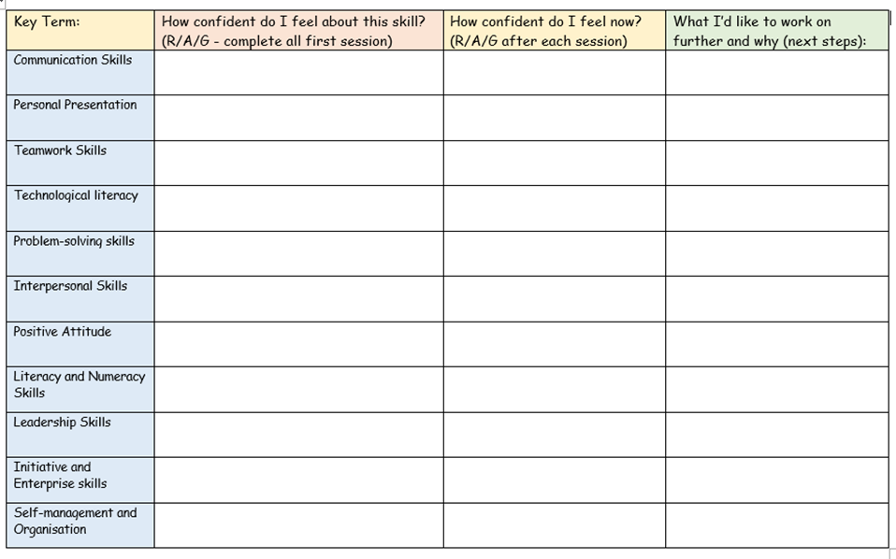
Plenary – Online branding:
Challenge: You will now be able to complete your employability skills competency audit for your online branding. Label the skill as Red, Amber or Green, depending on how confident you feel about your online presence.
More challenging: Be ready to describe the reasoning behind your RAG rating to the rest of the class.
Mega challenge: Based on today’s work, explain how you will amend your social media profiles or past posts to help improve your digital footprint.
Next lesson we will be focusing on the importance of our extra curricular activities and the experiences we gain from them.
Created by www.ecpublishing.co.uk 2019 ©
Notes:
www.ecpublishing.co.uk 2019 ©

