Slide 1
Selection (IF Statements)
Programming Guides

Slide 2
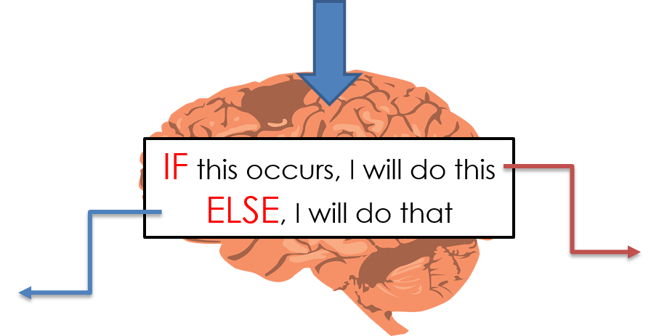
Selection (IF Statements)
If we want the computer to make a decision based on our input we use “selection”.
Selection uses If – Else statements
Outcome 1
Outcome 2

Slide 3
Selection (IF Statements)
What is your age?
Example of a virtual barman program deciding whether to serve a customer:
IF age > 17 do this
ELSE, do that
“What can I get you?”
“Go home boy!”
IF – ELSE statements allow programs to make decisions based on certain conditions occurring.

Slide 4
Selection (IF Statements)
Colons are needed at the end of each IF and ELSE statement
When you use selection statements you must indent accordingly.

Slide 5
Selection (IF Statements)
In IF statements we will be looking to compare some data.
We might want to see if a variable is equal to a number or a piece of text.
We might want to see if a variable contains a number greater than another
Or contains a number smaller than another.
In python we use certain symbols to compare data.
To see if something is mathematically equal to another we use a double equals sign (==)
To see if a variable contains a number greater than another we use the greater than symbol (>)
To see if a variable contains a number smaller than another we use the less than symbol (<)
Relational Operators | How They Compare
= (or ==) | Is equal to
<> (or !=) | Is not equal to
< | Is less than
> | Is greater than
<= | Is less than or equal to
>= | Is greater than or equal to

Slide 6
Selection (IF Statements)
You can compare the contents of two variables in an IF statement.
You can also compare the contents of a variable against some ‘hard coded’ data. Remember, if it’s a string, you must use speech marks!

