Slide 2
Objectives
Understand how intelligence can be measured in humans and computers
Know what the Turing test is and how it works
Understand why interpreting patterns is not as useful a skill as ‘thinking’
Program a chatbot

Slide 3
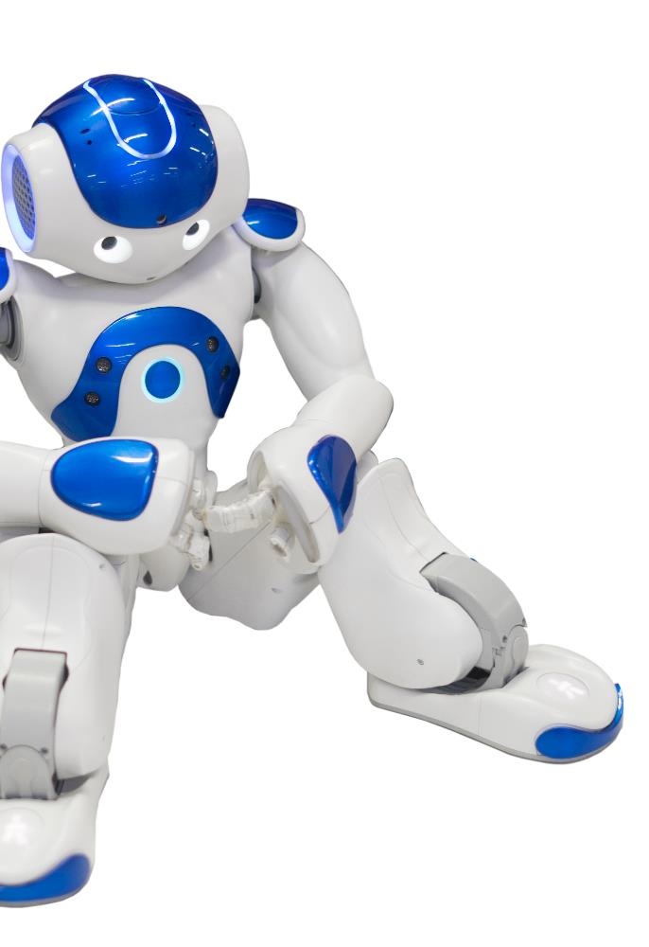
Measuring intelligence
IQ tests are used to test the intelligence of humans
AI can perform very well on these tests
Do IQ tests measure intelligence of people or how good they are at solving IQ tests?
How else could you measure the intelligence of a robot or machine?

Slide 4
Measuring intelligence
We can compare hardware: processor speeds, size of memory or storage
We can measure ability to perform tasks, e.g. playing chess, recognising faces, predicting weather
BUT what about general behaviour such as:
Learning to peel an orange
Comforting an unhappy friend
Reviewing a film?
Humans are often very good at this whilst machines find these problems very hard to solve

Slide 5
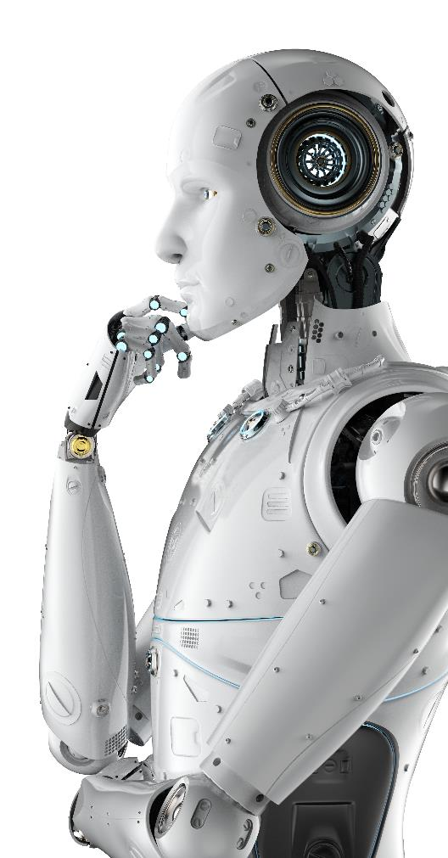
Human or computer?
Humans are intelligent
So one measure of artificial intelligence might be:
Can we tell the difference between a human, and a computer?

Slide 6
The Turing Test
This test was created by Alan Turing in 1950
A human sits in one room and asks questions through a computer
The questions go to a computer and a human
If the human cannot tell the difference between talking to a computer and a human, the computer passed the test
Human: What is your favourite sport?
Person A: I like football. Person B: I like lots

Slide 7
Computer or human?
Look at the following conversation in a Turing Test
Which person is the human and which is the computer?
Why do you think this?
Human: What was your primary goal in life?
Person A: I wanted to be a doctor
Person B: I did play football in primary school, but I never scored a goal.

Slide 8
Computer or human?
Which person is the human and which is the computer?
Person A is the human
Why do you think this?
Person B has misinterpreted the question
The computer has seen the words primary and goal and thought the human was talking about scoring a goal in primary school
Human: What was your primary goal in life?
Person A: I wanted to be a doctor
Person B: I did play football in primary school, but I never scored a goal.

Slide 9
Worksheet 5
Complete Task 1 on Worksheet 5

Slide 10
Thinking and doing
We have seen before that AI and machine learning work as follows
Start with some training data
Learn patterns from them
Classify new data with a best guess, based on step two
However, this method can lead to problems
99% Match

Slide 11
Problems with patterns
AI and machine learning are very good at finding patterns
AI would easily be able to find the pattern that GCSE passes in the UK have gone up with cinema ticket prices
AI is not good at understanding why things happen though
Why do you think ticket prices and GCSE passes have increased?

Slide 12
Ticket price vs exam results
Exam results are affected by:
How good schools are
How much students study
The difficulty of the exams
Cinema ticket prices are affected by:
Inflation
The quality of films and cinemas
Whilst these may rise together, neither one causes the other one

Slide 13
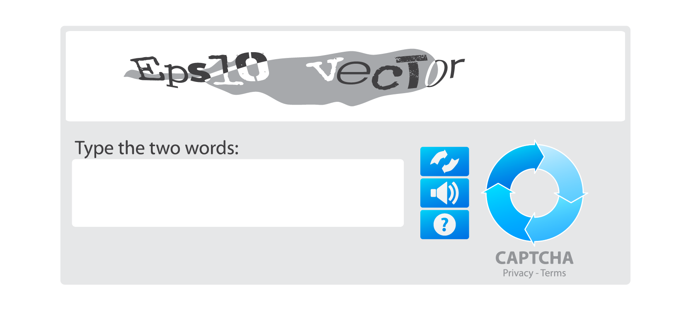
Captcha
Computers use problems that are hard for other computers to solve to check that they are being used by a human
The text written in the capture below is hard to recognise as it is deformed and has many colour changes that break any AI rules or pattern recognition

Slide 14
Worksheet 5
Complete Task 2 on Worksheet 5

Slide 15
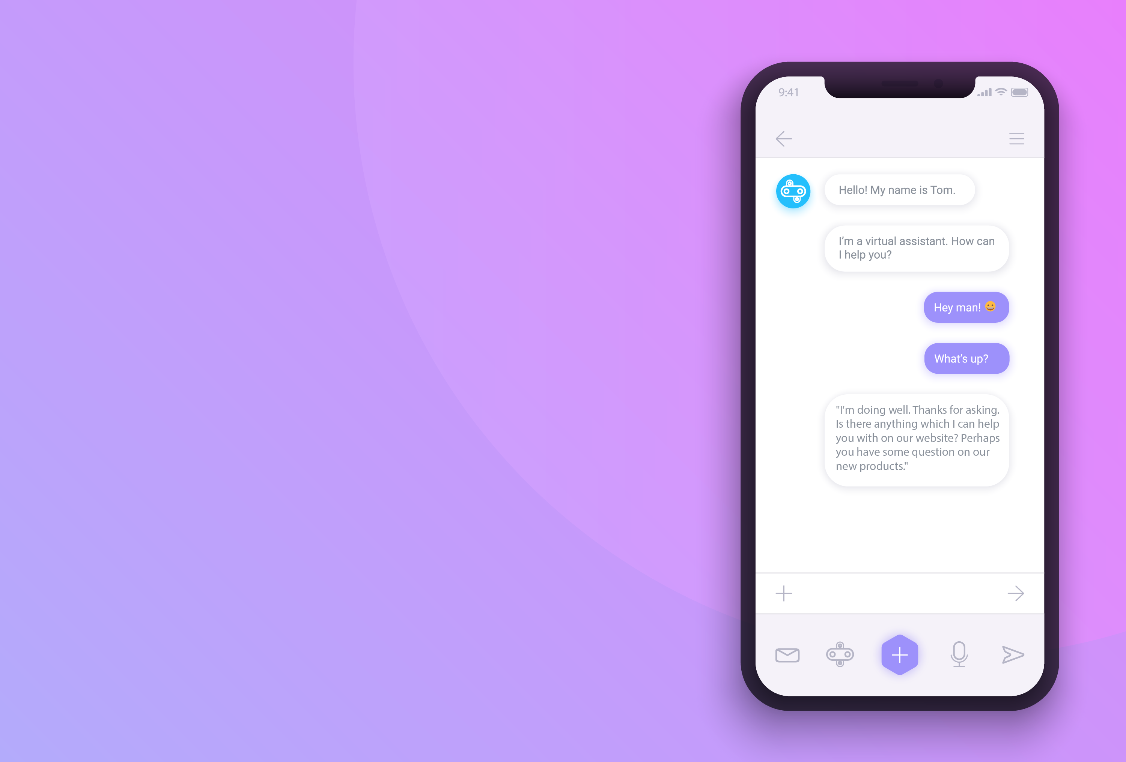
Chatbots
Chatbots, also known as virtual assistants are able to help people by replying to messages or voice commands
Where have you seen chatbots or virtual assistants being used?

Slide 16
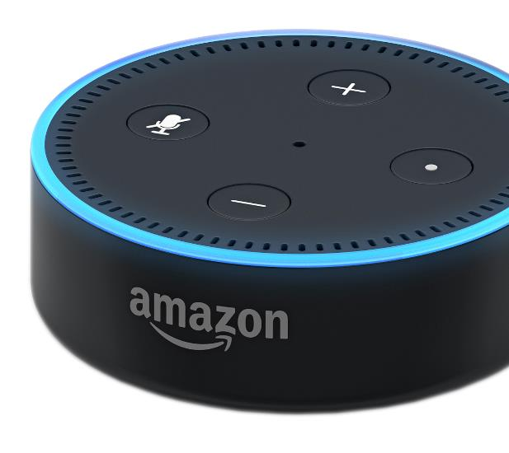
Chatbots
Where have you seen chatbots or virtual assistants being used?
They are often used on websites to help customers
More sophisticated virtual assistants will use AI and machine learning to answer voice queries
Examples include Amazon’s Alexa, Apple’s Siri and Google Assistant

Slide 17
Worksheet 5
Complete Task 3 on Worksheet 5

Slide 18
Plenary
Chatbots and virtual assistants try to act like a human in providing help to users
Discuss the following with a partner
How hard is it to make a simple virtual assistant?
How hard is it to make a virtual assistant that people will think is an actual human?
What is the name of the test that determines if a chatbot or virtual assistant is as good as a human?

Slide 19
Plenary
How hard is it to make a simple virtual assistant?
A simple virtual assistant is very easy. But it quickly becomes hard when the complexity of questions and answers increase
How hard is it to make a virtual assistant that people will think is an actual human?
This is very hard. Top computer scientists have still not achieved it, but virtual assistants are increasingly getting more sophisticated. Machine learning has helped to improve the results
What is the name of the test that determines if a chatbot or virtual assistant is as good as a human?
The Turing test

