Slide 1
Cambridge
IGCSE
Computer Science
Section 1
Introduction to the Internet
Communication and Internet technologies
3

Slide 2
Objectives
Describe the nature of the Internet as a worldwide collection of computer networks
Explain the roles of an Internet Service Provider (ISP)
Understand the advantages and disadvantages of the Internet as a research tool
Understand some of the ethical issues of Internet use
Understand the advantages of Cloud computing

Slide 3
What is the Internet?
A collection of inter-connected networks
How is this different from the World Wide Web?

Slide 4
Internet growth
In 1969, there were 4 networks connected to the Internet
By 1989, there were 100,000 networks connected to the Internet
By 2012, 2.1 billion people were Internet users
By 2020, it is predicted that more than 50 billion things will be connected to the Internet
Mobile devices, parking meters, thermostats, roads, cars, supermarket shelves, dogs, tigers…

Slide 5
A network of networks
Every computer that is connected to the Internet is part of a network, even the one in your home
You connect to the Internet Service Provider (ISP) that you are contracted with
When you connect to your ISP, you become part of their network
The ISP may then connect to a larger network and become part of that network

Slide 6
Internet Service Providers (ISP)
An ISP is a company supplying connectivity to the Internet
They also offer:
Email services
Web hosting
VOIP facilities
ISP

Slide 7
Accessing the World Wide Web
What type of software do you use to access the World Wide Web?
Name some examples of this type of software
What type of software do you use to get information from the World Wide Web about a particular topic?
Name some examples of this type of software

Slide 8
Browser software
Internet Explorer, Google Chrome, Mozilla Firefox and Safari are all examples of browser software
One way of accessing a particular page on the World Wide Web is to type its address into the address bar
Name another way of accessing a web page

Slide 9
Search engines
Google is the dominant search engine on the Internet
It processes billions of searches every day
Bing, Yahoo and Altavista are three other well-known search engines
But there are other, smaller search engines such as DuckDuckGo
Check out its history at duckduckgo.com/about

Slide 10
Finding information on the World Wide Web
What are the advantages of using the World Wide Web to find information? Consider:
Who provided the information
The accuracy of the information

Slide 11
Accuracy of information
Information can be put on the Internet by anyone
It may be biased
It may be inaccurate
It may be out-of-date
It may be so biased or inaccurate that it is potentially life-threatening

Slide 12
Worksheet 3
Try Task 1 on Worksheet 3

Slide 13
Who puts data on the World Wide Web?
Have you ever put data on the World Wide Web?
How?
Every ISP has its own data storage facility
Some large service providers like Google and Facebook have huge data storage facilities
Employees use scooters to get around the building

Slide 14
Privacy on the Internet
How does Google make its money?
In 2014, Google’s annual revenue was 66 billion US Dollars. About 60% of its revenue comes from online advertising
DropBox, Microsoft, Apple, Yahoo, Facebook, Skype and others all collect personal information every time you use their software
This information can be sold to advertisers, or passed to Government security agencies, for example the NSA in the US or GCHQ in the UK

Slide 15
Where is all the data stored?
Information about billions of private communications is collected every day
Where is all the information stored?
In vast storage facilities all over the world

Slide 16
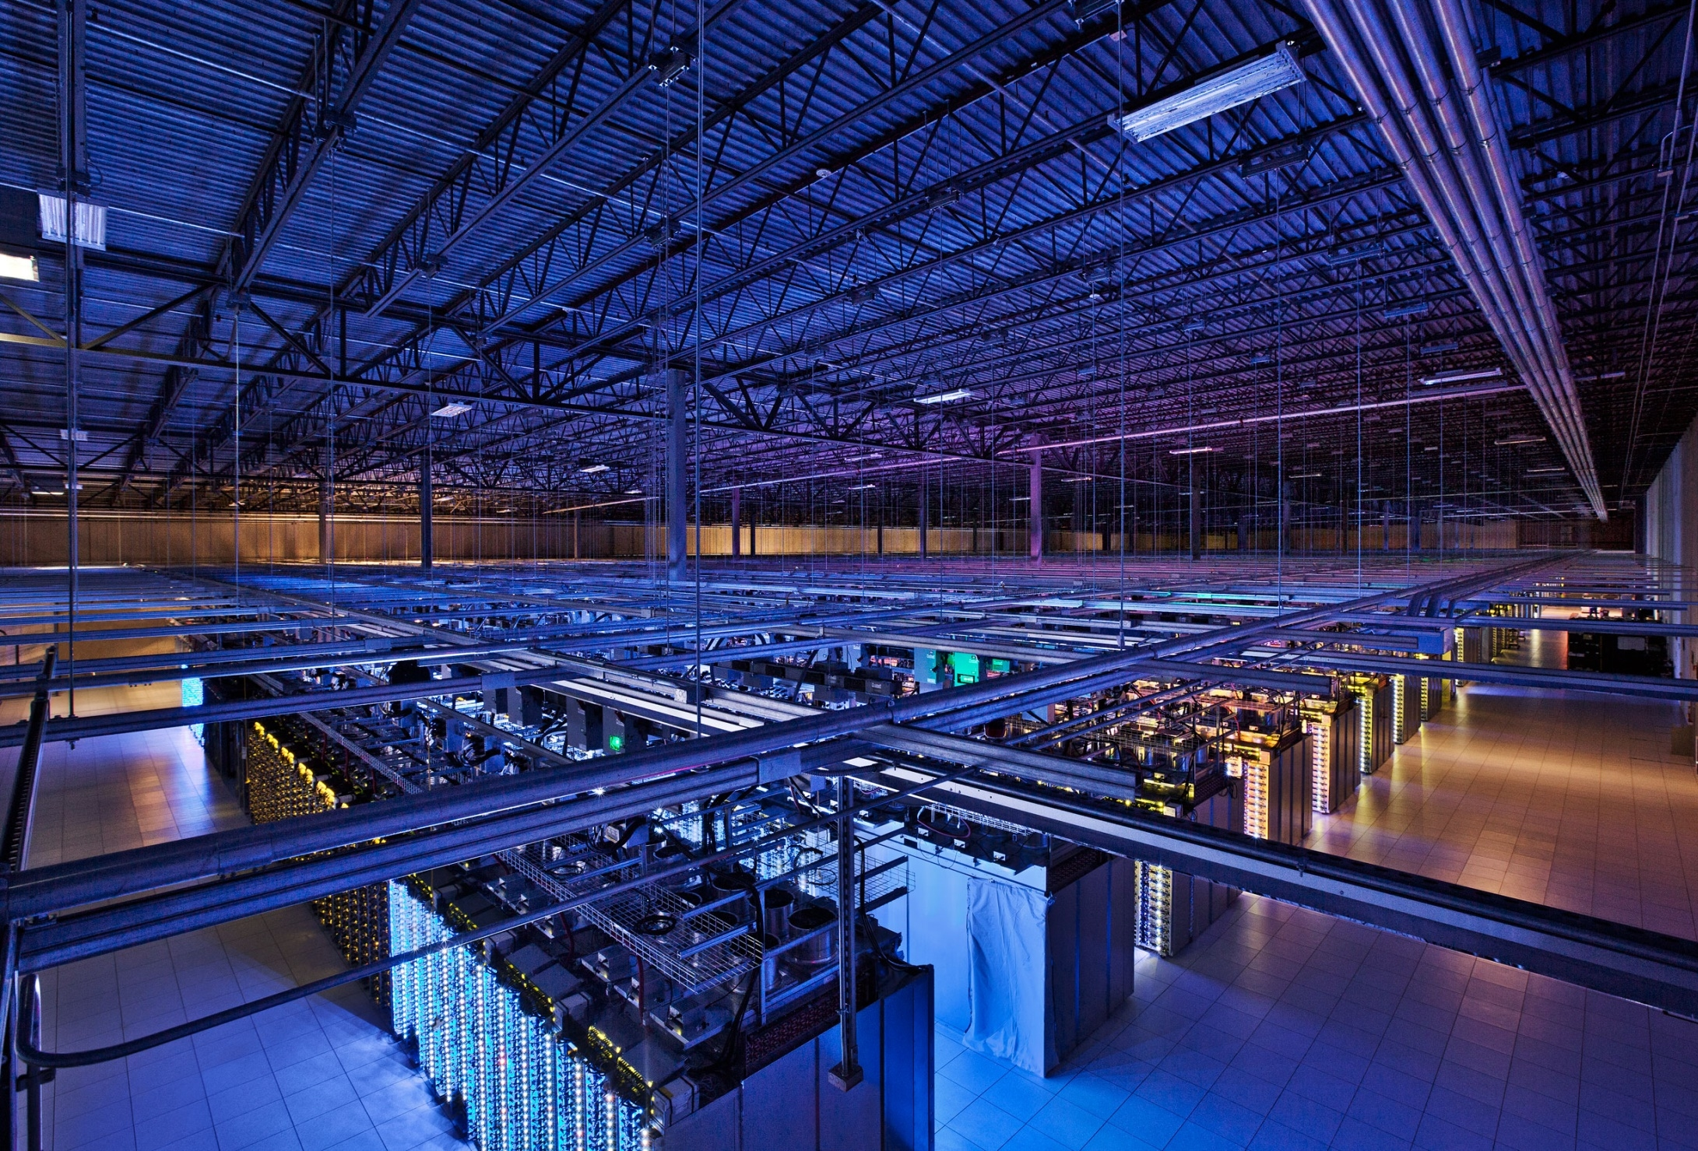
A Google server room in Council Bluffs, Iowa
Photo: Google/Connie Zhou
See more images of Google data centres

Slide 17
Worksheet 3
Try Task 2 on the worksheet

Slide 18
Communication on the Internet
The Internet gives people many different ways to communicate
Email
Social networking sites
Internet telephone or VOIP services, e.g. Skype
Blogs
Chatrooms
What are the advantages and disadvantages of each of these?

Slide 19
Shopping and banking
Online shopping has already led to the closure of up to 30% of high street shops in the UK
Similarly, many local bank branches have closed
BUT there are significant advantages to online shopping and online banking!
Can you name some of them?

Slide 20
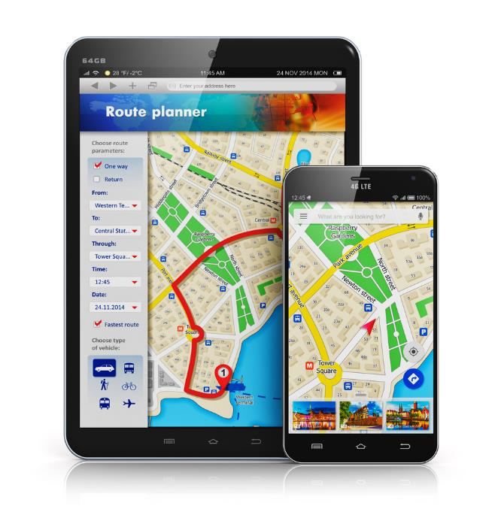
Travel sites, sat-nav, maps
The Internet has hundreds of applications to help you find out about hotels or beaches, book a holiday, or find your way around…

Slide 21
Cloud based services
Servers host software or services that you can access
Where is the cloud?

Slide 22
Online storage
Dropbox, OneDrive and Google Drive
How do they work?
What are the advantages of ‘cloud’ storage?

Slide 23
Plenary
The Internet has opened up a huge number of opportunities for individuals and businesses
It is a fantastic source of instant information on virtually any topic
BUT it should be used with caution – inaccurate information, lack of privacy, hacking and viruses are some of the dangers

