Slide 1
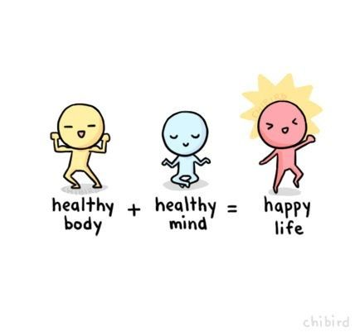
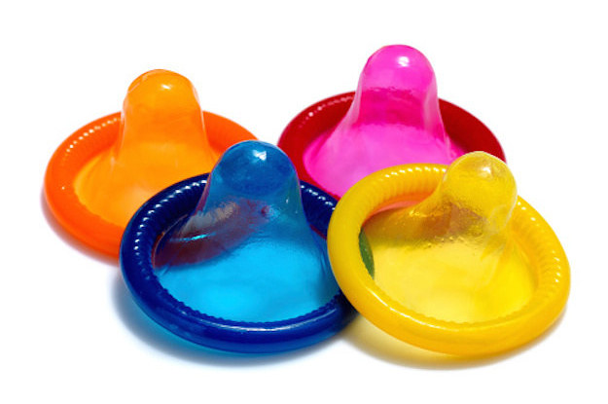
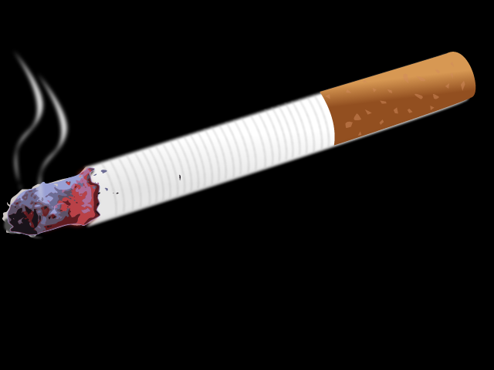
Biology Topic 5 Summary Sheet
Cb5b – Non-communicable Diseases
Many of these diseases are caused by many of a number of our lifestyle choices.
Cb5c – Cardiovascular Disease and Smoking
CVD is a collective term for disease that affects the heart and blood vessels e.g. heart attack, stroke, high blood pressure etc.
The harmful chemicals in tobacco smoke can increase your chances of CVC. These chemicals can:
Damage blood vessels
Increase blood pressure
Make blood vessels narrower and so increase the risk of blood clots
CB5f – Physical and Chemical Barriers
Physical barrier – stops the pathogens from getting into the body.
E.g. Skin
Ciliated hairs in nose and airways
Mucus
Chemical barrier – kills the pathogens before they can harm us.
E.g. Lysozyme in tears
Stomach acid
Cb5a – Health and Disease
The World Heath Organization (WHO)
describes health as :
‘a state of complete physical , mental and social well-being’.
It is NOT simply the absence of disease.
Disease | Lifestyle factor causing it
Cirrhosis | Alcohol ( ethanol)
Malnutrition | Unbalanced diet
Cardiovascular | Unbalanced diet, Smoking
Lung | Smoking
Obesity | Unbalanced diet high in sugar and fat
Lung cancer | Smoking
Kwashiorkor | Lack of protein in the diet
Scurvy | Lack of vitamin C
Rickets/Osteomalacia | Lack of vitamin D and/or calcium
Communicable Disease | Non-communicable Disease
Caused by pathogens | Caused by a problem in the body
Can be spread from one person to another | Cannot be spread
Cb5d/e – Pathogens and Spreading Pathogens
Pathogens are microorganisms that cause disease.
Pathogen | Type | Problems | How transmitted
Cholera | Bacteria | Diarrhoea | Water
Tuberculosis | Bacteria | Lung damage | Airborne
Chlamydia | Bacteria | Infertility | Sexual contact
Helicobacter | Bacteria | Stomach ulcer | Food
Chalara ash dieback | Fungi | Leaf loss in plants and lesions in bark | Airborne
Malaria | Protists | Damage to blood and liver | Animal vector i.e. mosquito
HIV | Virus | Destroys white blood cells leading to AIDs | Sexual contact
CB5f – Physical and Chemical Barriers
Artificial physical barriers are used to prevent the contraction and spread of Sexually Transmitted Infections (STI’s).
These help to reduce or prevent by avoiding direct contact with sexual fluids.

Slide 2
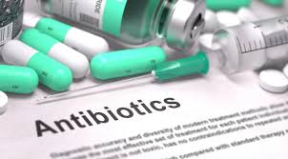
Biology Topic 5 Summary Sheet
CB5g – The Immune System
Immunity to a pathogen is called IMMUNISATION.
It can happen naturally or by using a VACCINE.
A vaccine contains an inactive weaker version or bits of a pathogen that include the pathogens.
CB5g – The Immune System
Sometimes pathogens manage to get past all physical and chemical barriers. When this happens, the immune system becomes active.
CB5h – Antibiotics
Antibiotics are substances that either kill bacteria or inhibit their cell processes
Stages in the production of a new antibiotic:
Pre-clinical stage: new antibiotic is tested on cells.
Antibiotic then tested on animals.
Clinical trial: antibiotic tested on a small number of humans to check that any side effects are small
Larger clinical trail: many people tested to try to find the correct dose.

