Slide 2
Objectives
Demonstrate how to work out angles in 2D shapes
Calculate surface area of simple 2D and 3D shapes
Calculate the volume of 3D shapes including simple composite shapes
Know how to interpret 2D drawings into 3D shapes and vice versa

Slide 3
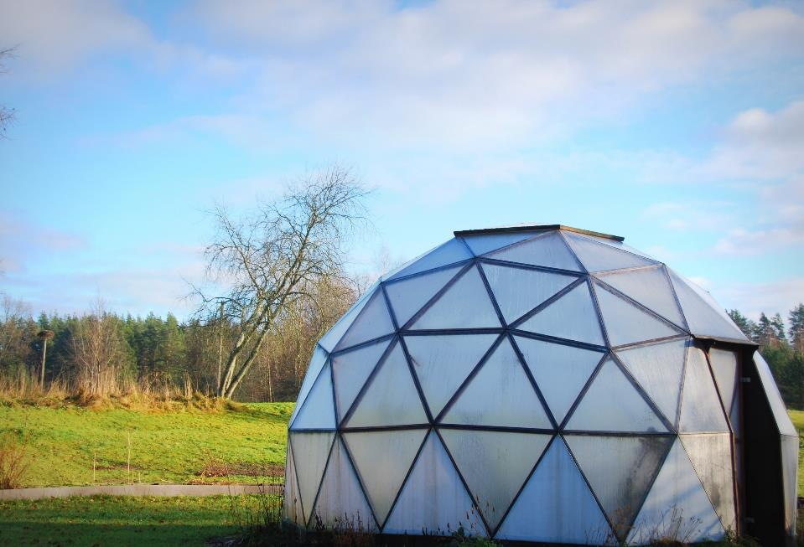
Starter
Making a geodesic dome requires the use of accurate angles to ensure all parts fit together
What shapes do you recognise in its external structure?

Slide 4
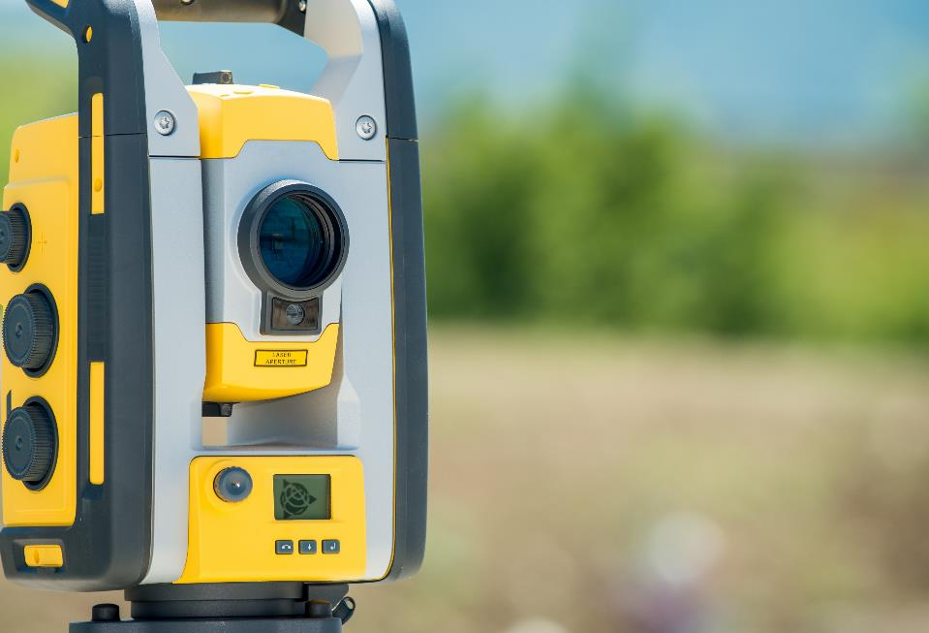
Angles
This is a theodolite which is used to measure angles
Angles are measured in degrees
How many degrees are there in the following:
one complete revolution
around a point on a straight line
in a right angle ?

Slide 5
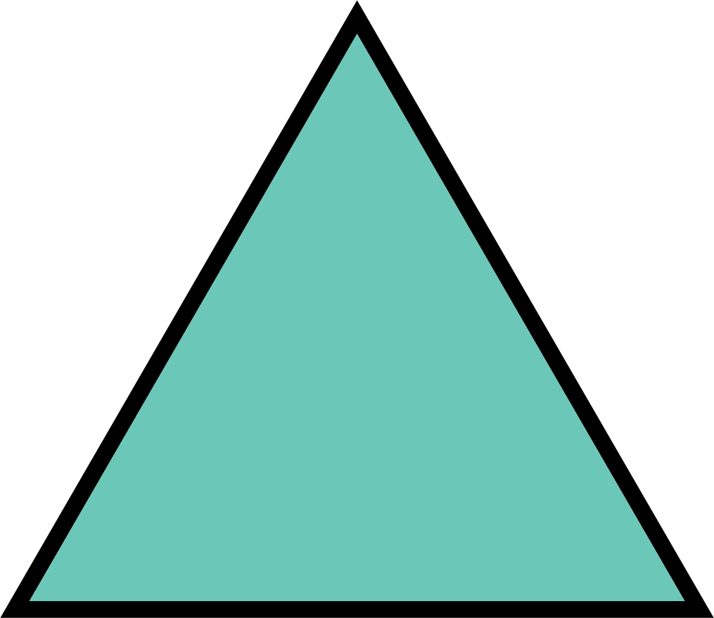
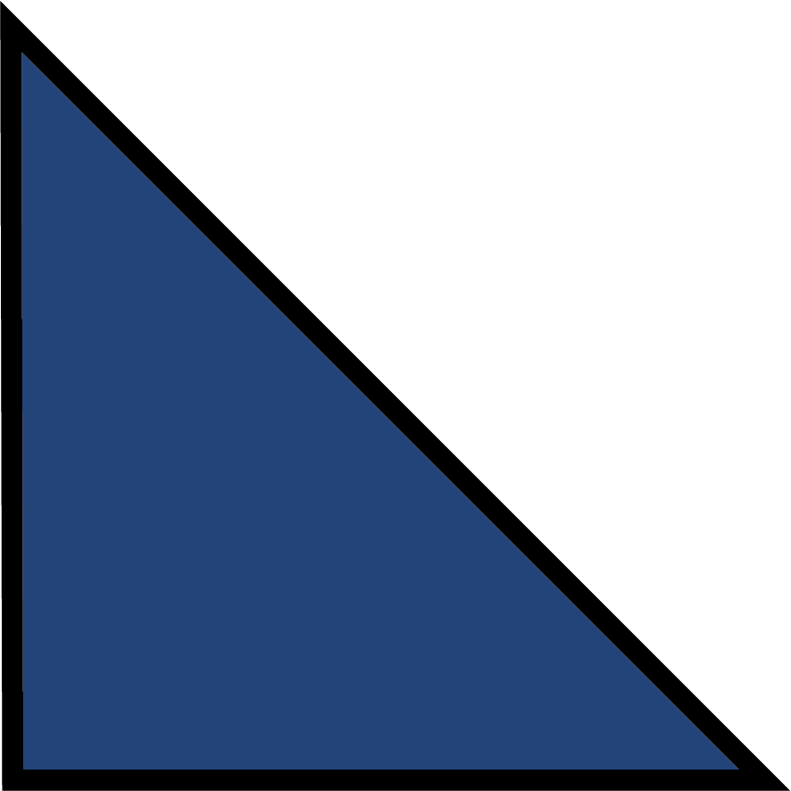
Angles in triangles
These are ‘special’ triangles
Notice that some angles and sides are equal
What do all the angles in a triangle add up to?
Equilateral triangles | Isosceles triangles | Right angle triangles
All 3 sides have the same length All angles are 60° | 2 sides are equal The two opposite angles are equal | 1 angle is equal to 90°

Slide 6
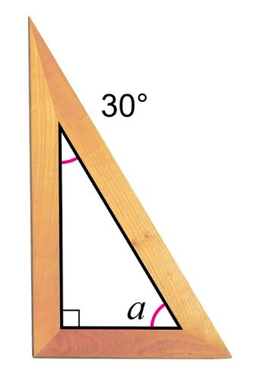
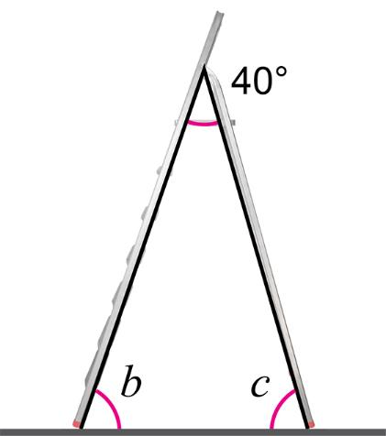
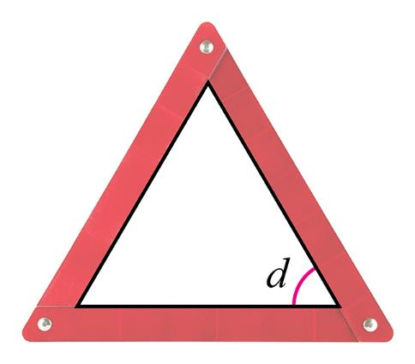
Angle quiz
What type of triangles are the objects below?
Work out the unknown angles a, b, c and d in each triangle

Slide 7
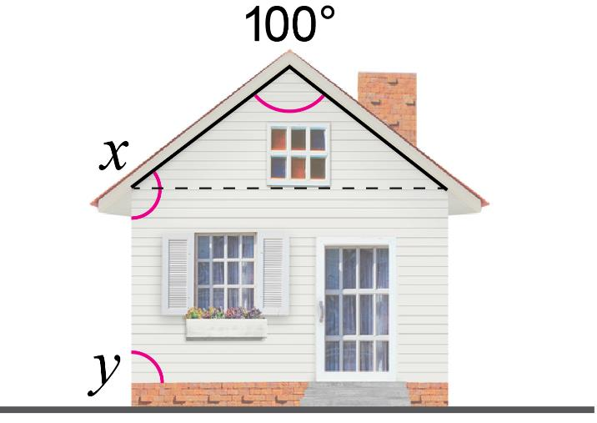
Apex angles
An architect knows that the angle at the apex of a roof is 100°
Work out the missing angles, x and y and state any assumptions that you make in getting to your answers

Slide 8
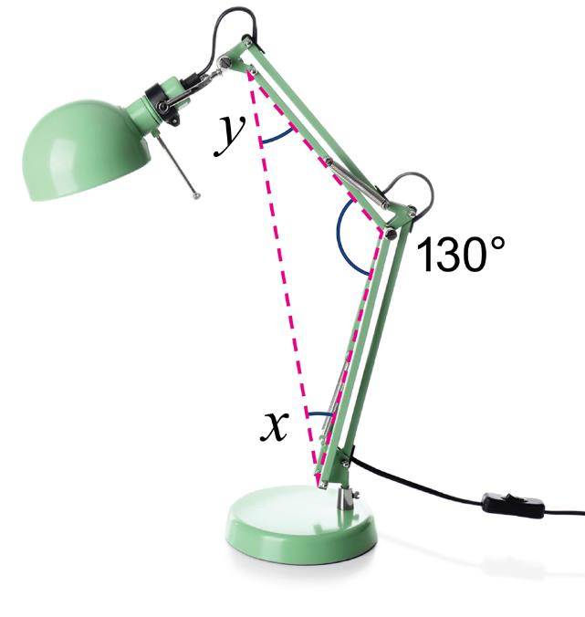
Anglepoise conundrum
A designer is interested in various angles within an anglepoise lamp
They notice that the pivoted arms are of the same length
They then create a triangle like the one shown in red
What is the size of angle x and y?

Slide 9
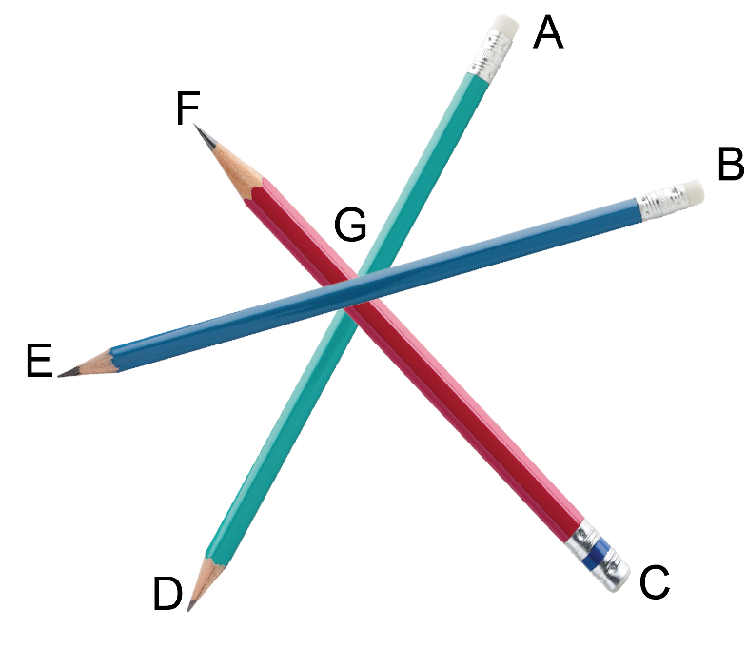
Pencil angles
Which of the statements about the angles between the pencils are true, and which are false?
All angles stated are less than 180°
FGE = AGB
DGC + AGC = 180°
AGB = EGD
CGB = 180° – BGF
FGA = DGC

Slide 10
Pencil angles
Which of the statements about the angles between the pencils are true, and which are false?
All angles stated are less than 180°
FGE = AGB false
DGC + AGC = 180° true
AGB = EGD true
CGB = 180° – BGF true
FGA = DGC true

Slide 11
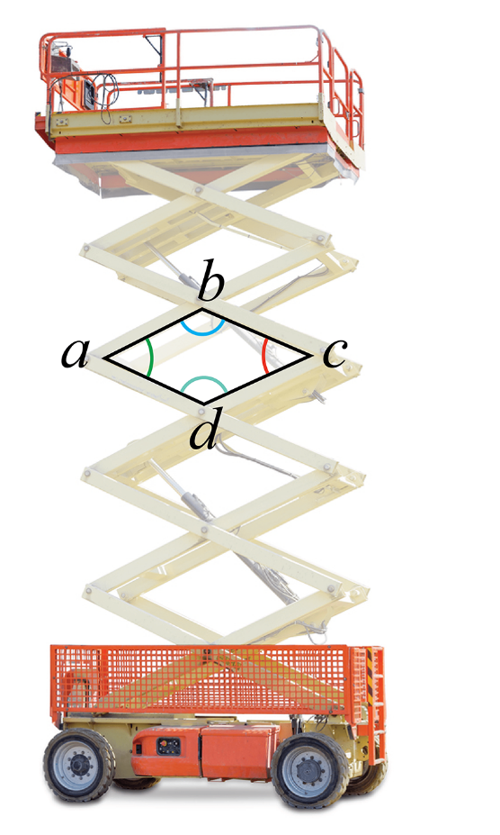
Up we go!
This is an extendable scissor lift
An engineer and wants to know how angles a, b, c and d change as the lift moves up and down
Which of these angles are equal to each other?
Predict how the angles change as the lift moves up and down

Slide 12
Worksheet task
Complete Task 1 of Worksheet 4

Slide 13
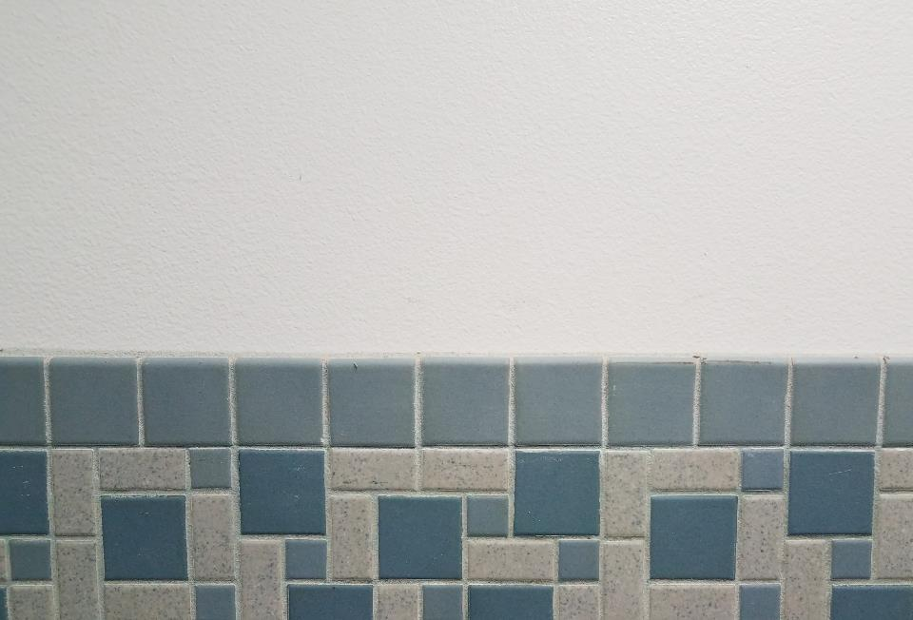
Areas of 2D shapes
These tiles are a mixture of squares and rectangles
To work out the area of a square or a rectangle, multiply the length by the width
Therefore, if a rectangle has a length of 8 cm and a width of 5 cm, its area = length × width = 8 × 5 = 40 cm²
If a small square tile has a side length of 6 cm, what is its area?

Slide 14
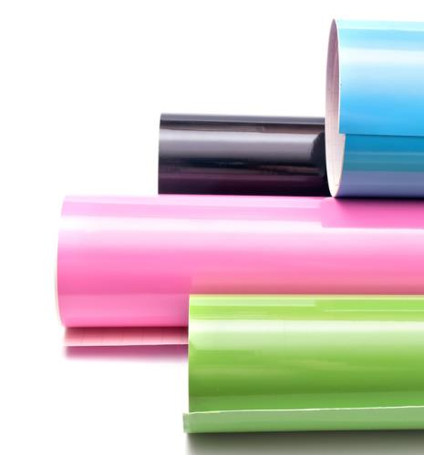
Vinyl by the roll
The image shows rolls of self-adhesive vinyl used for creating signs and stickers on a vinyl cutter
Each roll has a width of 50 cm What is the area of a vinyl sheet that is 100 cm in length, in cm²?
A student needs a 620 cm long piece of vinyl for their project. It costs £1.25 for each 100 cm of length How much do they spend?

Slide 15
Changes of units
A checkered pattern is made of black and white squares
The yellow square shown is 1 cm × 1 cm
Each 1 cm side is made of smaller 1 mm squares
How many 1 mm squares fit into 1 cm²?
How many mm² are there in 5 cm²?

Slide 16
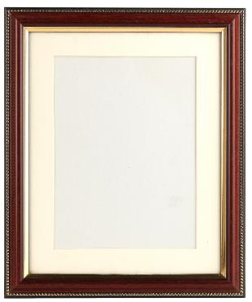
A question of units
Fill in the blanks:
1 cm = ……. mm
1 m = ……. cm
…… mm = 1 m
1 m² = …… cm²
….. m² = 1,000,000 mm²
A sheet of mountboard for a photo frame insert is 3 mm thick – What is this in metres? – What is this in microns?

Slide 17
A question of units
Fill in the blanks:
1 cm = 10 mm
1 m = 100 cm
10 mm = 1 m
1 m² = 10,000 cm²
1 m² = 1,000,000 mm²
A sheet of mountboard for a photo frame insert is 3 mm thick – What is this in metres? 0.003 – What is this in microns? 3,000 microns

Slide 18
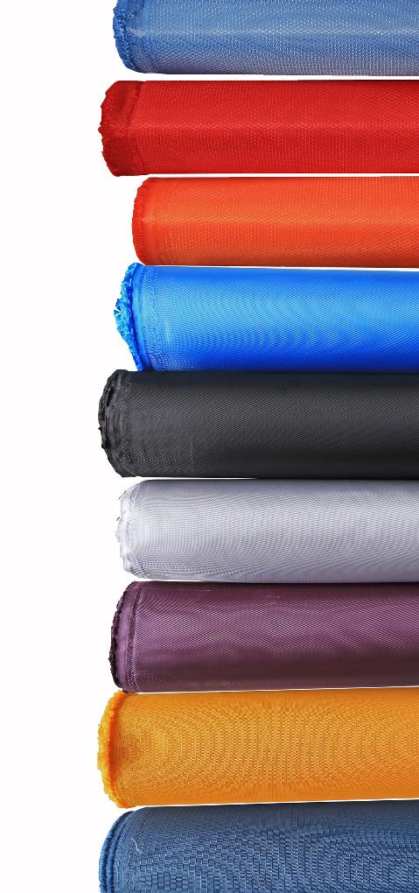
A fabric purchase
Fabric bolts come in standard widths
A designer requires 6 m of fabric 110 cm wide
Work out the area of the fabric in cm² and in m²
If the cost of the fabric is £12 per m², how much does the fabric cost to buy?
How much is the fabric per linear metre?
The designer also needs 10 m² of the same fabric to make a sofa covering, what length of fabric do they need to buy?

Slide 19
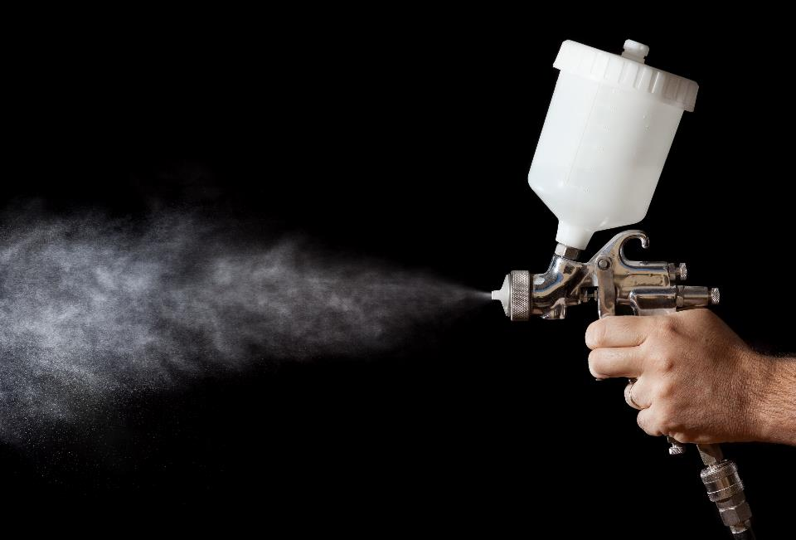
Spray painting
A mechanic has to re-spray a lorry with cellulose paint
The lorry has an area of 12 m² that needs covering
The coverage of the paint used is 1 litre per 5 m²
How many litres of paint do they need to use for 1 coat?
They buy 5 cans of spray paint with each containing 300 ml of paint – Do they have enough paint?

Slide 20
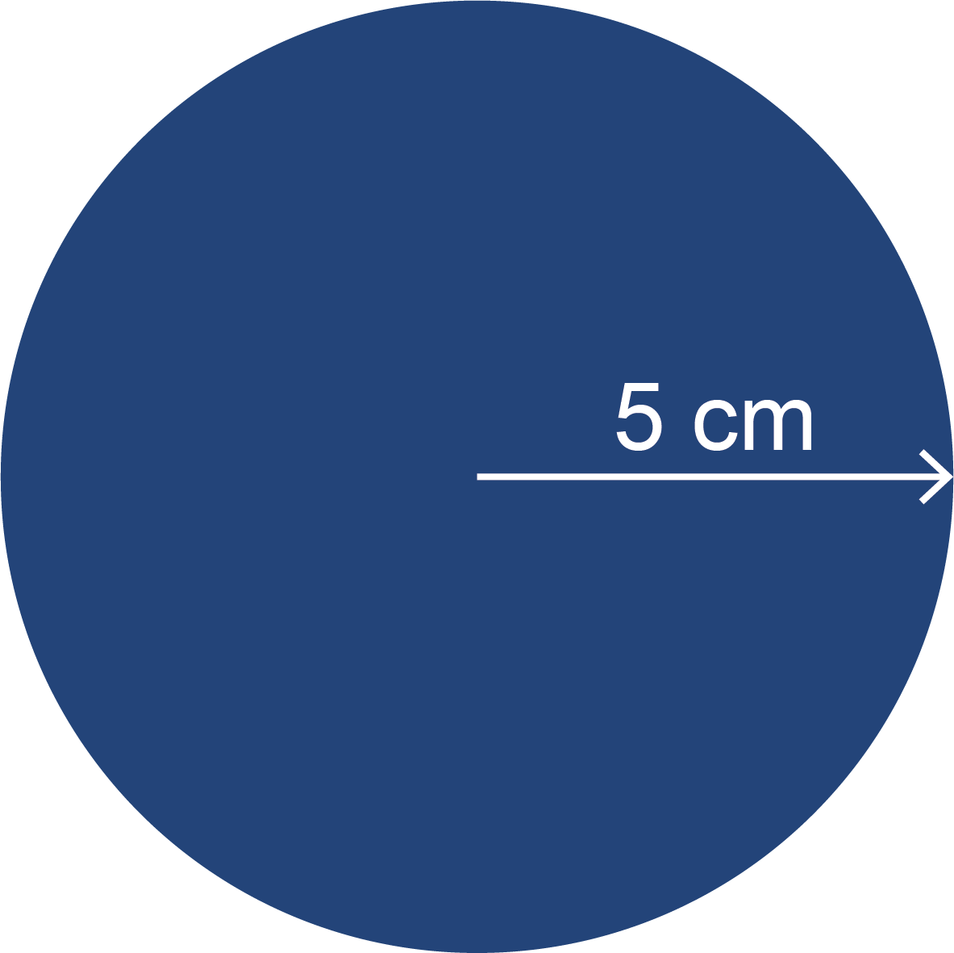
Circles and triangles
The area of triangles and circles can be worked out using some simple formulae
Area of triangle = ½ × base length × perpendicular height
Area of circle = π × (radius of circle)² or πr²
The circle below has a radius of 5 cm – Work out its area, writing your answer to 1 decimal place.

Slide 21
Raising the flag
This is a design for a triangular version of the Argentinian flag
Using the dimensions given on the flag, work out the total area of canvas needed to make this flag, giving your answer in cm² and to 1 decimal place Use the formula below in your working: Area of triangle = ½ × base length × perpendicular height
120 cm
140 cm

Slide 22
Raising the flag
This is a design for a triangular version of the Argentinian flag
Using the dimensions given on the flag, work out the total area of canvas needed to make this flag, giving your answer in cm² and to 1 decimal place $\frac{1}{2}$ × 120 ×140 = 8,400 cm²
120 cm
140 cm

Slide 23
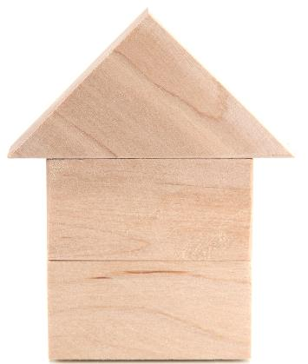
Coverage
8 cm
The wooden block house is made of two stacked rectangles and a triangle
Only the wood that can be seen is to be varnished
Given the dimensions in the diagram, work out the total area of the shape
The coverage of the varnish is 1 ml per 10 cm² What volume of varnish is needed?
4 cm
6 cm
6 cm

Slide 24
Coverage
8 cm
Given the dimensions in the diagram, work out the total area of the shape
6 × 6 = 36 cm²
½ × 8 × 4 = 16 cm²
36 + 16 = 52 cm²
What volume of varnish is needed?
If 1ml covers 10 cm² then 52 ÷ 10 = 5.2 ml
4 cm
6 cm
6 cm

Slide 25
Worksheet task
Complete Task 2 of your Worksheet

Slide 26
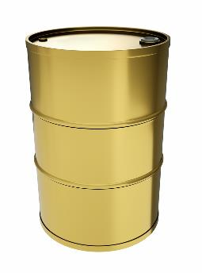
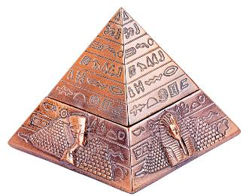
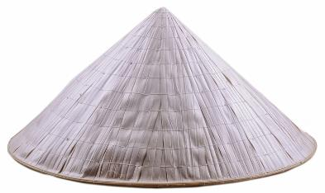
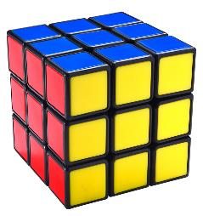
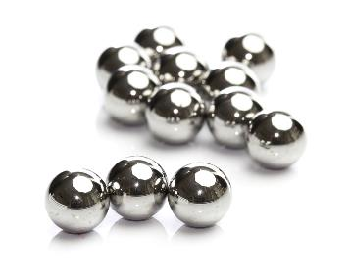
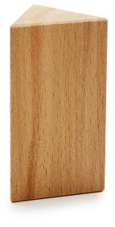
Name these 3D shapes

Slide 27
Name these 3D shapes
Cylinder
Pyramid
Cone
Cube
Sphere
Cuboid
Triangular prism

Slide 28
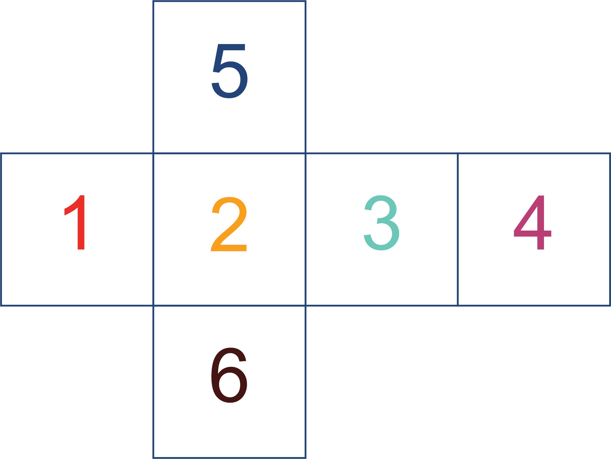
Showing 3D in 2D
A 2D shape that can be folded to make a 3D shape is called a net
The net below makes a cube
Sketch a 3D cube that would be made using the net shown and label the faces of the cube with the correct numbers

Slide 29
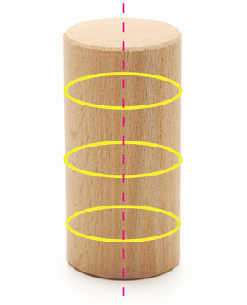
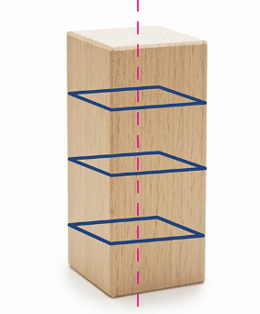
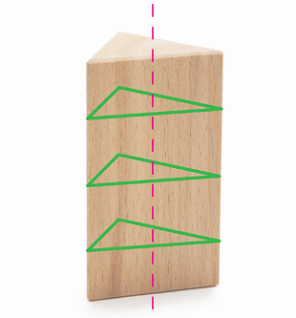
Volume of prisms
These 3D shapes are prisms
They have a constant cross-section when sliced perpendicular to the main axis
The volume of a prism = area of cross-section × length of prism
What is the volume of a cylinder whose cross-sectional area is 70 cm² and length is 15 cm?

Slide 30
A 3D puzzle
Sketch the 3D shapes made from these nets
Name the 3D shapes that are made

Slide 31
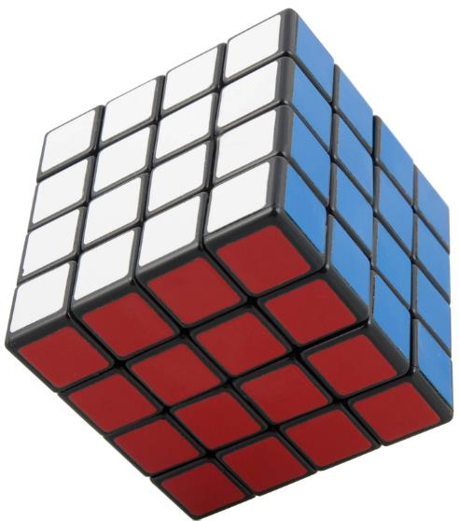
Rubik’s cube
This is a large version of a Rubik’s cube
Assume that each small square has a side length of 1 cm
What is the surface area of a) each face? b) the whole cube?
What is the volume of the cube, in cm³?
What is the surface area and volume of a Rubik’s cube with 3 squares along each edge?

Slide 32
Rubik’s cube
The surface area of each face is 4 × 4 = 16 cm²
The surface area of the whole cube is 4 × 4 x 6 = 96 cm²
The volume of the cube is 4 × 4 × 4 = 64 cm³
A Rubik’s cube with 3 x 3 squares has: 54 cm² surface area and 27 cm³ volume

Slide 33
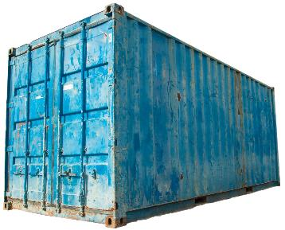
Cubes and cuboids
This freight container is a cuboid
To work out the volume of a cuboid, we multiply the length, width and height together
Volume may have units of ml (cm³), litres (1000 cm³) or m³
A container has dimensions of 10.1 m x 2.2 m x 2 m. What is its volume, in m³?

Slide 34
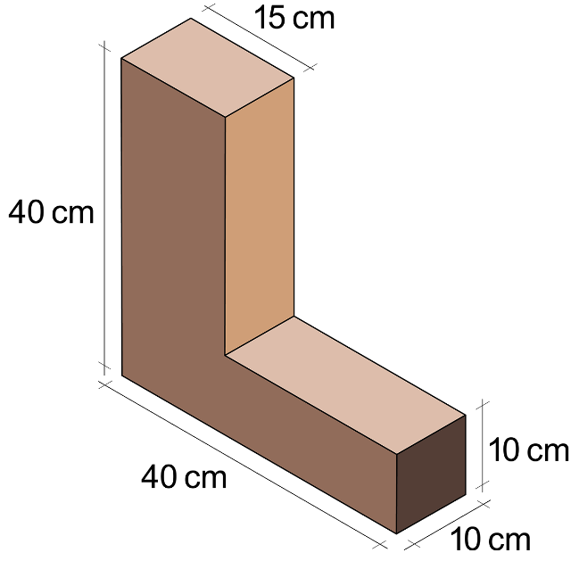
Capital cuboid
A student designs a wooden book-end based on a capital ‘L’
Its shape can be considered to be made up of two cuboids joined together, known as a composite shape
Given the dimensions in the diagram, work out the volume of this shape, giving your answer to 1 decimal place

Slide 35
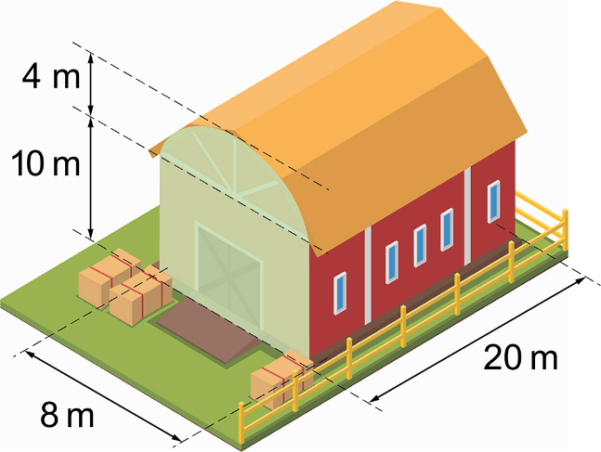
Composite shapes
This is a design for a farm barn which shape consists of cuboid with a half cylinder as a roof
Work out the total area of the light green shaded end of the barn, in m²
What volume of paint is needed to cover the outside of both green ends of the barn, if the paint has a coverage of 10 m² per litre?
Work out the total volume of the barn, in m³

Slide 36
Plenary
Complete Task 3 and 4 of your Worksheet

