Slide 1
One Kind Word

Slide 2
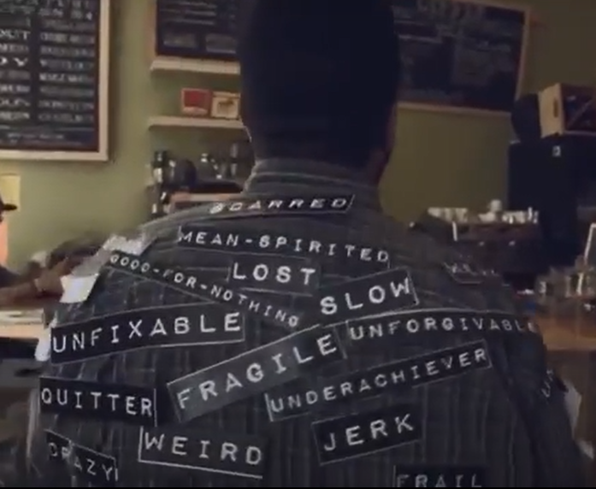
The labels we carry
https://youtu.be/hNS_D-pw8y4

Slide 3
It was only banter
https://youtu.be/653B2hpkaZ4

Slide 4
It is not banter if…
https://youtu.be/wbM5WowgqyE

Slide 5
“Offensive language consists of behaviour calculated to wound the feelings, arouse anger or resentment or disgust or outrage in the mind of a reasonable person. “

Slide 6
Definition of ‘banter’
Banter is teasing or joking talk that is amusing and friendly.

Slide 7
Definition of ‘sniping’
The act of adversely criticizing a person or persons from a position of security

Slide 8
Definition of 'cutting'
A cutting remark is unkind and likely to hurt someone's feelings. People make cutting remarks to help themselves feel superior or powerful.

Slide 9
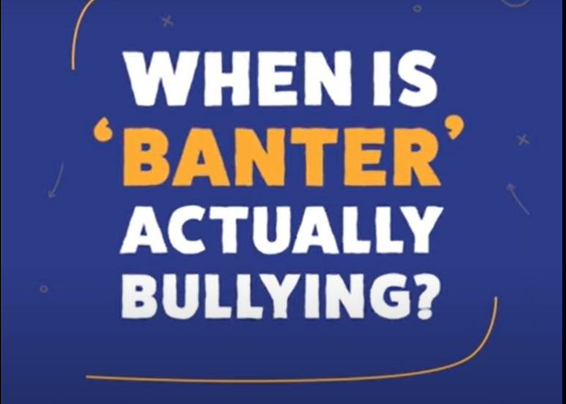
When is banter actually bullying?
https://youtu.be/GHdvxQ57zbw

Slide 10
What is the opposite?
Opposite of light-hearted joking, teasing, or banter:
Bullying

Slide 11
Putting yourself in some else's shoes
https://youtu.be/cTOhzcSYMlM

Slide 12
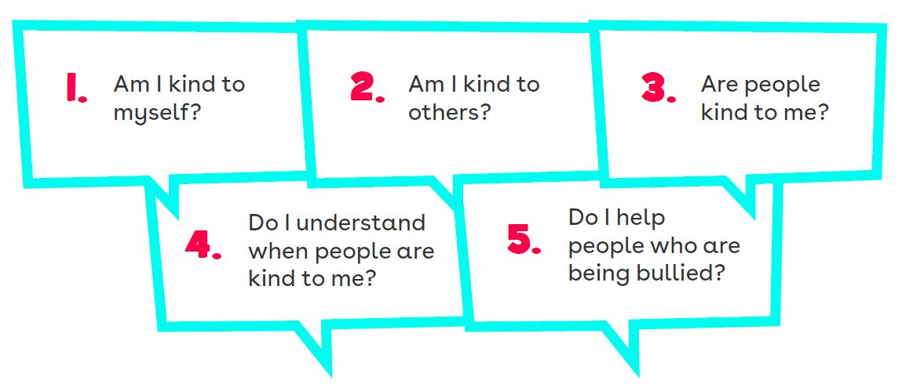
5 Key Kindness Questions
Heads down / eyes closed

Slide 13
One Kind Word
https://youtu.be/SmgiR5s0cHU

Slide 14
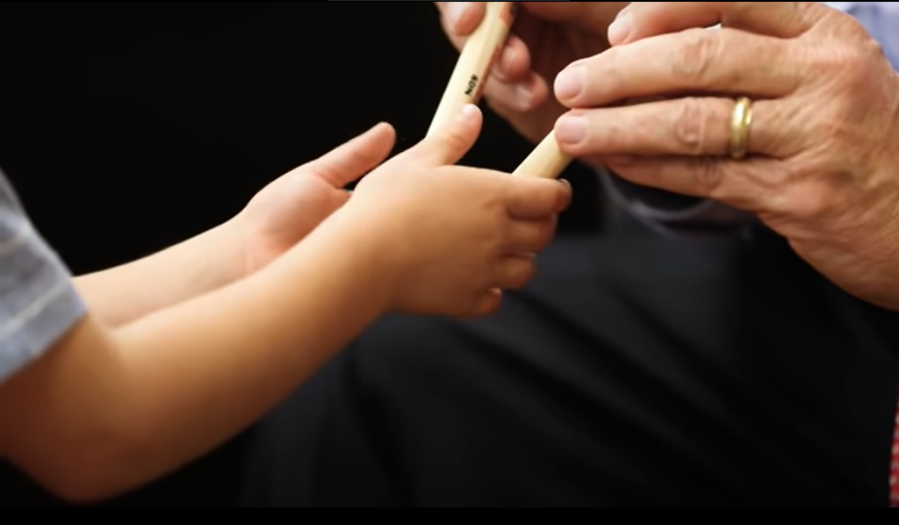
Can YOU be a Mr. Jensen
https://youtu.be/4p5286T_kn0

Slide 15
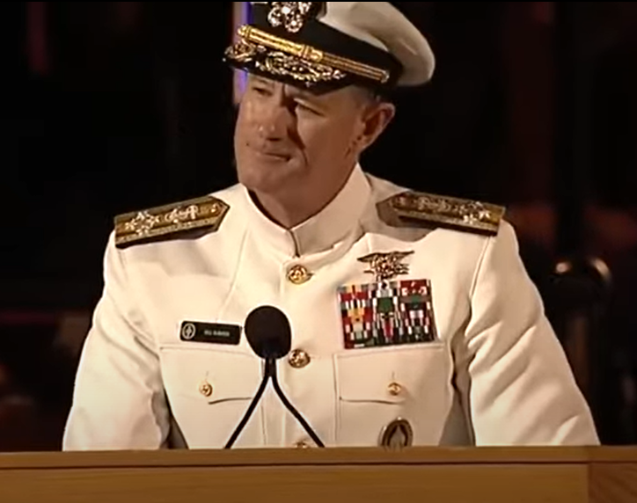
Admiral McRaven - "Make Your Bed"
https://youtu.be/sBAqF00gBGk

Slide 16
Thank you

