Slide 1
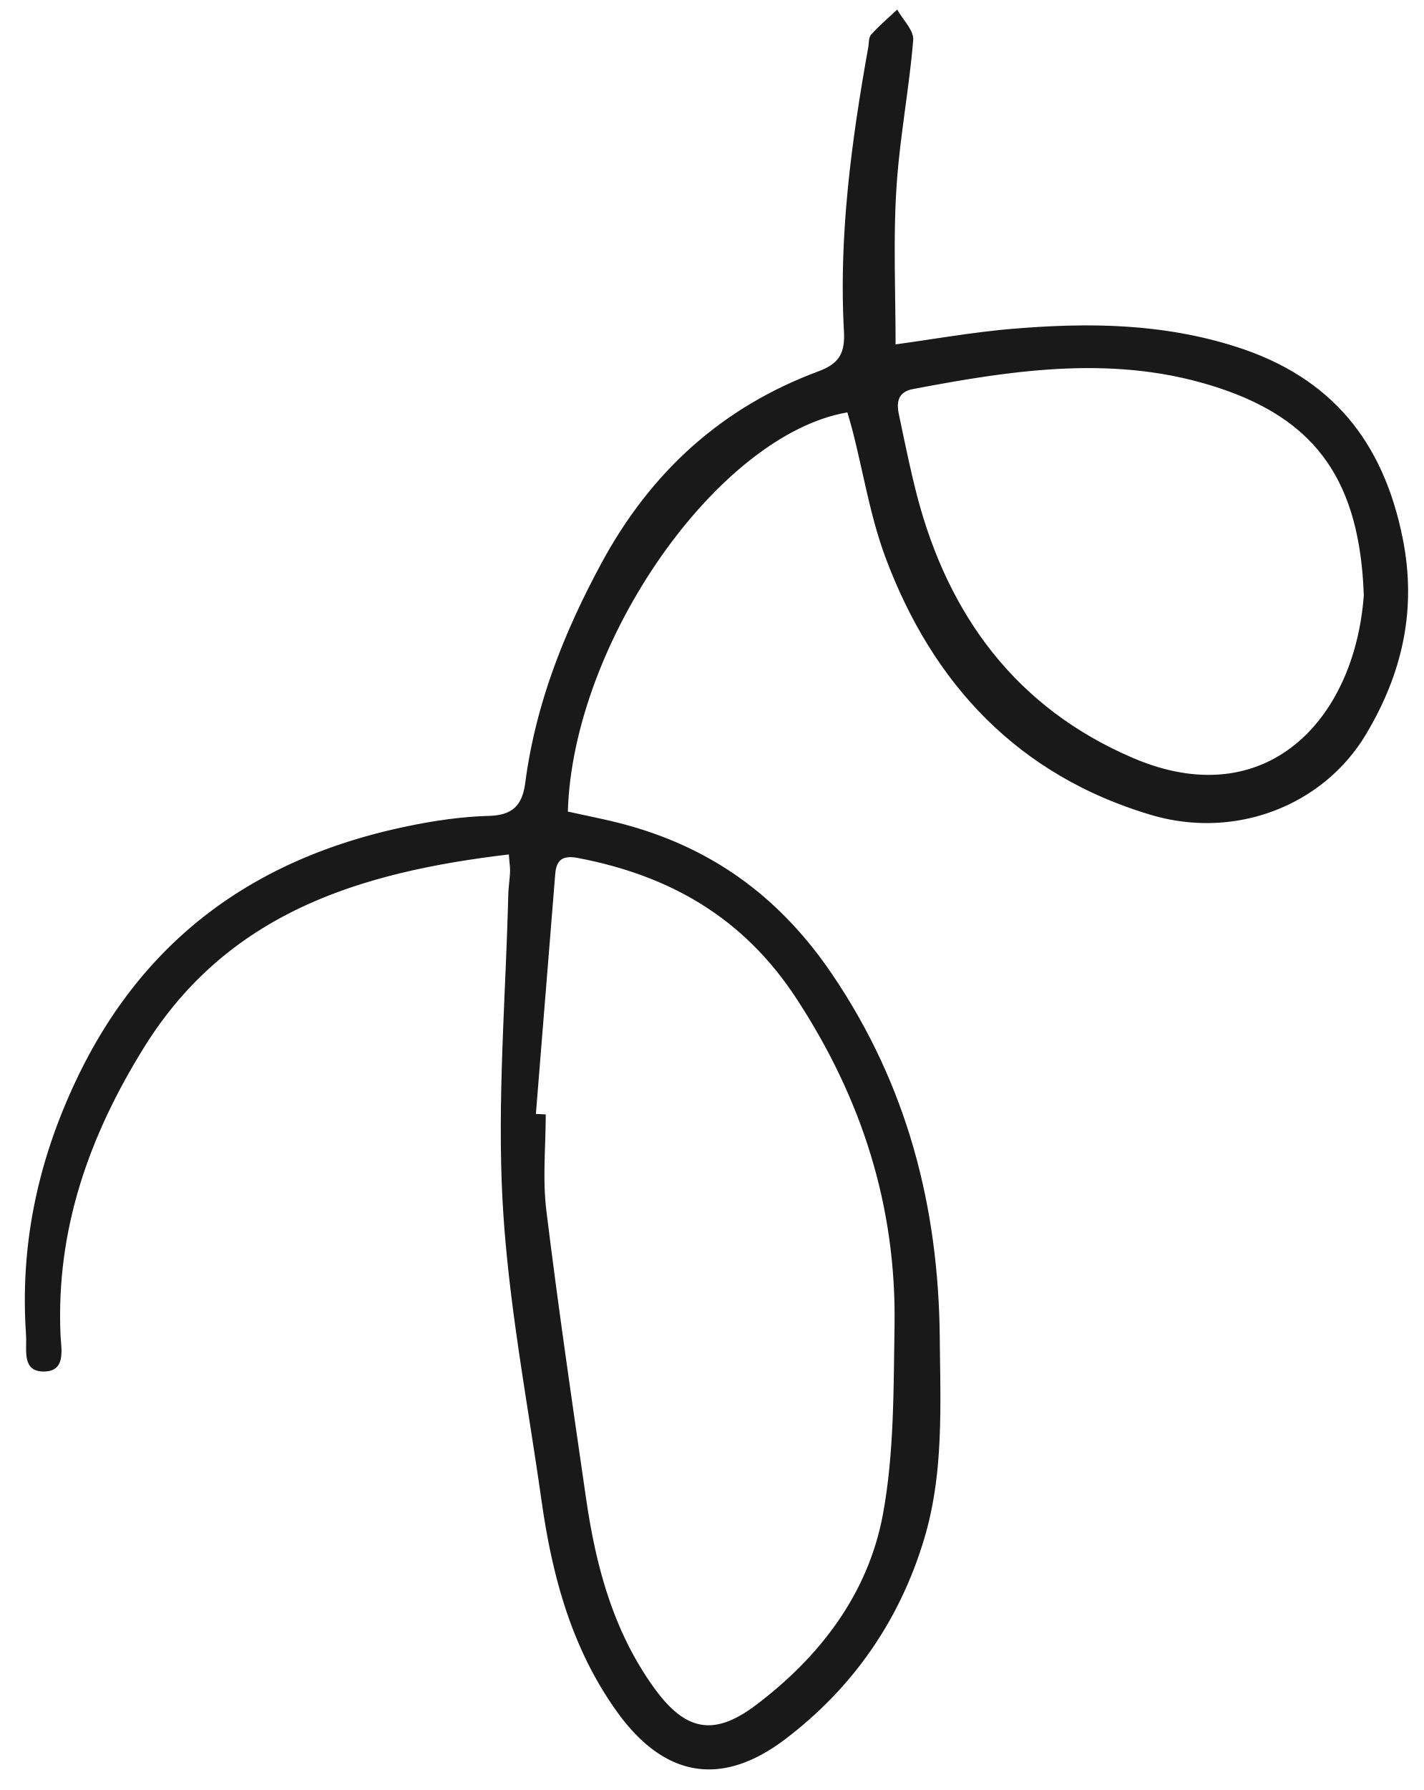
WARMINSTER COMPUTER SCIENCE DEPT
A LEVEL
COMPUTER SCIENCE (AQA)

Slide 2
Computer Science theory
COURSE STRUCTURE
Pupils will study a range of fundamental topics such as Programming, Data structures, Algorithms and Theory of Computation.
What will you study?
Programming and problem solving
Pupils will learn hands-on how to solve problems using coding techniques.

Slide 3
UNDERSTANDING THE EXAM
Exam structure and timing
Pupils will sit 2 papers; Paper 1 is an on-screen exam, and it is 2 hours and 30 minutes long. Pupils answer a series of short questions and write/adapt/extend programs in an Electronic Answer Document. Paper 2 is also 2 hours and 30 minutes, answering questions on the theory covered over the course.
What is an NEA?
The pupils will complete an NEA or Non-exam Assessment. This is done in lessons and is coursework which equates to 20% of the exam.

Slide 4
LOOKING FOR MORE INFO?
Contact Mr Hill on:
ahill@warminsterschool.org.uk

