Slide 1
Cambridge
IGCSE
Computer Science
Section 2
Algorithms and flowcharts Unit 7: Algorithm design and programming
1

Slide 2
Objectives
Define what is meant by an “algorithm”
Use standard flowchart symbols
Use standard arithmetic operators
Use totalling and counting

Slide 3
What is an algorithm?
We use “algorithms” every day without even being aware of it
Have you ever
Made a cup of tea?
Followed directions to a destination?
Taken part in a school play?

Slide 4
An algorithm for a computer
Imagine programming a robot to do any of these things…
What could possibly go wrong?

Slide 5
Writing algorithms
An algorithm is a series of steps to solve a problem or carry out a task
A flowchart is a common “tool” used to help plan and write down the steps needed
How many different flowchart symbols are you familiar with?
Start

Slide 6
Drawing a flowchart
An algorithm is a series of steps to solve a problem or carry out a task
What algorithm does this flowchart represent?
Start
Ask new user to input their chosen ID
Input ID
Is this ID already in use?
Yes
Output “Choose another ID”
No
Store ID
End

Slide 7
Flowchart symbols
Start
End
Calculation/ Assignment
Input/Output
No
Decision
Yes
Count = 1
Input Grade
No
Is Count = 10?
Total = Total + A
Output Total
Yes

Slide 8
Arithmetic operators
The following operators are used for calculations:
Addition +
Subtraction -
Multiplication *
Division /
Exponentiation ** e.g. 2**3 = 8
Integer division div e.g. 17 div 3 = 5
Remainder mod e.g. 17 mod 3 = 2
Calculate: cost = ((5 * 7) + 3) / 4
x = ((3**2) * 4 + 7)) div 4

Slide 9
Counting and totalling
The statement count = count + 1 means “Add 1 to the variable, called count”
total = 0
count = 0
count = count + 1
total = total + count
Is count = 1000?
No
Output total

Slide 10
Worksheet 1
Complete Tasks 1 - 4 on the worksheet

Slide 11
Program structures
All programs are composed of three basic structures:
Sequence
Selection
Iteration (repetition)
Look at Tasks 2, 3 and 4 in the worksheet and find examples of all these three structures
In the next two lesson we will look in more detail at selection and iteration

Slide 12
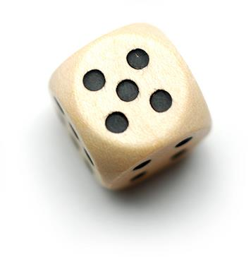
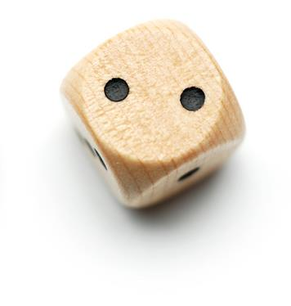
Worksheet 1
Complete Task 5 on the worksheet

Slide 13
Plenary
As well as using sequence, selection and iteration in algorithms, in Task 5 you used an inbuilt function
What was the name of the function?
What did it do?
How did it do it? Do you need to know?
You will be using many different inbuilt functions in your programs to perform useful tasks, without having to worry how the function works

