Slide 1
Sequencing: Controlling traffic lights
Control systems with Flowol 3rd Edition

Slide 2
Objectives
Understand why a control system might fail and explain the impact this can have on safety
Develop a control solution for a system that uses two flowcharts operating in sequence

Slide 3
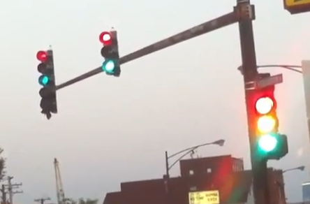
What’s happening here? Why?

Slide 4
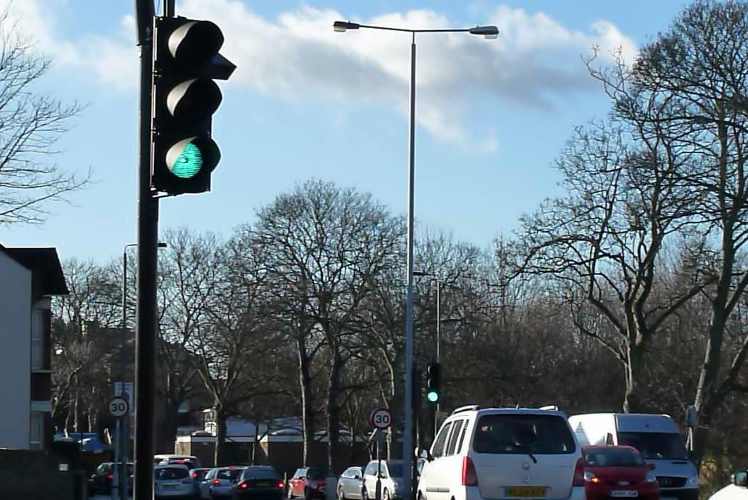
Traffic Light Sequences
Watch the video clip
Complete Worksheet 2 Traffic Light Sequences by timing the delays between light changes

Slide 5
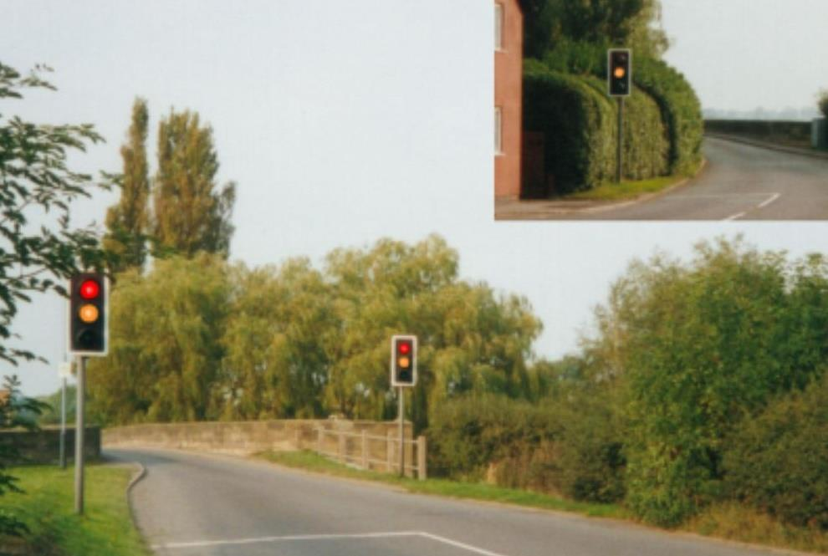
Bridge Light Mimic

Slide 6
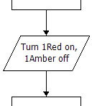
Adding multiple instructions
You can add more than one instruction to an Output symbol
This helps reduce the number of symbols you need
How few symbols can you use to complete the task?

Slide 7
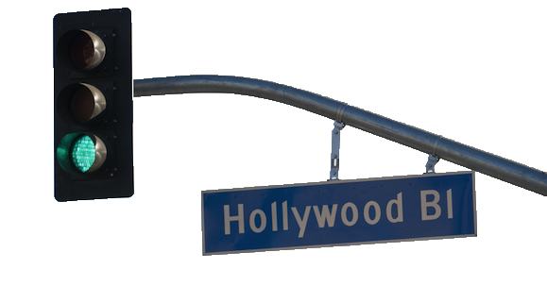
Syncing traffic lights in LA
How are the lights controlled?
What determines the light timings and flow of traffic?

