Slide 1
Objectives
Describe the digital representation of sound in terms of sampling rate and resolution
Describe the principles of operation of an analogue to digital converter and a digital to analogue converter
Understand and apply the Nyquist theorem
Calculate sound sample sizes in bytes
Describe the purpose and advantages of MIDI and the use of event messages

Slide 2
Image representation
What are the steps involved in converting an analogue image into a digital photograph?
What factors affect digital image quality?

Slide 3
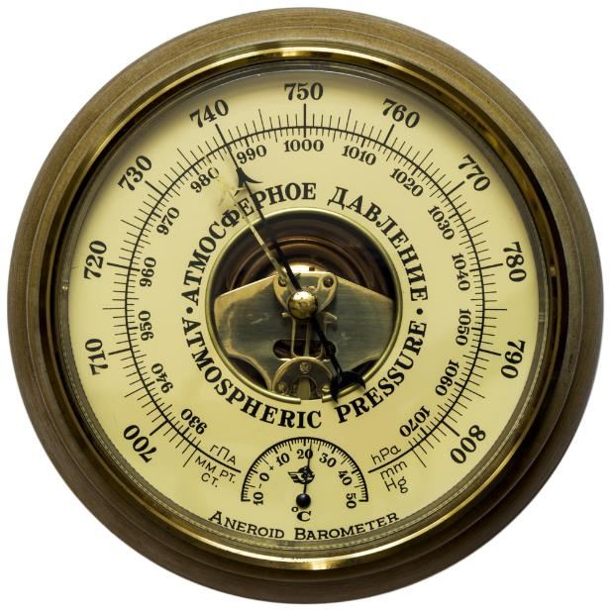
Real-world data
Real-world data is usually analogue in nature with values that vary by any amount over time
Sound is a result of changes in air pressure
Pressure fluctuations cause our eardrums to vibrate
Nerve signals are interpreted as sound

Slide 4
Analogue and digital signals
Analogue signals are continuous, whereas digital signals are discrete
Signals can be converted from one form to another

Slide 5
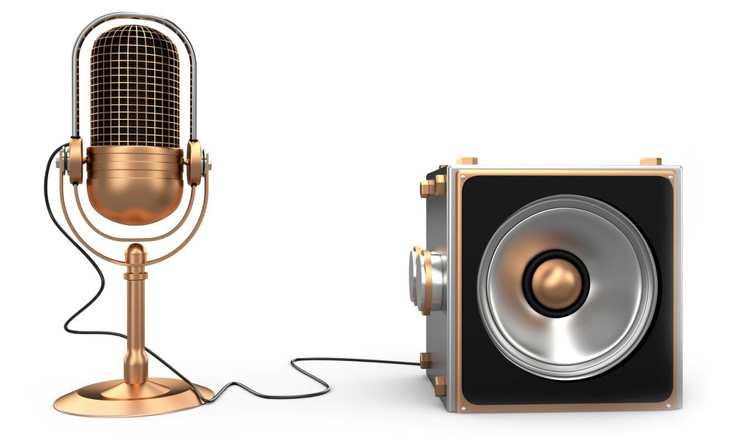
Analogue to digital convertors
Examples of ADCs and DACs are:
Microphones
Speakers

Slide 6
Analogue to digital conversion
Analogue sound samples are recorded via an amplifier
Each sample is quantised to measure its wave height and translate this into an integer value
The integer value is then converted and stored digitally as a binary value
To output a sound, the reverse happens

Slide 7
Analogue and digital signals
Complete Task 1 on Worksheet

Slide 8
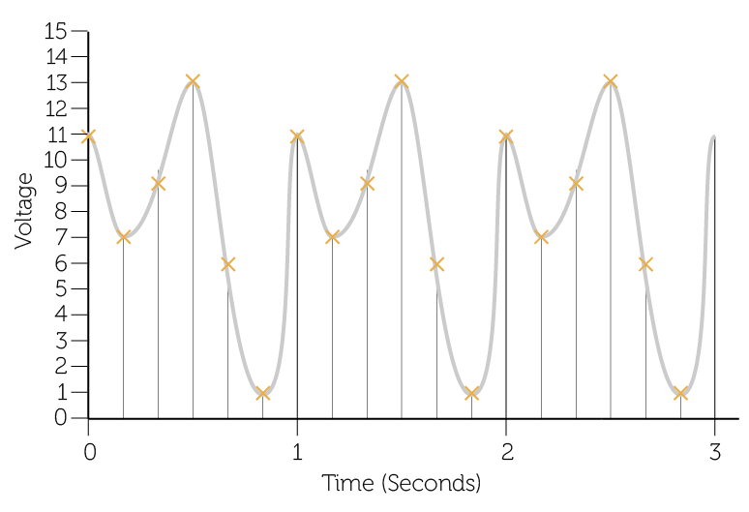
Sampling
An analogue signal is measured at regular periods
The amplitude (or voltage of the analogue signal at that point in time) is referred to as the sample resolution
The sampling rate and is measured in Hertz (The number of samples taken in one second)
Sample resolution
Sample rate

Slide 9
Sample resolution
The number of bits (audio bit depth) used to record each measurement is known as the resolution
More bits used per sample enables the height of the wave to be more accurately measured but increases file size
High resolution
Low resolution

Slide 10
Resolution of bit depths
2ⁿ Where n is bit depth = Number of possible integer values

Slide 11
Sampling rate
The frequency or sample rate per second affects the level of detail in the digital representation
The greater the frequency, the greater the accuracy, and file size
High frequency
Low frequency

Slide 12
File size
The sampling rate and the resolution allow us to determine the size of file required to create a digital copy of the sound waves
Sampling rate indicates number of samples per second (Hertz)
Resolution is number of bits used per sample
File size =
sample rate x resolution x length in seconds

Slide 13
Calculating audio file size
A 30 second audio track is recorded
The sample rate is set at 44,000 Hertz (or 44kHz)
The resolution is selected as 16 bit
The size of the file produced is:
(44,000 x 16) x 30 = 21,120,000 bits
21,120,000 / 8 = 2,640,000 bytes / 1,000,000 = 2.64MB
For stereo sound, two channels are recorded for left and right, doubling the file size

Slide 14
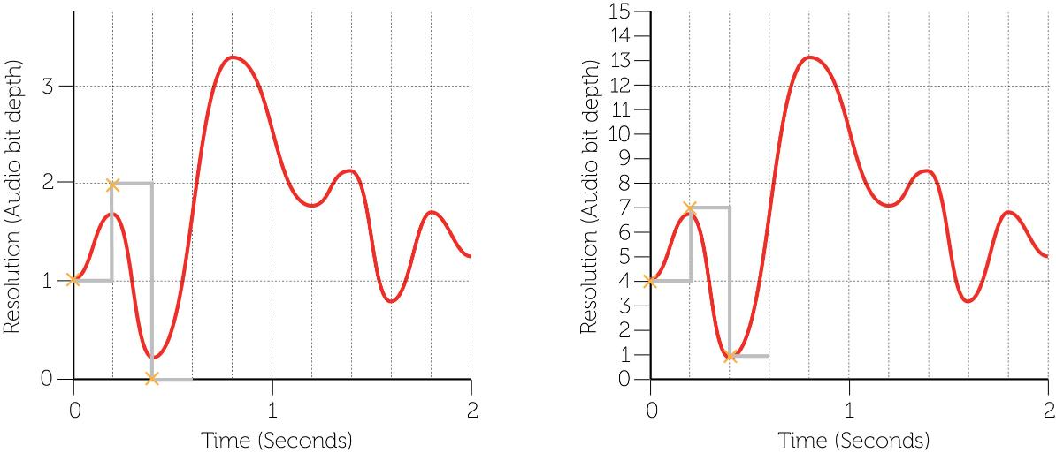
Sampling sound
Complete Task 2 of Worksheet 5

Slide 15
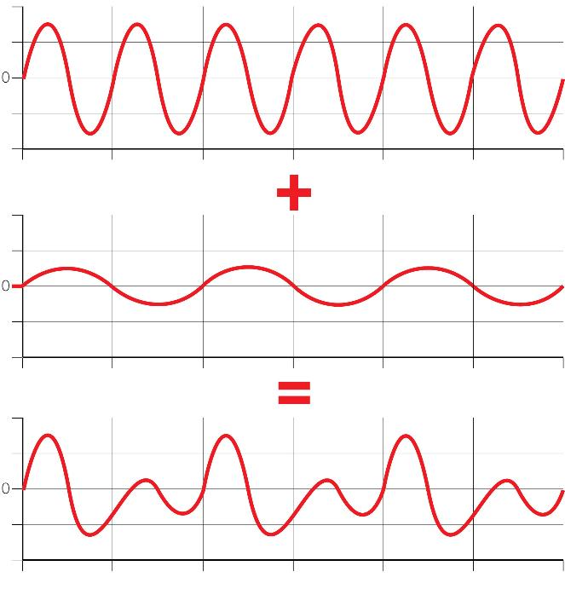
Real sound
Sound in the real-world is made up of combinations of different frequencies
A sound wave is a combination of these different frequencies:

Slide 16
Sampling limitations
There is a limit on the lowest sampling rate (f_{s}) that can be used for an accurate recording
Because sound is made up of many components each at different frequencies, samples must be twice the highest frequency in order to replicate the original sound wave
This concept is known as the Nyquist Theorem:
f_{s} > 2f_{max}

Slide 17
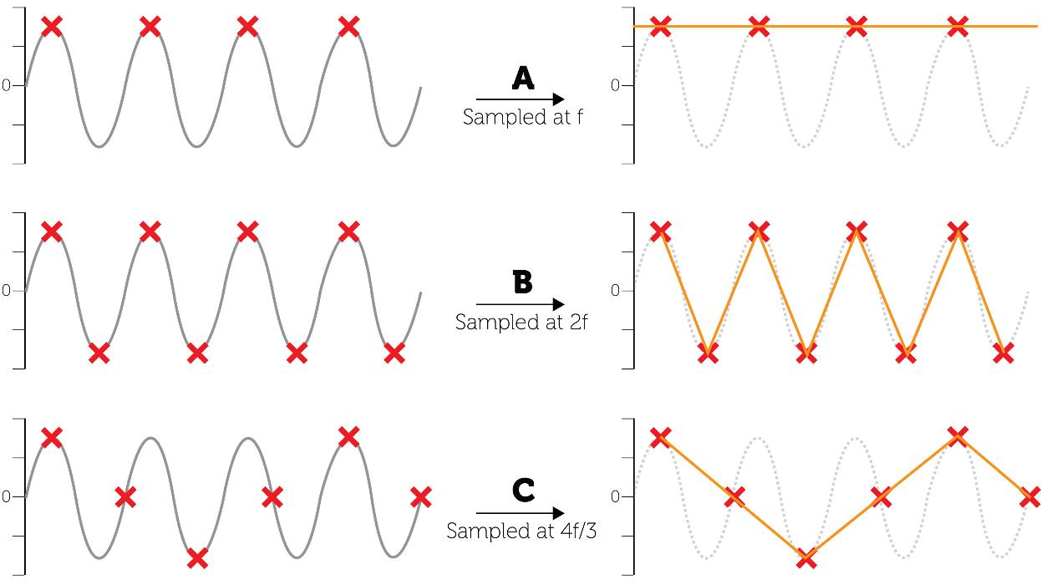
Nyquist’s theorem

Slide 18
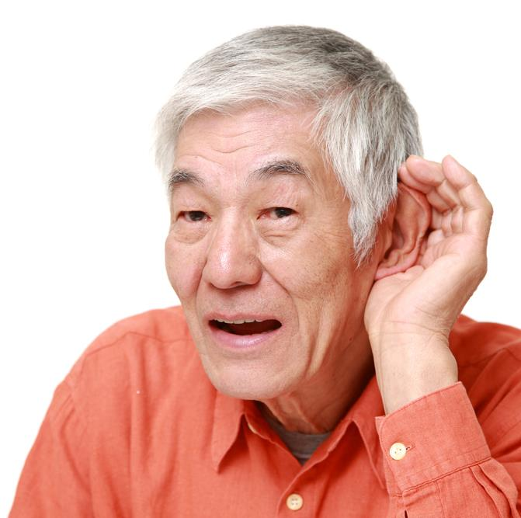
The human ear
Humans can hear frequencies of between 20Hz and 22kHz
This reduces as we age
Listen to the samples and test your own hearing
Why are CD’s sampled at 44.1kHz?

Slide 19
Activity
Complete Task 3 on Worksheet 5

Slide 20
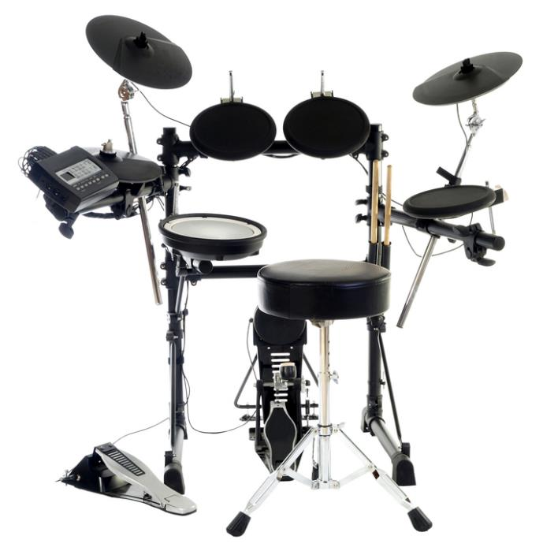
MIDI
The MIDI standard (Musical Instrument Digital Interface) creates sounds as requested either from an instrument of piece of software
It is not a live recording, but a synthesised sound

Slide 21
MIDI benefits
With this system the full sound signal does not need to be transmitted, only the instructions to play the sound
It is up to the instrument to create the sound
This significantly reduces the amount of data transferred
As sounds are synthesised, they may be less realistic

Slide 22
Event messages
A sound processor can be linked to several instruments or computers
This can send a timed sequence of event messages to:
Synchronise tempo
Control pitch
Change volume
Introduce and silence other instruments in a digital orchestra

Slide 23
Plenary
Real world analogue sound data can be digitised
Sound sampled at a specified rate and resolution
Signals can change due to interference but this can be detected
MIDI is an alternative system for producing sound

